Slide 1



Slide 2



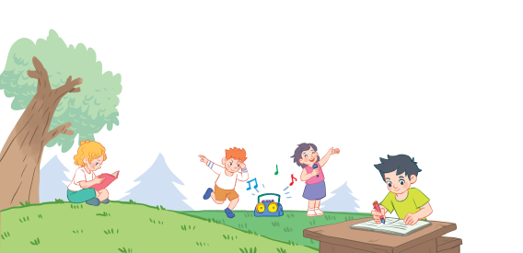
18
Period 4

Slide 3
Contents
1
Warm-up and review
2
3
4
Listen and number.
Look, complete and read.
Let’s sing.
5
Fun corner and wrap-up

Slide 4
1. Warm-up and review

Slide 5

Notes:
Game: Matching pairs
Divide the class into two teams. (Boys and Girls)
Ask pupils to choose the matching pairs. (words with pictures)
Pupils come to the front and choose the pictures in order to match with the words. Who can make it will have points for the team.
Give points for the pupils. Encourage the pupils to join the activity.

Slide 6

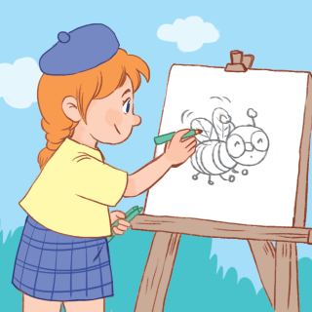
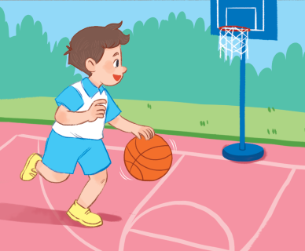
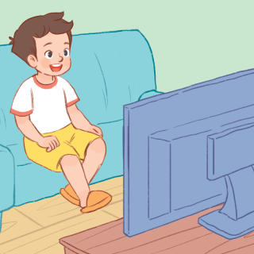
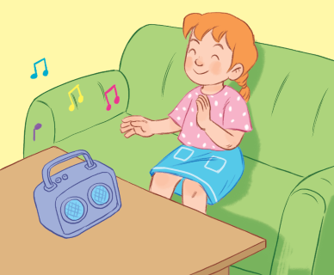
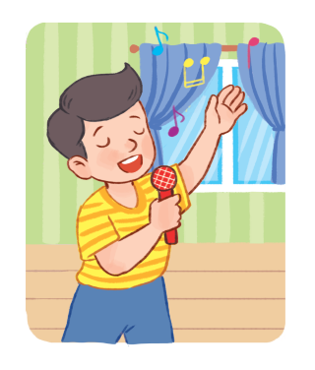
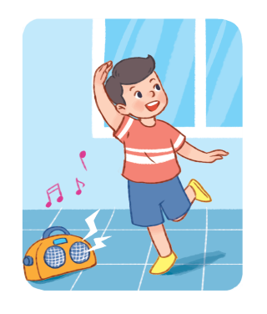
listening
to music
singing
dancing
playing basketball
drawing a picture
watching TV

Slide 7
2.Listen and number.

Slide 8
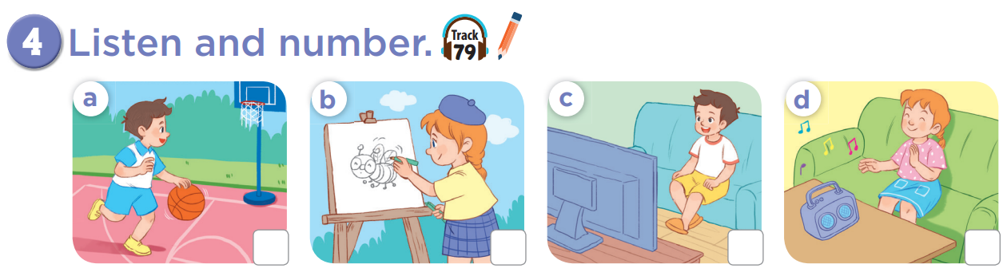


Slide 9
3
2
1
4

Slide 10

Game: What’s missing?
Notes:
Ask pupils to look at the pictures.
One picture is missing, they have to say quickly what the picture is.
This game will become harder when there are 2 pictures missing.
This game can be play in groups or by the whole class.

Slide 11
Game: What’s missing?
watching TV

Slide 12
What’s missing?
playing basketball

Slide 13
What’s missing?
drawing
a picture

Slide 14
What’s missing?
listening
to music

Slide 15
What’s missing?
playing basketball
watching TV

Slide 16
What’s missing?
drawing
a picture
listening
to music

Slide 17
What’s missing?
playing basketball
drawing
a picture

Slide 18
What’s missing?
watching TV
listening
to music

Slide 19
3. Look, complete and read.

Slide 20
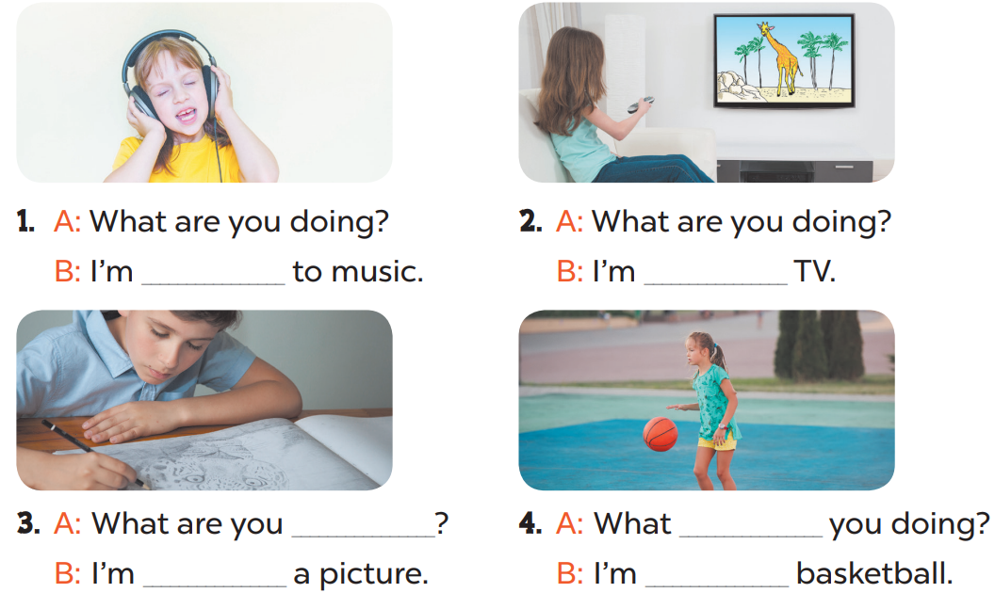

Slide 21
listening
watching
doing
are
drawing
playing

Slide 22


Game:
are
watching TV
doing
you
Notes:
Game: Slap the board
T divides the class into 2 teams: BOYS and GIRLS.
T shows 1 sentence on the TV, 1 boy and 1 girl of each team come to the board, look at the sentences and choose the best words to make correct sentences. (Pupils slap the words on the board)

Slide 23
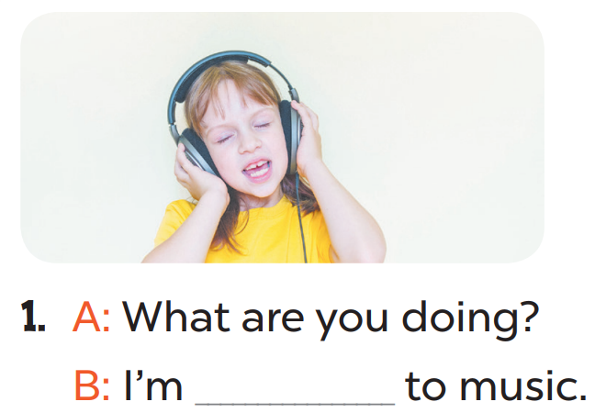
watching
you
doing
listening

Slide 24
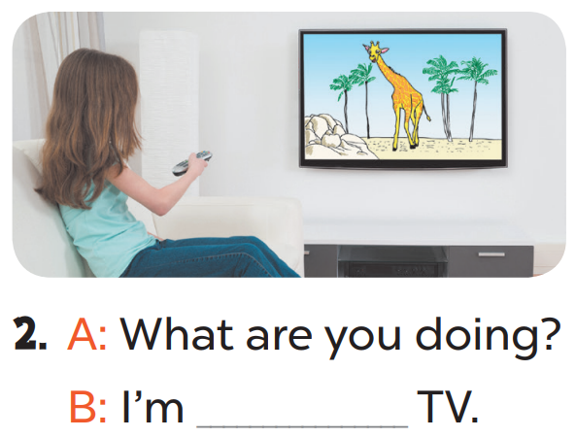
watching
doing
playing
drawing a picture

Slide 25
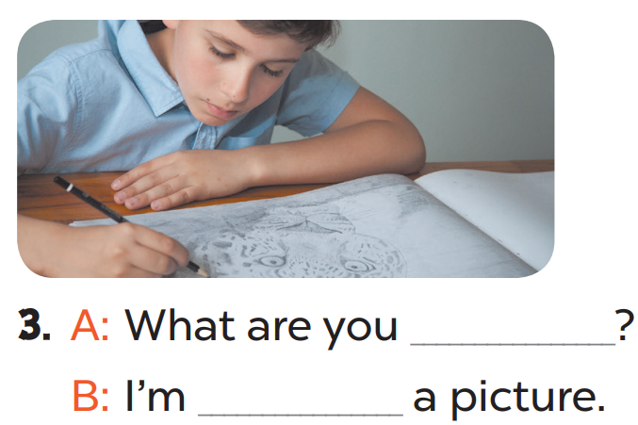
doing/ playing
doing/ drawing
doing/ are

Slide 26
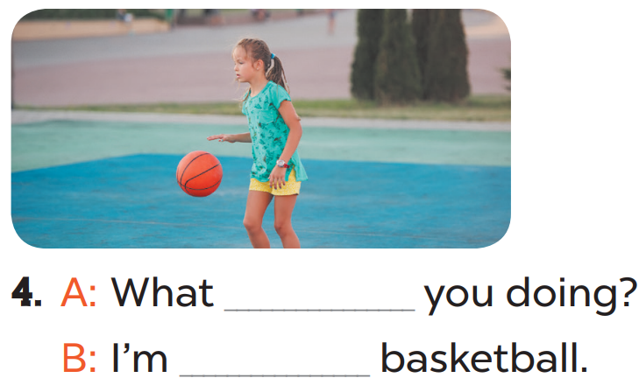
are/playing
are/ playing
Is/doing
Is/listening

Slide 27
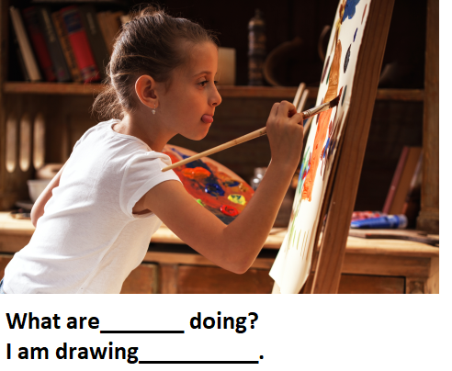
watching
are
doing
you/ a picture

Slide 28
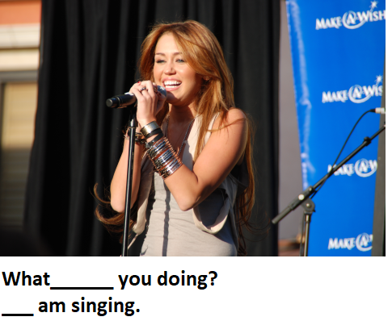
Are / I
Is/ I
Is/ You
Are / you

Slide 29
4. Let’s sing.

Slide 30
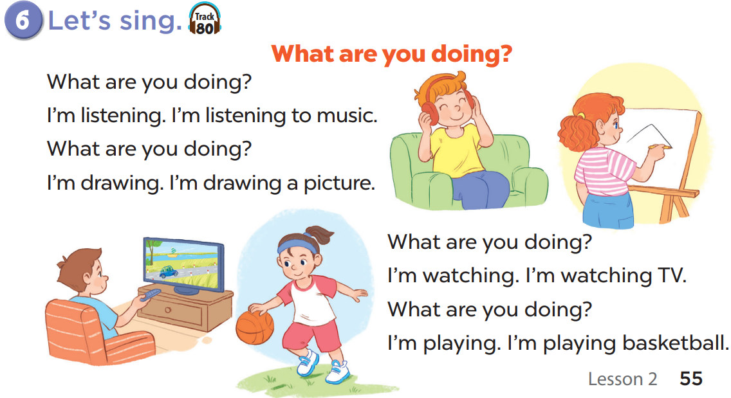

Slide 32
5. Fun corner and wrap-up

Slide 33

Notes:
Step 1: Tell pupils that they are going to look at the cards in 60 seconds, memorise the words, then remember as many of the words as possible. Explain how the game is played. Check comprehension.
Step 2: Put the cards on a desk or stick them on the board. Then cover them with a piece of cloth. Do not let pupils see what is beneath the piece of cloth.
Step 3: Divide the class into 2 or 4 groups. Remove the cloth and show the cards for 60 seconds. Then cover them again. In their groups, pupils try to say as many of the words as they can remember.
Step 4: Have the groups say the names of the things aloud. For each correct word, give them a star or a point. The group with the most stars / points wins.
Option 3: Teacher tells pupils to make sentences with I’m...........

Slide 34









Slide 35


Slide 36

Website: hoclieu.vn
Fanpage: https://www.facebook.com/tienganhglobalsuccess.vn/

