Slide 1





Slide 2


My family’s weekend
15
Lesson 3 – Period 6

Slide 3
Table of contents
01
02
03
04
05
Warm-up
Read and tick
True or False.
Let’s write.
Project
Game

Slide 4
01
Warm-up

Slide 5


catch THE sentence!

Slide 6
HOW TO PLAY
Letters or words will appear then disappear.
Read them quickly, the quicker one gets points for your team.

Slide 7
Level 1

Slide 8
1
She goes to the swimming pool.
Notes:
Animation: Text disappears after 2 seconds

Slide 9
WHAT’S THE ANSWER?
She goes to the swimming pool.

Slide 10
2
What does your mother do on Sundays?
Notes:
Animation: Text disappears after 1.5 seconds

Slide 11
WHAT’S THE ANSWER?
What does your mother do on Sundays?

Slide 12
Level 2

Slide 13
3
What
on Saturdays?
does
she
do
Notes:
Animation: Scrambled text disappears after 3 seconds

Slide 14
WHAT’S THE ANSWER?
What does she do on Saturdays?

Slide 15
on
does
4
Where
Sundays?
go
he
Notes:
Animation: Scrambled text disappears after 3 seconds

Slide 16
WHAT’S THE ANSWER?
Where does he go on Sundays?

Slide 17
Level 3

Slide 18
5
tennis
on Sundays.
He
plays
Notes:
Animation: Scrambled text moves then disappears

Slide 19
WHAT’S THE ANSWER?
He plays tennis on Sundays.

Slide 20
goes
6
My mother
the
to
on Sundays
cinema
Notes:
Animation: Scrambled text moves then disappears

Slide 21
WHAT’S THE ANSWER?
My mother goes to the cinema on Sundays.

Slide 22
Level 4

Slide 23
7
He washes the dishes on Saturdays.
Notes:
Animation: Text moves across the screen horizontally

Slide 24
WHAT’S THE ANSWER?
He washes the dishes on Saturdays.

Slide 25
8
She cleans the house on Sundays.
Notes:
Animation: Text moves across the screen vertically

Slide 26
WHAT’S THE ANSWER?
She cleans the house on Sundays.

Slide 27
GREAT JOB!

Slide 28
Read and tick
True or False.
02

Slide 29
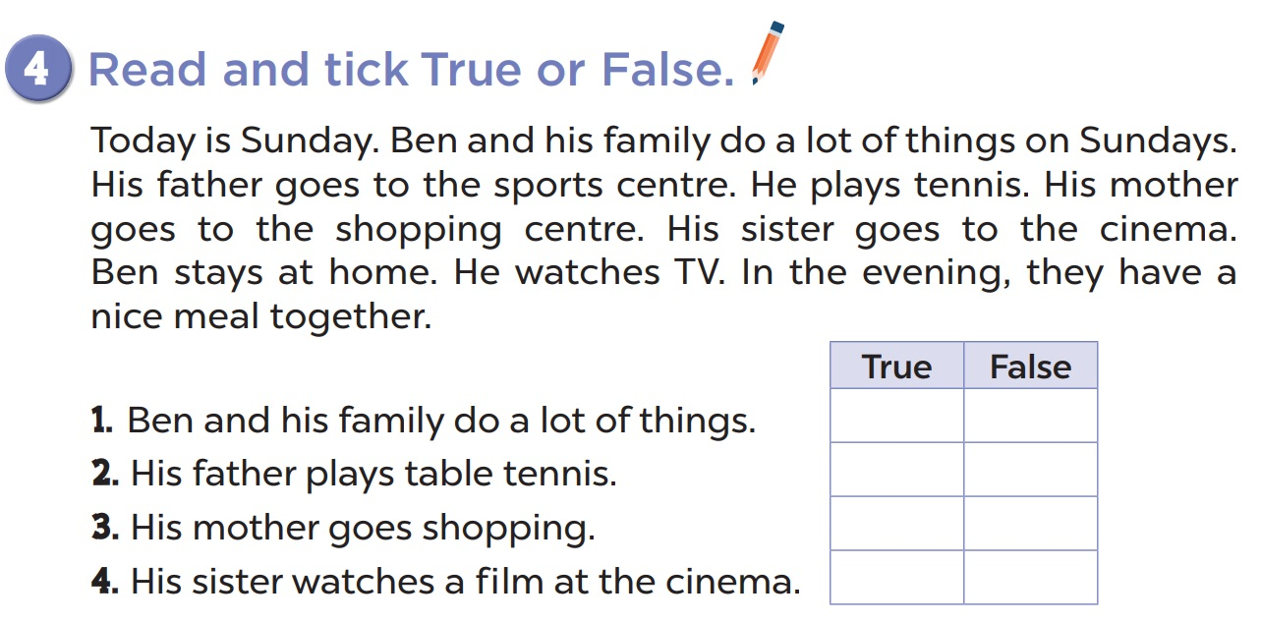


Slide 30
03
Let’s write.

Slide 31
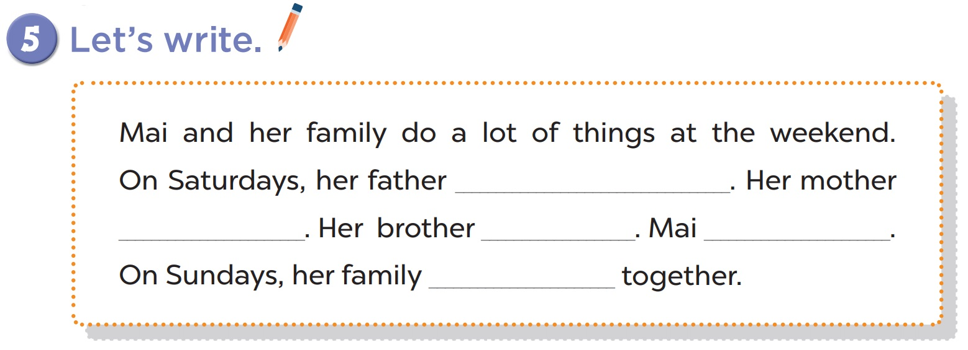

Slide 32
04
Project

Slide 33
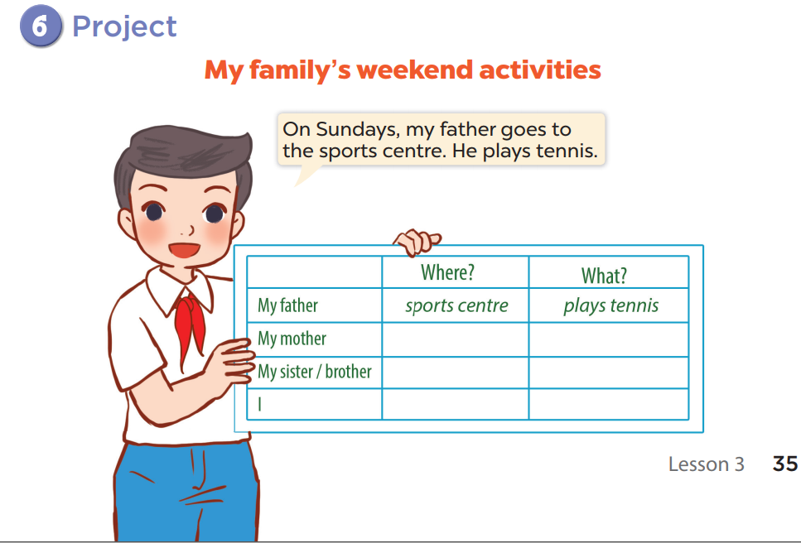

Slide 34
05
Whispering game

Slide 35








THANK YOU
Website: hoclieu.vn
Fanpage: facebook.com/www.tienganhglobalsuccess.vn
Website: sachmem.vn; hoclieu.vn
Fanpage: www.facebook.com/sachmem.vn

