Slide 1
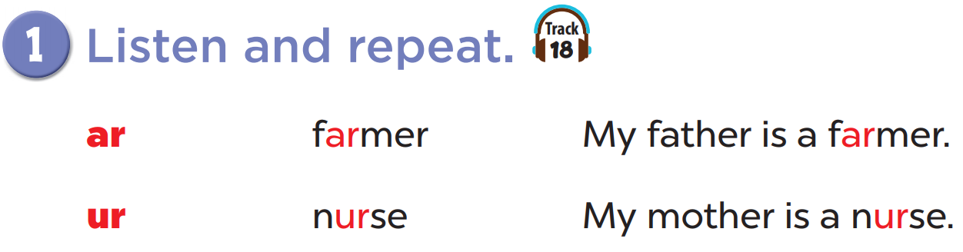


Slide 2
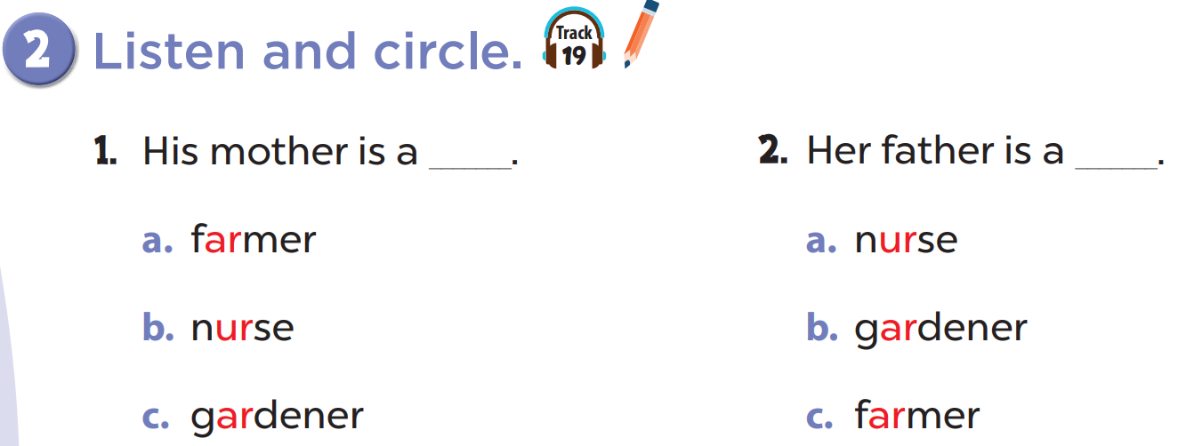

Slide 4
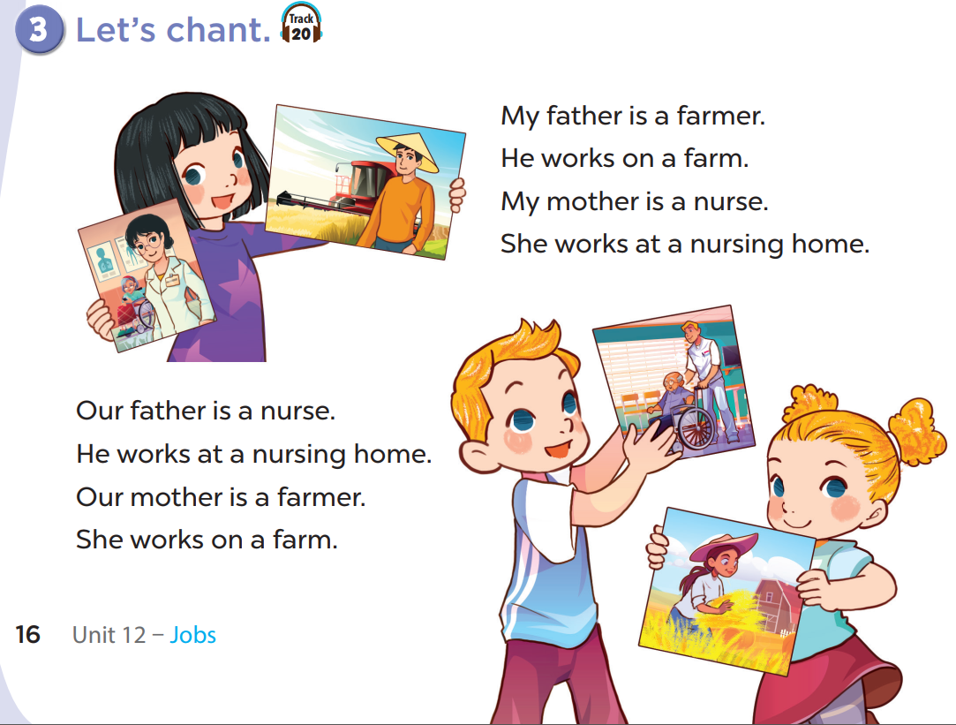

Slide 7
Write your own chant about your family!
My father is...
He works...
My mother is...
She works...

