Slide 2
Unit 5 – Lesson 1 At the fish and chip shop
Notes:
By the end of the unit, pupils will be able to:
- pronounce the sound of the letter I/i in isolation and in the words chicken, chips, fish and milk correctly.
- say the sound of the letter I/i and the words chicken, chips, fish and milk in a chant.
- recognize the words in different situations when listening.
- use I like _____ to talk about someone’s favourite food/drinks.
- trace the letter I/i.
sing a song with the structure “I like _____.”
Lesson 1
By the end of lesson 1, pupils will be able to:
pronounce the sound of the letter I/i in isolation and in the words chicken, chips, fish and milk correctly.
point to the letter I/i and food/drinks (chicken, chips, fish and milk) in the picture and say the sound of the letter I/i , the words chicken, chips, fish, milk.

Slide 3
Warm-up
Notes:
Game: Hungry Bobby
Goals:
- Help pupils feel happy at the beginning of the lesson.
- Review vocabulary of previous lesson.
Time limit: 5 mins
- Teacher shows a picture covered partly by a wheel turning 360* clockwise.
- Teacher calls 1 pupil from each team in a turn. Pupils look and say the word. Faster team gets 2 stars, the others get 1 star.
- Teacher has whole class read the word out loud at the end of a turn.

Slide 4
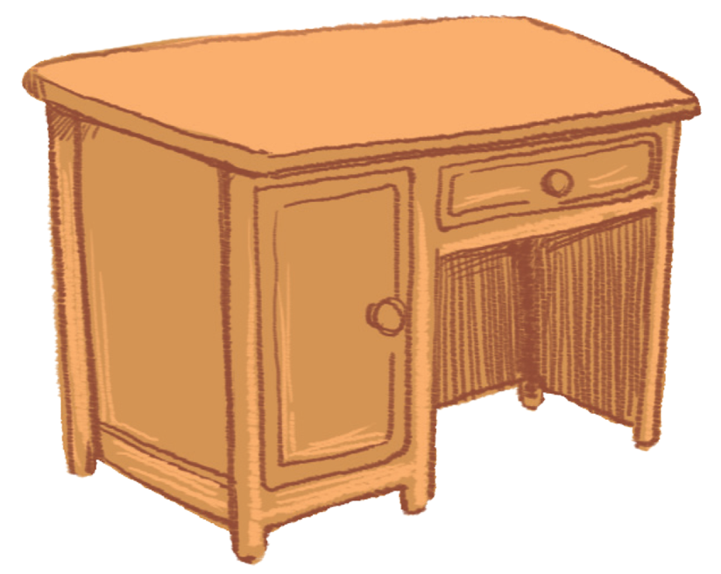
desk

Slide 5
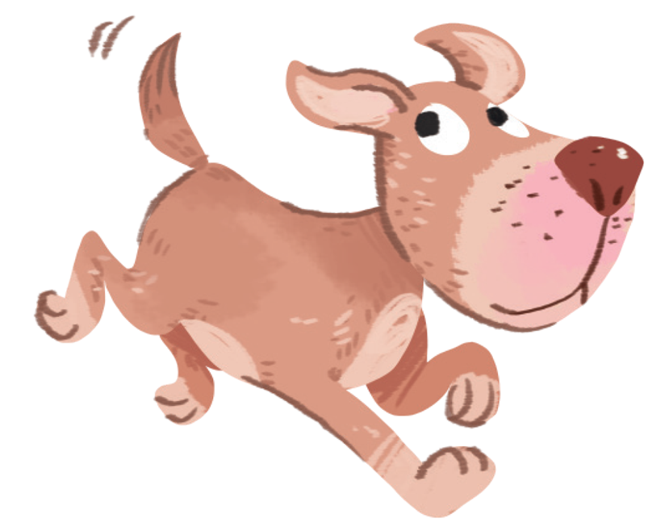
dog

Slide 6
door

Slide 7
duck

Slide 8
Notes:
Listen and repeat is divided into 3 steps.
Goals:
Pupils identify and pronounce /i/
Pupils identify and pronounce the sound /i/ in four new words: fish, chips, milk, chicken

Slide 9
i
Notes:
Step 1: Lead-in
Time limit: 3 mins
Goals: Pupils are able to identify and pronounce sound /i/.
- Teacher shows letter “i” on slide and asks pupils What letter is this? and What sound does this make?
- Teacher pronounces sound /i/. Pupils listen and repeat. (as a class/ teams)
- Teacher says: Today we are going to learn 4 words that have the sound /i/.

Slide 10
chicken
Notes:
Step 2: Listen and repeat vocabulary
Time limit: 5 mins
Goal: Pupils are able to identify and pronounce 4 words: fish, chips, milk, chicken correctly.
Teacher shows pictures on slide and says the words. (Teacher may pronounce each sound of the word separately, for example f-i-sh).
Pupils listen to teacher and repeat.
Step 3: Quick check
Time limit: 4 mins
Teacher checks pronunciation (as teams).
Teacher sticks flashcards and word cards on the board randomly. Teacher has pupils go to the board and put word cards under the matching flashcards.
Teacher checks pronunciation individually. Teacher points to a picture and has a pupil say the word.

Slide 11
chips

Slide 12
fish

Slide 13
milk

Slide 14
Notes:
Goal:
Pupils will be able to point to the letter I/i and food/drinks (chicken, chips, fish and milk) in the picture and say the sound of the letter I/i , the words chicken, chips, fish, milk.
Step 1: Listen, point and repeat
Goals: Pupils are able to point to the correct picture and pronounce the words.
Time limit: 3 mins
Teacher plays the audio.
1st time: Pupils listen and point only.
2nd time: Pupils listen, point and repeat.
Pupils repeat the words as a class and teams.
Step 2: Listen, point and repeat (in pairs)
Time limit: 3 mins
Pupils work in pairs: 1 pupil points, 1 pupil says the words.
Teacher goes around the class and gives feedback on pupils’ pronunciation.

Slide 15
Hands on your head!
Notes:
Step 3: Quick check
Time limit: 5 mins
Game: Hands on your head
- Teacher says Hands on your head, pupils put a hand on their head.
- Teacher says a word, pupils quickly slap on the corresponding picture, then put their hand back to the head.
- Teacher may have some pupils say the words.

Slide 16
GAME
Notes:
Game: What’ s missing?
Time limit: 6 mins
Teacher shows on slide 4 pictures. Teacher may have pupils read all the words. After that, a picture will disappear. Pupils guess the word.
Teacher gives star if pupils are correct.
Note: In some slides there are only words, in other there are both words and pictures.

Slide 17
chicken
chips
milk
fish

Slide 18
chicken
chips
milk
fish

Slide 19
chicken
chips
milk
fish

Slide 20
chicken
chips
milk
fish

Slide 21
chicken
chips
milk
fish

Slide 22
chicken
chips
milk
fish

Slide 23
chicken
chips
milk
fish

Slide 24
chicken
milk
chips
fish

Slide 25
chicken
milk
chips
fish

Slide 26
chicken
milk
chips
fish

Slide 27
Goodbye
Notes:
Teacher shows the vocabulary of the lesson on slide.
Pupils say goodbye.

Slide 28
Goodbye

Slide 29
Goodbye

Slide 30
Goodbye

Slide 31
Website: hoclieu.vn
Fanpage: facebook.com/www.tienganhglobalsuccess.vn

