Slide 2
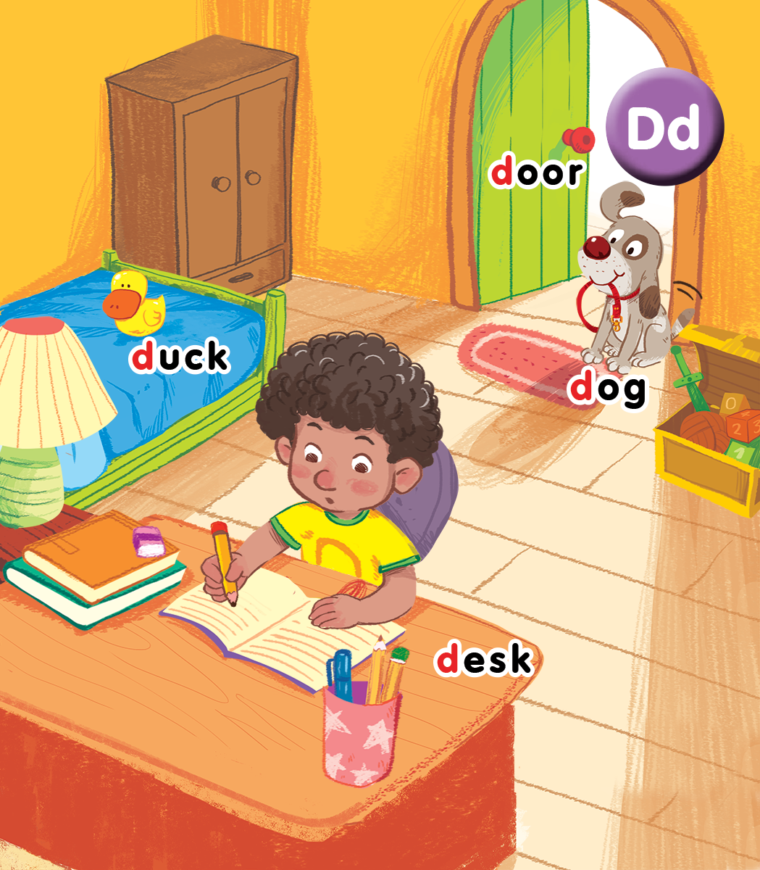
Unit 4
Lesson 1
In the bedroom
Notes:
By the end of the unit, pupils will be able to:
pronounce the sound of the letter D/d in isolation and in the words desk, dog, door, duck correctly.
say the sound of the letter D/d and the words desk, dog, door, duck in a chant.
recognize the words in different situations when listening.
use This is a _____. to introduce something.
trace the letter D/d.
sing a song with the structures This is a _____. It’s on/near the _____.
Lesson 1
By the end of the lesson 1, pupils will be able to:
- pronounce the sound of the letter D/d in isolation and in the words desk, dog, door, duck correctly.
- point to the letter D/d and the things in the picture; say the sound of the letter D/d; understand and say the sound of the words desk, dog, door, duck.

Slide 3
Sit in groups and try to get as many stars as possible!
Group 1 | Group 2 | Group 3 | Group 4
O | O | O | O
O | O | O | O
O | O | O | O
O | O | O | O
O | O | O | O
O | O | O | O
O | O | O | O
O | O | O | O
Notes:
Classroom management
Pupils sit in groups.
Each group will have a star if they do the task well.
At the end of the lesson, the group with the most stars will be the winners.

Slide 4




Class rules
Sit nicely!
Listen!
Be happy!
Notes:
Set up the class rules.
Hold up or point to the picture and say Sit nicely! and do the TPR action. Have pupils do the TPR action.
Do the same with Listen! and Be happy!

Slide 5

Warm-up
Notes:
Goals:
Warm up the class and have pupils guess the keywords.
Create the curiosity in learning.
Time: 5 minutes
Play Jump, jump, stop at https://youtu.be/Pxe4j_rhixQ?list=RDPxe4j_rhixQ
Sing along and do the action.
Guessing game: What animal is it?

Slide 6


Notes:
https://www.freesoundeffects.com/free-sounds/cars-10069/

Slide 7

Notes:
Stick the flashcard for cat on board.
Have pupils repeat the word duck after having guessed.

Slide 8


Slide 9

Notes:
Stick the flashcard for dog on board.
Have pupils repeat the word dog after having guessed

Slide 11

duck
Notes:
Stick the flashcard for duck on board.
Have pupils repeat the word duck after having guessed.

Slide 12

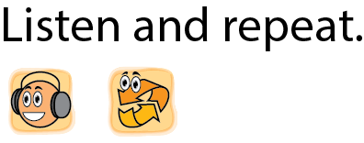

Notes:
Listen and repeat is divided into 3 steps.
Step 1
Goals: Set up the context; Predict what pupils will learn.
Time: 3 minutes
Say Open your book! with a TPR action. Have pupils open the book. Teacher opens the digital book.
Introduce the context and point to something in the picture. Ask pupils if they know these things.
Play the recording and have pupils listen and repeat.
Step 2
Goals:
- Pupils will be able to listen and repeat the unit key words dog and duck.
- Recognize and say the words with flashcards.
Time: 3-4 minutes
Do the TPR action for dog and say dog. Stick the flashcard on the board.
Have pupil repeat the word twice or three times.
Do the same with duck.
On the board, there are two flashcards for dog and duck. The flashcard for dog is above the flashcard for duck.
Teacher points to the dog, say the word and have pupils repeat the word. Do the TPR action which saying the word.
Do the same with duck.
Have pupils guess the word and repeat by pointing to duck or dog. Hold your hand up or down to the position of the flashcard.
Turn over the cards, have pupils guess the card and shout out the word.
Swap the cards and have pupils guess.

Slide 14
duck

Slide 15
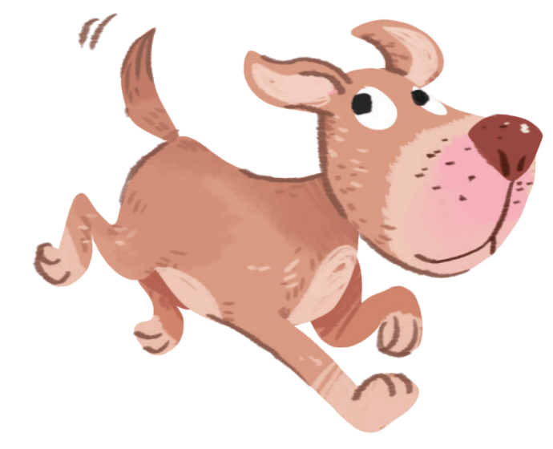
dog
duck

Slide 16
dog
duck
or

Slide 17
dog
duck
or
Notes:
Tick on the word dog, tick (V) will appear
Tick on the word duck, cross (X) will appear

Slide 18
dog
duck
or
Notes:
Tick on the word duck, tick (V) will appear
Tick on the word dog, cross (X) will appear

Slide 19

desk
Notes:
Step 3
Listen and repeat
Goals:
- Pupils will be able to listen and repeat the unit keywords desk and door; listen and repeat the sound d.
- Recognize and say the words with flashcards.
Time 3-4 minutes.
Introduce the unit keywords desk and door with flashcards.
Hold up the flashcard for desk and have pupils shout out the word. Stick the flashcard on the board.
Continue with the flashcard for door.
On the board, there are two flashcards for desk and door. The flashcard for desk is above the flashcard for door.
Teacher points to the desk, say the word and have pupils repeat the word. Do the TPR action which saying the word.
Do the same with door.
Have pupils guess the word and repeat by pointing to desk or door. Hold your hand up or down to the position of the flashcard.
Turn over the cards, have pupils guess the card and shout out the word.
Swap the cards and have pupils guess.
Play the game with all four 4 flashcards for dog, duck, desk, door.
Ask pupils what is similar at the beginning of each word.
Introduce the sound d, point to the first letter of each word and say. Have pupils listen and repeat.

Slide 20
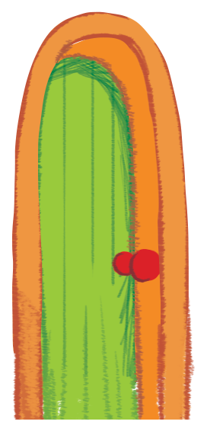
door

Slide 21
desk
door
or

Slide 22
desk
door
or
Notes:
Tick on door, the tick (V) will appear.
Tick on desk, the cross (X) will appear.

Slide 23
desk
door
or
Notes:
Tick on desk, the tick (V) will appear.
Tick on door, the cross (X) will appear.

Slide 24
dog
duck
or
Notes:
Tick on duck, the tick (V) will appear
Tick on dog, the cross (X) will appear

Slide 25
dog
duck
or
Notes:
Tick on dog, the tick (V) will appear.
Tick on duck, the cross (X) will appear.

Slide 26



Notes:
Point and say is divided into 3 main steps.
Step 1
Goal: Pupils will be able to listen and repeat the words.
Time: 3 minutes
Choose a picture on the digital book, click on the picture and have pupils listen and repeat.
Ask and prompt pupils to say Dan, door, duck, desk, dog.
Introduce the context and say Dan is in the bedroom.
Have pupils repeat the word softly, loudly in groups to motivate them.
Step 2.
Goal: Pupils will be able to point and say to the pictures.
Time: 5 minutes
Play the audio and have pupil listen and point.
Point to the pictures and have pupils say the words in chorus.
Ask one or two students to point to the picture and have other pupils say the word.
Step 3
Goal: Pupils will be able to point and say the pictures in pairs.
Time: 5 minutes
Have pupils work in pairs and do the activity.

Slide 27
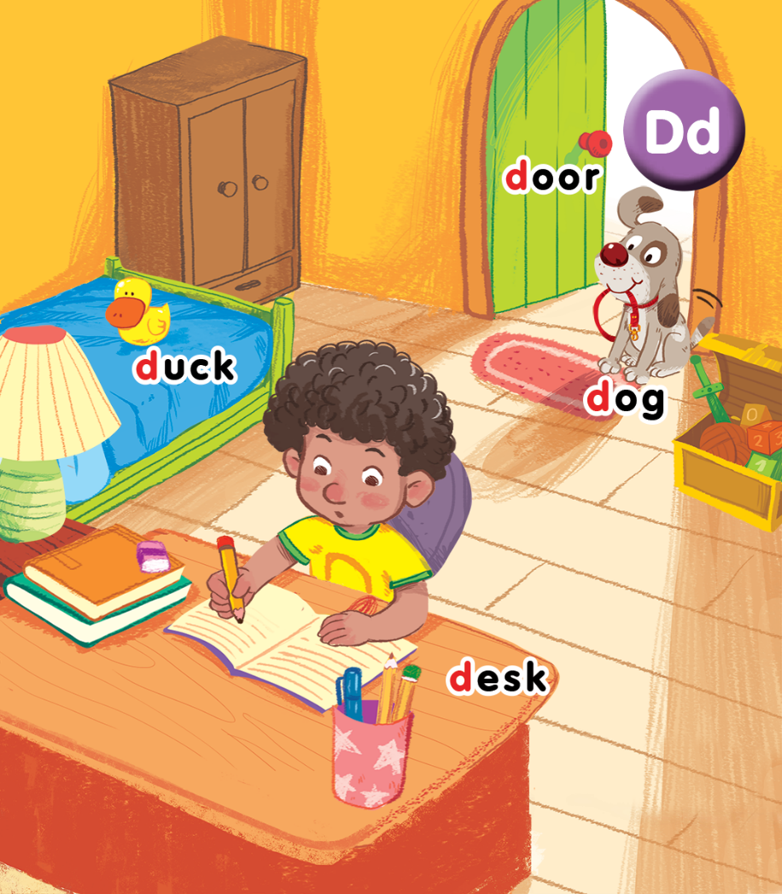
Point and say

Slide 28
Game
Notes:
Who’s faster?
Goal: Pupils will be able to recognize the unit words through pictures, sounds, meaning.
Time: 5 minutes
Invite 2 pupils to play the game.
They stand back to back.
Count 1, the pupils go 1 step apart.
Count 2, the pupils go one more step.
Count 3, the pupils go one more step and turn around.
Teacher shows a flashcard. Who says the word faster get one point.
Teacher can include the keywords in units 1 and 2 in this game.

Slide 29
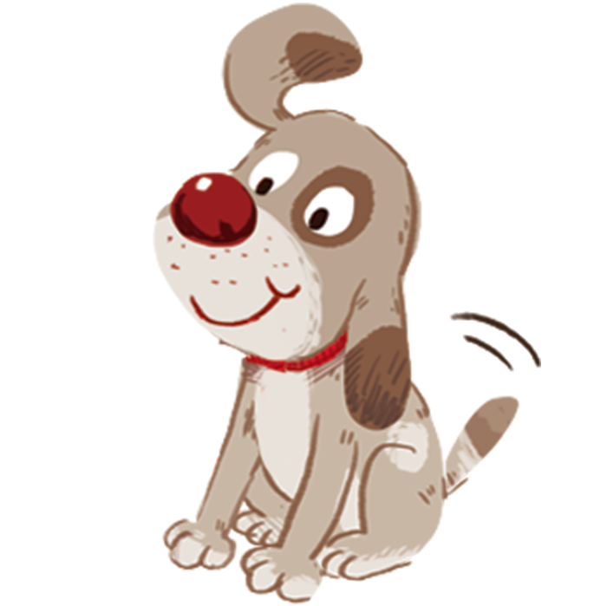
Goodbye
dog

Slide 30
Goodbye
desk

Slide 31
Goodbye
door

Slide 32
Goodbye
duck

Slide 33
Website: hoclieu.vn
Fanpage: facebook.com/www.tienganhglobalsuccess.vn

