Slide 2
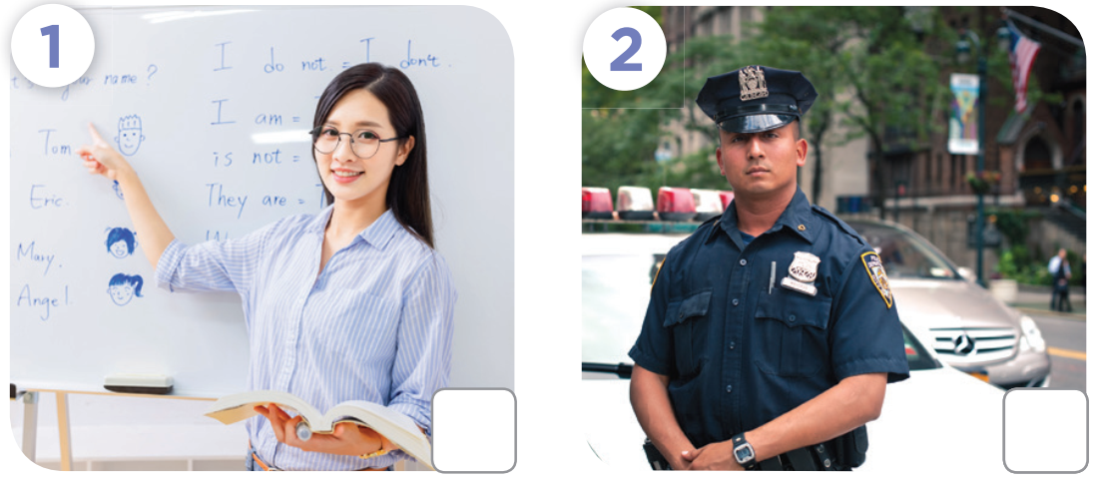
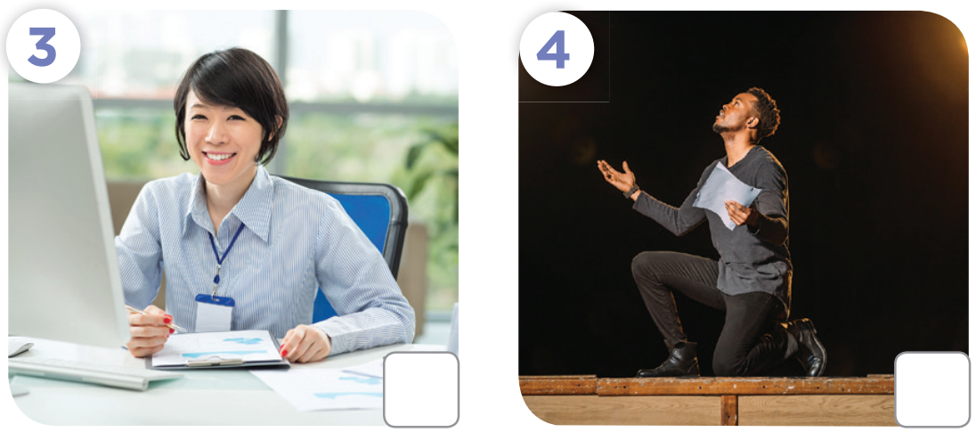
✗
✓
✓
✗

Slide 4
office worker
an actor
What
do
a policeman
She’s a farmer

