Slide 1
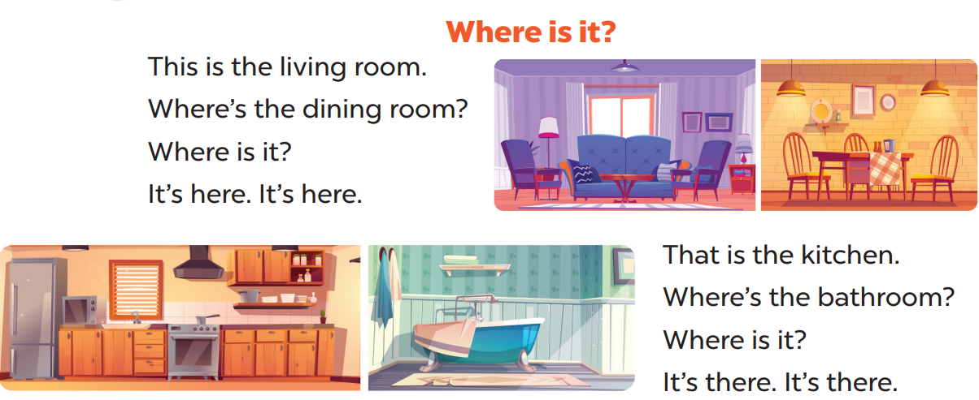
Sing a song
Option 1

Slide 2
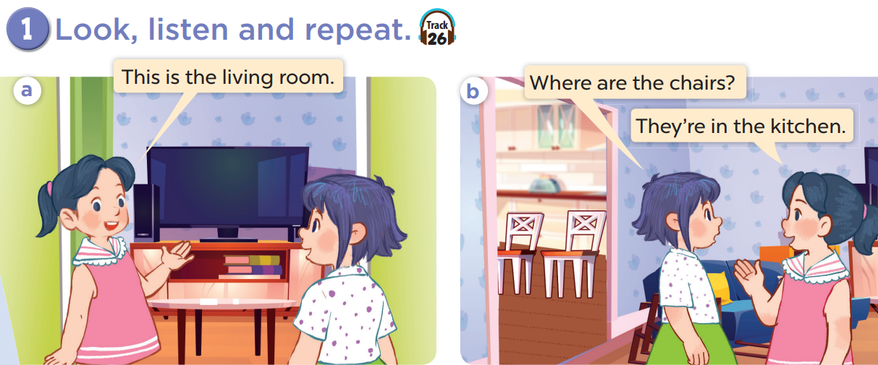

Slide 3
4
Let’s talk.

