Slide 1
01.
Warm-up and review

Slide 3
living room
kitchen
bathroom
bedroom
there
here

Slide 4
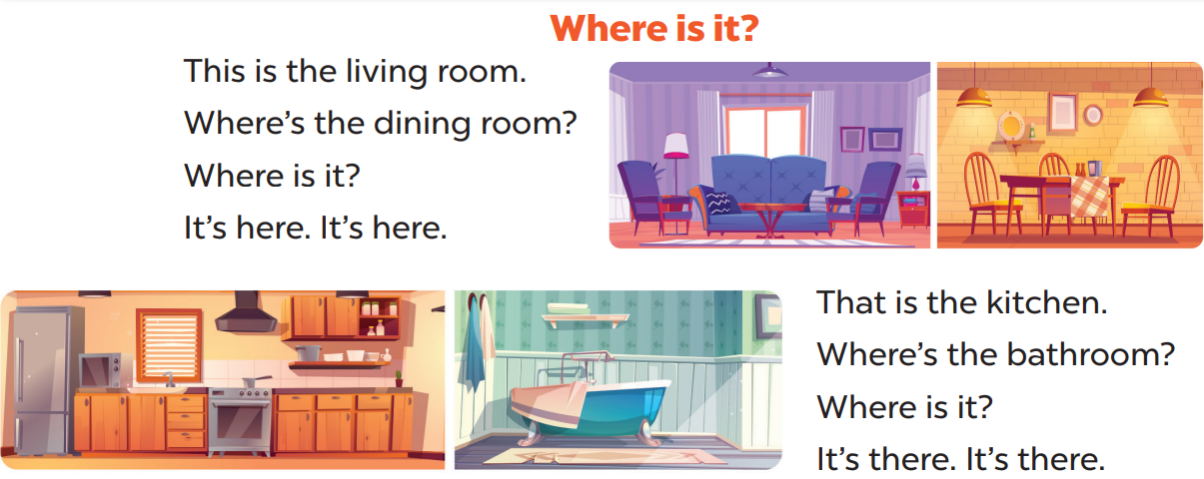

Slide 5
Sing the song quietly.

Slide 6
Sing the song loudly.

