Slide 1
1
Warm-up and review

Slide 2
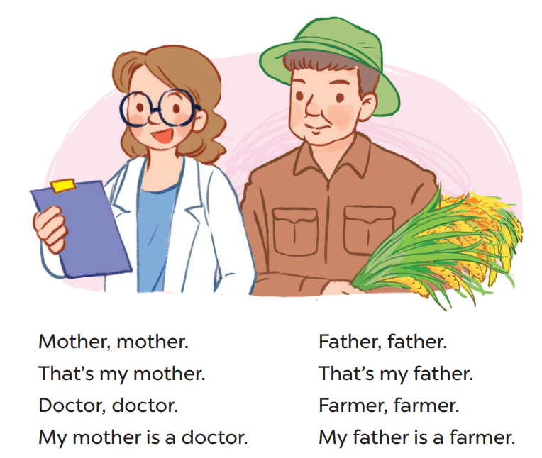
Say the chant

Slide 3
3
Listen, point and say..

Slide 4
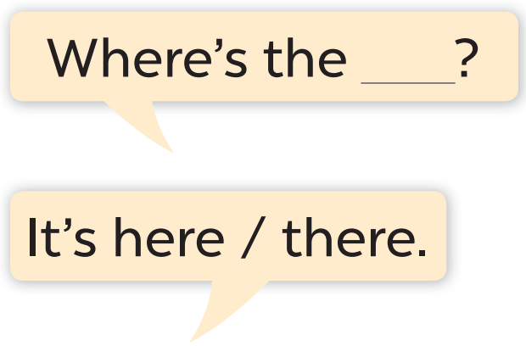
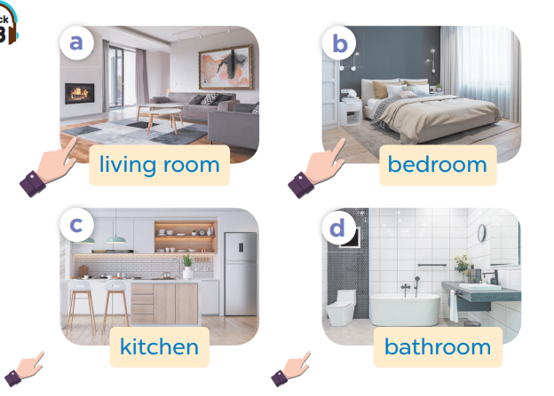

Slide 5
Work in pairs. Ask and answer.

Slide 6
Work in pairs.
Ask and answer.

Slide 7
4
Let’s talk.

Slide 8
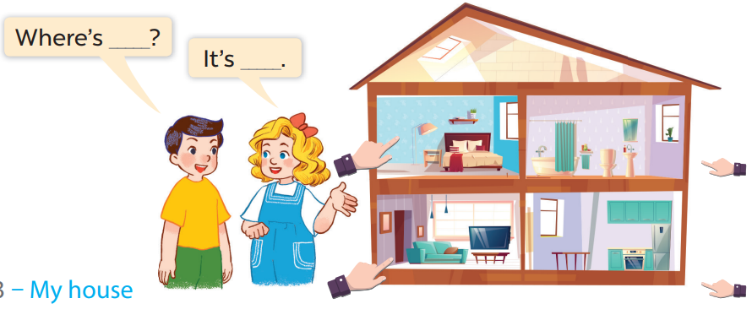
Work in pairs.
Ask and answer.

Slide 9
5
Fun corner and wrap-up

