Slide 2
Unit 14: STAYING HEALTHY
Lesson 3 - Period 5

Slide 3
Table of contents
1
Warm-up and Review.
2
Activity 1: Listen and repeat.
3
Activity 2: Listen and underline one more stressed word. Then repeat.
4
Activity 3: Let’s chant.
5
Fun corner and Wrap-up.

Slide 4
01
Warm-up and Review.

Slide 5
Let’s sing
Staying healthy
My sister wants to stay healthy.
She does morning exercise daily.
She eats healthy food,
And drinks fresh juice.
My brother wants to stay healthy.
He plays sport every day.
He eats healthy fruit,
And drinks fresh juice.

Slide 6
02
Activity 1
Listen and repeat.

Slide 7
Listen and repeat.
Does she 'eat ‘healthy 'fruit?
Notes:
Step 1: Have pupils look at the first question. Draw their attention to the stress on the words (e.g. eat, vegetables, every, day). Explain that they are the “content” (important) words in the question and need to be stressed. Check comprehension.
Step 2: Play the recording for pupils to listen to and repeat, in chorus and individually, until they feel confident. Correct their stress and pronunciation if necessary. Repeat Steps 1 and 2 with the second question.

Slide 8
Listen and repeat
Is your 'brother a 'strong 'swimmer?
Notes:
Step 1: Have pupils look at the first question. Draw their attention to the stress on the words (e.g. eat, vegetables, every, day). Explain that they are the “content” (important) words in the question and need to be stressed. Check comprehension.
Step 2: Play the recording for pupils to listen to and repeat, in chorus and individually, until they feel confident. Correct their stress and pronunciation if necessary. Repeat Steps 1 and 2 with the second question.

Slide 9
Work in pairs
Does she 'eat ‘healthy 'fruit?
Is your 'brother a 'strong 'swimmer?
Notes:
Step 3: Let pupils work in pairs or groups, saying questions with correct stressed words and pronunciation. Go around the classroom to offer help if necessary.
Step 4: Invite a few pupils to listen to and repeat the questions in front of the class. Praise them when their pronunciation is good.

Slide 10
03
Activity 2
Listen and underline one more stressed word. Then repeat.

Slide 11
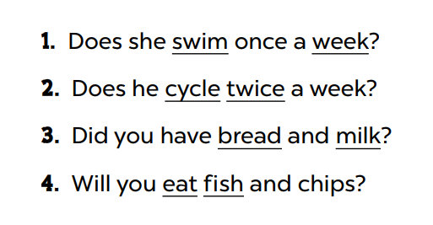
Look and say.
Notes:
Step 1: Draw pupils’ attention to the four sentences. Explain what pupils have to do. Check comprehension.

Slide 12
Listen and underline one more stressed word. Then repeat.
Notes:
Step 2: Play the recording for pupils to listen and underline one more stressed word in each question. Play the recording again for pupils to listen and check.

Slide 13
Swap your book.
Notes:
Step 3: Tell pupils to swap books with a partner, then check the answers as a class. Write the correct answers on the board.

Slide 14
Work in pairs.
Notes:
Step 4: Get pupils to work in pairs or groups, reading the Yes / No questions aloud with correct word stress. Go around the classroom and correct their pronunciation if necessary.
Step 5: Invite a few pupils to read aloud the questions in front of the class. Praise when they read the sentences correctly.

Slide 15
04
Activity 3
Let’s chant.

Slide 16
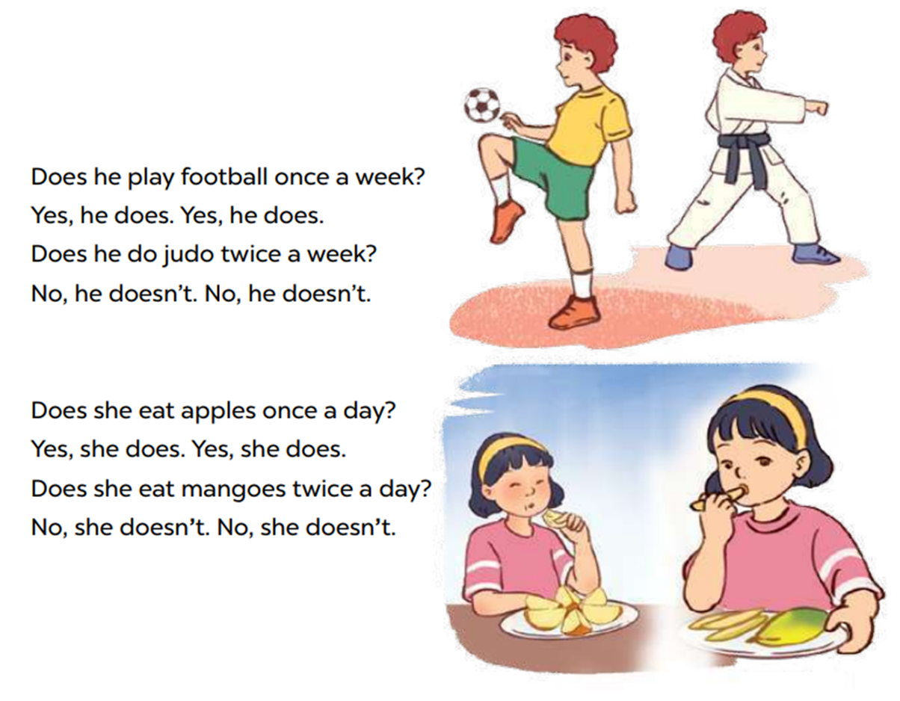
Look and read.
Notes:
Step 1: Have pupils read the lyrics of the chant. Then get them to look at the picture to reinforce their understanding. Check comprehension.

Slide 17
Listen and chant.
Notes:
Step 2: Play the recording all the way through for pupils to listen to the whole chant. Encourage them to listen carefully to the stressed words. Play it again line by line, for pupils to listen and repeat. Draw their attention to the pronunciation and rhythm. Encourage them to clap while chanting.

Slide 18
Chant and clap.
Notes:
Step 3: Divide the class into two groups to take turns listening to and repeating the chant, while the rest of the class claps along.

Slide 19
05
Wrap-up

Slide 20
Share your activities to stay healthy with your partner!

Slide 22
FOR PLAYING!

Slide 23
Website: hoclieu.vn
Fanpage: https://www.facebook.com/tienganhglobalsuccess.vn/

