Slide 2
Unit 12: Our Tet holiday
Lesson 2 - Period 3

Slide 3
Table of contents
1
2
3
Activity
Activity
4
5
Game time
Activity
Warm-up
Look, listen and repeat.
Listen, point and say.
Let’s talk.

Slide 4
1
Warm-up
What are the missing letters?

Slide 5
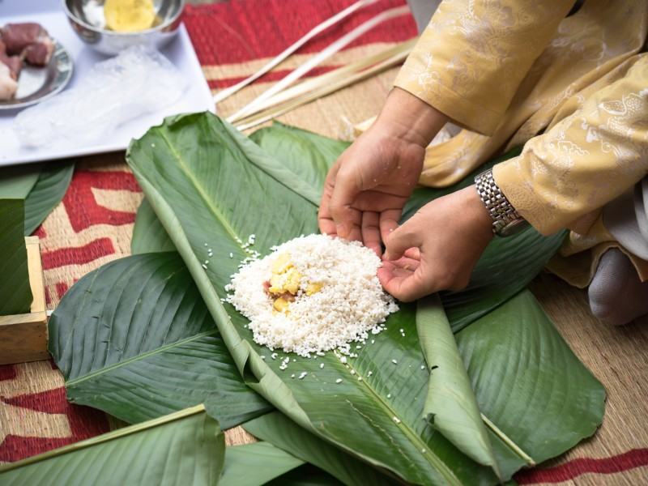
k
_ake chung ca_e
m

Slide 6
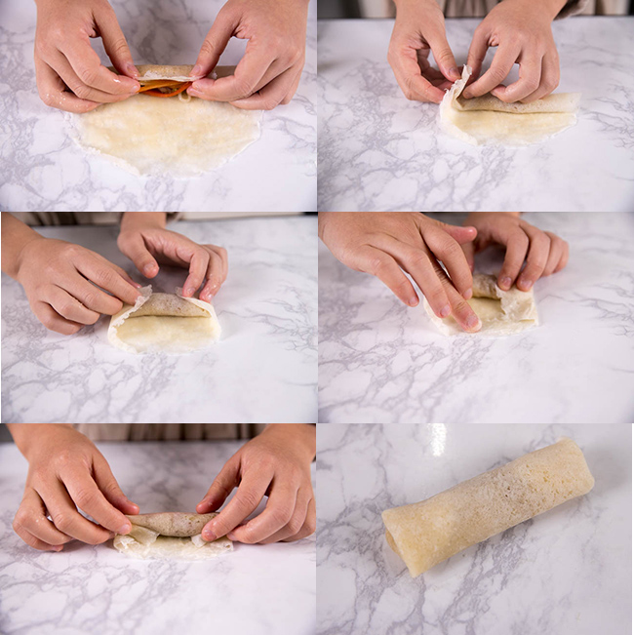
a
p
l
m_ke s_ring ro_ls

Slide 7
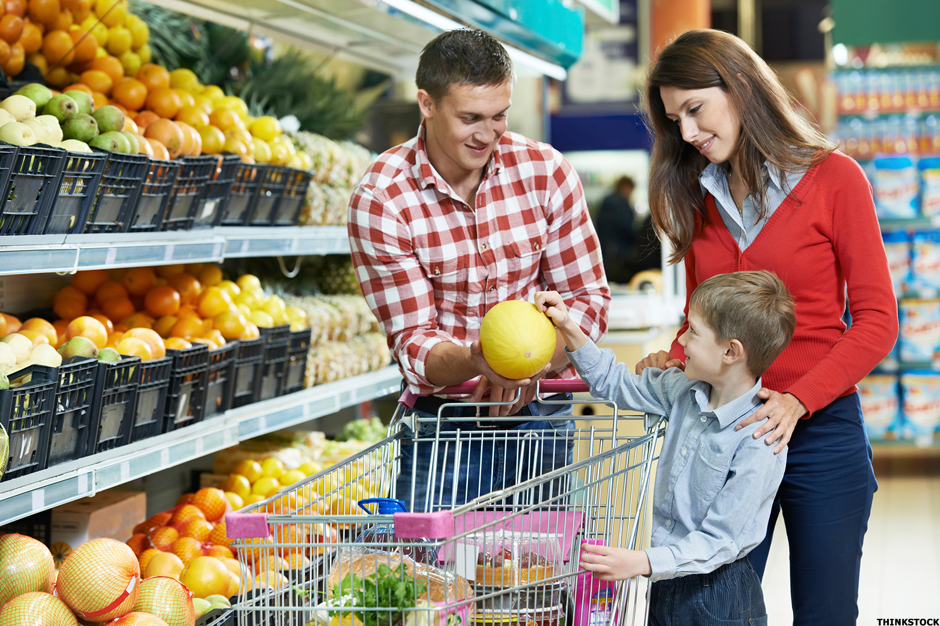
d_ the s_op_ing
o
h
p

Slide 8
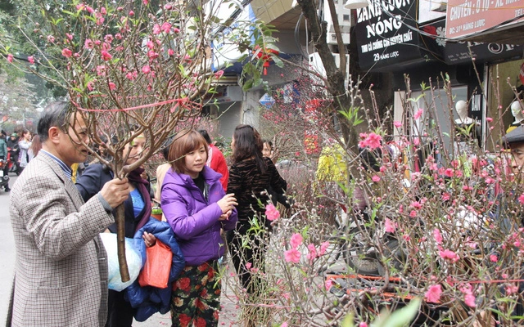
r
bu_ a b_anch of
pe_ch blo_soms
y
a
s

Slide 9
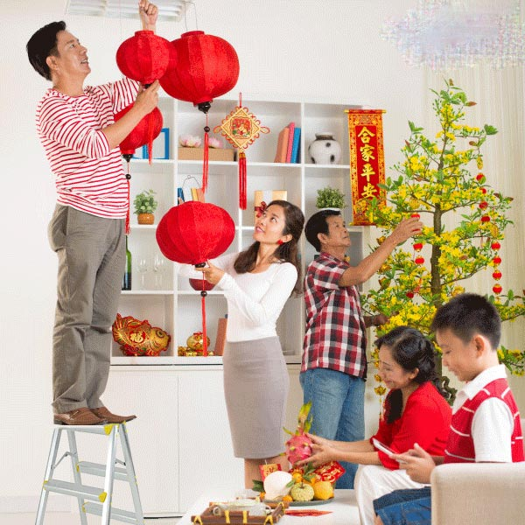
s
d_co_ate the hou_e
e
r

Slide 10
Awesome words

Slide 11
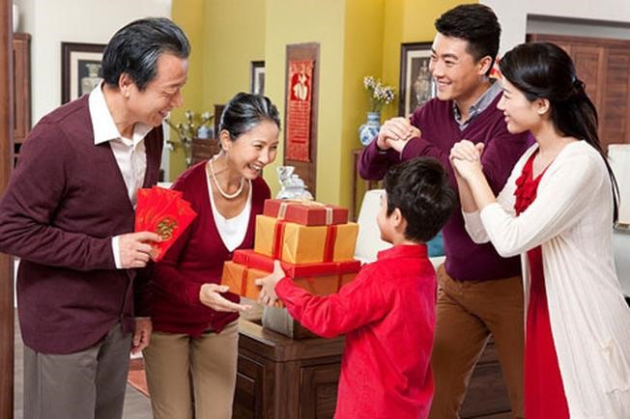
our grandparents’ house

Slide 12
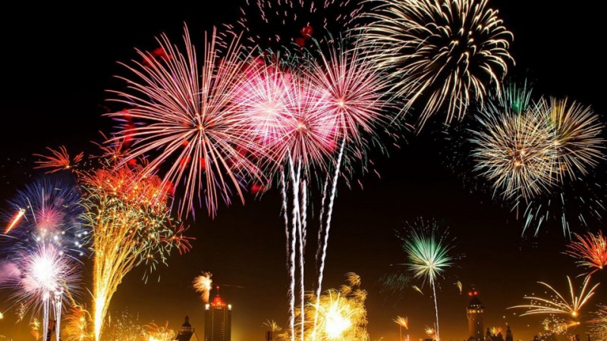
a fireworks show

Slide 13
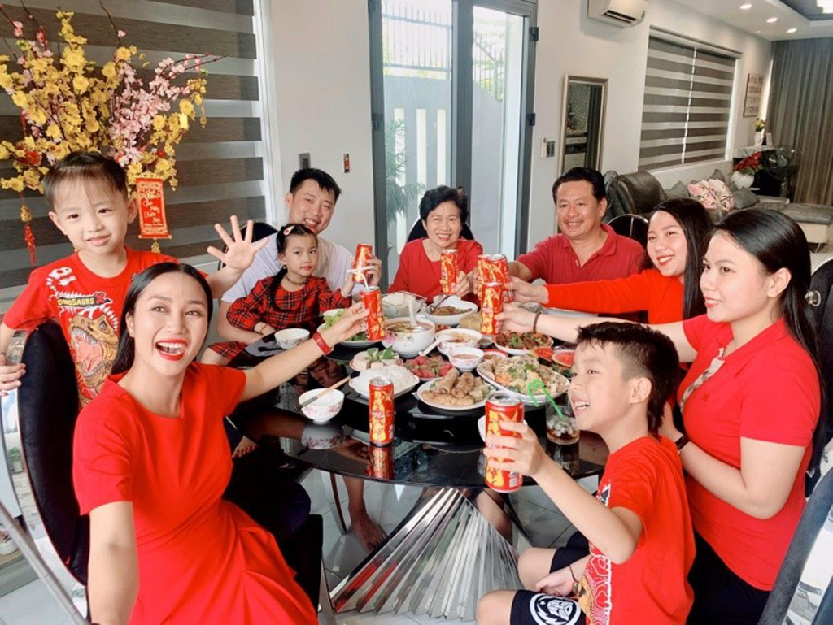
a New Year party

Slide 14
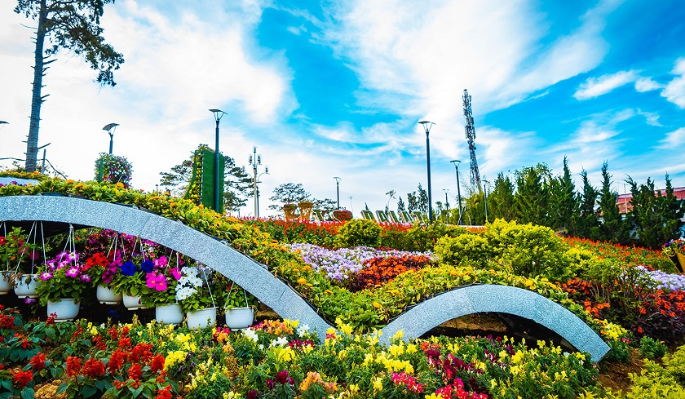
a flower festival

Slide 15
2
Look, listen and repeat.
Activity 1

Slide 16
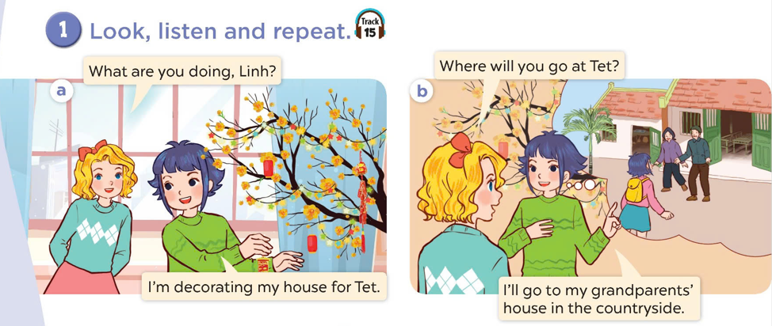
Look at the pictures.
Where are they?
What are they doing?

Slide 17
Look, listen and repeat.

Slide 18
3
Listen, point and say.
Activity 2

Slide 19
Where will you go at Tet?
I will go to my grandparents’ house.

Slide 20
Where will you go at Tet?
I will go to a fireworks show.

Slide 21
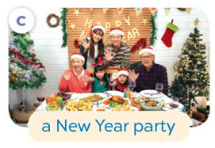
Where will you go at Tet?
Where will you go at Tet?
I will go to a New Year party.

Slide 22
Where will you go at Tet?
I will go to a flower festival.

Slide 23
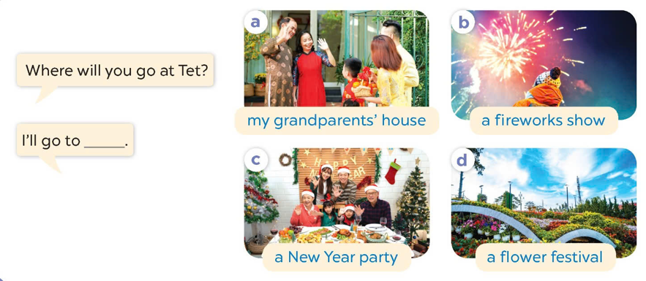
Listen and repeat.
Look and repeat the phrases.
Work in pairs. Ask and answer.

Slide 24
4
Let’s talk.
Activity 3

Slide 25
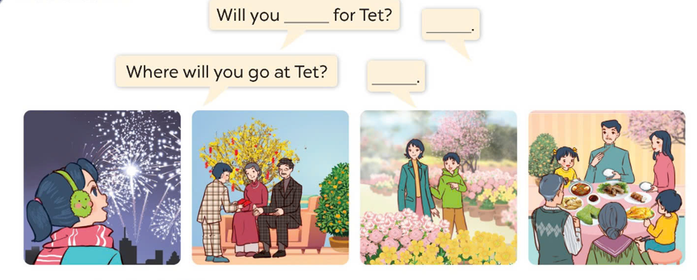
Look and say.
a fireworks show
my grandparents’ house
a flower festival
a New Year party

Slide 26
Work in pairs. Ask and answer.
Where will you go at Tet?
I’ll go to ________.
a fireworks show
my grandparents’ house
a flower festival
a New Year party

Slide 27
5
Game time Lucky number

Slide 28
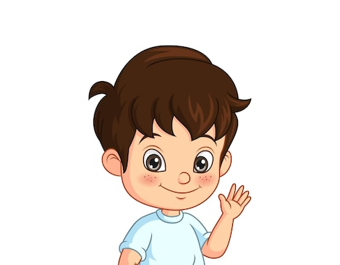
2

Slide 29
I will go to ……………………… .
my grandparents’ house.

Slide 30
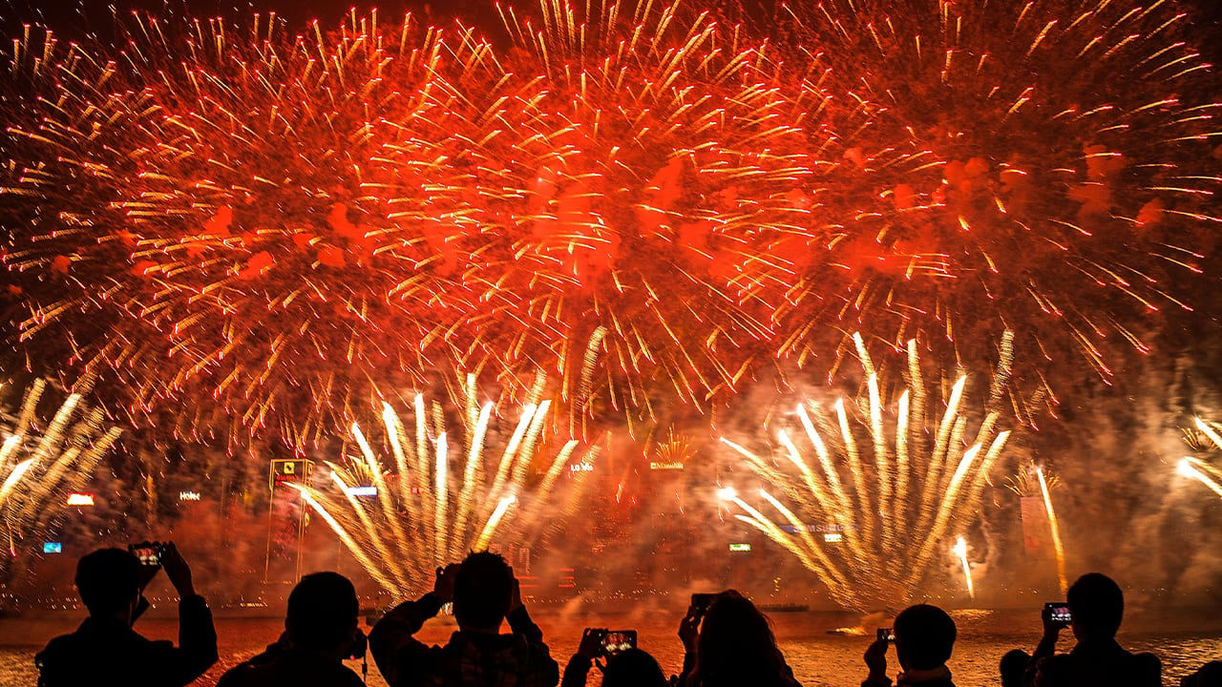
I will go to ……………………… .
a firework show.

Slide 31
a New Year party.
I will go to ……………………… .

Slide 32
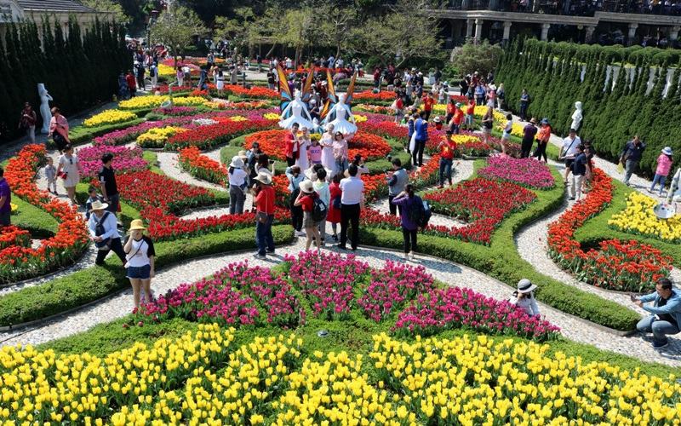
a flower festival.
I will go to ……………………… .

Slide 33
at/ Where/ will/ go/ Tet?/ you/
.…..?
Where will you go at Tet?

Slide 34
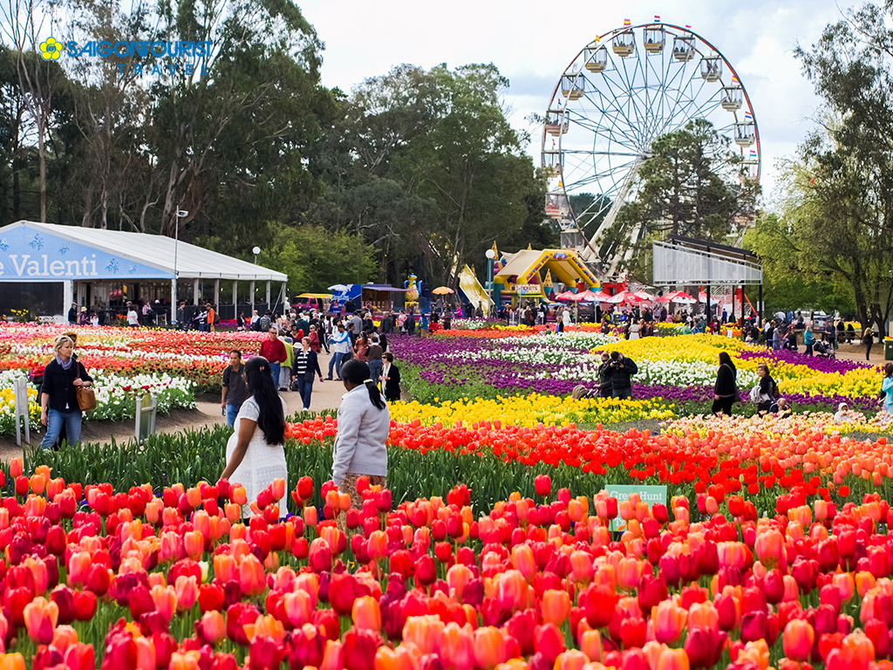
will/ I/ to / festival./ a / go/ flower/
I will go to a flower festival.

Slide 35
Website: hoclieu.vn
Fanpage: https://www.facebook.com/tienganhglobalsuccess.vn/

