Slide 1




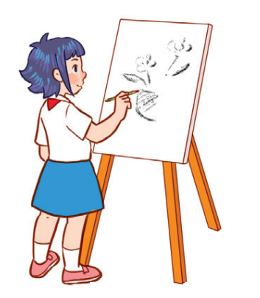

Unit 8
Period 4

Slide 2
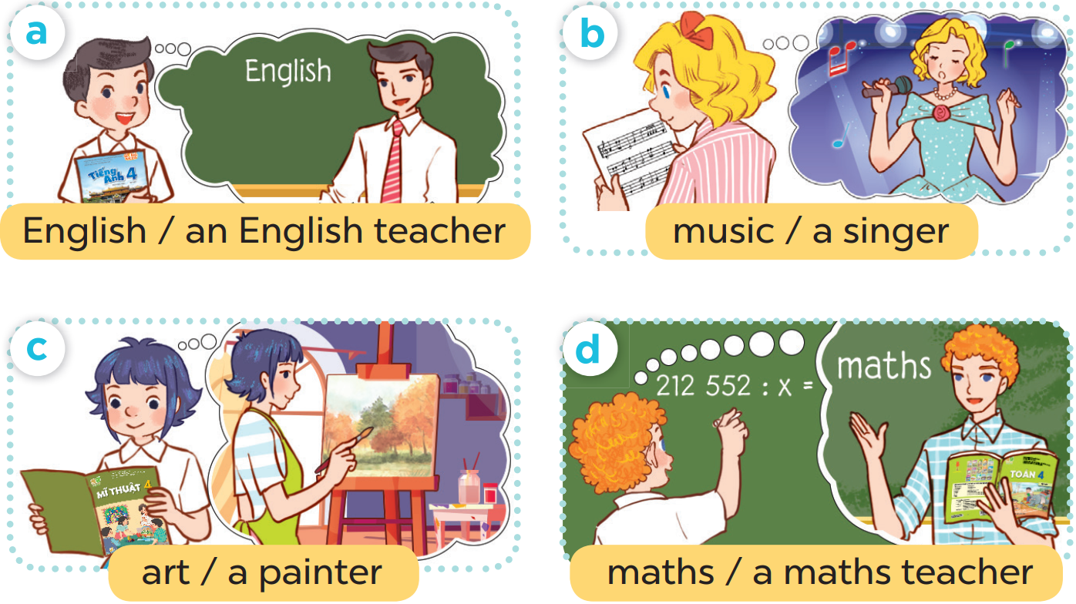

Slide 3



Slide 4
3
1
4
2

Slide 5
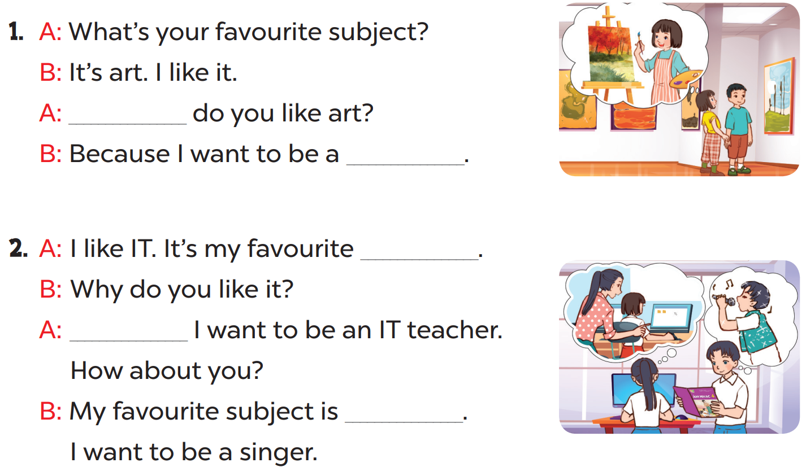

Slide 6
Why
painter
subject
Because
music

