Slide 2

Unit 10
Our school trip
Lesson 3 - Period 5

Slide 3
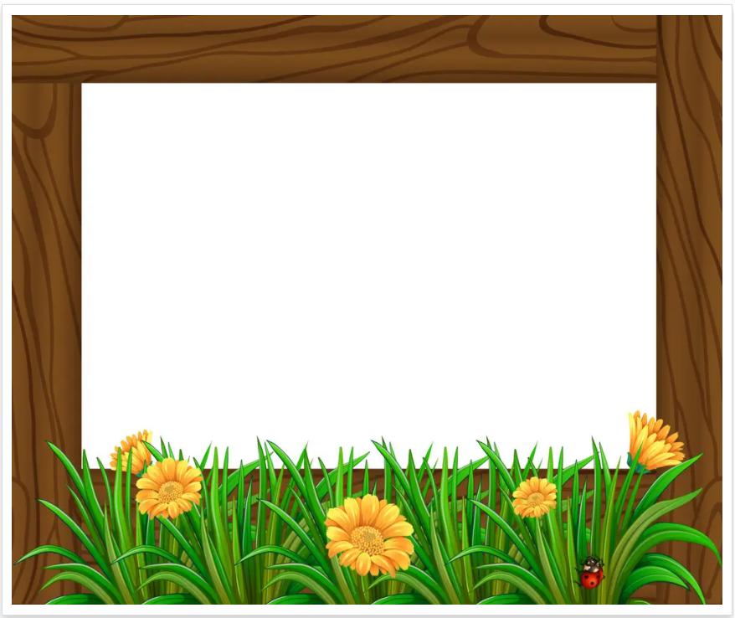
Table of contents
01
Warm-up and Review
02
Activity 1. Listen and repeat.
03
Activity 2. Circle, listen and check.
04
Activity 3. Let’s chant.
05
Fun corner and Wrap-up

Slide 4


01
Warm-up and Review

Slide 5


Slide 6
02
Activity 1. Listen and repeat.

Slide 7

Listen and repeat.
'
'
No vember
We went to Sa Pa last No vember.

Slide 8
Listen and repeat.
'
'
De cember
They visited Da Lat last De cember.

Slide 9
Listen and repeat.
'
'
No vember
We went to Sa Pa last No vember.
'
'
De cember
They visited Da Lat last De cember.

Slide 10
03
Activity 2.
Circle, listen and check.

Slide 11
Circle, listen and check.
1.
a. September
b. yesterday
c. Saturday
2.
a. October
b. Saturday
c. December
3.
a. banana
b. bakery
c. badminton

Slide 12
Circle, listen and check.
1.
a. September
b. yesterday
c. Saturday

Slide 13
Circle, listen and check.
2.
a. October
b. Saturday
c. December

Slide 14
Circle, listen and check.
3.
a. banana
b. bakery
c. badminton

Slide 15

'
Sep tember
'
Saturday
ba nana
'

Slide 16
04
Activity 3. Let’s chant.

Slide 17

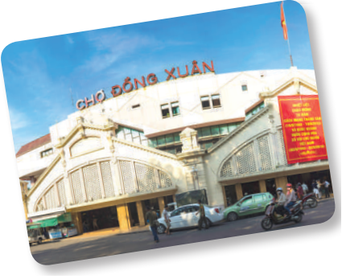
Let’s chant.
November, December.
November, December.
Where did you go last November?
We went to Ben Thanh Market last November.
November, December.
November, December.
Where did they go last December?
They went to Dong Xuan Market last December.

Slide 18


Let’s chant.
November, December.
November, December.
Where did you go last November?
We went to Ben Thanh Market last November.
November, December.
November, December.
Where did they go last December?
They went to Dong Xuan Market last December.

Slide 19
Let’s chant.
September, October.
September, October.
Where did you go last September?
We went to Ben Thanh Market last October.
September, October.
September, October.
Where did they go last October?
They went to Dong Xuan Market last September.

Slide 20
05
Fun corner and Wrap-up

Slide 21

Musical cards

Slide 22

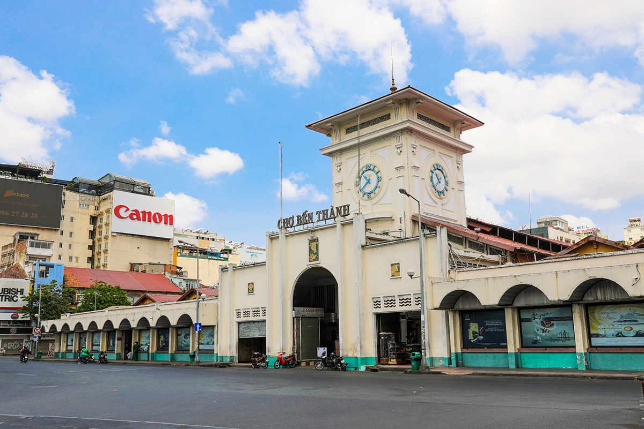
E.g
Where did you go last November?
I went to Ben Thanh Market last November.

Slide 23
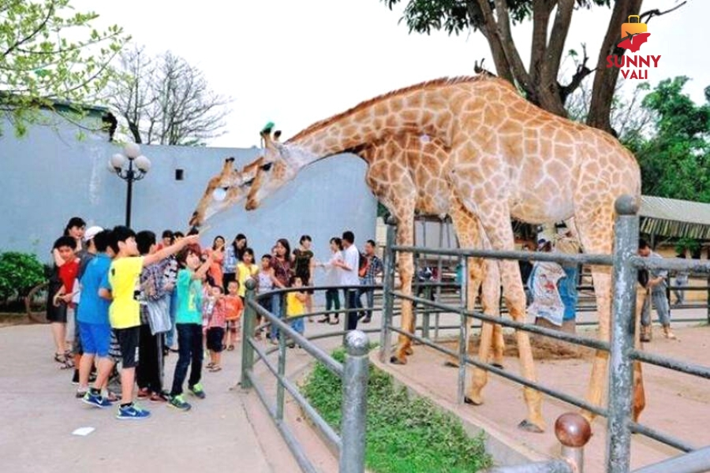
Where did you ______?
I went t __________.
Notes:
Nháy chuột lần 1 bật nhạc, nháy chuột lần 2 nhạc tắt hình ảnh xuất hiện, HS hỏi đáp về hình ảnh.

Slide 24
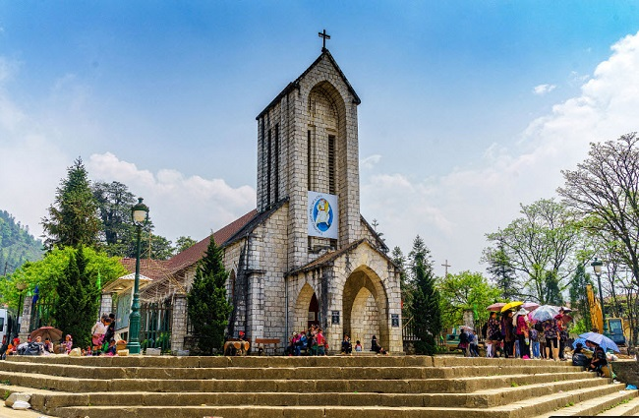
Where did you ______?
I went t __________.

Slide 25
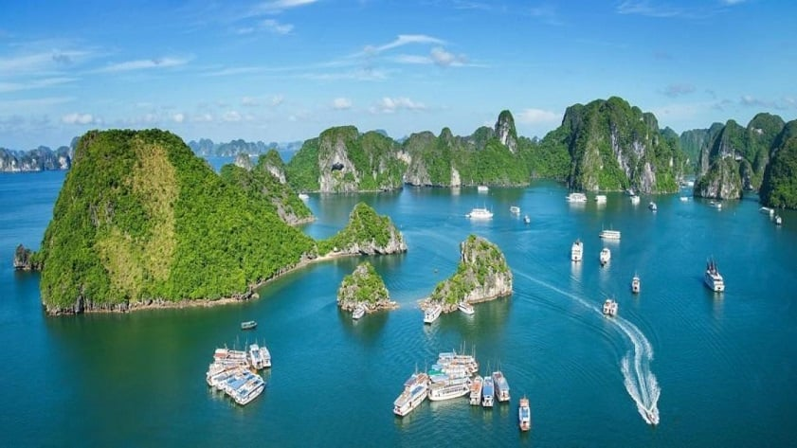
Where did you ______?
I went t __________.

Slide 26
Where did you ______?
I went t __________.

Slide 27


Very Good!

Slide 28
Website: hoclieu.vn
Fanpage: https://www.facebook.com/tienganhglobalsuccess.vn/

