Slide 2
Unit 10 Our school trip
Lesson 1 - Period 1

Slide 3
Table of contents
01
Warm-up and Review
02
Activity 1. Look, listen and repeat
03
Activity 2. Listen, point and say
04
Activity 3. Let’s talk
05
Fun corner and Wrap-up

Slide 4
01
Warm-up and Review

Slide 5
Let’s chant.
Yesterday, I was at the cinema.
I wanted to watch a film.
The film was interesting.
I liked the film.
Yesterday, we were at the bakery.
We wanted to buy some cakes.
The cakes were delicious.
We loved the cakes.

Slide 6
Let’s chant.

Slide 7
02
Activity 1.
Look, listen and repeat.

Slide 8
Look, listen and repeat.

Slide 9
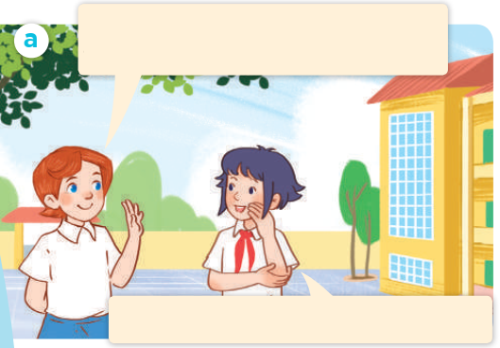
Look, listen and repeat.
Hello, Linh. How was your school trip last weekend?
It was great! We went to Da Nang.
Notes:
Nháy vào hội thoại để nghe lại âm thanh từng câu.

Slide 10
Look, listen and repeat.
Did Nam and Mai go with you?
Yes, they did. We all enjoyed it very much.
Notes:
Nháy vào hội thoại để nghe lại âm thanh từng câu.

Slide 11
Look, listen and repeat.
Hello, Linh. How was your school trip last weekend?
Did Nam and Mai go with you?
It was great! We went to Da Nang.
Yes, they did. We all enjoyed it very much.
Notes:
Nháy vào hội thoại để nghe lại âm thanh từng câu.

Slide 12
03
Activity 2.
Listen, point and say.

Slide 13
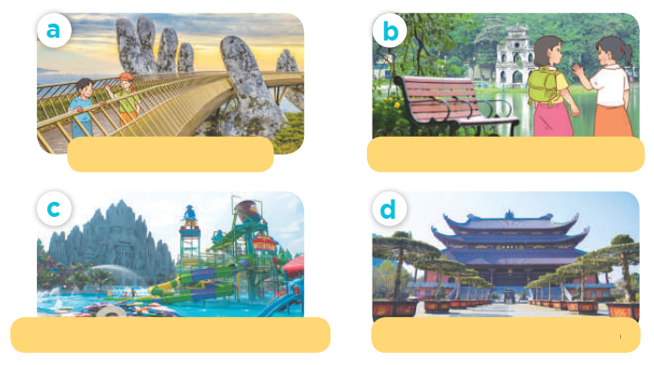
Listen, point and say.

Slide 14
Listen, point and say.
Ba Na Hills / yes

Slide 15
Listen, point and say.
Hoan Kiem Lake/ yes

Slide 16
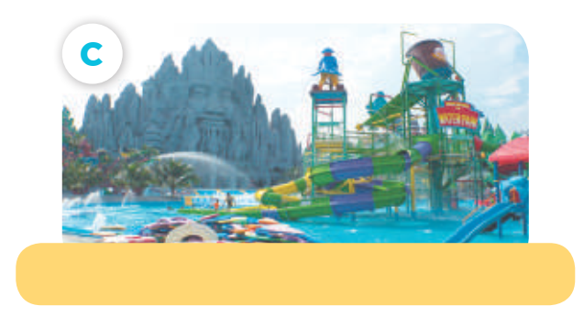
Listen, point and say.
Suoi Tien Theme Park/ no

Slide 17
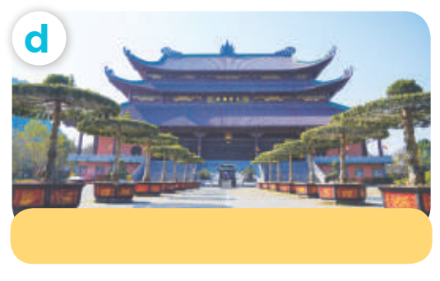
Listen, point and say.
Bai Dinh Pagoda / no

Slide 18
Did they go to __?
Yes, they did.
No, they didn’t.

Slide 19
Listen, point and say.
Did they go to Ba Na Hills ?
Yes, they did.
Ba Na Hills / yes

Slide 20
Listen, point and say.
Did they go to Hoan Kiem Lake?
Yes, they did.
Hoan Kiem Lake/ yes

Slide 21
Listen, point and say.
Did they go to Suoi Tien Theme Park?
No, they didn’t.
Suoi Tien Theme Park/ no

Slide 22
Listen, point and say.
Did they go to Bai Dinh Pagoda ?
No, they didn’t.
Bai Dinh Pagoda / no

Slide 23
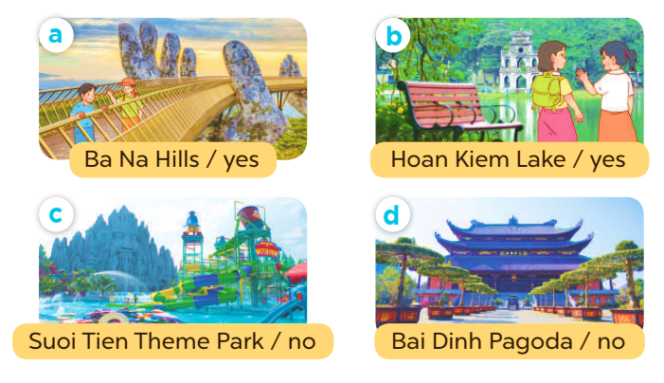
Did they go to __?
Yes, they did.
No, they didn’t.

Slide 24
04
Activity 3. Let’s talk.

Slide 25
Let’s talk.
Did they go to ____?
____.

Slide 26
05
Fun corner and Wrap-up

Slide 27
Did they go to __?
Yes, they did.
No, they didn’t.

Slide 28
Musical pictures

Slide 29
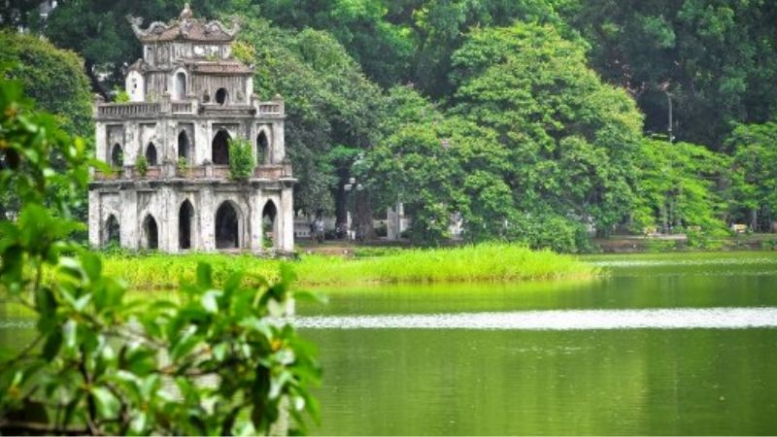
Did you go to __?
____
Notes:
Nháy choột lần 1 bật nhạc, nháy chuột lần 2 nhạc tắt hình ảnh xuất hiện, HS hỏi đáp về hình ảnh.

Slide 30
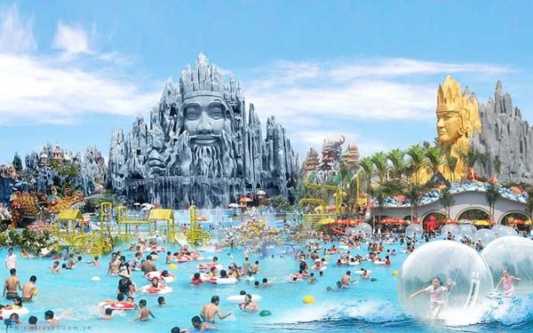
Did you go to __?
____
Notes:
Nháy choột lần 1 bật nhạc, nháy chuột lần 2 nhạc tắt hình ảnh xuất hiện, HS hỏi đáp về hình ảnh.

Slide 31
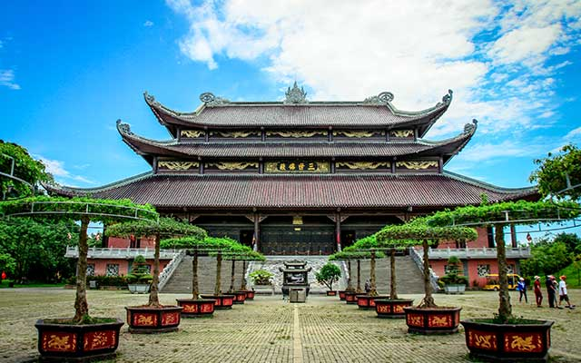
Did you go to __?
____
Notes:
Nháy choột lần 1 bật nhạc, nháy chuột lần 2 nhạc tắt hình ảnh xuất hiện, HS hỏi đáp về hình ảnh.

Slide 32
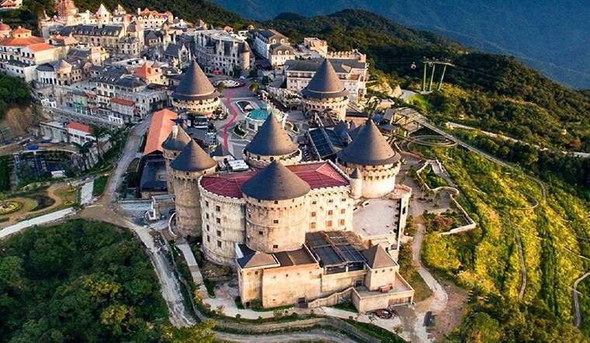
Did you go to __?
____
Notes:
Nháy choột lần 1 bật nhạc, nháy chuột lần 2 nhạc tắt hình ảnh xuất hiện, HS hỏi đáp về hình ảnh.

Slide 33
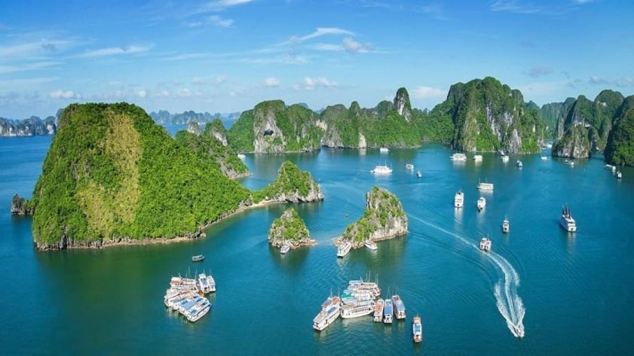
Did you go to __?
____
Notes:
Nháy choột lần 1 bật nhạc, nháy chuột lần 2 nhạc tắt hình ảnh xuất hiện, HS hỏi đáp về hình ảnh.

Slide 34
Very Good!

Slide 35
Website: hoclieu.vn
Fanpage: https://www.facebook.com/tienganhglobalsuccess.vn/

