Slide 2
Unit 8
IN OUR CLASSROOM
Lesson 2 – Period 4

Slide 3
/
TABLE OF CONTENTS
Warm-up & Review
Listen and tick.
Read and complete.
Let’s play.
Fun corner & Wrap-up

Slide 4
01
Warm-up & Review

Slide 5
Game
FLOWER PICKING!

Slide 6
Group 1
Group 2
Notes:
Click the box to give scores to groups.
Click numbers to link to the Question slide.
Click star to end the game.

Slide 7
A: Whose glue is this?
Trung
It’s Trung’s.
B: ________
Notes:
GV nháy vào biểu tượng ngôi sao để về slide tính điểm cho đội trả lời đúng

Slide 8
pencil sharpener
A:Whose ____________ is this?
Thoa
It’s Thoa’s.
B: _______

Slide 9
crayon
A: Whose _____ is this?
David
It’s David’s.
B: _________

Slide 10
pencil case
A:Whose ________ is this?
Peter
It’s Peter’s.
B: _________

Slide 11
set square
A: Whose ________ is this?
Thu
It’s Thu’s.
B: _______

Slide 12
ruler
A: Whose ____ is this?
Hoai
It’s Hoai’s.
B: _________

Slide 13
Good job!

Slide 14
02
Listen and tick.

Slide 15
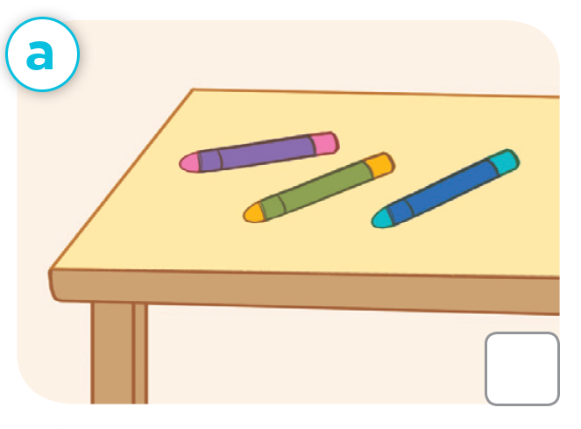
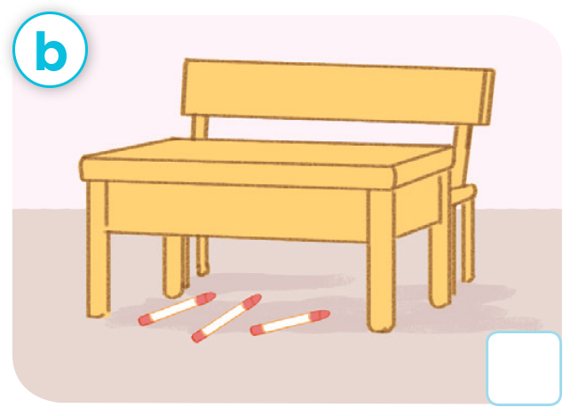
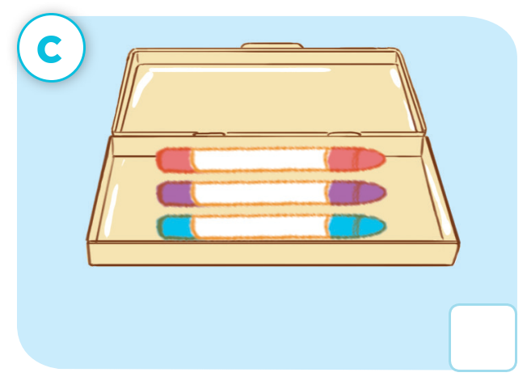
Look and say.

Slide 16
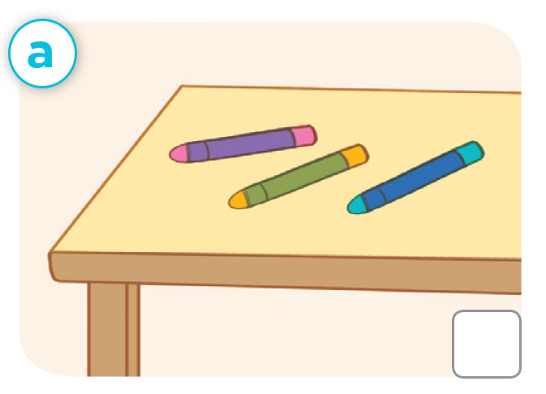
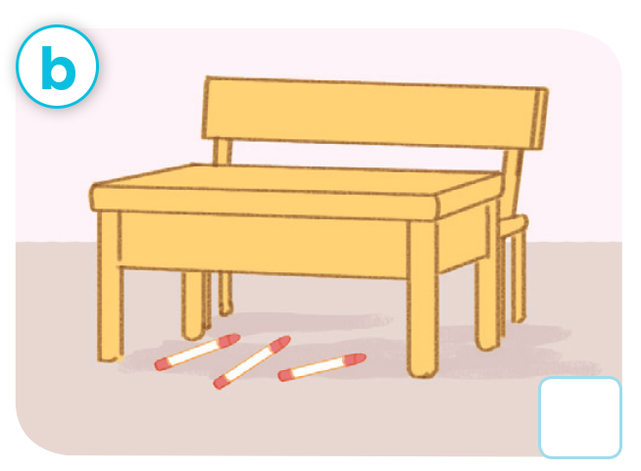
Look and say.
✓

Slide 17
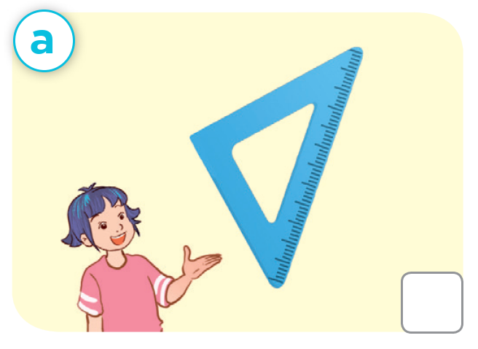
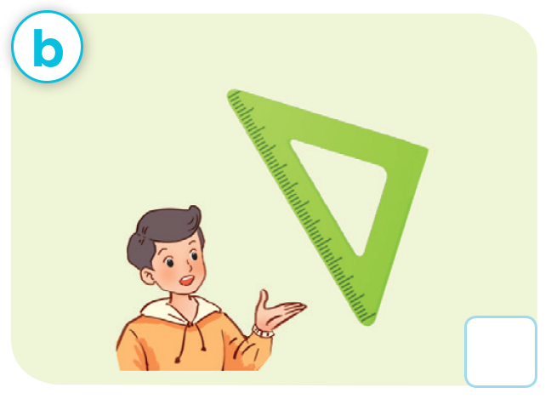
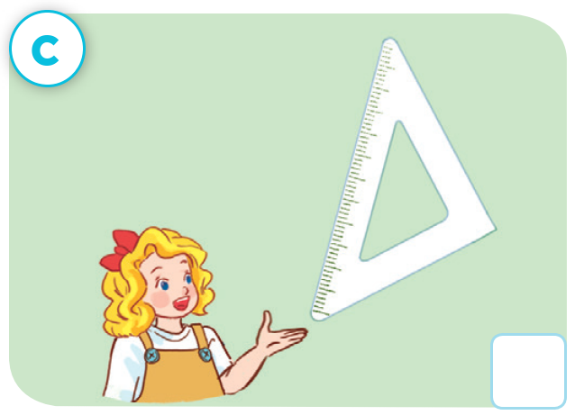
Look and say.

Slide 18
Swap your books!

Slide 19
Let’s check!
✓

Slide 20
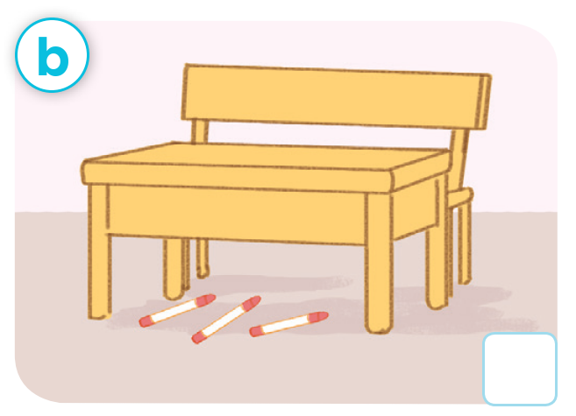
Make a new conversation.

Slide 21
Make a new conversation.

Slide 23
03
Read and complete.

Slide 24
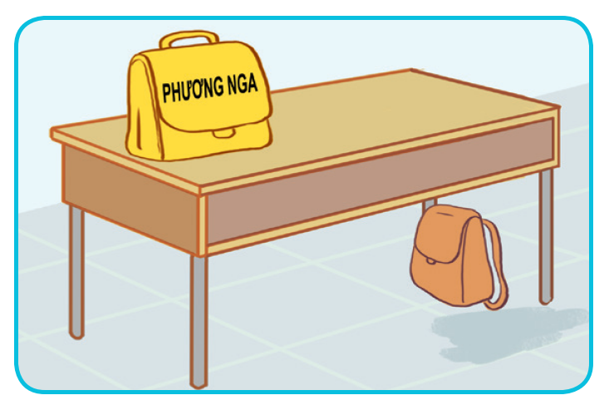
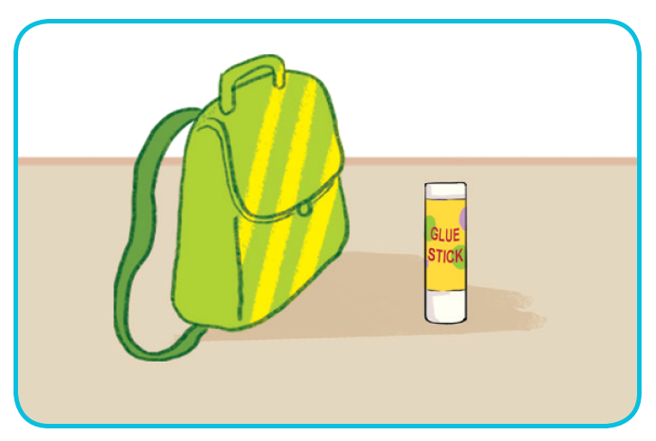
Look and say

Slide 25
Look and guess.
1. A: Excuse me, whose school bag is this?
B: _____ Phuong Nga’s.
A: And where’s my school bag?
B: Look! It’s there, ______ the desk.
A: Thank you.

Slide 26
Look and guess.
2. A: Is this your glue stick?
B: No, it isn’t.
A: ________________ glue stick is this?
B: It’s Tom’s.
A: _____________ my glue stick?
B: It’s there, beside the ________________.

Slide 27
Read and complete.
1. A: Excuse me, whose school bag is this?
B: ____ Phuong Nga’s.
A: And where’s my school bag?
B: Look! It’s there, ______ the desk.
A: Thank you.
It’s
under

Slide 28
Read and complete.
2. A: Is this your glue stick?
B: No, it isn’t.
A: ________ glue stick is this?
B: It’s Tom’s.
A: ______ my glue stick?
B: It’s there, beside the ___________.

Slide 29
SWAP YOUR BOOKS!

Slide 30
Let’s check!
2. A: Is this your glue stick?
B: No, it isn’t.
A: ________ glue stick is this?
B: It’s Tom’s.
A: _________ my glue stick?
B: It’s there, beside the ____________.
Whose
Where’s
school bag

Slide 32
04
Let’s play.

Slide 33
Whose pen is this??
Whose pen is this?
It’s Mai.

Slide 34
Let’s play!
WHOSE PEN IS THIS?
Group A
Group B

Slide 36
05
Fun corner & Wrap-up

Slide 37
Where are the ___?
They’re ____.
Whose ___ is this?
It’s ____.

Slide 38
Pass
the
balls

Slide 39
Listen, sing and pass the balls.

Slide 40
Listen, sing and pass the balls.

Slide 41
Listen, sing and pass the balls.

Slide 42
Good job!

Slide 43
See you
next time!

Slide 44
Website: hoclieu.vn
Fanpage: https://www.facebook.com/tienganhglobalsuccess.vn/

