Slide 1
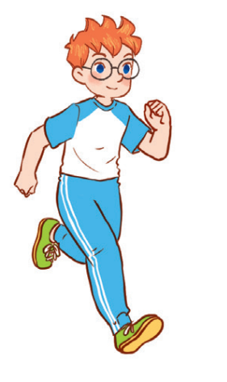
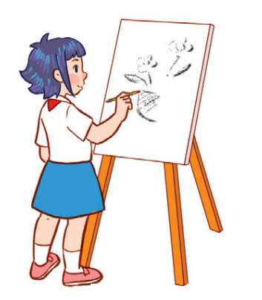
Unit 8
Period 1

Slide 2
2
Look, listen and repeat.
2
2

Slide 3
