Slide 2
9
Colours
LESSON 3
Period 5

Slide 3
01
Warm-up and review

Slide 4
That door could be really fun. Let’s play a game to find out. Are you ready?
Hello, everyone, this is me Mary. Do you like my Anywhere Door?

Slide 5
TEAM 1
0
TEAM 2
0
Notes:
Divide the class into 2 teams.
Each team takes turns choosing from door 1 to 8. Then answer the questions.
Then students can choose to keep or give the points they get to the other team. (Students cannot choose to keep or give twice in a row)

Slide 6
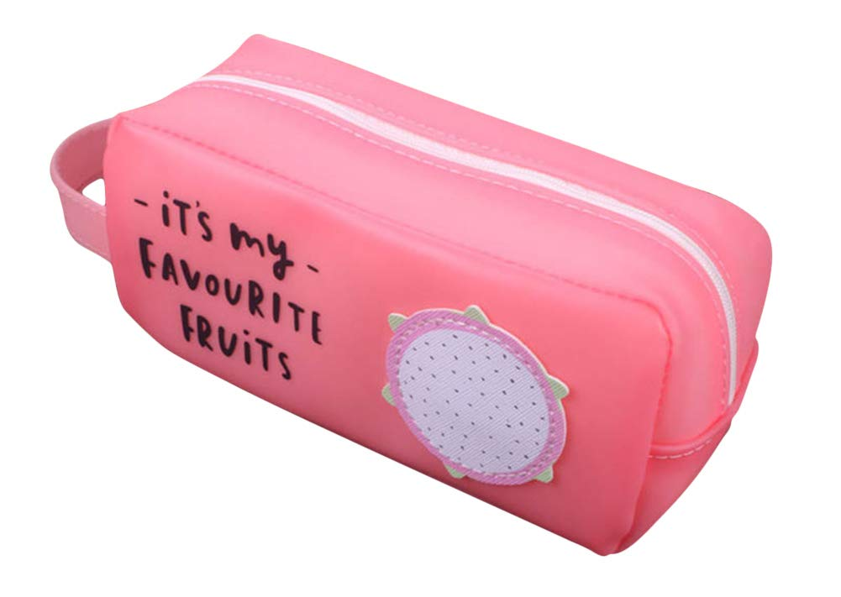
What is it?
What colour is it?
It’s a pencil case.
It’s pink.

Slide 7
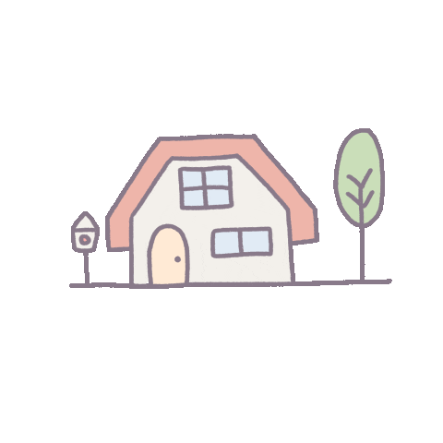
4 points
or
Notes:
Click the home to go back.

Slide 8
What colour are they?
What are they?
They’re notebooks.
They’re orange.

Slide 9
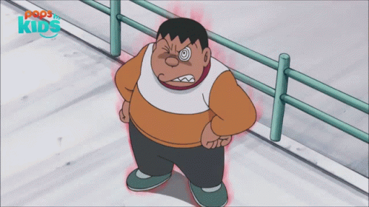
1 point
or
Notes:
Click the home to go back.

Slide 10
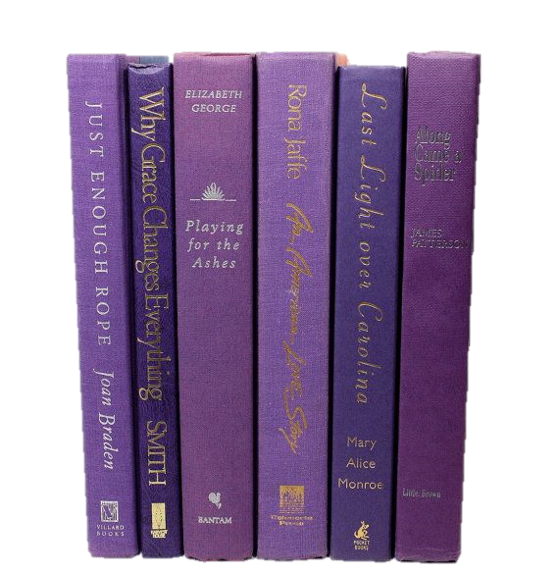
What are they?
What colour are they?
They’re books.
They’re purple.

Slide 11
3 points
or
Notes:
Click the home to go back.

Slide 12
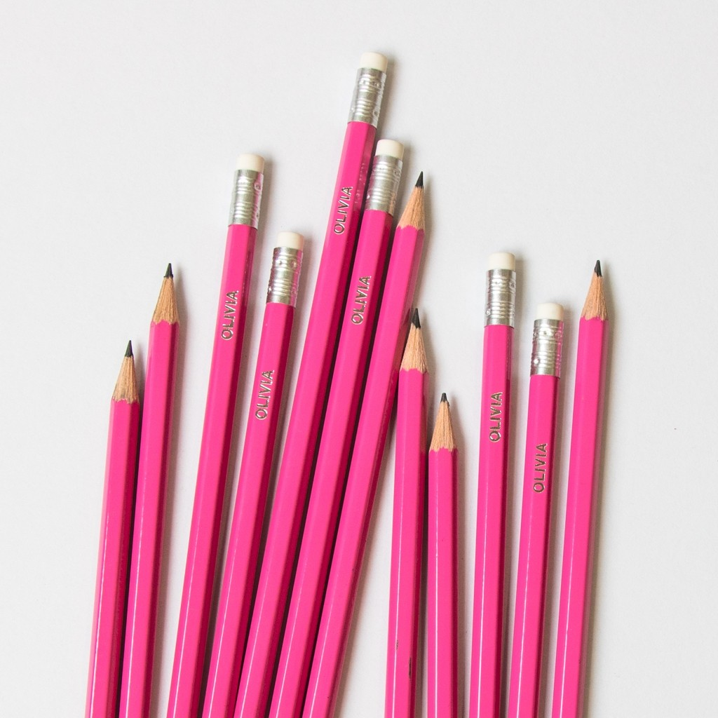
What are they?
What colour are they?
They’re pink.
They’re pencils.

Slide 13
2 points
or
Notes:
Click the home to go back.

Slide 14
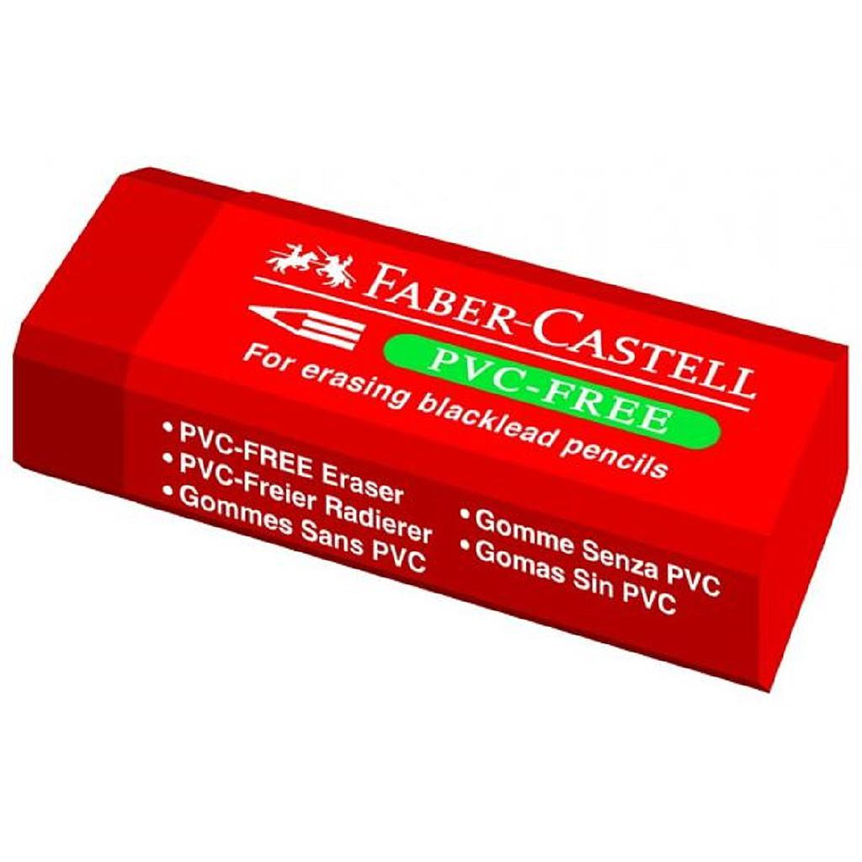
What colour is it?
What is it?
It’s an eraser.
It’s red.

Slide 15
2 points
or
Notes:
Click the home to go back.

Slide 16
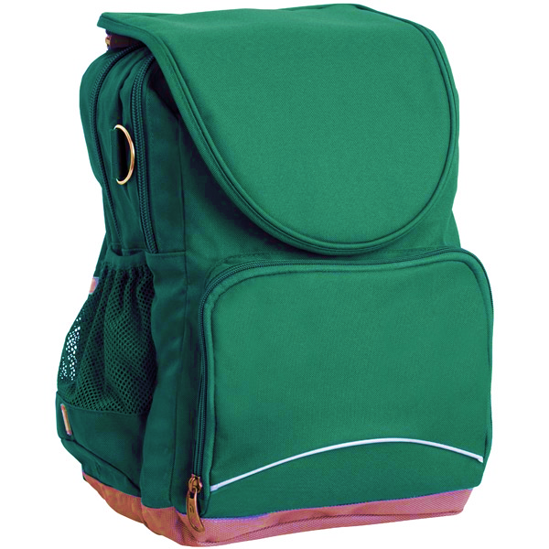
What colour is it?
What is it?
It’s a school bag.
It’s green.

Slide 17
3 points
or
Notes:
Click the home to go back.

Slide 18
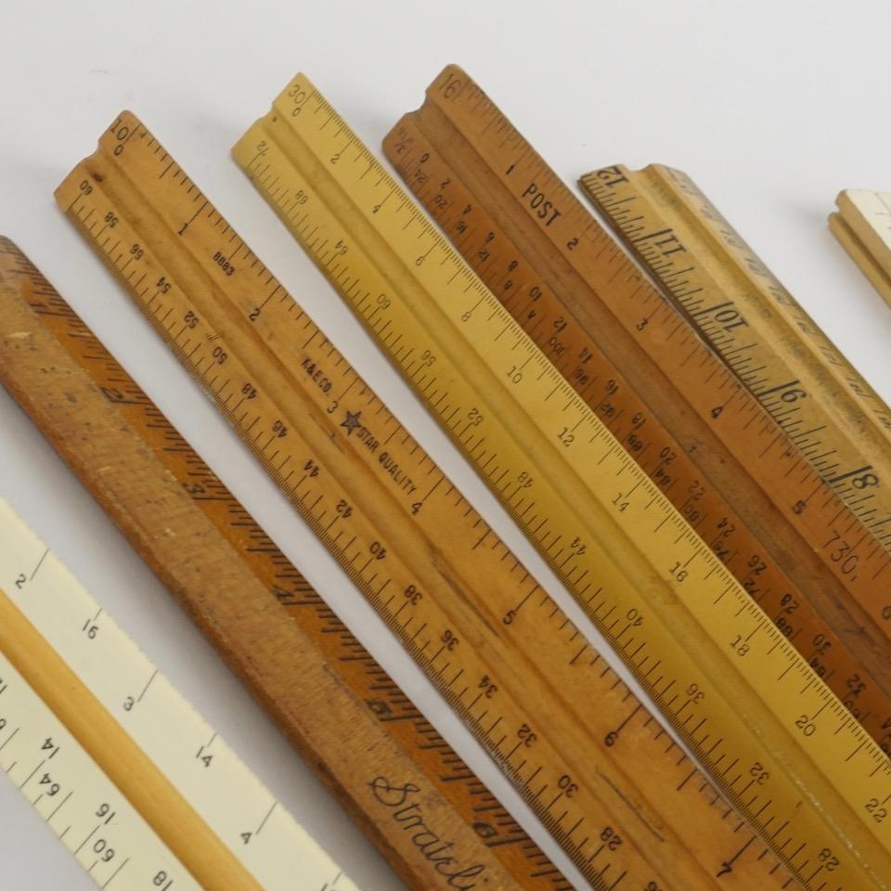
What colour are they?
What are they?
They’re rulers.
They’re brown.

Slide 19
0 point
or
Notes:
Click the home to go back.

Slide 20
What colour are they?
What are they?
They’re yellow.
They’re pens.

Slide 21
6 points
or
Notes:
Click the home to go back.

Slide 22
Listen and repeat.

Slide 23
Well done, boys and girls. Now let’s learn some sounds. Listen and repeat.

Slide 24
bl
ack

Slide 25
bl
ue

Slide 26
br
own

Slide 28
Listen and circle.

Slide 30
Let’s chant.

Slide 31
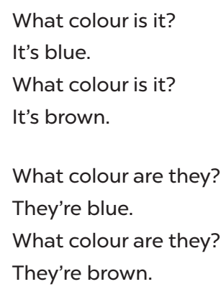
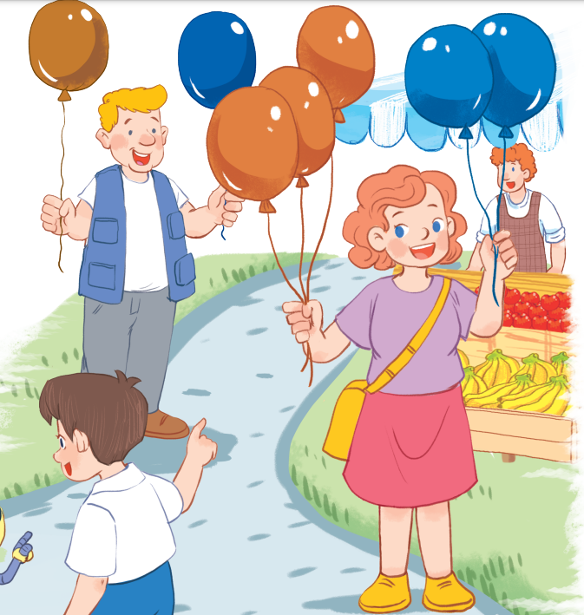
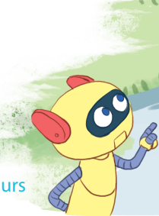

Slide 32
Now it’s your turn. Let’s chant in pairs!

Slide 34
Let’s chant in groups. Are you ready? Let’s go!

Slide 36
Fun corner and wrap-up

Slide 37
bl
ack
Notes:
Slap the board game. (choose the sounds and phonics words)
- Divide the class into groups or play individually.
- Teacher writes some words on the board then plays the sounds.

Slide 38
bl
ue

Slide 39
br
own

Slide 40
Website: sachmem.vn
Fanpage: www.facebook.com/sachmem.vn

