Slide 1
9
Colours
LESSON 1
Period 2

Slide 2
CLASSROOM RULES

Slide 3
Read and complete.
What colour is ________?
it
It’s blue.

Slide 4
Read and complete.
colour
What ________ is it?
It’s red.

Slide 5
Read and complete.
What colour is it?
___________brown.
It’s

Slide 6
Read and complete.
What colour is it?
yellow
It’s _________.

Slide 7
Read and complete.
What _______ is it?
colour
It’s blue.

Slide 8
Read and complete.
What colour is it?
brown
It’s ________.

Slide 9
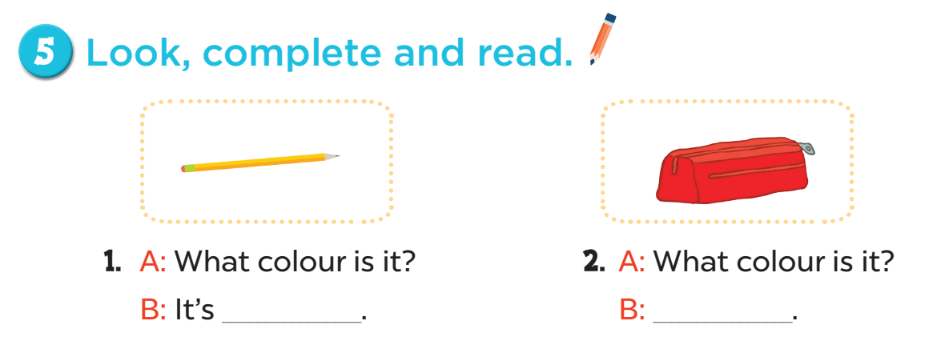
yellow
It’s red
63

Slide 10
3. A: _______colour is it?
B: It’s __________.
4. A: ______________is it?
B: It’s __________.
What
What colour
brown
blue

Slide 11
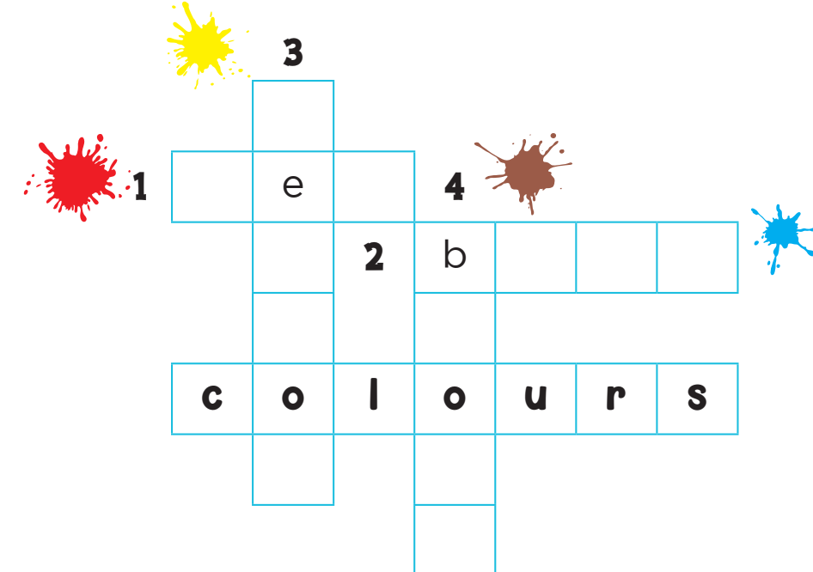
y
l
l
w
r d
l u e
r
w
n

