Slide 2
5
My future job
Lesson 3 – Period 6

Slide 3
TABLE OF CONTENTs
01. Warm-up and Review
02. Read and circle.
03. Let’s write.
04. Project
05. Fun corner and Wrap-up

Slide 4
01.
Warm-up and Review

Slide 6
02.
Read and circle.

Slide 7
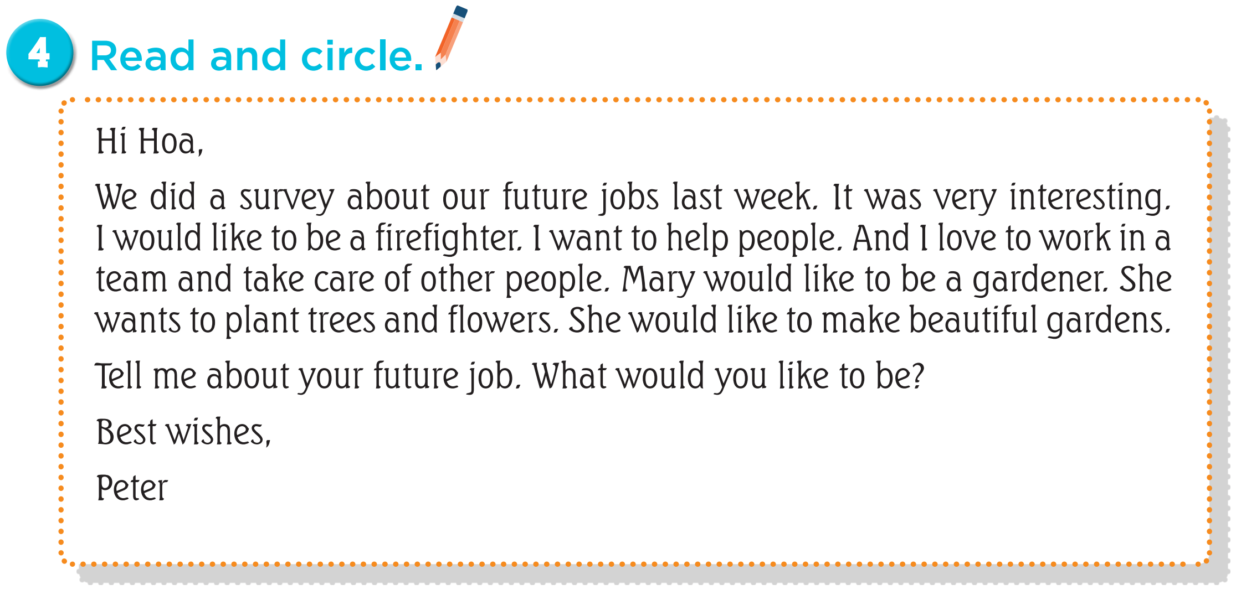
Read the email.

Slide 11
03.
Let’s write.

Slide 13
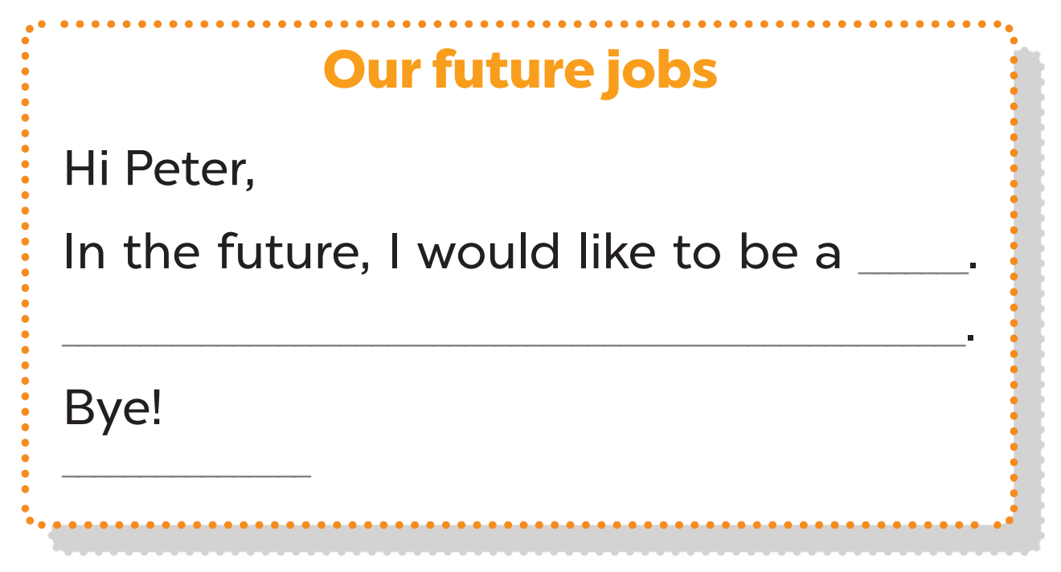

Slide 14
04.
Project

Slide 16
05.
Fun corner and Wrap-up
Lucky number

Slide 17
Notes:
Choose a number
Read the question and say the answer
Get points in each question

Slide 18
What would you like to be in the future?
I’d like to be a dentist.
Notes:
If the answer is correct, click “check” icon to get points.
If not, click “cross” icon (x) to move back to slide 16

Slide 19
+ 4 POINTS
Notes:
Click the arrow to move back to slide 16

Slide 20
What would you like to be in the future?
I’d like to be a firefighter.
Notes:
If the answer is correct, click “check” icon to get points.
If not, click “cross” icon (x) to move back to slide 16

Slide 21
- 2 POINTS
Notes:
Click the arrow to move back to slide 16

Slide 22
What would you like to be in the future?
I’d like to be a doctor.
Notes:
If the answer is correct, click “check” icon to get points.
If not, click “cross” icon (x) to move back to slide 16

Slide 23
+ 3 POINTS
Notes:
Click the arrow to move back to slide 16

Slide 24
Why would you like to be a gardener?
Because I’d like to grow flowers.
Notes:
If the answer is correct, click “check” icon to get points.
If not, click “cross” icon (x) to move back to slide 16

Slide 25
Winner +5 points
Notes:
- Play rock, paper, scissors to get points, winner will get 5 points
- Click the arrow to move back to slide 16

Slide 26
Why would you like to be a writer?
Because I’d like to write stories.
Notes:
If the answer is correct, click “check” icon to get points.
If not, click “cross” icon (x) to move back to slide 16

Slide 27
- 3 POINTS
Notes:
Click the arrow to move back to slide 16

Slide 28
Why would you like to be a reporter?
Because I’d like to report the news.
Notes:
If the answer is correct, click “check” icon to get points.
If not, click “cross” icon (x) to move back to slide 16

Slide 29
+ 10 POINTS
Notes:
Click the arrow to move back to slide 16

Slide 30
Why would you like to be a teacher?
Because I’d like to teach children.
Notes:
If the answer is correct, click “check” icon to get points.
If not, click “cross” icon (x) to move back to slide 16

Slide 31
STEAL 5 POINTS
Notes:
Click the arrow to move back to slide 16

Slide 32
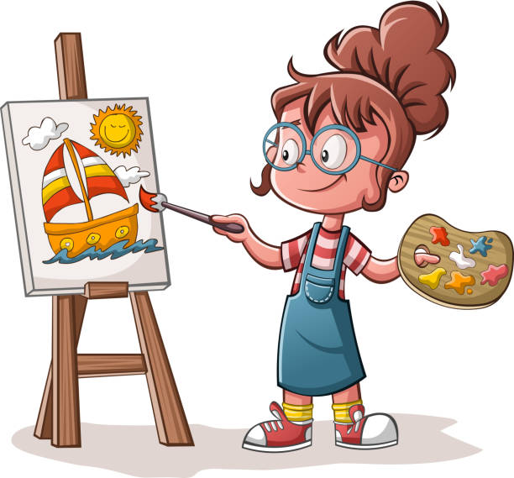
Would you like to be an artist?
Yes, I would.
Notes:
If the answer is correct, click “check” icon to get points.
If not, click “cross” icon (x) to move back to slide 16

Slide 33
DOUBLE POINTS
Notes:
Click the arrow to move back to slide 16

Slide 34
Would you like to be a firefighter?
No, I wouldn’t.
Notes:
If the answer is correct, click “check” icon to get points.
If not, click “cross” icon (x) to move back to slide 16

Slide 35
+ 1 POINT
Notes:
Click the arrow to move back to slide 16

Slide 36
Would you like to be a cook?
No, I wouldn’t.
Notes:
If the answer is correct, click “check” icon to get points.
If not, click “cross” icon (x) to move back to slide 16

Slide 37
- 5 POINTS
Notes:
Click the arrow to move back to slide 16

Slide 38
Website: hoclieu.vn
Fanpage: https://www.facebook.com/tienganhglobalsuccess.vn/

