Slide 2









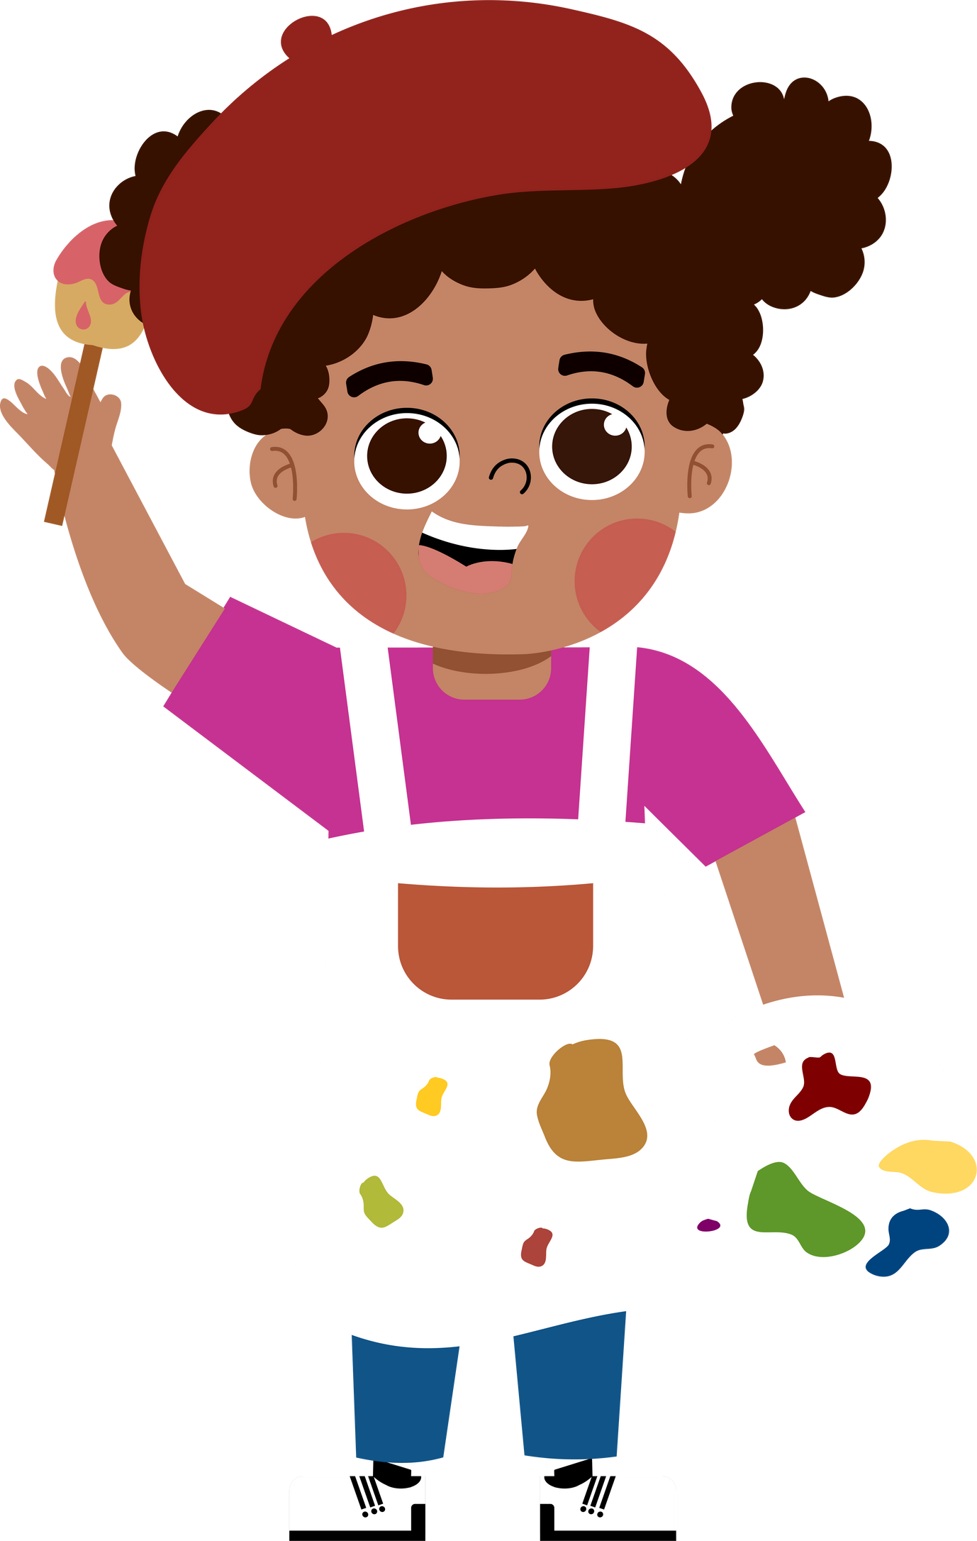








5
My future job
  Lesson 3 - Period 5

Slide 3





TABLE OF CONTENTs
  01. Warm-up and Review
  02. Listen and repeat.
  03. Circle, listen and check.
  04. Let's chant.
  05. Fun corner and Wrap-up

Slide 4




01.
Warm-up and Review
  Unscramble the letters.

Slide 5


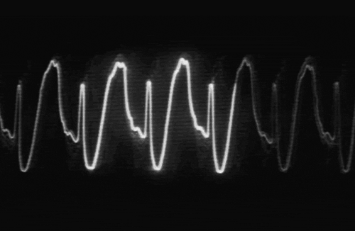


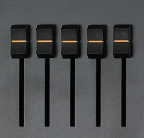




T R D C O O
DOCTOR
Notes:
Click on the red button to reveal the answer.

Slide 6
T I E R W R
WRITER
Notes:
Click on the red button to reveal the answer.

Slide 7
C H T R E A E
TEACHER
Notes:
Click on the red button to reveal the answer.

Slide 8
I S N T E D T
DENTIST
Notes:
Click on the red button to reveal the answer.

Slide 9
R I F E G T R E F H I
FIREFIGHTER
Notes:
Click on the red button to reveal the answer.

Slide 10
N E R D E R G A
GARDENER
Notes:
Click on the red button to reveal the answer.

Slide 11
R O R P E R E T
REPORTER
Notes:
Click on the red button to reveal the answer.

Slide 12




More jobs
  Guess the job.

Slide 13
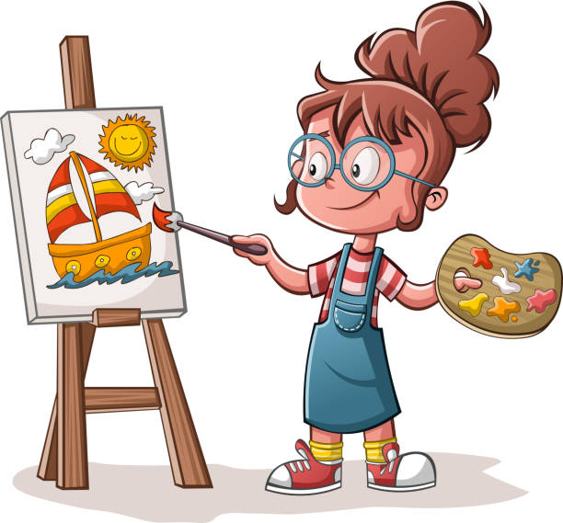
artist

Slide 14
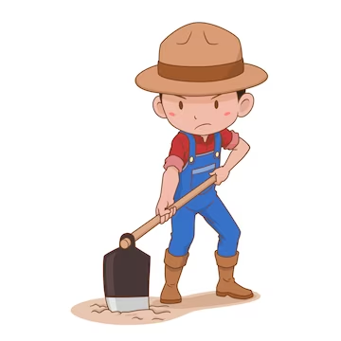
farmer

Slide 15

dentist

Slide 16

actor

Slide 17

pilot

Slide 18
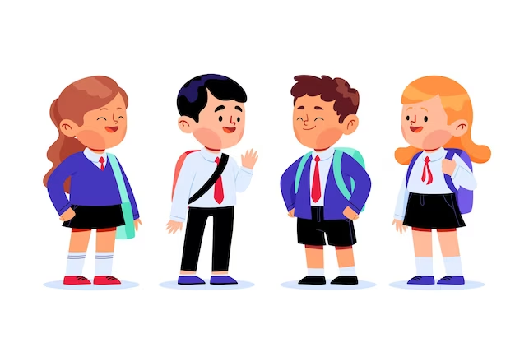
student

Slide 19




NOUNS
How many syllables?
artist
teacher
writer
gardener
pilot
dentist
actor
firefighter
doctor
student
farmer
reporter

Slide 20
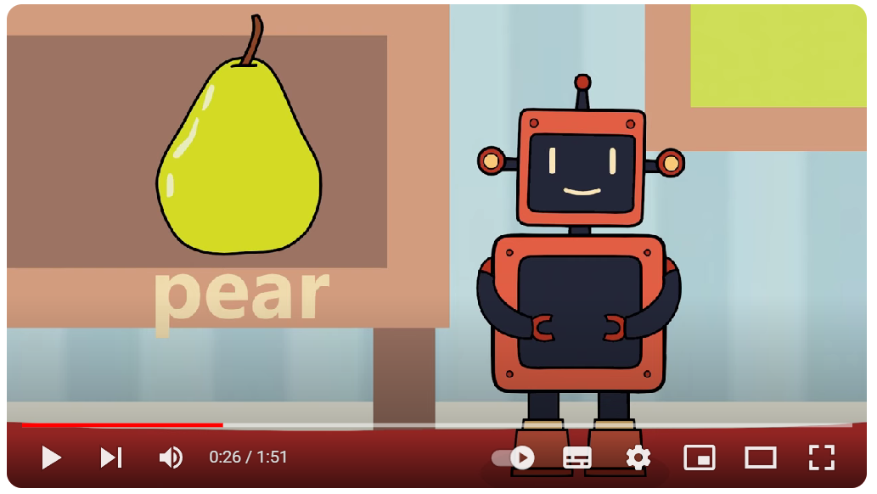
https://www.youtube.com/watch?v=UWaomqRcHuw

Slide 21
2syllables
3syllables
artist
teacher
writer
gardener
pilot
dentist
actor
firefighter
doctor
student
farmer
reporter

Slide 22
2syllables noun
Stress on the 1st syllable
artist
teacher
writer
artist
teacher
writer
pilot
dentist
actor
pilot
dentist
actor
doctor
student
farmer
doctor
student
farmer

Slide 23
02.
Listen and repeat.

Slide 24

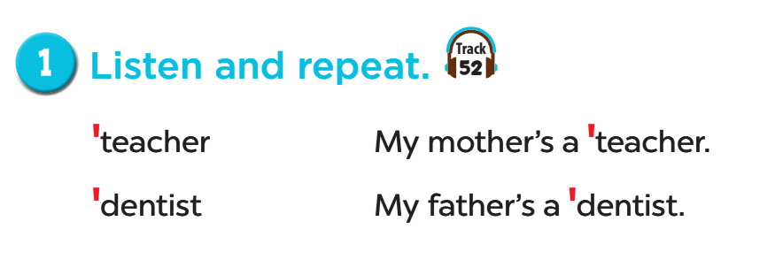
Listen and repeat.

Slide 25
03.
Circle, listen and check.

Slide 26
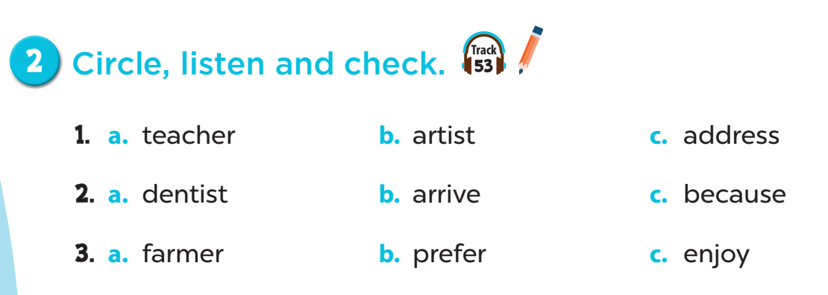
Listen and check.

Slide 27
04.
Let's chant!

Slide 28
1. Close your book.
2. Listen to the chant.
3. Listen again:
- Clap your hands on the stress.

Slide 29
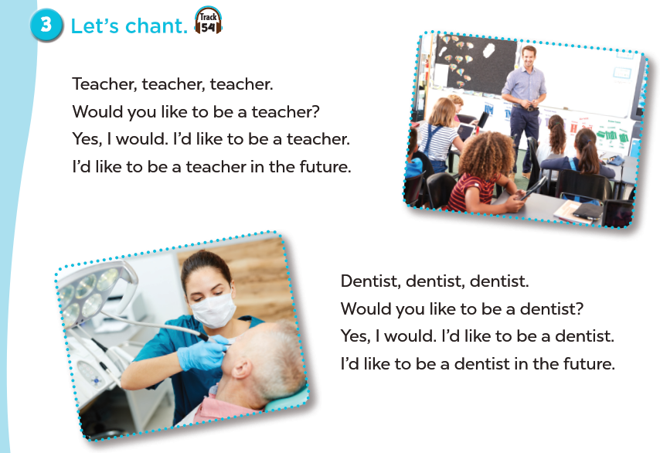

Slide 30
05.
Fun corner and Wrap-up

Slide 31

Let's chant like a robot!

Slide 32
Website: hoclieu.vn
Fanpage: https://www.facebook.com/tienganhglobalsuccess.vn/

