Slide 1









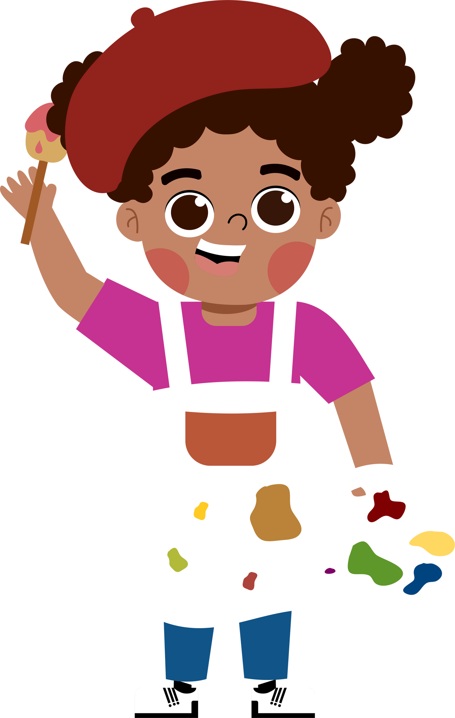
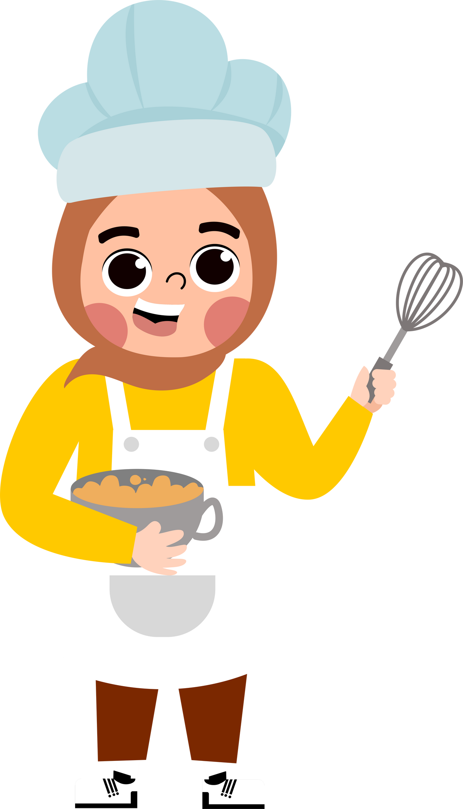







5
My future job
  Lesson 1 - Period 2

Slide 2





TABLE OF CONTENTs
  01. Warm-up and Review
  02. Listen and number.
  03. Read and complete.
  04. Listen, complete and sing.
  05. Fun corner and Wrap-up

Slide 3




01.
Warm-up
and Review

Slide 4



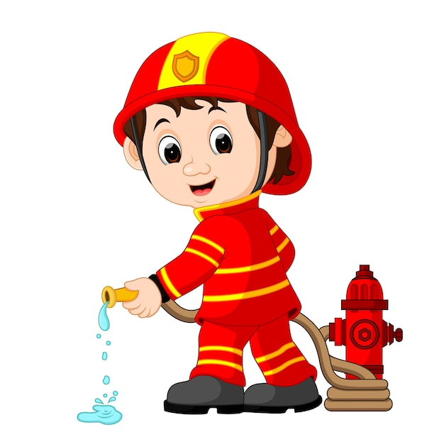
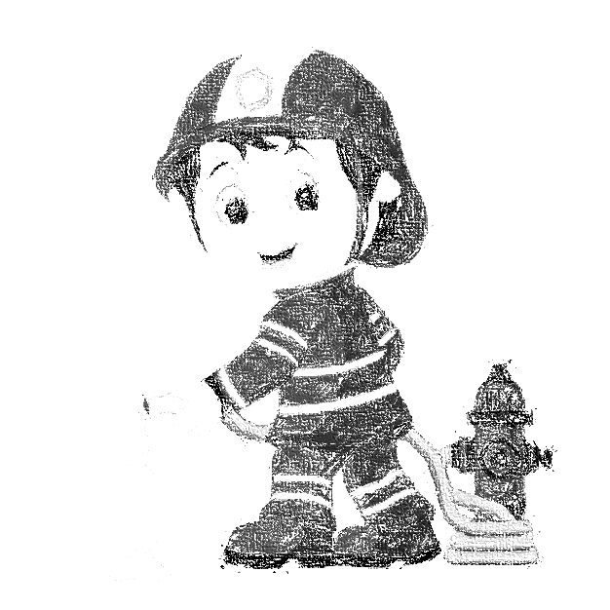

I would like to be a ______.
firefighter

Slide 5


I would like to be a ______.
writer

Slide 6
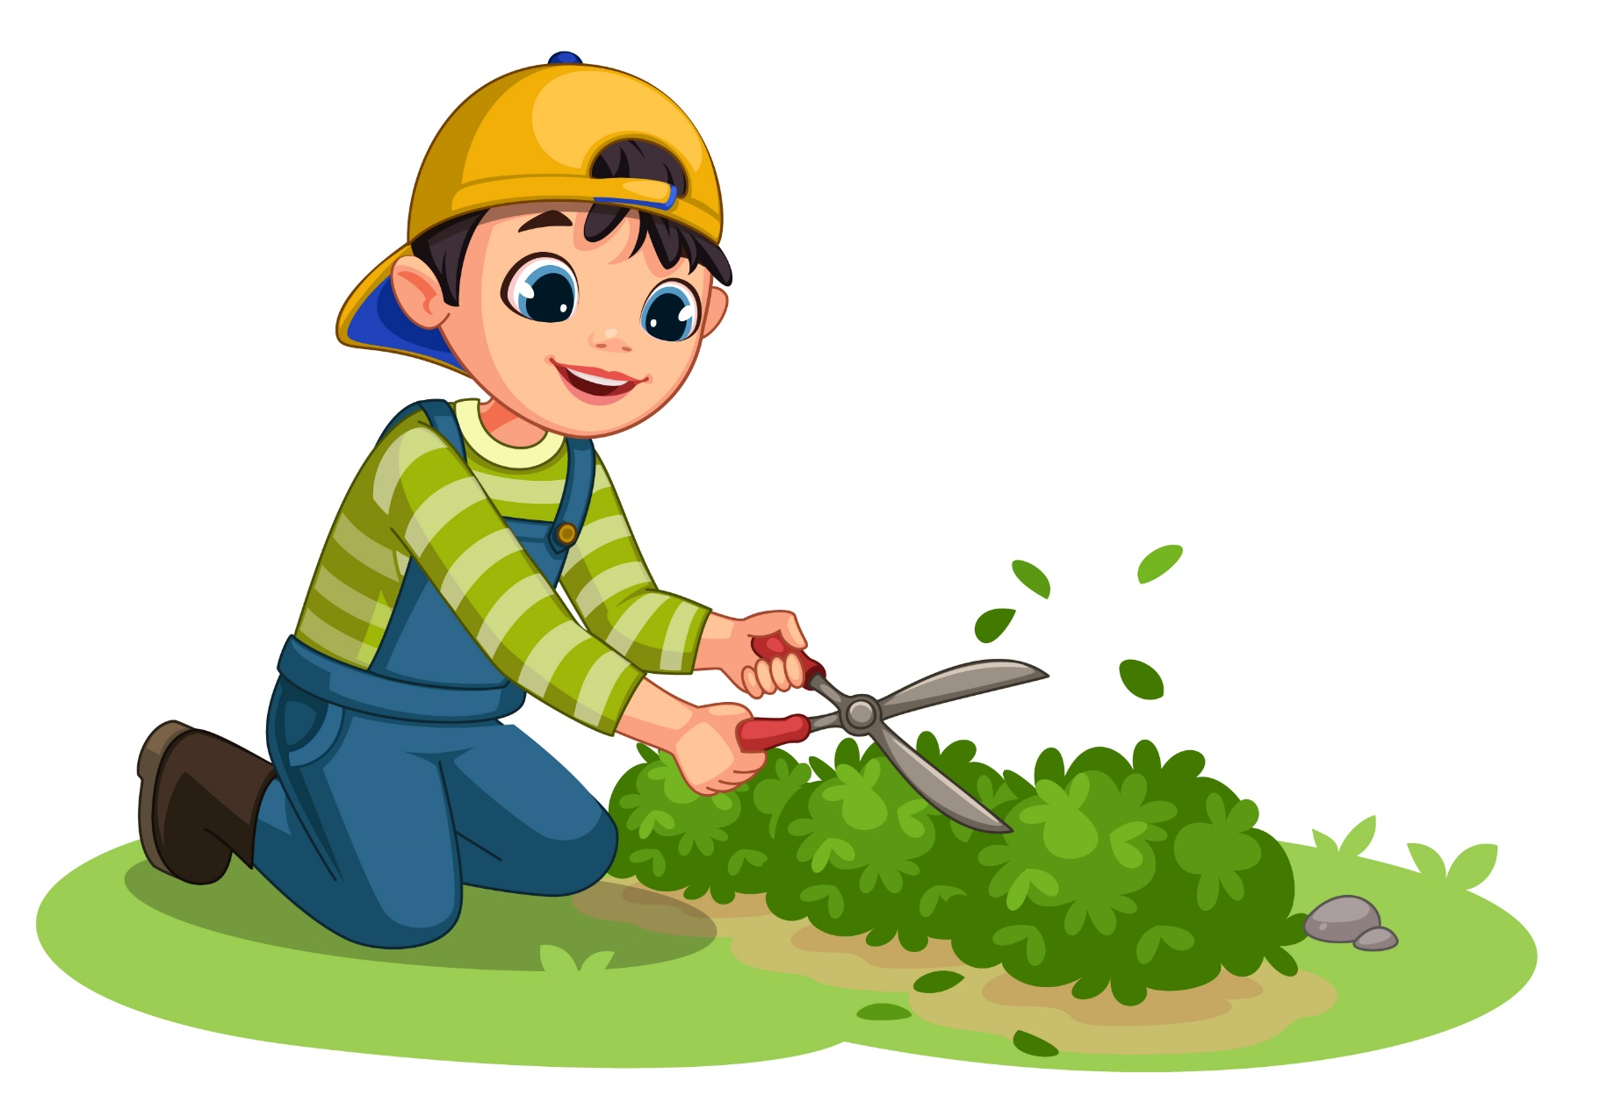
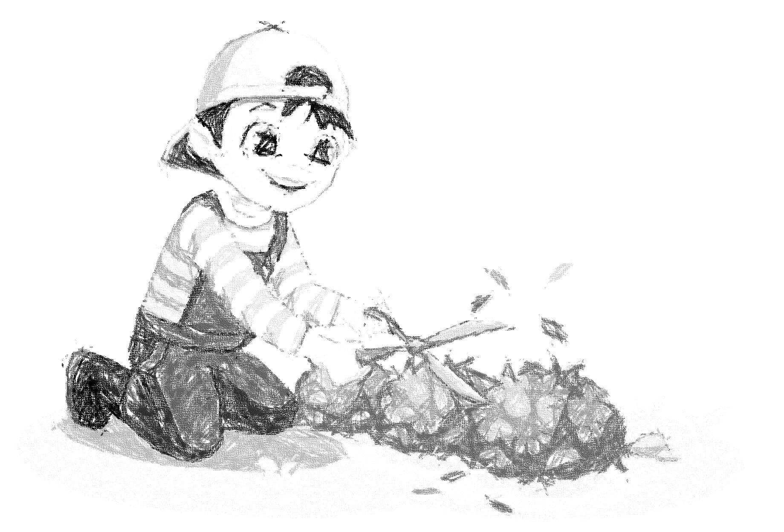
I would like to be a ______.
gardener

Slide 7


I would like to be a ______.
teacher

Slide 8

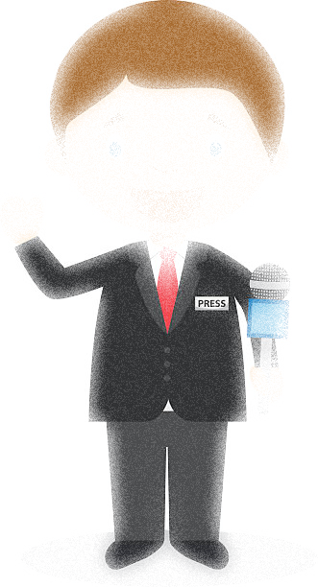
I would like to be a ______.
reporter

Slide 9
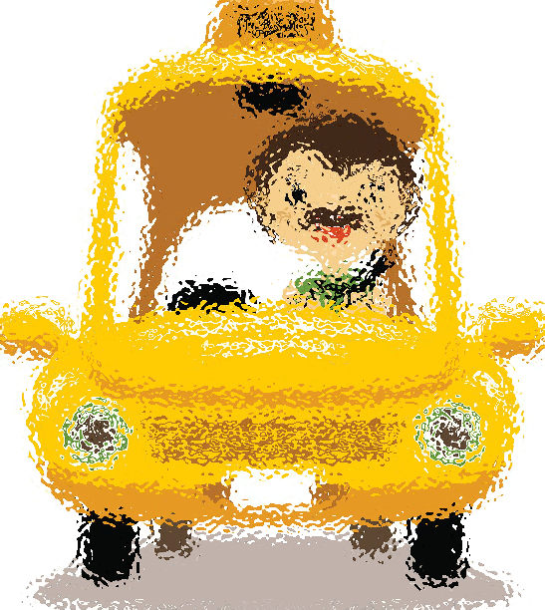
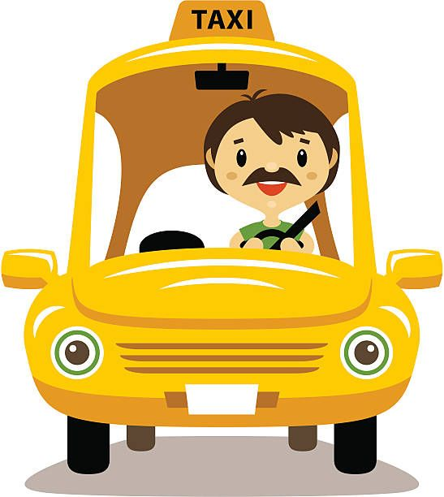
I would like to be a ______.
driver

Slide 10
02.
Listen and number.

Slide 11



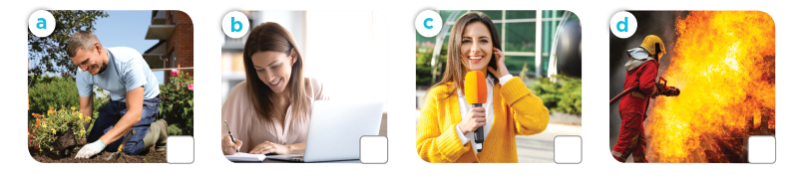


Listen and number.
2
3
1
4
gardener
writer
reporter
firefighter

Slide 12
03.
Read and complete.

Slide 13
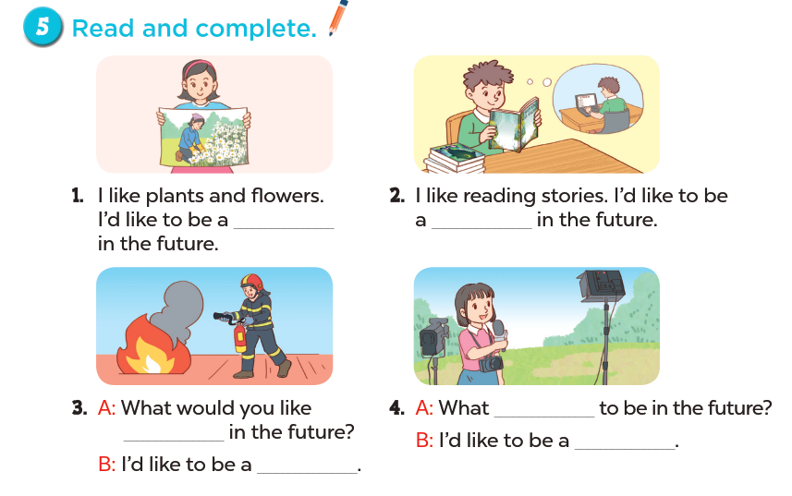
Read and complete.

Slide 14
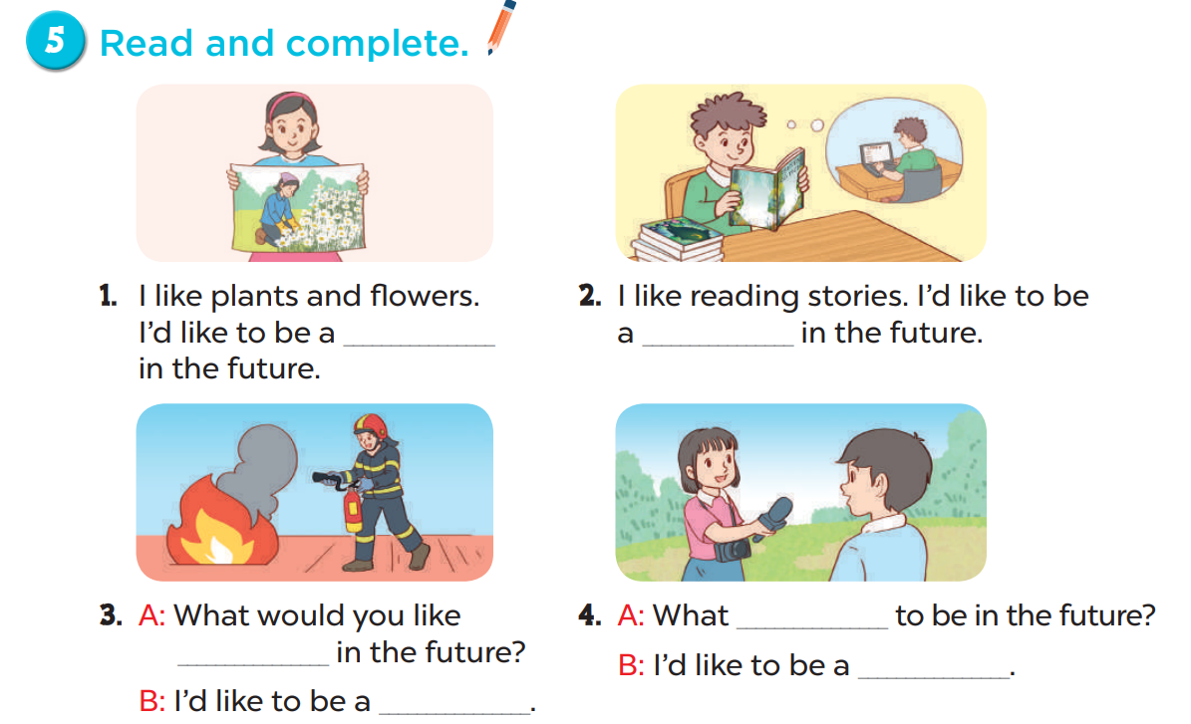
Look and say.
Read and complete.
gardener
writer
would
to be
reporter
firefighter

Slide 15
04.
Listen, complete and sing.

Slide 16
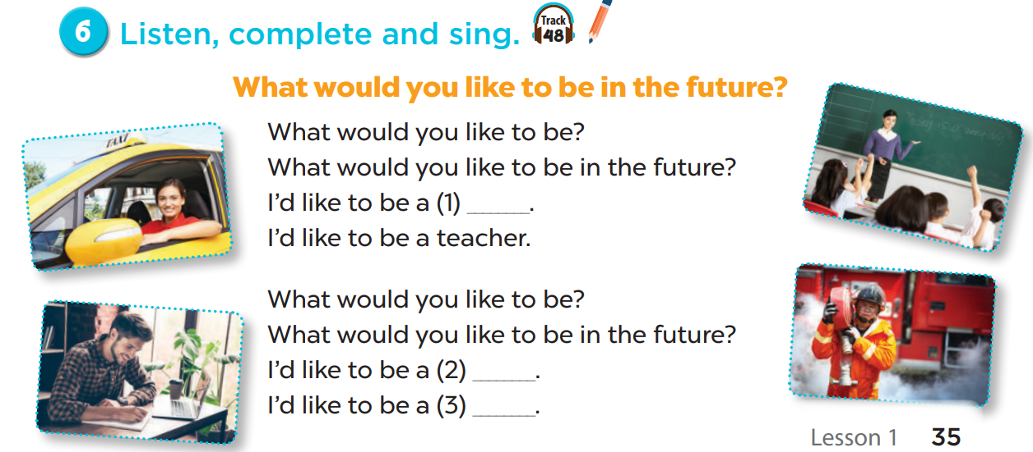
Listen, complete and sing.
firefighter
writer
driver

Slide 17
05.
Fun corner and Wrap-up

Slide 18


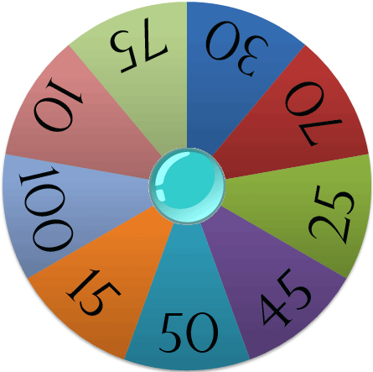






Spin the wheel
A
B
Points

Slide 19
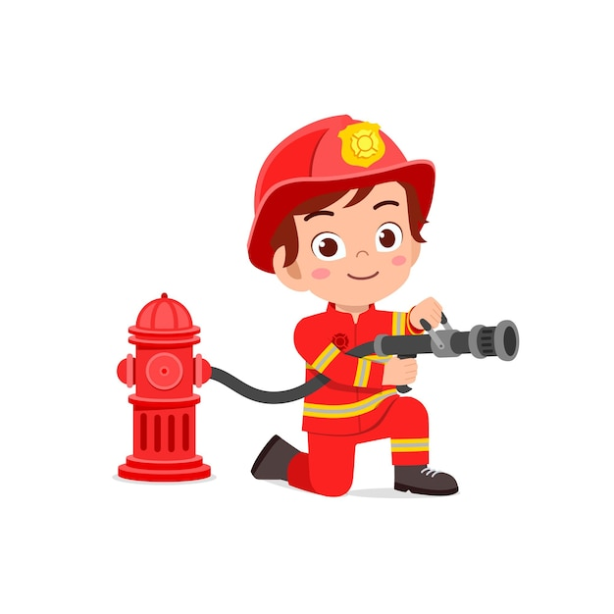
would / ’d
I _________ like to be
a firefighter.
SPIN

Slide 20
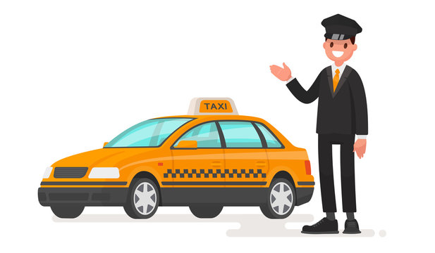
like/ I’d / to/ a/ be/./ driver/
I’d like to be a driver.
SPIN

Slide 21
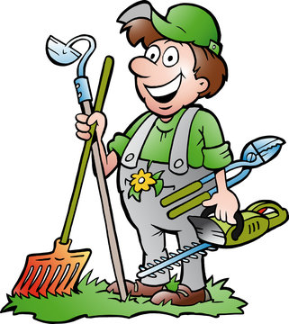
like
I’d ________ to be a gardener.
SPIN

Slide 22

I like reading stories. I’d like to be a _______.
writer
SPIN

Slide 23

reporter
I’d like to be a ________.
SPIN

Slide 24

would
What ______ you like to be in the future?
teacher
SPIN
I’d like to be a ________.

Slide 25
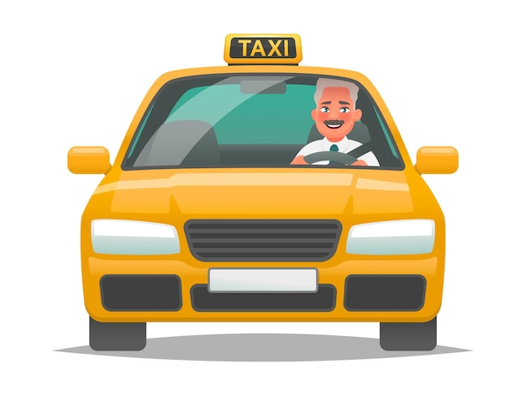
driver
I’d like to be a ________.
SPIN

Slide 26
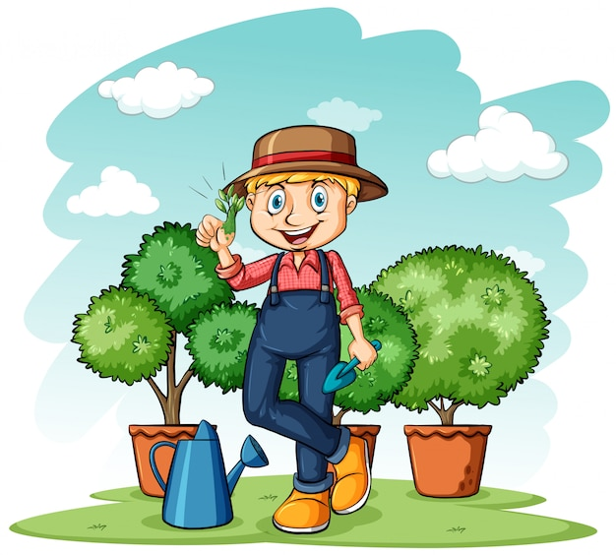
like/ to/ I’d/ gardener/ be/a/./
I’d like to be a gardener.
SPIN

Slide 27

would/ reporter/ I/ like/ be/ to/ a/./
I would like to be a reporter.
SPIN

Slide 28
Website: hoclieu.vn
Fanpage: https://www.facebook.com/tienganhglobalsuccess.vn/

