Slide 2
4
Our free-time activities

Slide 3
01. Warm-up and Review
02. Listen and tick.
03. Read and complete.
04. Let's sing.
05. Fun corner and Wrap-up

Slide 4
01. Warm-up and Review
Choose a number and say the activity.

Slide 5
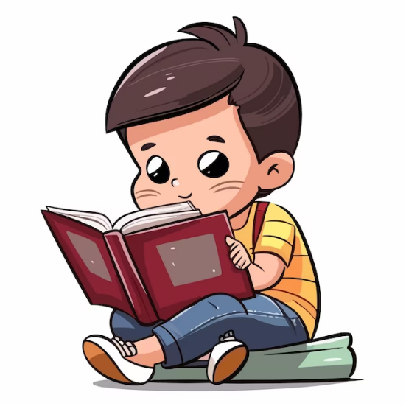
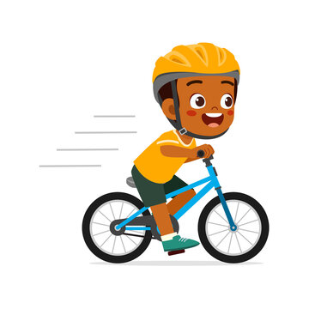
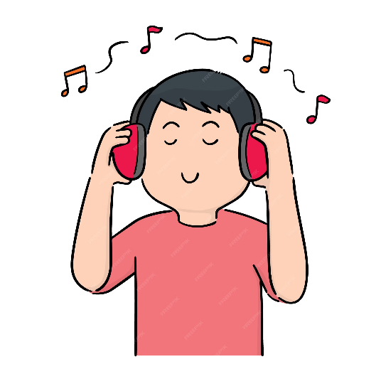
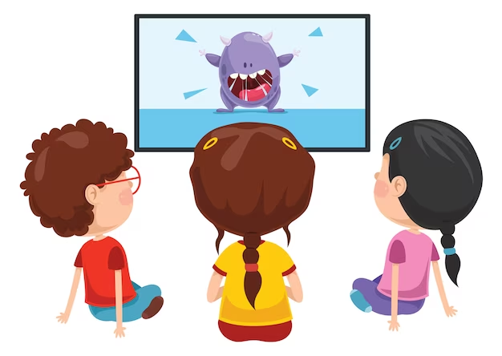
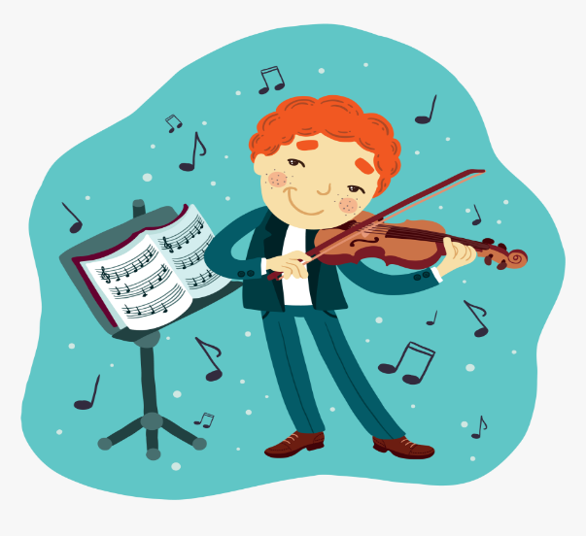
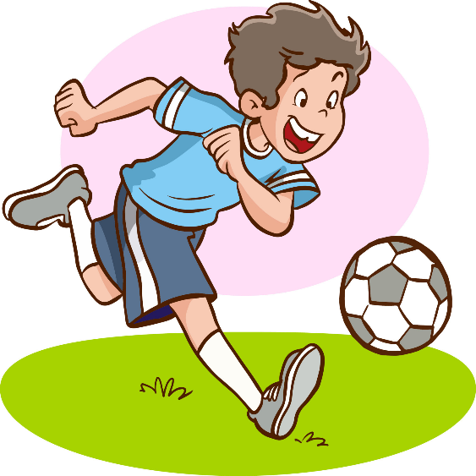
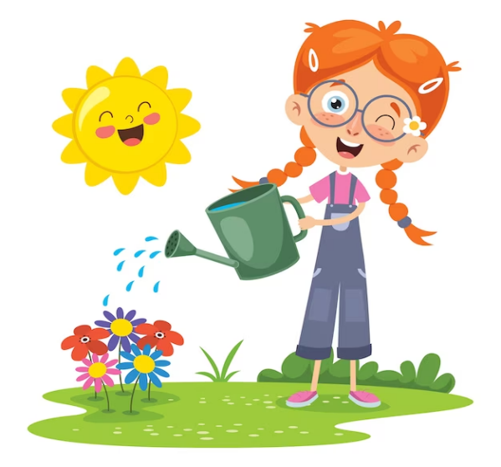
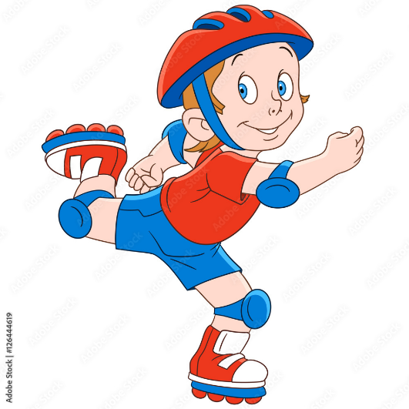
1
2
3
= +1 point
4
5
6
= lose 2 points
= rock, paper, scissors
(winner takes 2)
7
8
9
Notes:
- Divide the class into 3 teams.
- Pupils from each team choose a number (or throw sticky ball on the grid to choose the number), then have 2 pupils from each team ask and answer with the picture in that number.
- Pupils or teacher clicks on the month to reveal the icons indicating the points for that team.
- After 9 numbers, the team with the most points is the winner.

Slide 6
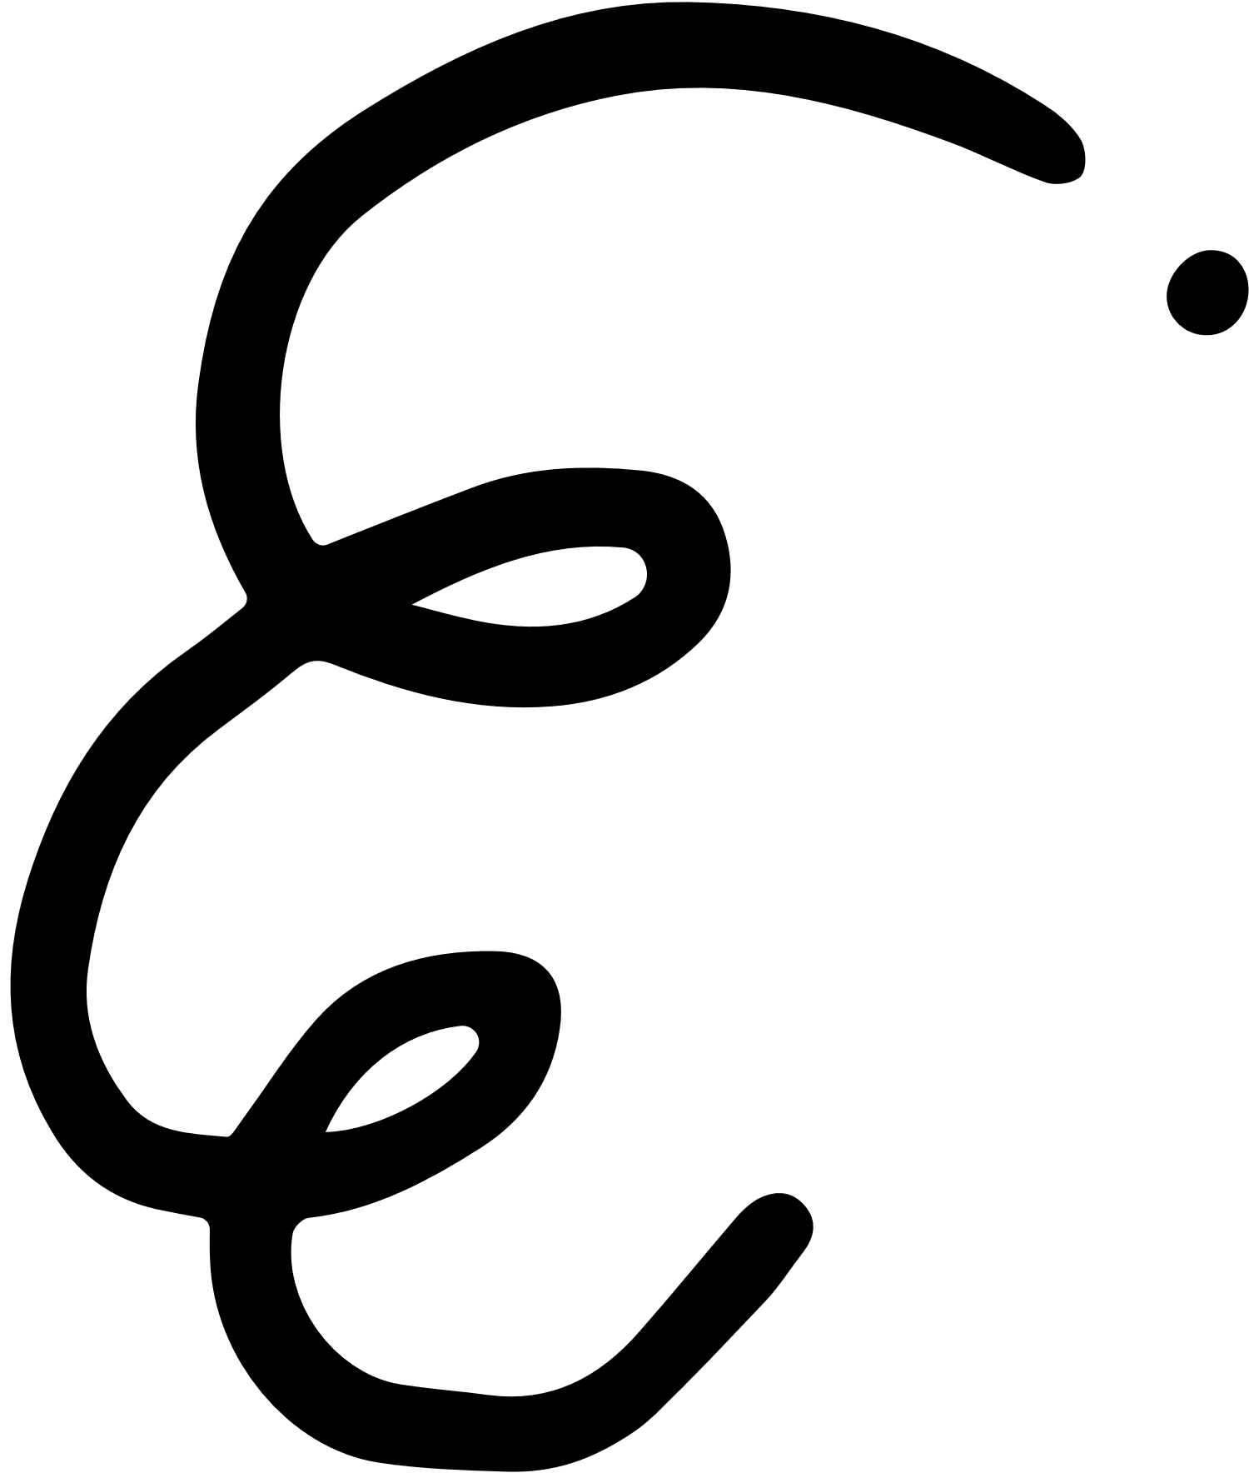
Adverbs of frequency
always
✓✓✓✓
usually
✓✓✓
often
✓✓
sometimes
✓
never
✗

Slide 7
What do you do at the weekend?
Mon. | Tue. | Wed. | Thu. | Fri. | Sat. | Sun.
always
I always read stories.

Slide 8
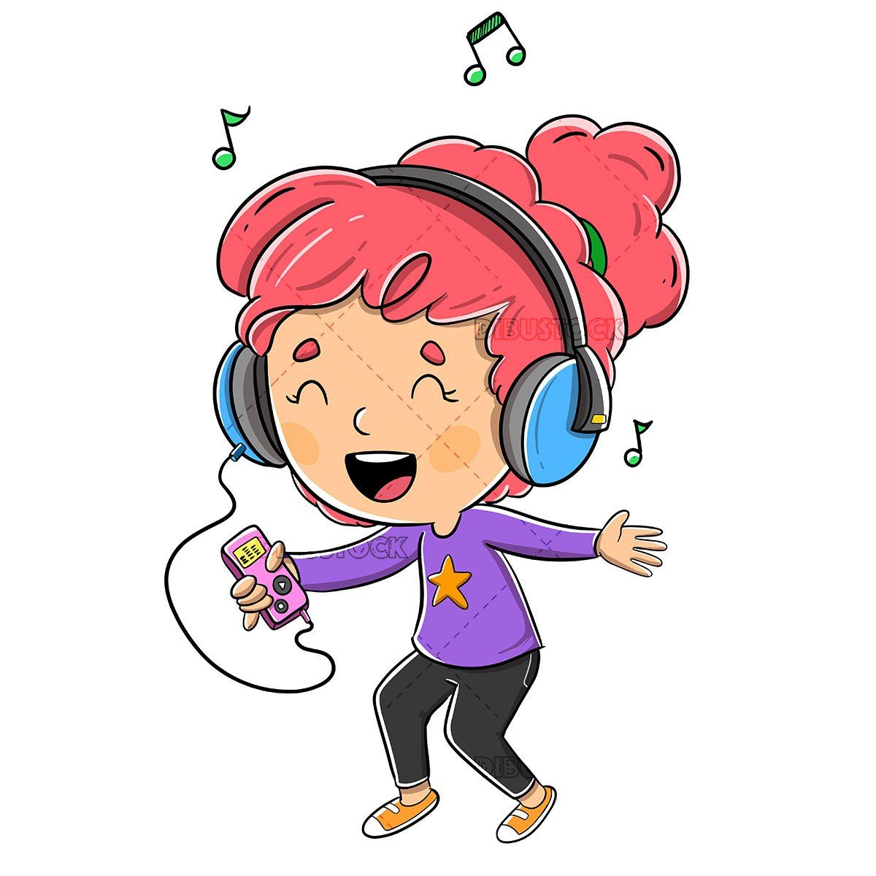
What do you do at the weekend?
Mon. | Tue. | Wed. | Thu. | Fri. | Sat. | Sun.
usually
I usually listen to music.

Slide 9
What do you do at the weekend?
Mon. | Tue. | Wed. | Thu. | Fri. | Sat. | Sun.
never
I never ride my bike.

Slide 10
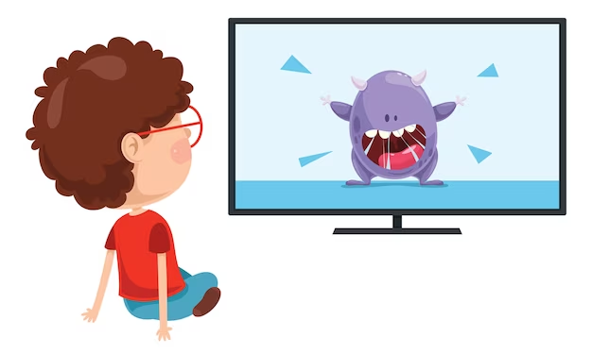
What do you do at the weekend?
Mon. | Tue. | Wed. | Thu. | Fri. | Sat. | Sun.
often
I often watch cartoons.

Slide 11
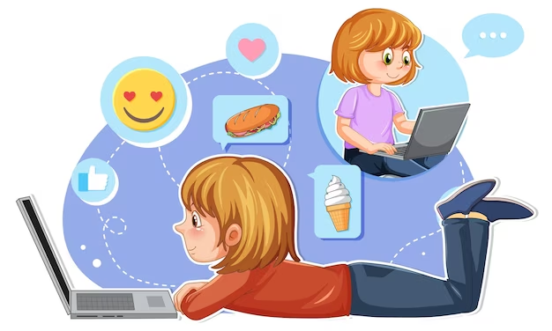
What do you do at the weekend?
Mon. | Tue. | Wed. | Thu. | Fri. | Sat. | Sun.
sometimes
I sometimes surf the Internet.

Slide 12
02.
Listen and tick.

Slide 13
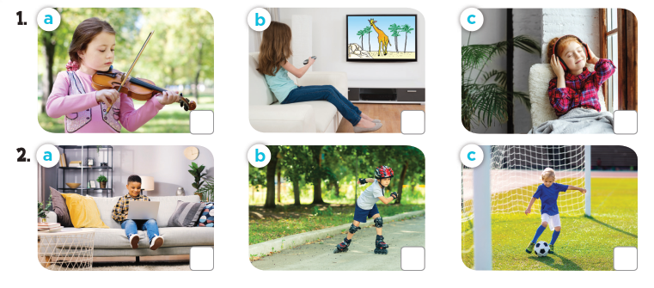
Look and answer.
Notes:
Press the spacebar or down arrow to reveal the answer.
Press the X to go back to the letter slide (wrong answer), press the question box to go the reward slide (correct answer).

Slide 14
What do they do at the weekend?
Notes:
Press the spacebar or down arrow to reveal the answer.
Press the X to go back to the letter slide (wrong answer), press the question box to go the reward slide (correct answer).

Slide 15
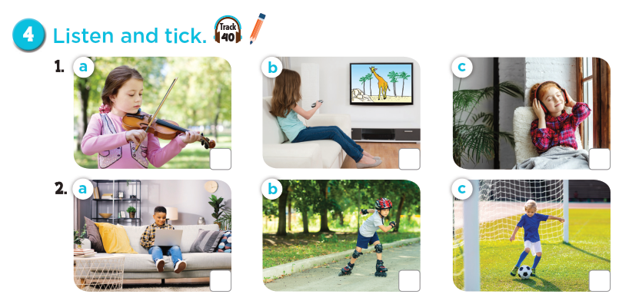
Notes:
Press the spacebar or down arrow to reveal the answer.
Press the X to go back to the letter slide (wrong answer), press the question box to go the reward slide (correct answer).

Slide 16
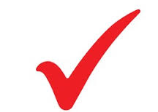
Let's check!
Notes:
Press the spacebar or down arrow to reveal the answer.
Press the X to go back to the letter slide (wrong answer), press the question box to go the reward slide (correct answer).

Slide 17
Listen and repeat.
Notes:
Press the spacebar or down arrow to reveal the answer.
Press the X to go back to the letter slide (wrong answer), press the question box to go the reward slide (correct answer).

Slide 18
03.
Read and complete.

Slide 19
Read. What's the missing word?
like watching
do you
cartoons

Slide 20
Read. What's the missing word?
What
the flowers
Do

Slide 21
Read aloud.
like watching
do you
cartoons

Slide 22
Act it out.
What
the flowers
Do

Slide 23
04.
Let's sing.

Slide 24
Listen and complete.
guitar
weekend
always

Slide 25
Let's sing.
guitar
weekend
always
Notes:
Link video hoạt hình: https://hoclieu.vn/hop-phan-bo-tro/video-hoat-hinh/203

Slide 26
05. Fun corner and Wrap-up

Slide 27
1
2
3
THE
FOOTBALL GAME
4
5
6
7
8
9

Slide 28
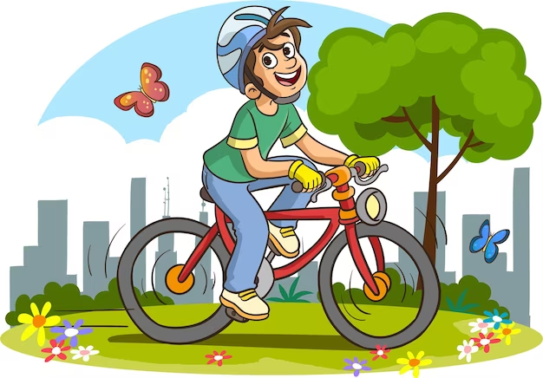
What do you at the weekend?
I sometimes ride a bike.

Slide 29
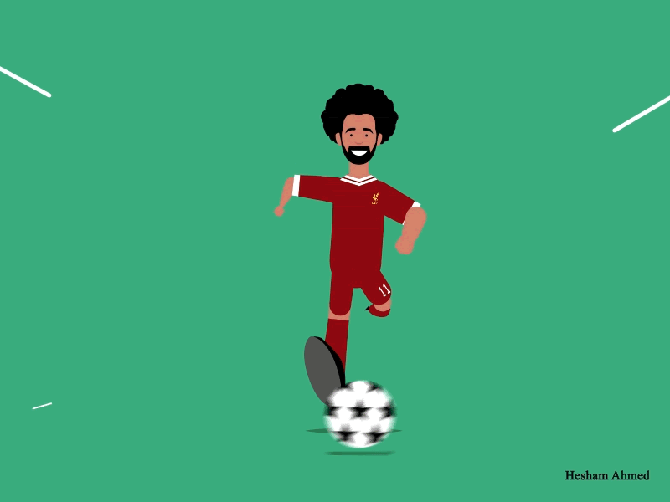
+ 3 points

Slide 30
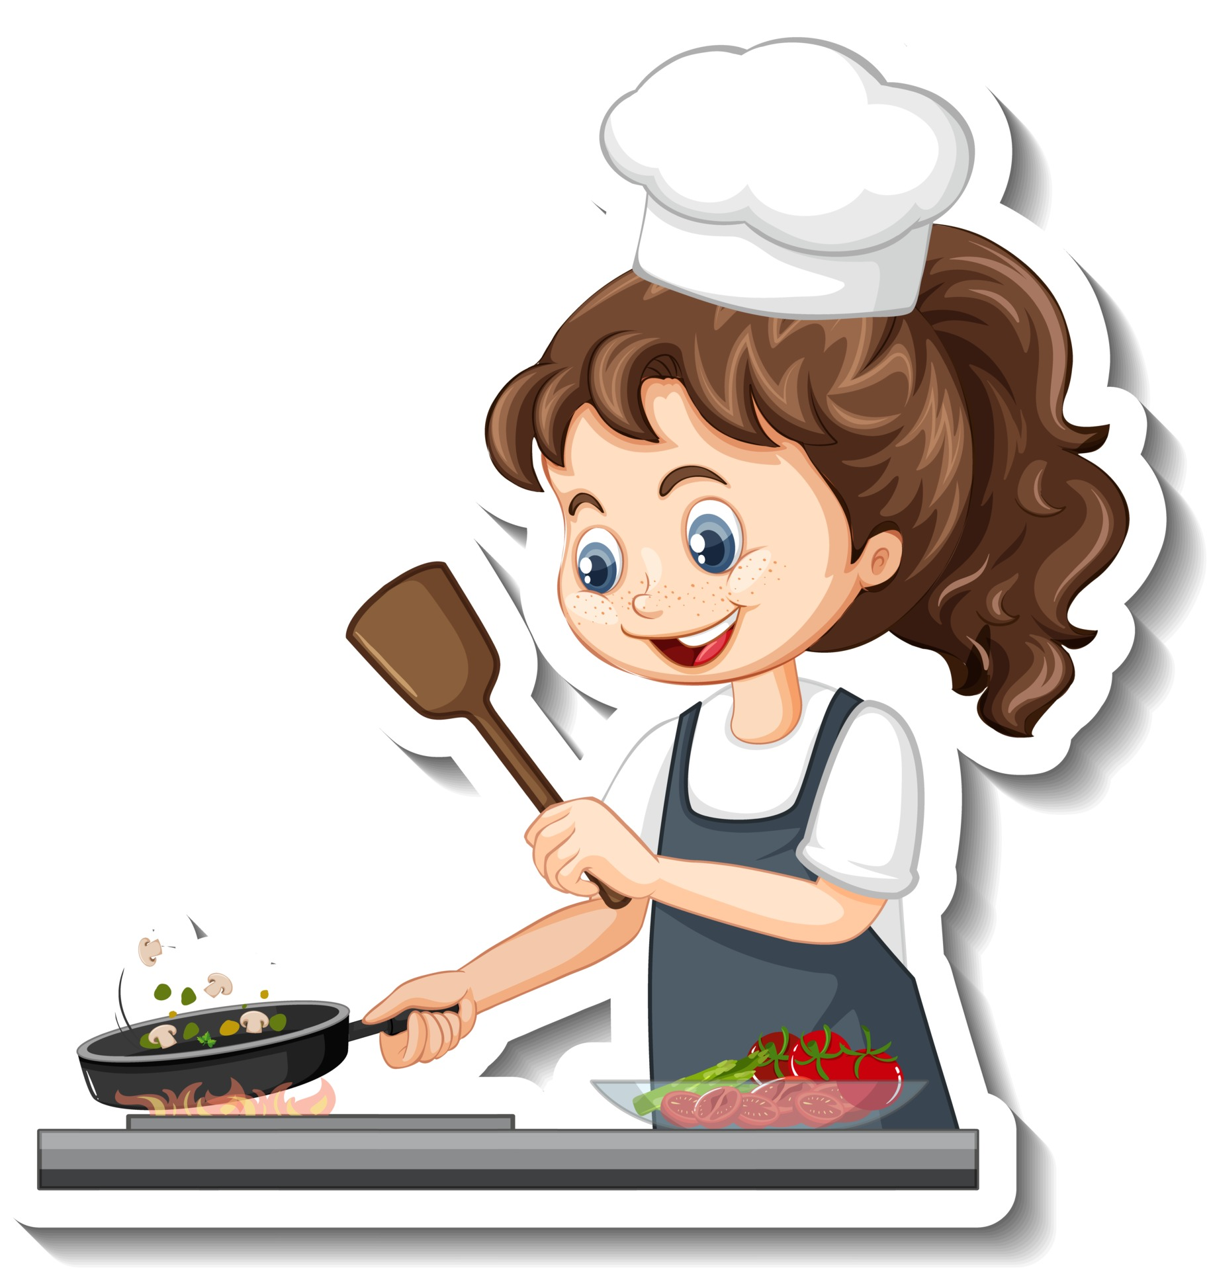
Do you always cook at the weekend?
No, I don't.

Slide 31
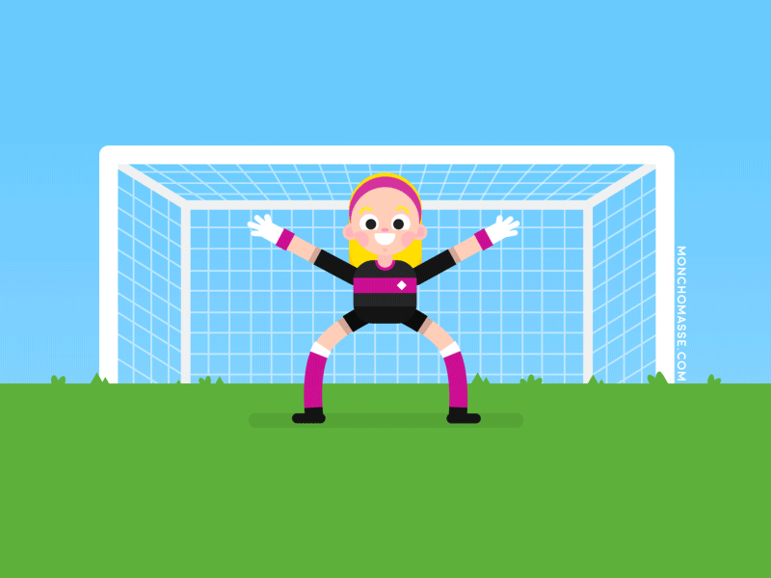
+ 5 points

Slide 32
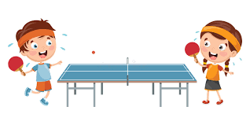
What do you like doing in your free time?
I like playing table tennis.

Slide 33
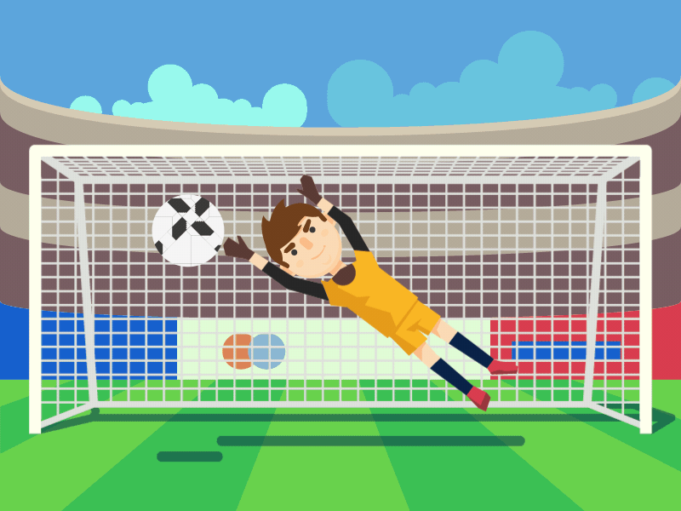
+ 2 points

Slide 34
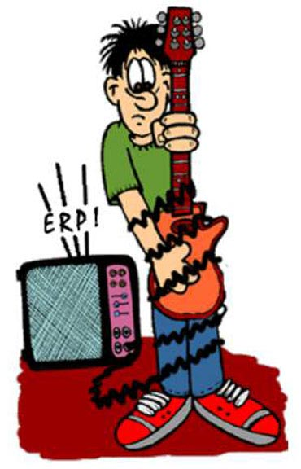
Do you like playing the guitar?
No, I don't.
I never play the guitar.

Slide 35
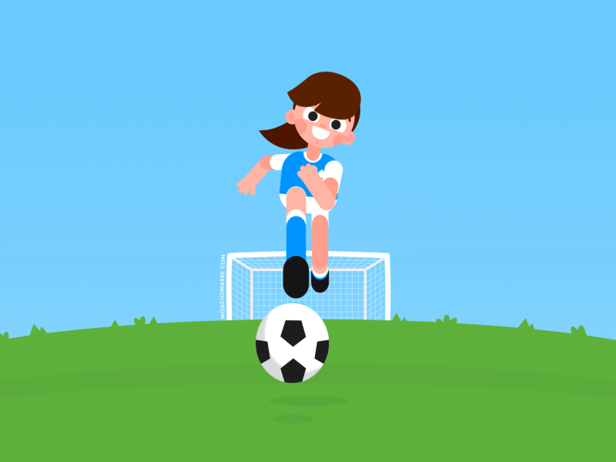
Take 2 points from another team

Slide 36
What
______ do you do at the weekend?
A. Who
B. When
C. What
I water the flower.

Slide 37
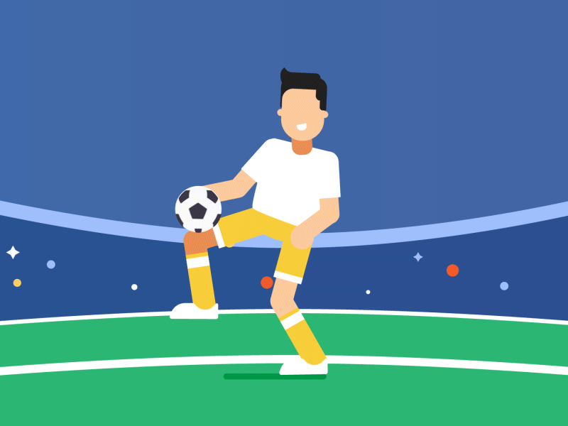
Change points with another team

Slide 38
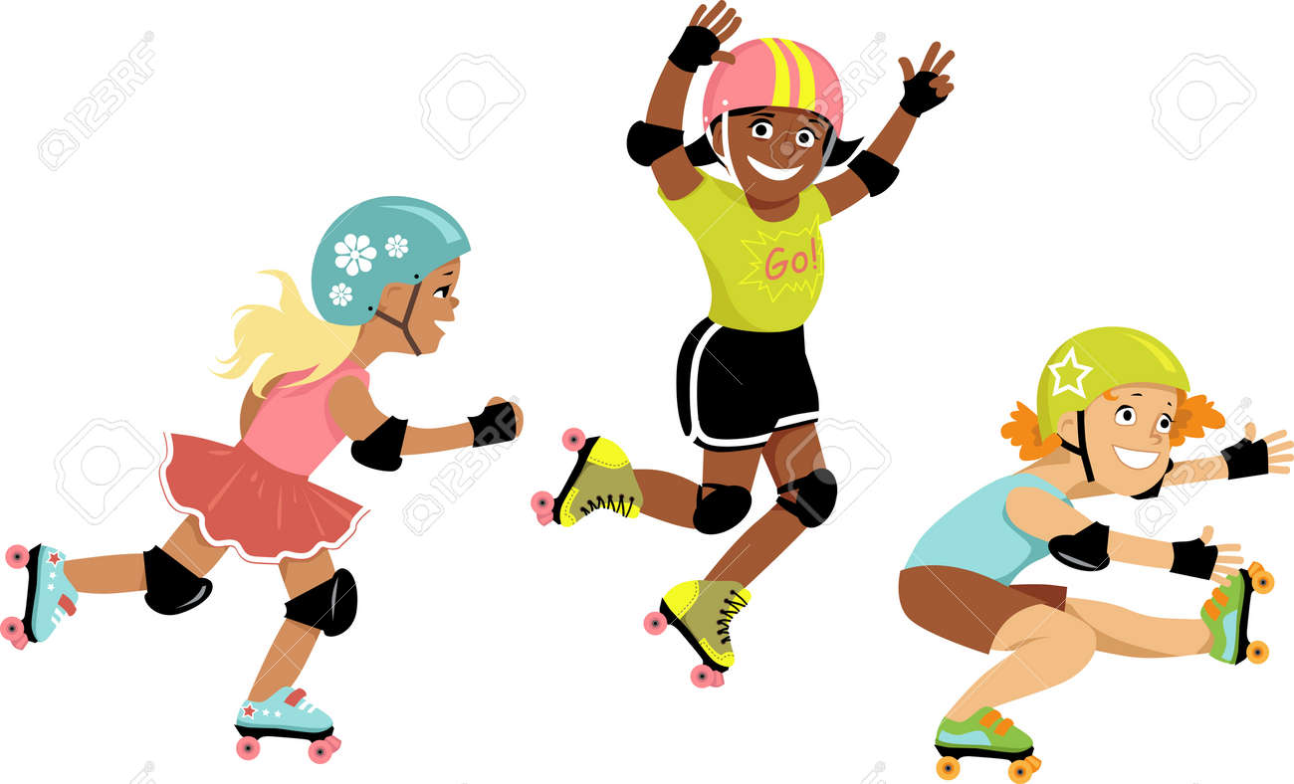
______ always roller skate
at the weekend?
Do you
Yes, I do.
I sometimes roller skate.

Slide 39
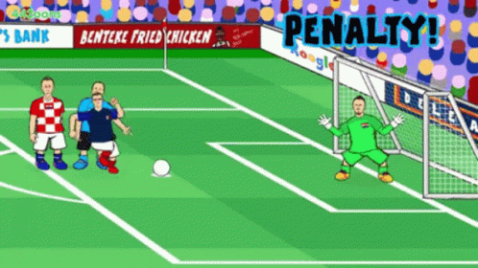
Oh no!
-3 points

Slide 40
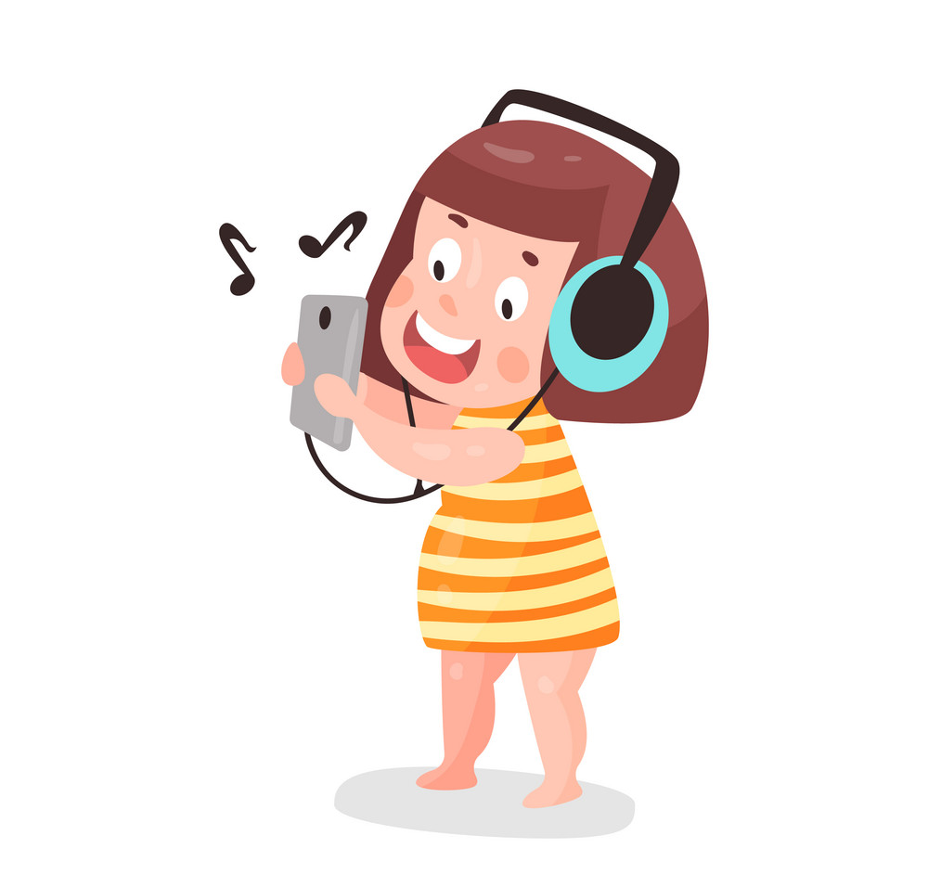
What are you doing?
I'm listening to music.

Slide 41
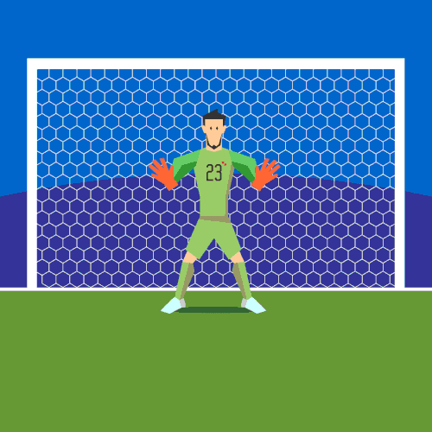
+ 4 points

Slide 42
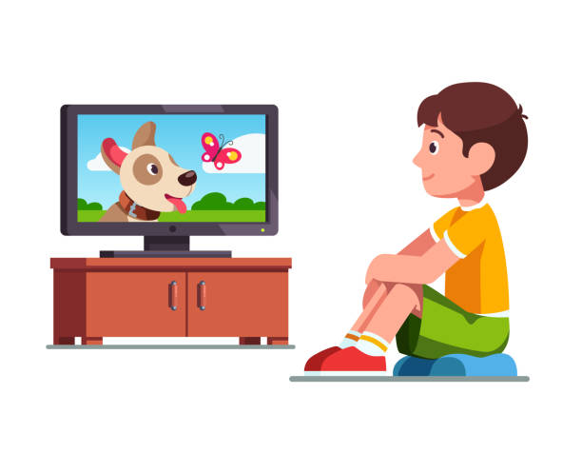
Do you like _____________ at the weekend?
watching cartoons
Yes, I do.

Slide 43
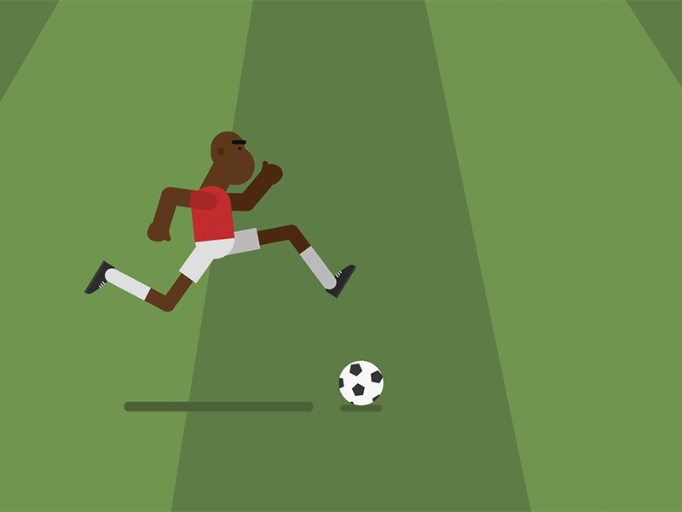
Too slow!
-2 points

Slide 44
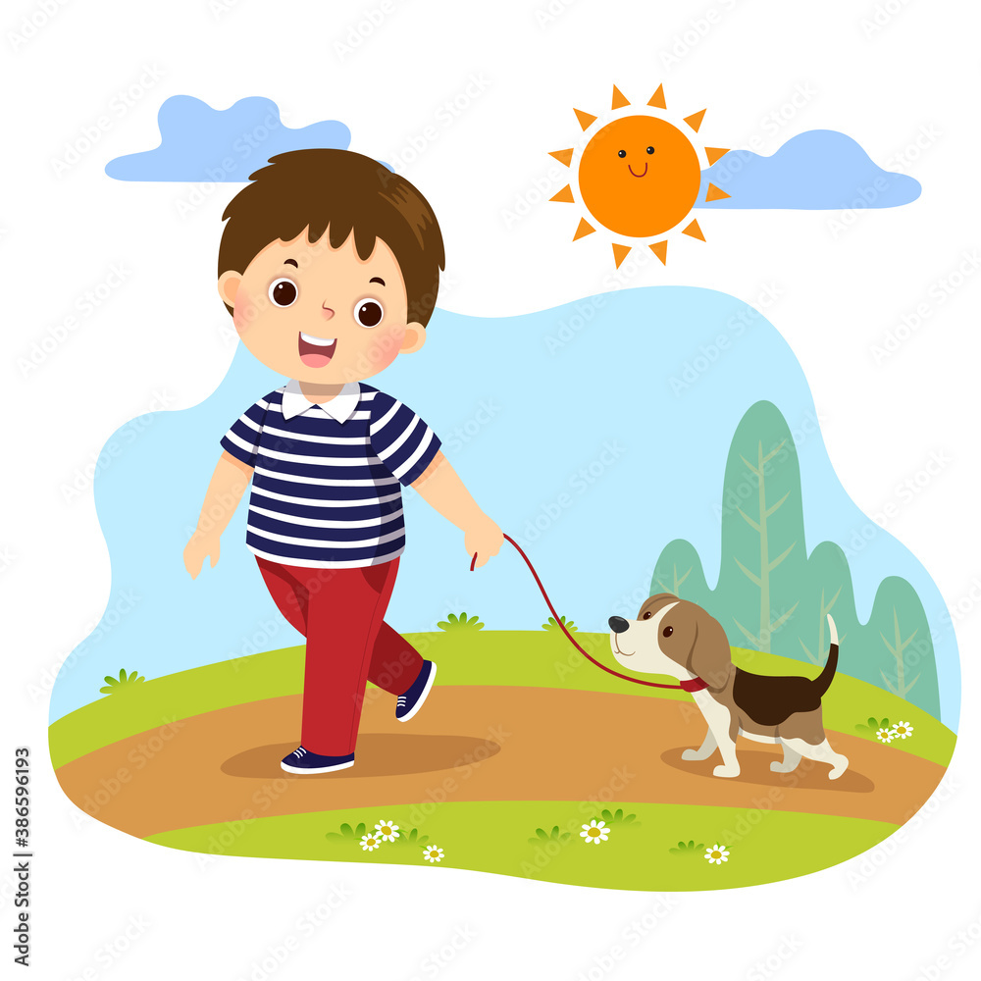
What do you at the weekend?
I _______ go for a walk.
usually

Slide 45
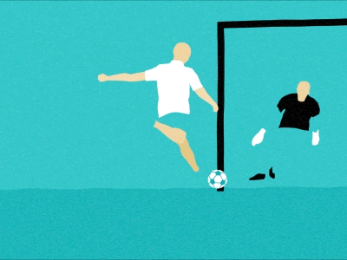
Oops!
-3 points

Slide 46
Website: hoclieu.vn
Fanpage: https://www.facebook.com/tienganhglobalsuccess.vn/

