Slide 1





Slide 2


My birthday party
4
Lesson 1 – Period 2

Slide 3


Table of contents
01
Warm-up
Activity 4
03
02
Activity 5
Yes or No
Listen and number.
Look, complete and read.
04
05
Activity 6
Game
Let’s sing.

Slide 4
01
Warm-up
Yes or No

Slide 5
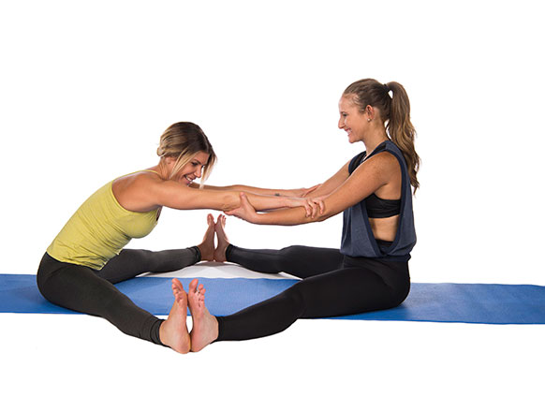
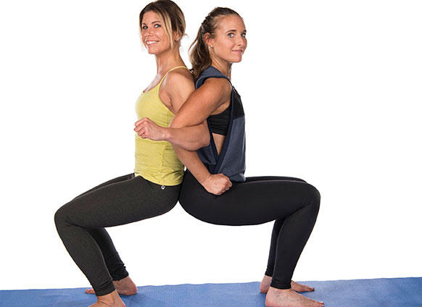
Yes or No

Slide 6

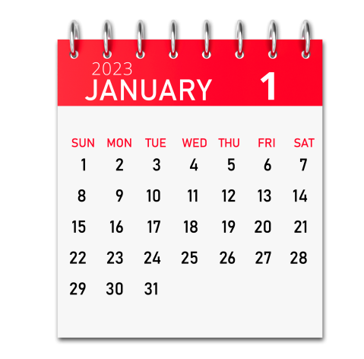
January
No
Yes

Slide 7
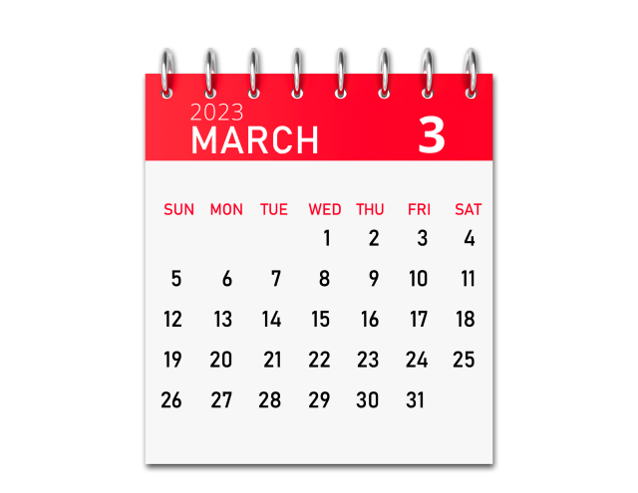
May
Yes
No

Slide 8
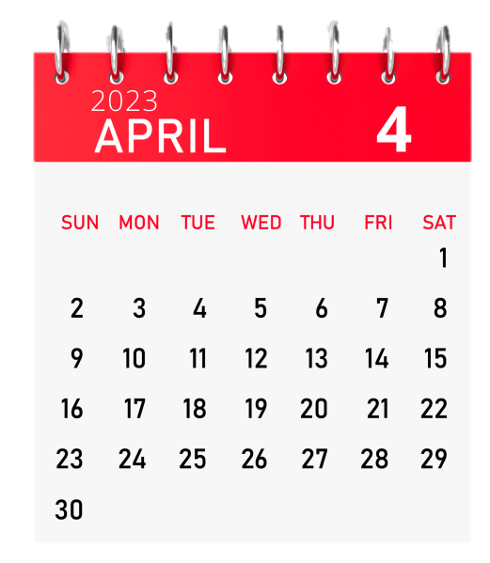
April
Yes
No

Slide 9
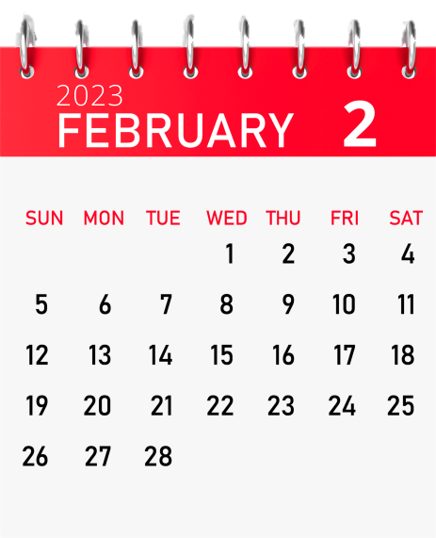
March
No
Yes

Slide 10
February
No
Yes

Slide 11
March
Yes
No

Slide 12
02
Activity 4
Listen and number.

Slide 13
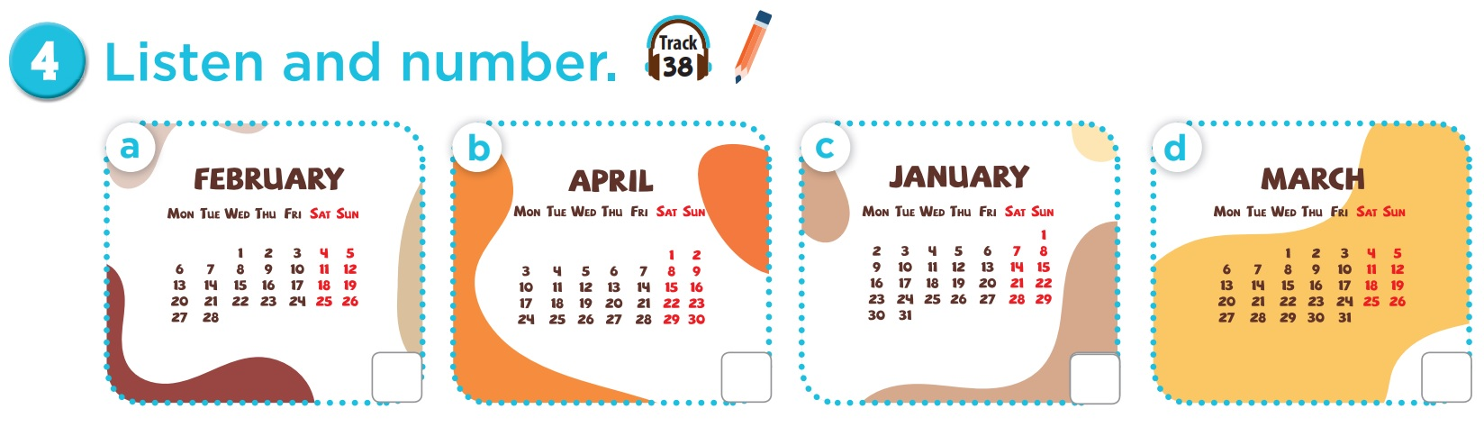

Listen and number.

Slide 14
Listen and check.
2
1
4
3

Slide 15
03
Activity 5
Look, complete and read.

Slide 16
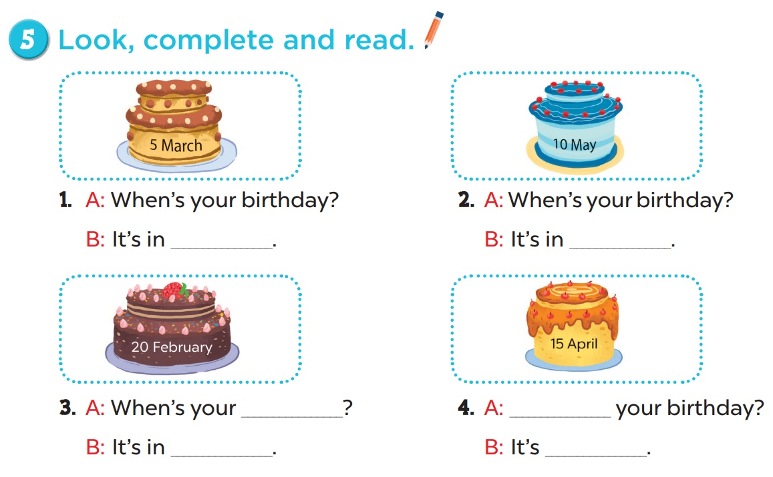

Slide 17
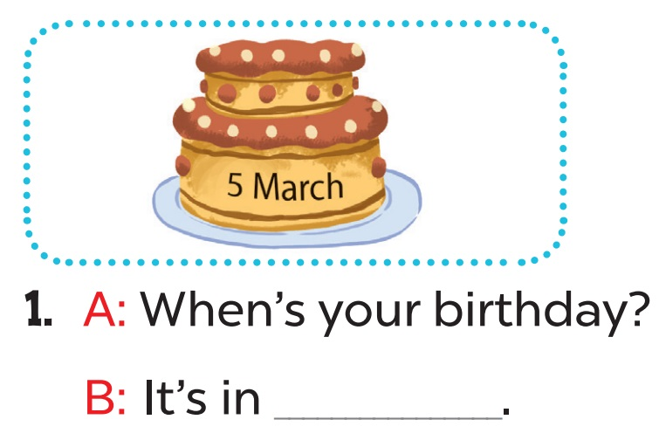
March

Slide 18
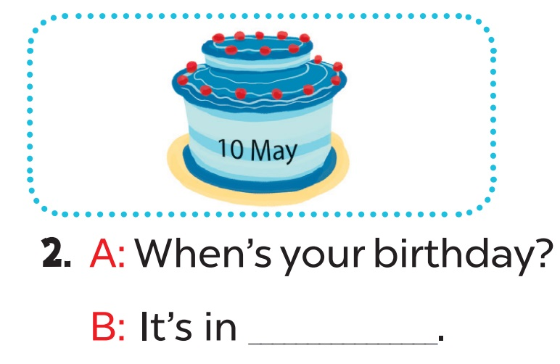
May

Slide 19
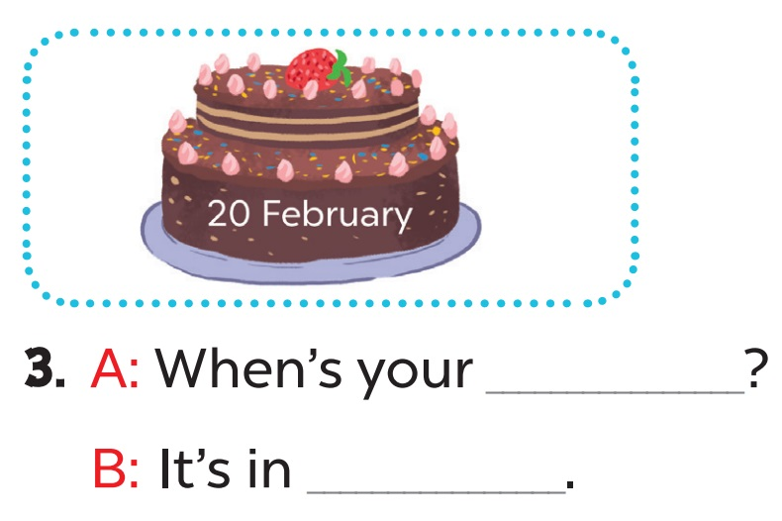
birthday
February

Slide 20
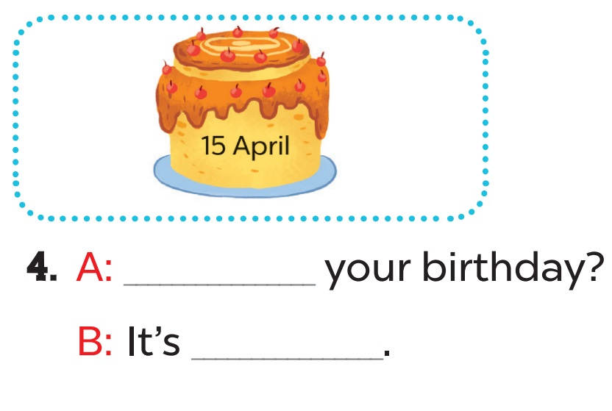
When’s
in April

Slide 21
04
Activity 6
Let’s sing.

Slide 22
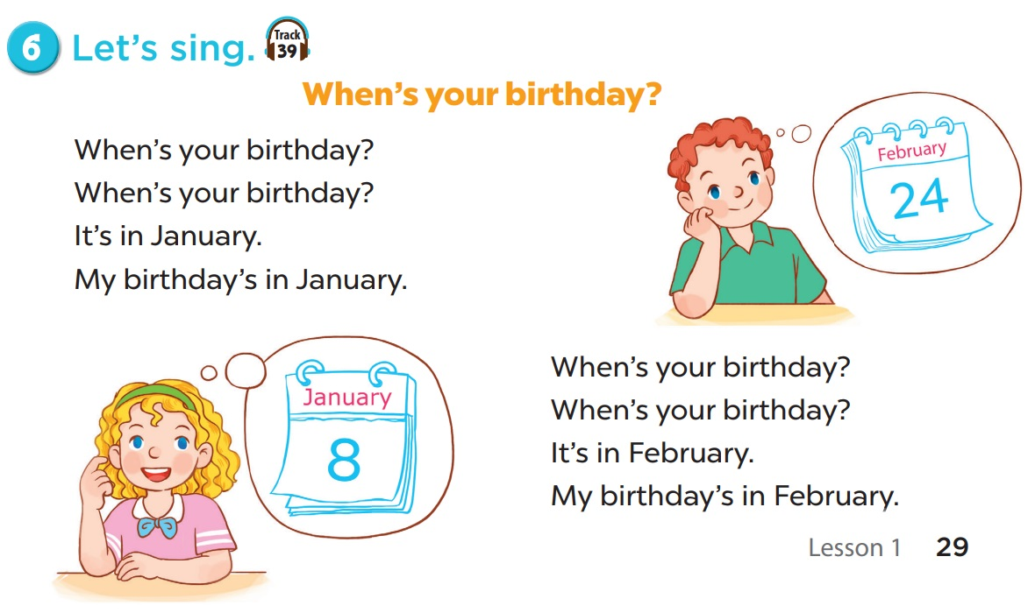

Slide 23
05
Game

Slide 24
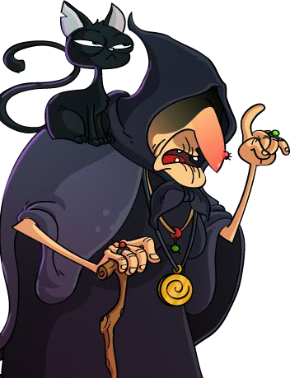
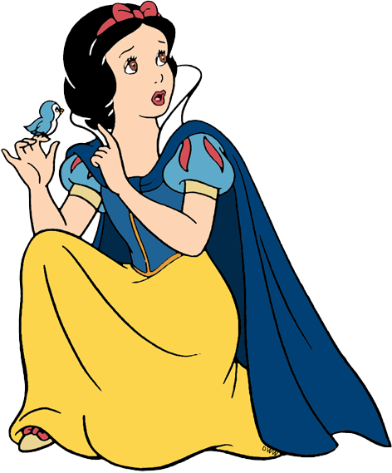



Choose one apple! Now!!
Play

Slide 25
- When’s your birthday?
- It’s in ____.
A. March
B. May
The next day

Slide 26
_____’s your birthday?
- It’s in April.
A. What
B. When
The next day

Slide 27
- When’s your birthday?
- It’s _____ February.
A. in
B. on
The next day

Slide 28
- When’s your ______?
- It’s in May.
A. birthday
B. weekdday
The next day

Slide 29
I
- When’s your birthday?
- _____ in January.
A. Is
B. It’s
The next day

Slide 30








THANK YOU
Website: hoclieu.vn
Fanpage: facebook.com/www.tienganhglobalsucces.vn
Website: sachmem.vn; hoclieu.vn
Fanpage: www.facebook.com/sachmem.vn

