Slide 2
6
Our school
LESSON 1 PERIOD 1

Slide 3
Contents
Warm-up and new words
Activity 1
01
02
Activity 2
Activity 3
03
04
Sing a song and learn new words.
Look, listen and repeat.
Listen, point and say.
Let’s talk.
Fun corner
05
Game

Slide 4
Warm-up

Slide 5
Let’s sing.

Slide 6
New words

Slide 7
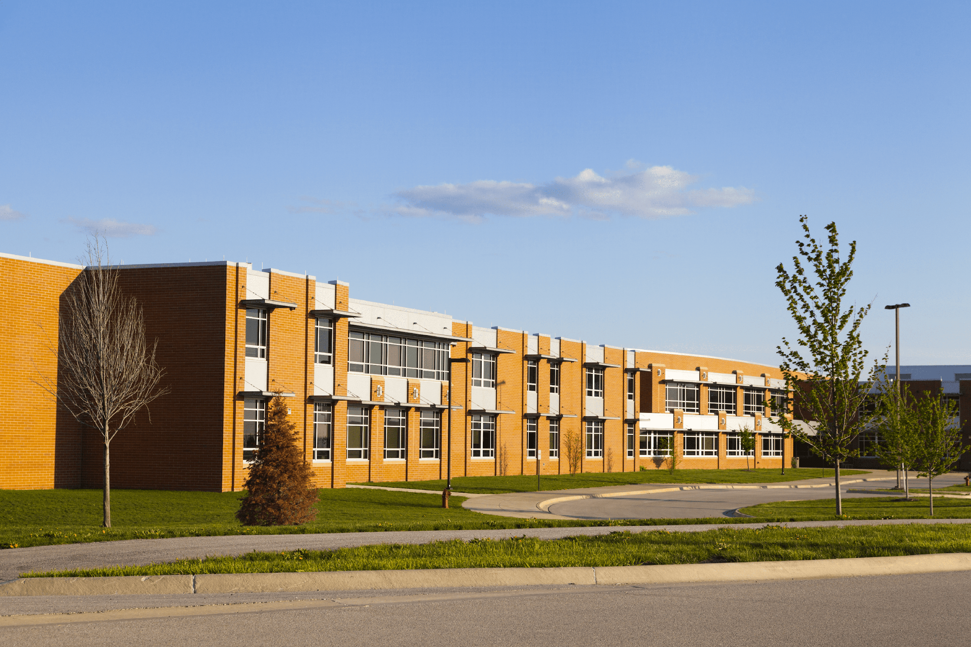
school

Slide 8
classroom

Slide 9
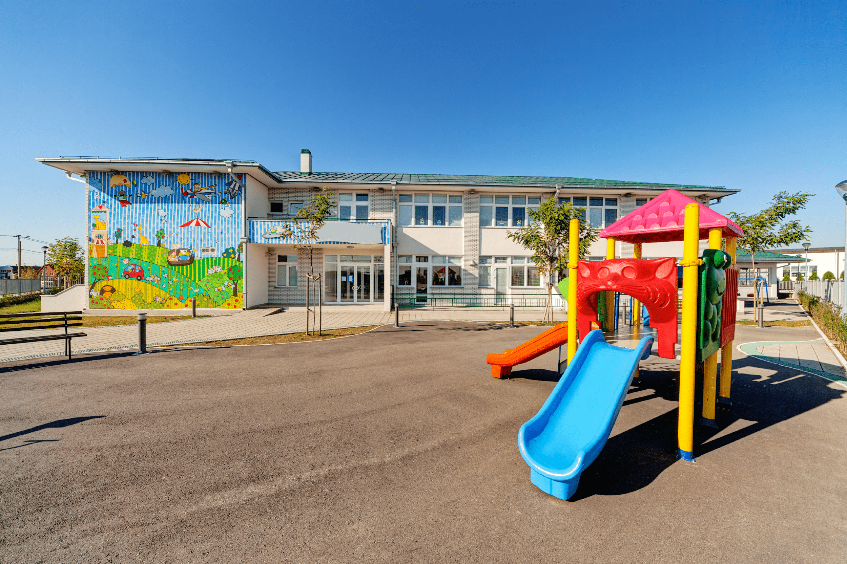
playground

Slide 10
library

Slide 11
Look and guess.

Slide 12
playground

Slide 13
classroom

Slide 14
library

Slide 15
school

Slide 16
Look, listen and repeat.

Slide 17
Look and answer the questions.
Where are they?
Who are they?
What are they doing?

Slide 20
Work in pairs. Practise.
Listen and repeat.

Slide 21
Listen, point and say.

Slide 22
Is this our classroom?
Yes, it is.
No, it isn’t.

Slide 23
Is this our library?
Yes, it is.
No, it isn’t.

Slide 24
Is this our playground?
Yes, it is.
No, it isn’t.

Slide 25
Work in pairs. Practise.

Slide 26
Let’s talk.

Slide 28
Fun corner

Slide 29
Let’s play a game.
No
Yes
classroom
10 points
No
4
library
5 points
3 points
2
bomb
1
Yes
3
playground
school
school
10 points
school
5
library
- 3 points
6
Yes
1 point
Yes
7
playground
No
Yes
4 points
10 points
8
Notes:
Gv chia 2 đội.
Hs chọn số, 1 bạn đặt câu hỏi, 1 bạn trả lời với từ cho sẵn và nhận điểm

Slide 30
Website: sachmem.vn
Fanpage: www.facebook.com/sachmem.vn

