Slide 2
Unit 1 My friends
Lesson 2 - Period 3

Slide 3
Table of contents
Warm-up
Activity 1
New words
Activity 2
Activity 3
Fun time
01
02
03
05
06
04

Slide 4
01
Warm-up
Sing a song.

Slide 6
02
Activity 1
Look, listen and repeat.

Slide 7
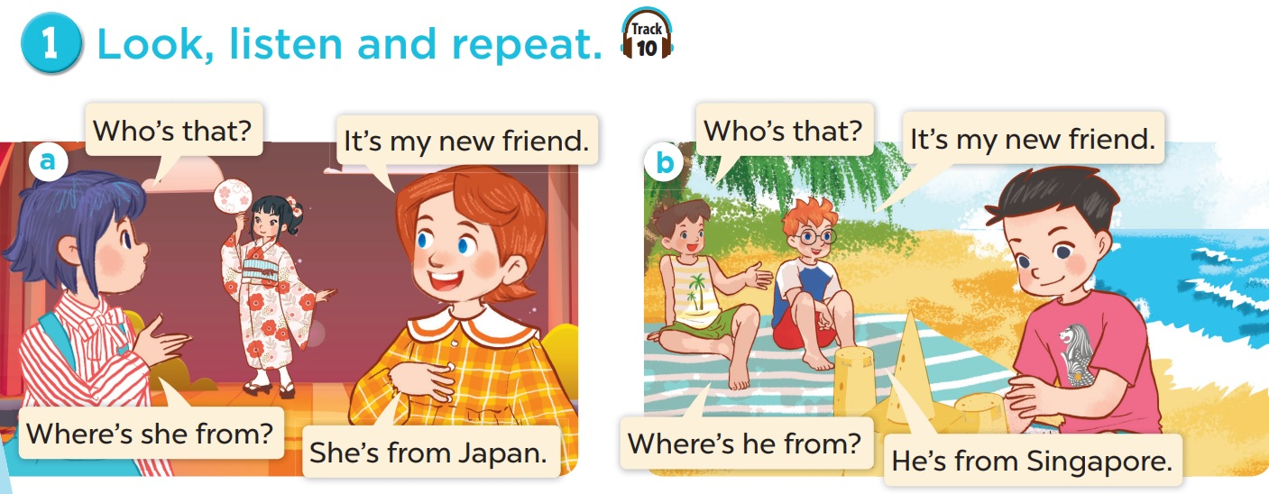
Who are they?

Slide 8
Look, listen and repeat.

Slide 9
02
New words

Slide 10
Singapore

Slide 11
Malaysia

Slide 12
Thailand

Slide 13
Japan

Slide 14
Look and guess.

Slide 15
Viet Nam

Slide 16
Malaysia

Slide 17
Singapore

Slide 18
Britain

Slide 19
Australia

Slide 20
Thailand

Slide 21
04
Activity 2
Listen, point and say.

Slide 22
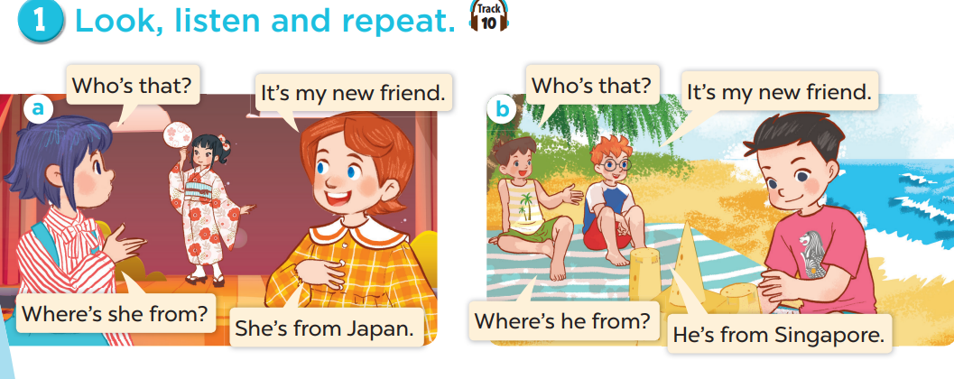
Look and think.
Notes:
Draw pupils' attention to the words HE and SHE. Ask them to think of the differences.

Slide 23
SHE
(a girl / a woman)
HE
(a boy / a man)

Slide 24
Where’s he from?
He’s from Singapore.

Slide 25
Where’s she from?
She’s from Thailand.

Slide 26
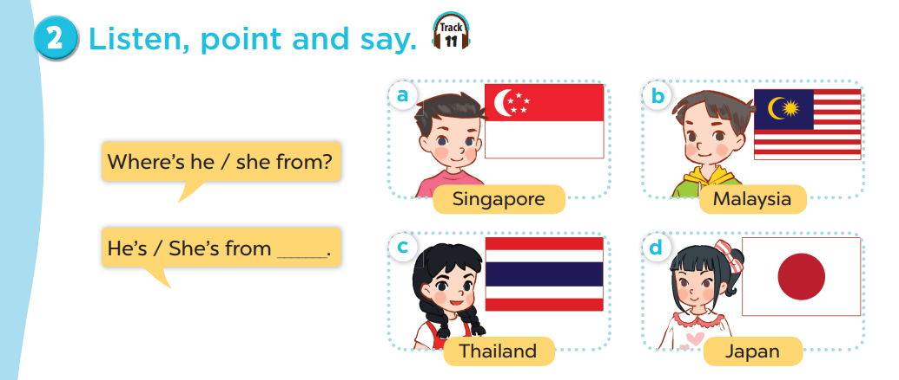
Work in pairs. Practise.

Slide 27
05
Activity 3
Let’s talk.

Slide 28
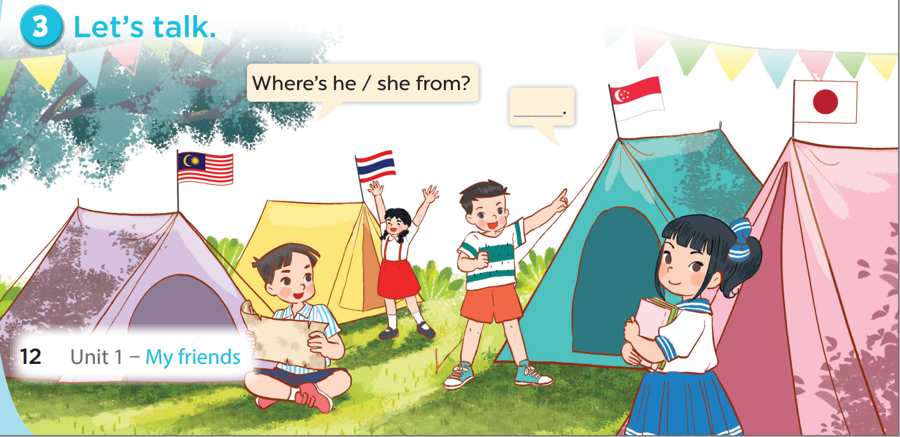

Slide 29
06
Fun time

Slide 31
1
2
3
4
5
6
7
8
1
2
3
4
5
6
7
8
1 point
3 points
Take 5 points
2 points
4 points
Notes:
Click to numbers at the top to answer the questions
Click to numbers in the bricks to review points
31

Slide 32
Where’s she from?
She’s from Thailand.
Notes:
Click the red angry bird to come back

Slide 33
Where’s she from?
She’s from Japan.
Notes:
Click the red angry bird to come back

Slide 34
Where’s he from?
He’s from Australia.
Notes:
Click the red angry bird to come back

Slide 35
Where’s she from?
She’s from Viet Nam.
Notes:
Click the red angry bird to come back

Slide 36
Where’s he from?
He’s from Britain.
Notes:
Click the red angry bird to come back

Slide 37
Where’s he from?
He’s from Malaysia.
Notes:
Click the red angry bird to come back

Slide 38
Where’s he from?
He’s from America.
Notes:
Click the red angry bird to come back

Slide 39
Where’s she from?
She’s from Singapore.
Notes:
Click the red angry bird to come back

Slide 40
THANK YOU
Website: hoclieu.vn
Fanpage: facebook.com/www.tienganhglobalsuccess.vn
Website: sachmem.vn; hoclieu.vn
Fanpage: www.facebook.com/sachmem.vn

