Slide 2
Unit 1 My friends
Lesson 1 - Period 2

Slide 3
Table of contents
Warm-up
Activity 4
Activity 5
Activity 6
Fun time
01
02
03
04
05

Slide 4
01
Warm-up

Slide 5
Where are you from?
I'm from Britain.
?
?

Slide 6
Where are you from?
I'm from Viet Nam.
?
?

Slide 7
Where are you from?
I'm from America.
?
?

Slide 8
Where are you from?
I'm from Australia.
?
?

Slide 9
02
Activity 4
Listen and number.

Slide 10
Where's he from?

Slide 11
Where's she from?

Slide 13
Let's check.
4
1
3
2

Slide 14
03
Activity 5
Look,complete and read.

Slide 15
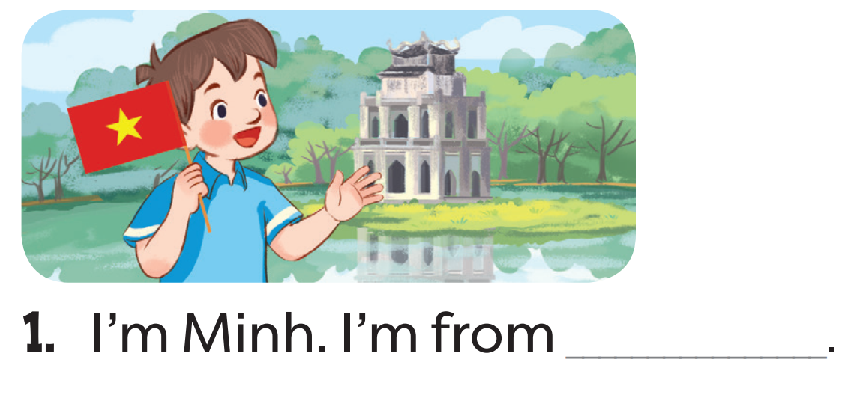
Read. What's the missing word?
Viet Nam

Slide 16
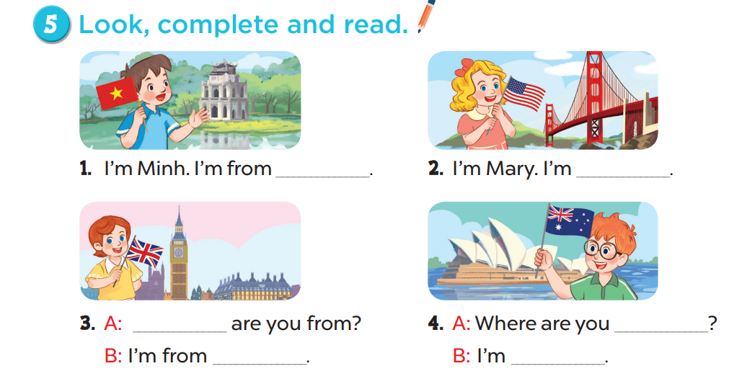
Viet Nam
from America
Where
from
Britain
from Australia

Slide 17
Read aloud.
Viet Nam
from
America

Slide 18
Act it out.
Where
from
Britain
from Australia

Slide 19
04
Activity 6
Let's sing.

Slide 20
Read the lyrics.

Slide 21
Listen.
Practise line by line.
Sing the song.

Slide 22
05
Fun time
What's the missing word?

Slide 23
Choose and answer.
Boys
Girls

Slide 24
Where are you ....... ?
from
A. from
B. form
C. for

Slide 25
......... are you from?
Where
A. How
B. I'm
C. Where

Slide 26
Hello. ........ Lan.
I'm
A. Where
B. I'm
Lan
C. I

Slide 27
Where ........ you from?
are
A. am
B. are
C. I'm

Slide 28
I'm .................. .
from America
A. from Australia
B. from America
C. America

Slide 29
I'm .................. .
from Britain
A. from Britain
B. Form Britain
C. from America

Slide 30
I'm from ........... .
Australia
A. From Britain
B. Australia
C. from Australia

Slide 31
....... from Viet Nam .
I'm
A. Im
B. I'm
C. I

Slide 32
THANK YOU
Website: hoclieu.vn
Fanpage: facebook.com/www.tienganhglobalsuccess.vn
Website: sachmem.vn; hoclieu.vn
Fanpage: www.facebook.com/sachmem.vn

