Slide 2
Unit 1 My friends
Lesson 3 - Period 6

Slide 3
Table of contents
Warm-up and review
Read and tick True or False.
Let’s write.
Games
Project
01
02
03
04
05

Slide 4
Warm-up and review
01

Slide 5
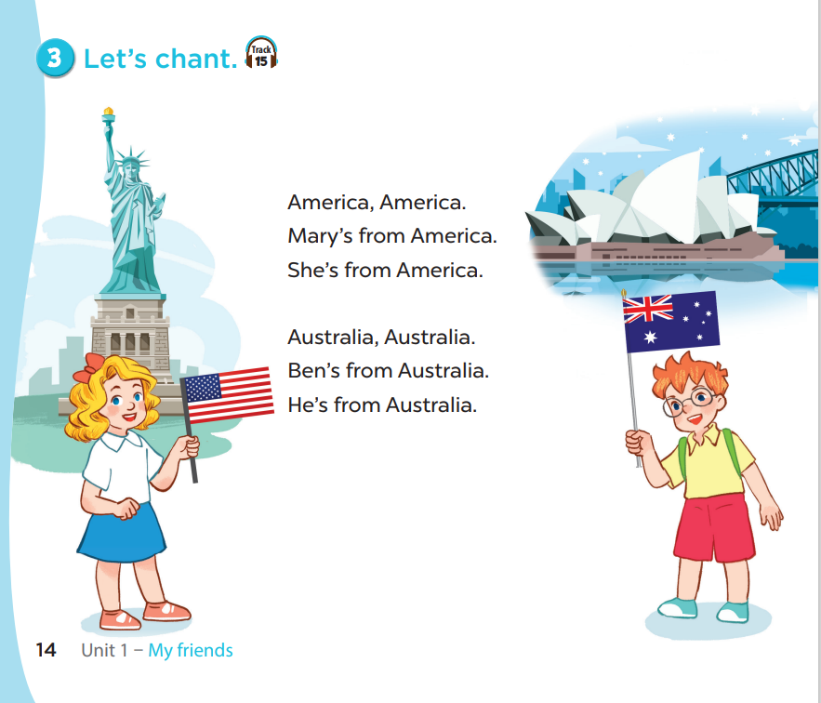

Slide 6
Work in pairs. Ask and answer.

Slide 7
Where are you from?
I’m from
Viet Nam.

Slide 8
Where is she from?
She’s from Australia.

Slide 9
Where is he from?
He’s from America.

Slide 10
Where is she from?
She’s from
Britain.

Slide 11
Where are you from?
I’m from Thailand.

Slide 12
Where is she from?
She’s from Japan.

Slide 13
Where is she from?
She’s from Malaysia.

Slide 14
Where are you from?
I’m from Singapore.

Slide 15
02
Read and tick true or false.

Slide 16
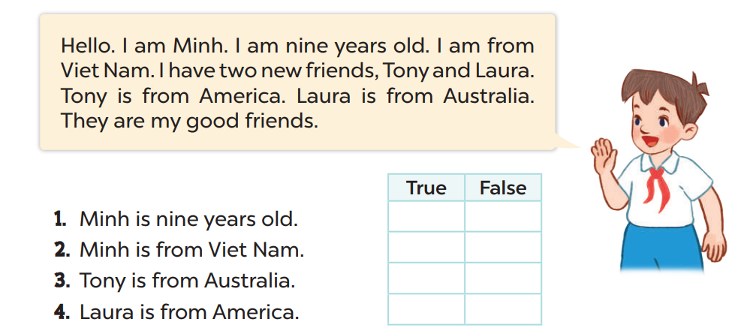
Read and tick.

Slide 17
03
Let’s write.

Slide 18
T’s name / T’s age
Teacher’s photo
My name is Ms._____. I’m _______ years old.
T’s name
T’s age

Slide 19
America / Ben
This is my friend, …...... He is from …………...
Ben
America

Slide 20
Read the text
Lulu
eight
Laura
Japan
Mary
America

Slide 21
04
Games

Slide 22
Find the treasure.

Slide 23
-
=
=
=

Slide 24
Choose the country.

Slide 25
She is ……….... years old. She is from …………….
eight
Thailand

Slide 26
Where are you from?
I am
………………. from Viet Nam.

Slide 27
She is ……….... years old. She is from …………….
nine
Singapore

Slide 28
Where …………….... from?
is she
Japan
She is from ……………….

Slide 29
Where …………….... from?
is he
Singapore
He is from …………………….

Slide 30
She is ……….... years old. She is from …………….
ten
Japan

Slide 31
Where …………….... from?
is he
Australia
He is from …………………….

Slide 32
Where …………….... from?
is he
Malaysia
He is from …………………….

Slide 33
05
Project

Slide 34
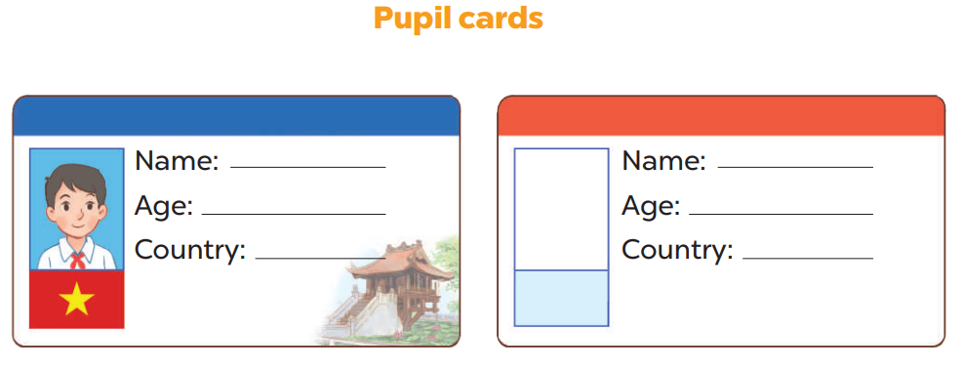

Slide 35
Work in groups.
This ……. .She is …... years old. She is from …….
This ……...He is … years old. He is from …….
is Thu
is Hieu
ten
ten
Viet Nam
Viet Nam

Slide 36
Let’s talk.
Yourself

Slide 37
THANK YOU
Website: hoclieu.vn
Fanpage: facebook.com/www.tienganhglobalsuccess.vn
Website: sachmem.vn; hoclieu.vn
Fanpage: www.facebook.com/sachmem.vn

