Slide 2
Unit 1 My friends
Lesson 3 - Period 5

Slide 3
Table of contents
Warm-up
Activity 1
Activity 2
Activity 3
Fun time
01
02
03
04
05

Slide 4
01
Warm-up
The Hangman Game: Country names
Notes:
Words used: Malaysia, America, Australia, Japan, England, Singapore
Setup the game by drawing a gallow and a underline for each letter in the unknown word.
As letters in the word are guessed, write them above the cooresponding underline. If a letter not in the word is guess, draw a picture of a person on the gallow–one part for each incorrect letter guess.
Most frequently, the person is drawn in 6 parts (for 6 letter guesses) in the order: head, body, left leg, right leg, left arm, right arm. If too many letters which do not appear in the word are guessed, the player is hanged (and loses).

Slide 5
02
Activity 1
Look, listen and repeat.

Slide 6
Australia
Look at the last letters.
a
America
They look similar.
But the sounds are different.
ia
ia
Malaysia

Slide 7
Listen and repeat.

Slide 8
Work in groups, practice.

Slide 9
03
Activity 2
Listen and circle.

Slide 11
04
Activity 3
Let's chant.

Slide 13
05
Fun time

Slide 14
More words
Country names

Slide 15
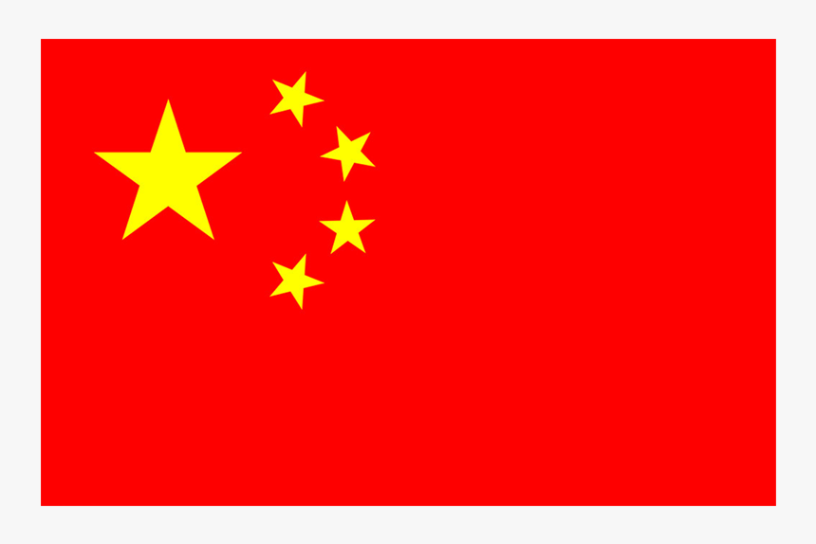
China

Slide 16
Canada

Slide 17
India

Slide 18
Cambodia

Slide 19
Slap the board!

Slide 20
Listen and choose.
a
ia
America

Slide 21
Listen and choose.
a
ia
Australia

Slide 22
Listen and choose.
a
ia
China

Slide 23
Listen and choose.
a
ia
Cambodia

Slide 24
Listen and choose.
a
ia
Canada

Slide 25
Listen and choose.
a
ia
India

Slide 26
Listen and choose.
a
ia
Malaysia

Slide 27
THANK YOU
Website: hoclieu.vn
Fanpage: facebook.com/www.tienganhglobalsuccess.vn
Website: sachmem.vn; hoclieu.vn
Fanpage: www.facebook.com/sachmem.vn

