Slide 2
Unit 1 My friends
Lesson 1 - Period 1

Slide 3
01
Warm-up

Slide 4
We live in many different countries in the world.

Slide 5
02
Activity 1
Look, listen and repeat.

Slide 6
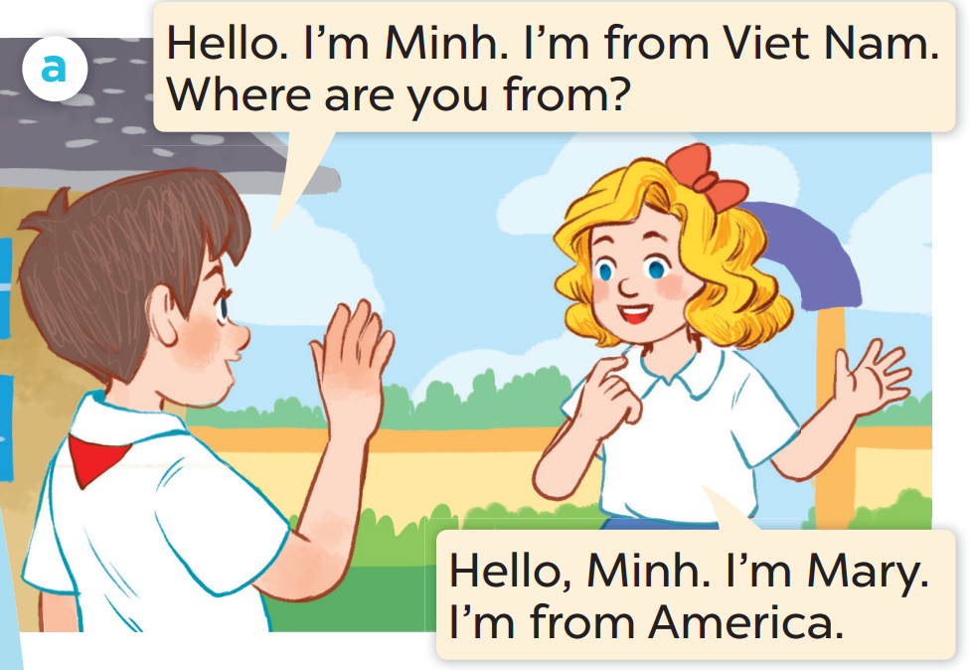
Listen and repeat.
Notes:
Click on the Speaker Icon to play the audio.

Slide 7
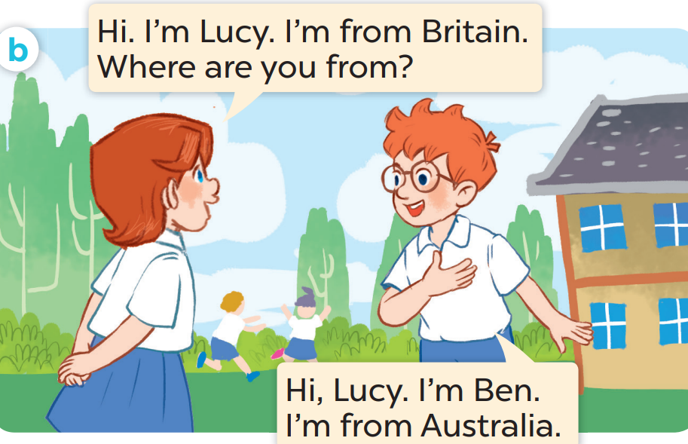
Listen and repeat.
Notes:
Click on the Speaker Icon to play the audio.

Slide 8
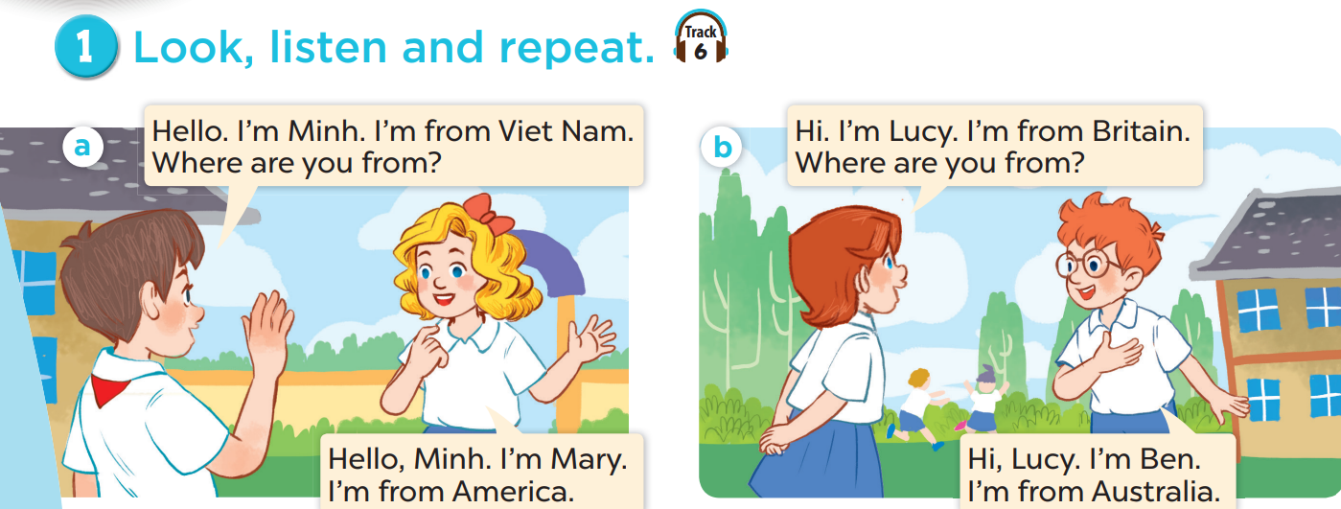
Work in pairs, practise.
Act it out.

Slide 9
03
New words

Slide 10
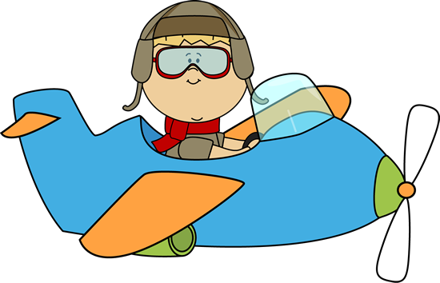
Look, guess, then learn.
Let's visit some countries with me.
Hello. I'm Ben.

Slide 11
Viet Nam

Slide 13
Britain

Slide 15
America

Slide 16
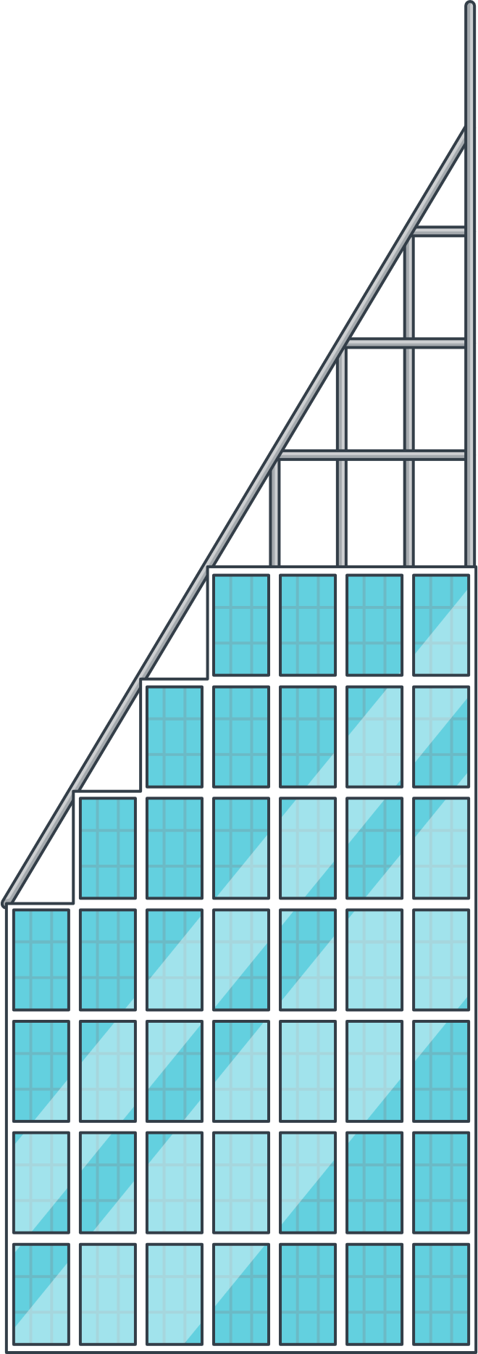

Slide 17
Australia

Slide 18
Review
Viet Nam
America
Britain
Australia

Slide 19
Look and say the name.

Slide 20
Viet Nam

Slide 21
America

Slide 22
Australia

Slide 23
Britain

Slide 24
04
Activity 2
Listen, point and say.

Slide 25
Notes:
Click on the Speaker Icon to play the audio.

Slide 26
05
Activity 3
Let's talk.

Slide 27
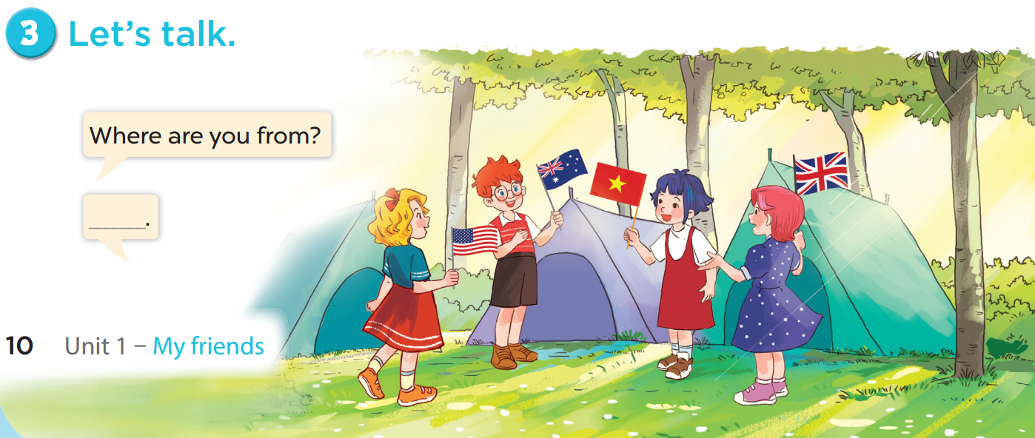

Slide 28
06
Fun time
Choose a number.
Ask, answer and have fun.

Slide 29
THANK YOU
Website: hoclieu.vn
Fanpage: facebook.com/www.tienganhglobalsuccess.vn
Website: sachmem.vn; hoclieu.vn
Fanpage: www.facebook.com/sachmem.vn

