Slide 1
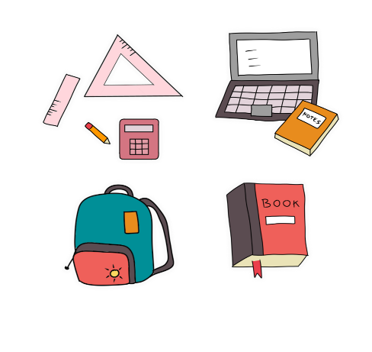
Thursday, December 3rd 2024
My school things
Unit
8
Lesson 2 (1+2+3)

Slide 2
Warm-up

Slide 3
Let’s sing.
School things
A book, a book, a book.
This is a book.
I have a book.
I have a book.
A pen, a pen, a pen.
This is a pen.
I have a pen.
I have a pen.

Slide 4
Well done!

Slide 5
Contents
Look, listen and repeat.
Listen, point and say.
Let’s talk.

Slide 6
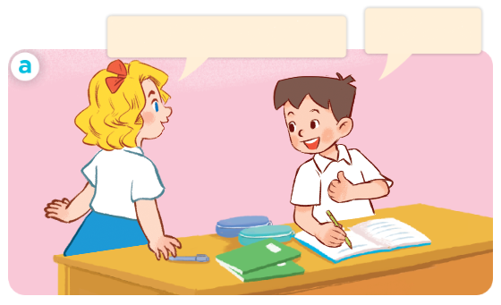
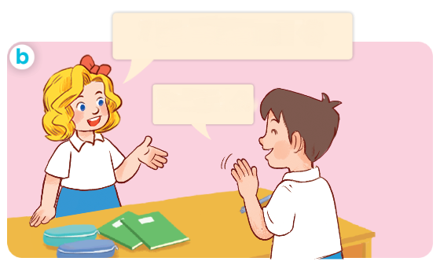
1. Look, listen and repeat.
Do you have a pen?
Yes, I do.
Do you have a ruler?
No, I don’t.
What are they doing?
Where are they?
Who are they?

Slide 7
Vocabulary

Slide 8
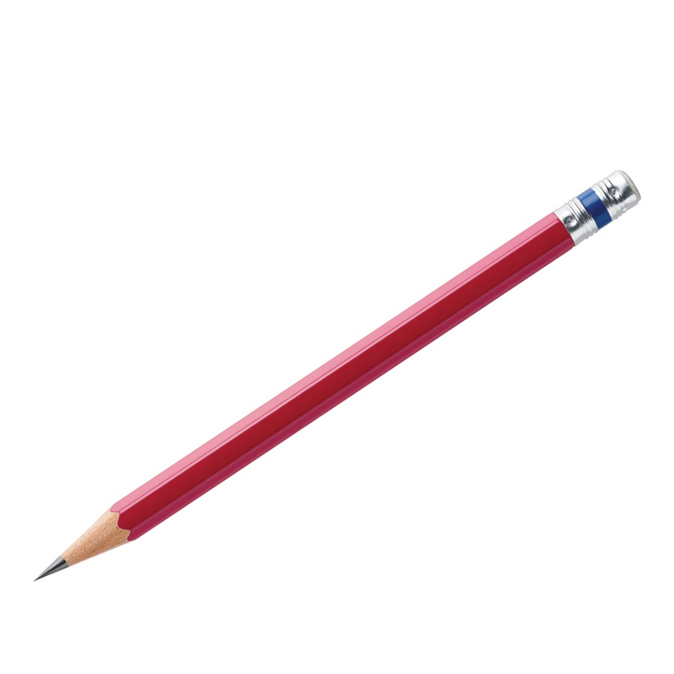
Vocabulary
pencil
/ˈpen.səl/
bút chì

Slide 9
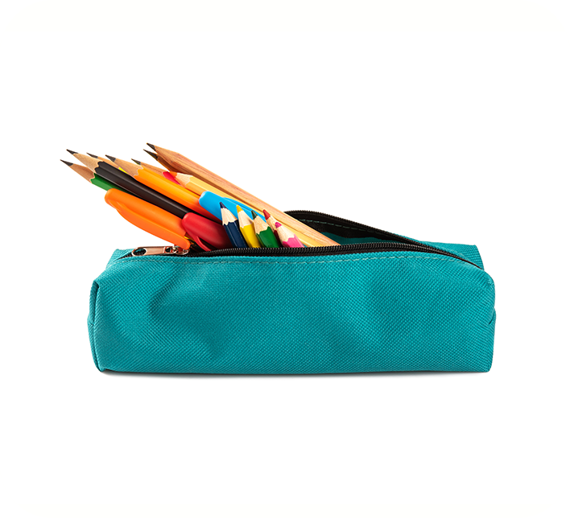
Vocabulary
pencil case
/ˈpen.səl ˌkeɪs/
hộp bút

Slide 10
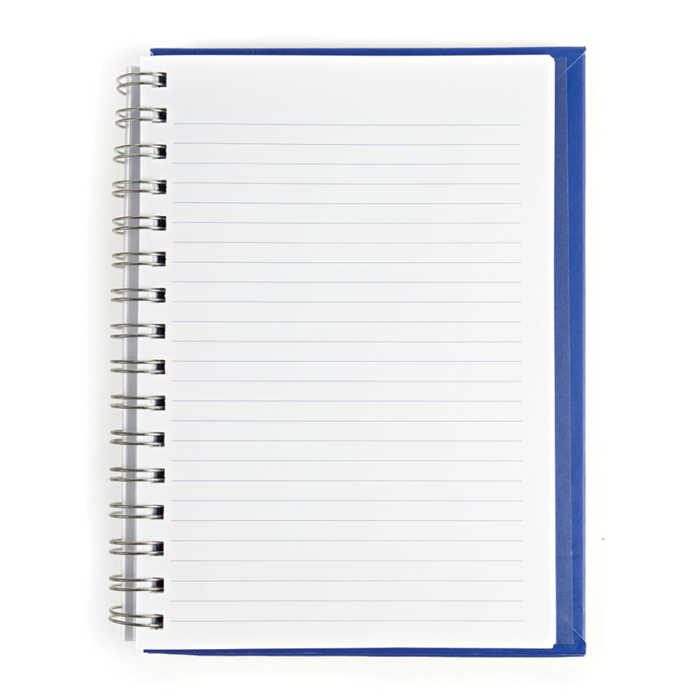
Vocabulary
notebook
/ˈnəʊt.bʊk/
vở viết

Slide 11
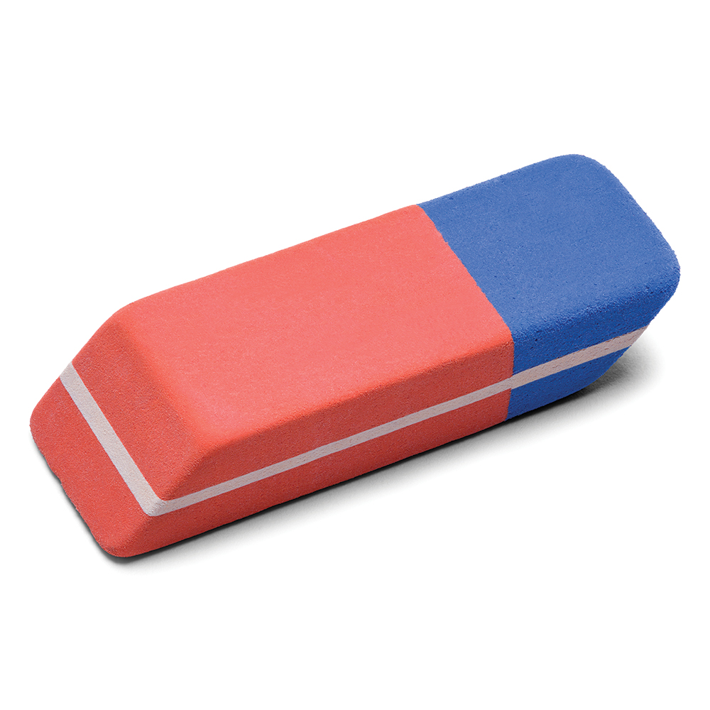
Vocabulary
eraser
/ɪˈreɪ.zər/
cục tẩy

Slide 12
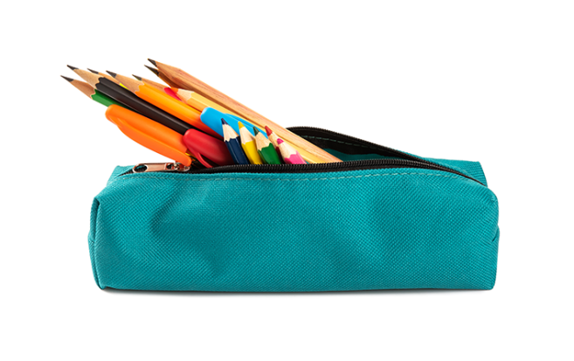
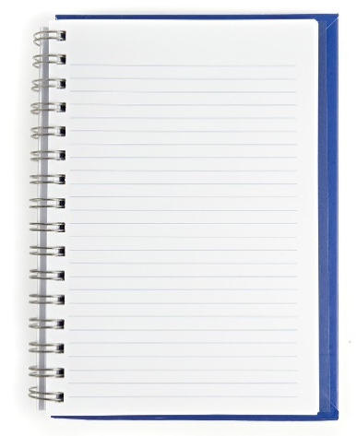
Review
pencil
pencil case
notebook
eraser

Slide 13
Checking vocabulary
1
2
3
4
eraser
notebook
pencil
pencil case
_____
_____
_____
_____
a
notebook
c
pencil case
b
eraser
d
pencil

Slide 14
Structures

Slide 15
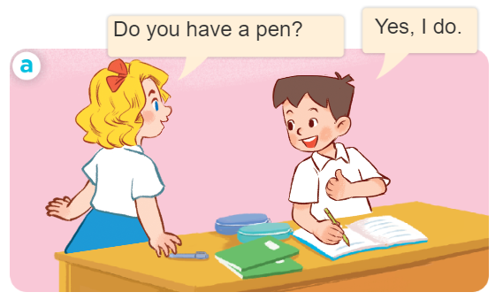
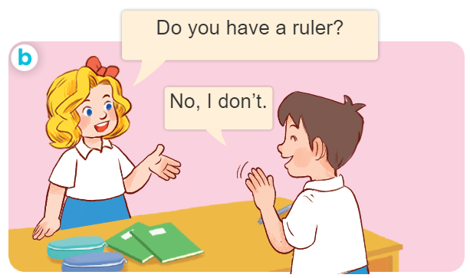
* Hỏi và trả lời ai đó có cái gì không?.
- Do you have _______?
+ Yes, I do.
+ No, I don’t.
- Bạn có ______ không?
+ Ừ, tớ có.
+ Không, tớ không có.

Slide 16
2. Listen, point and say.
Do you have ____ ?
Yes, I do
No, I don’t
Don’t = do not
a pencil / yes
a pencil case / no
a notebook / yes
an eraser / no

Slide 17
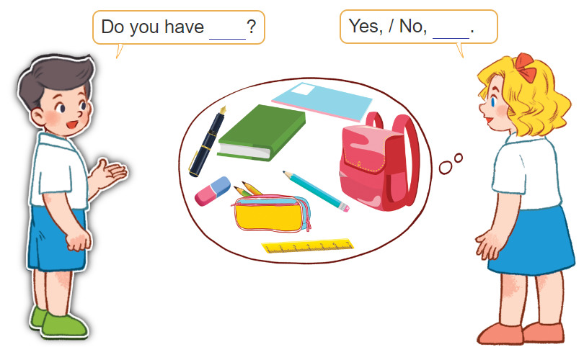
3. Let’s talk.

Slide 18
Let’s play!

Slide 19
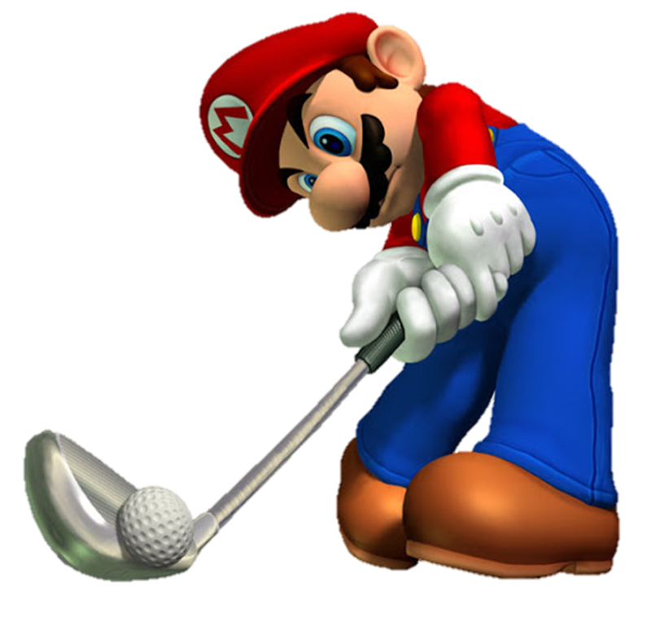
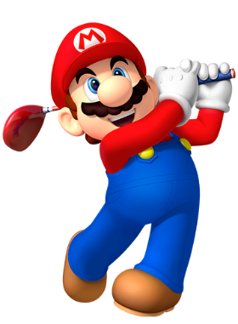

Slide 20
A. pen
B. pencil
C. pencil case

Slide 21
A. book
B. ruler
C. notebook

Slide 22
A. eraser
B. book
C. ruler

Slide 23
A. school thing
B. school bag
C. pencil case

Slide 24
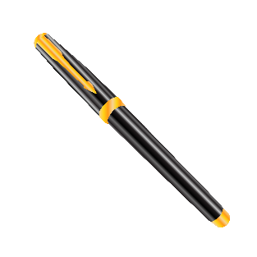
notebook
A.
B.
C.

Slide 25
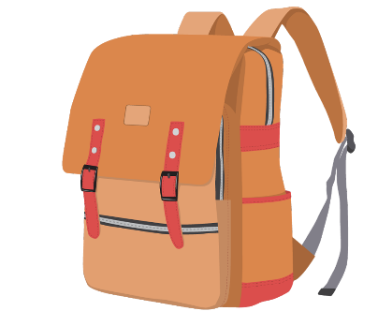
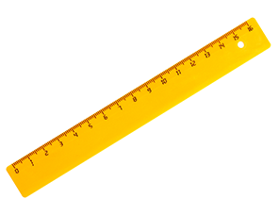
pencil
A.
B.
C.

Slide 26
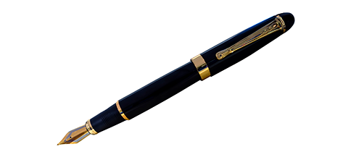
eraser
A.
B.
C.

Slide 27
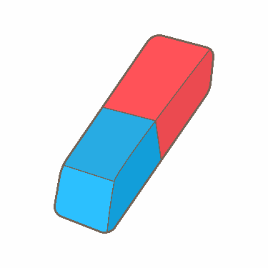
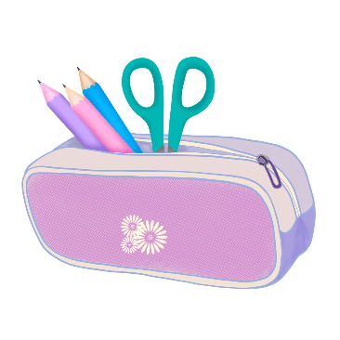
pencil case
A.
B.
C.

Slide 28
Do you have ______?
A. a pencil
B. an eraser
C. a pen

Slide 29
Do you have _____?
A. a school bag
B. a pencil
C. a notebook

Slide 30
Do you have _______?
A. a pencil
B. an eraser
C. a pencil case

Slide 31
Do _____ have a pencil case?
Yes, I do.
A. you
B. she
C. he

Slide 32
_____ you have an eraser?
A. Does
B. Do

Slide 33
Do you have a pencil?
______, I do.
A. No
B. Yes

Slide 34
Do you have a pencil case?
No, ______.
A. I don’t
B. I do

Slide 36
Wrap up

Slide 37
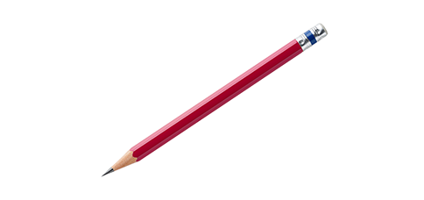
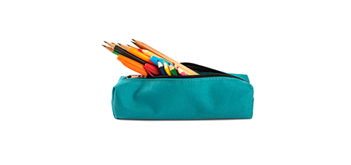
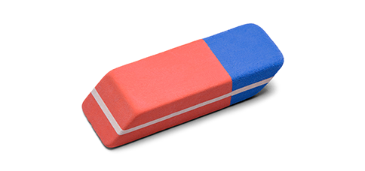
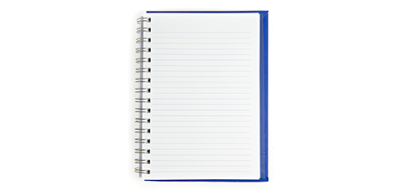
Review
a
b
I have _______.
a pencil / yes
a pencil case
c
d
a notebook / yes
an eraser / no

Slide 38
Homework
Learn by heart all the new words.
Read again the dialogue in part 1.

Slide 39
Thank you!

