Slide 1
Unit 9: FESTIVALS AROUND THE WORLD
Lesson 7: Looking back+ Project
March 12th

Slide 2
Festivals around the word

Slide 3
Complete each sentence by filling in the blank with a word or phrase in the box
floats Bunny lion dances costumes gathering
The best part of the Mid-Autumn Festival is the performance of ___________.
There are flower ____________ in the Tulip Festival.
We like to wear traditional ____________ at Tet.
One of the symbols of Easter is the Easter ____________.
The Twins Day Festival is the largest ____________ for twins in the world.
lion dances
floats
costumes
Bunny
gathering

Slide 4
Choose the correct question A or B.
1. A. Did you go to the Lim Festival yesterday?
B. Are you go to the Lim Festival yesterday?
2. A. Are they always celebrate the festival in May?
B. Do they always celebrate the festival in May?
3. A. Will you wear a costume for Halloween?
B. Will do you wear a costume for Halloween?
4. A. Does he interested in joining the festival?
B. Is he interested in joining the festival?
5. A. Do people listen to traditional songs at the Hoi Mua Festival last year?
B. Did people listen to traditional songs at the Hoi Mua Festival last year?

Slide 5
Answer the following questions about yourself.
1. Are you interested in festivals?
2. Do you eat banh chung at Tet?
3. Can you cook any traditional food?
4. Did you see a fireworks display last year?
5. Does your family gather together at Tet?

Slide 6
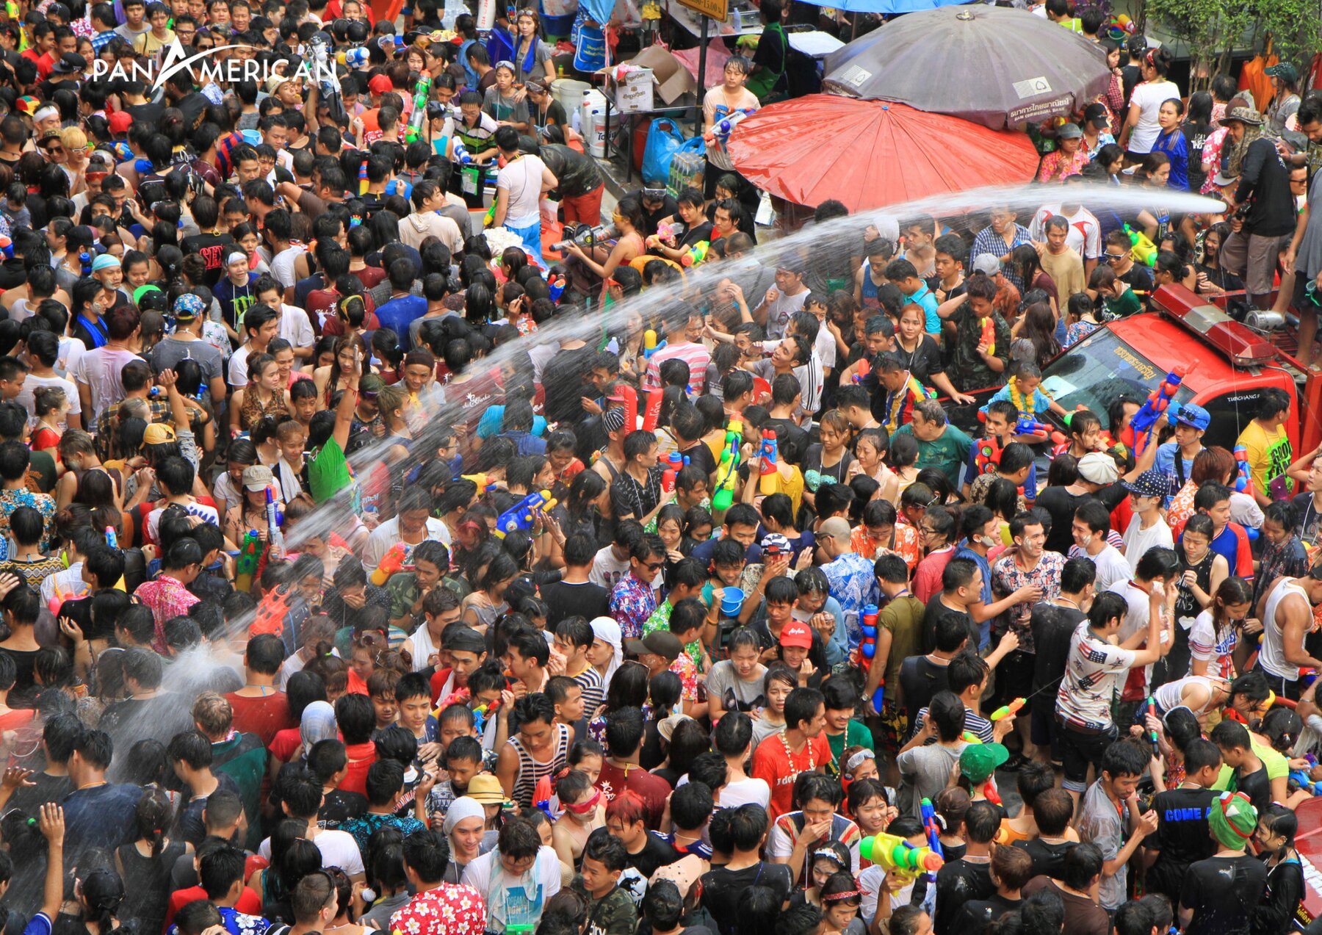
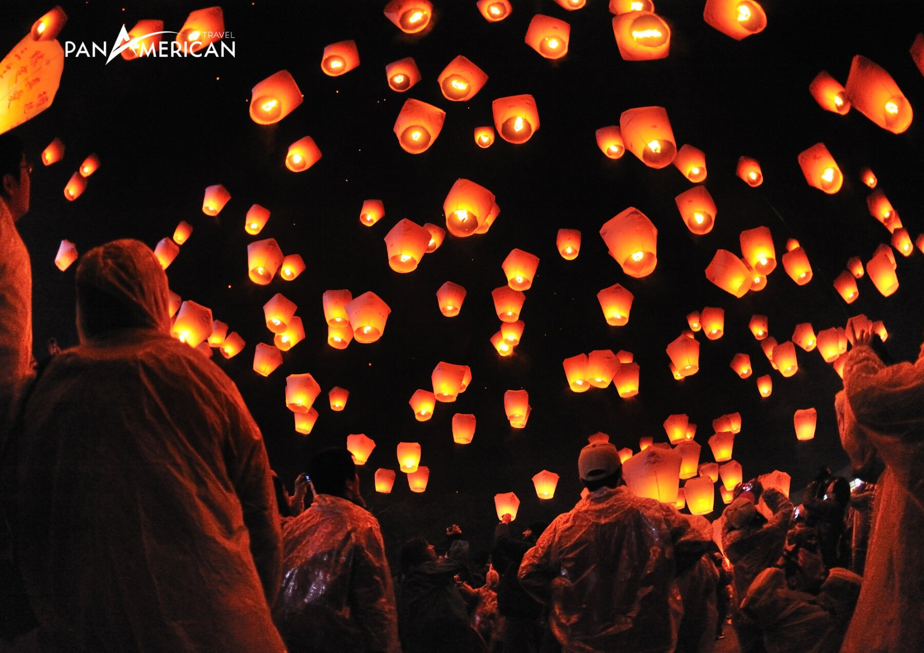
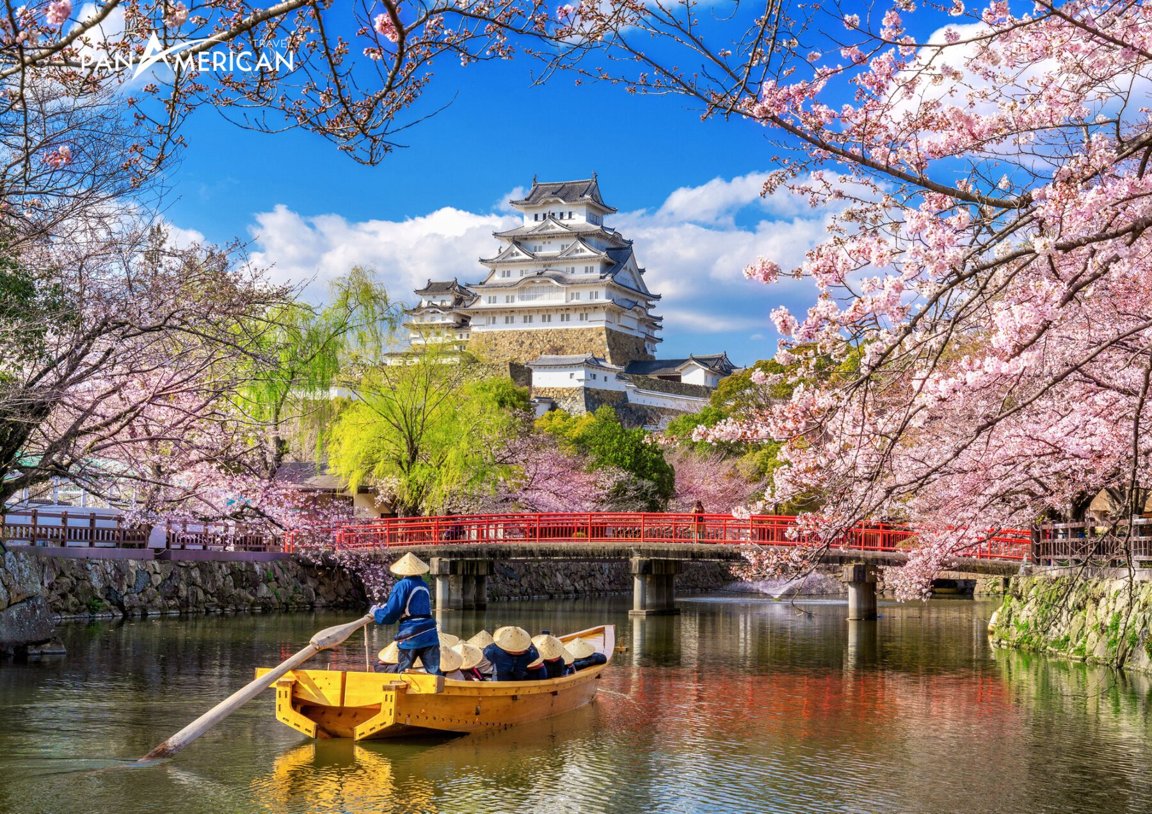
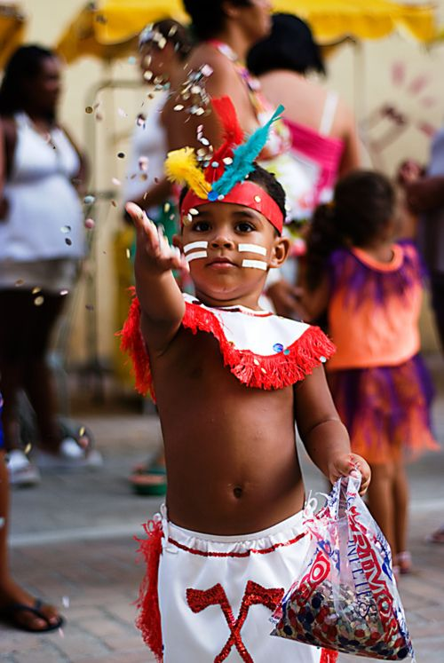
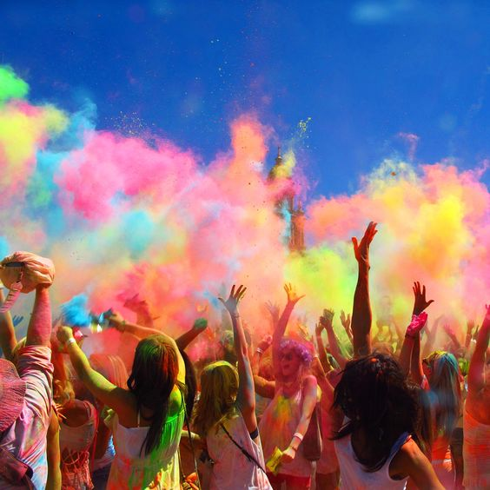
Some well-known festivals in the world
Songkran in Thailand
Pingxi lanterns inTaiwan
cherry blossom in Japan
Rio Carnival Brazil
Festival of Colors in India

Slide 7
PROJECT
5
* Think of a new festival that you would like to celebrate. Discuss the following points:
- Name of the festival
- Time and place of the festival
- Festival activities

Slide 8
THANK YOU!

