Slide 1
Unit
10
ENERGY SOURCES
LESSON 3: A CLOSER LOOK 2
Unit
HOBBIES

Slide 2
WARM-UP
Jumble sentences
1. She / now / English / learning / is / .
____________________________________________
2. are / They / not / energy / using / solar / .
____________________________________________
3. project / you / on / working / Are / your / ?
____________________________________________
4. studying / brother / Where / your / is / ?
____________________________________________
5. basketball / she / yard / the / in / playing / Is / school / ?
____________________________________________
She is learning English now.
They are not using solar energy.
Are you working on your Project?
Where is your brother studying?
Is she playing basketball in the school yard ?

Slide 3
Unit
10
ENERGY SOURCES
LESSON 3: A CLOSER LOOK 2
GRAMMAR:
THE PRESENT CONTINUOUS
Unit
HOBBIES

Slide 4
PRESENTATION
THE PRESENT CONTINUOUS
- She is learning English now.
(+) S + am/ is/are + V-ing.
- They are not using solar energy.
(-) S + am/ is/are + not + V-ing.
(?) Am/ Is/ Are + S + V-ing ?
- Are you working on your Project?
Yes, S + am/is/are.
Yes, I am.
No, S + am/is/are + not.
* Cách dùng:
Thì HTTD diễn tả hành động đang xảy ra lúc nói.
* Dấu hiệu:
now, at the moment, at this time, at present, today, nowadays, this week/ month.

Slide 5
PRACTICE
2
Complete the sentences, using the present continuous form of the verbs in brackets.
1. Mai (talk) ____________ about types of energy sources now.
2. We (use) ____________ solar energy to replace energy from coal today.
3. Keep quiet! The students of Class 7C (take) ____________ a test.
4. Scientists (develop) ____________ new energy sources to protect the environment.
5. We (reduce) ____________ the use of nuclear energy nowadays.
is talking
are using
are taking
are developing
are reducing

Slide 6
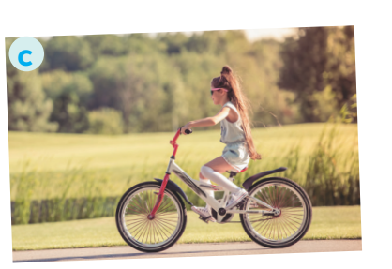

Slide 7
PRACTICE
1
Work in pairs. Tell your partner what the people in the pictures are doing.
a. She is teaching maths/ is writing on the board.
b. They are playing football/ soccer.

Slide 8
PRACTICE
1
Work in pairs. Tell your partner what the people in the pictures are doing.
c. She is riding her bike/ bicycle.
d. She is cooking.

Slide 9
PRACTICE
1
Work in pairs. Tell your partner what the people in the pictures are doing.
e. She is singing.
f. He is watering the flowers/ plans.
He is doing gardening.

Slide 10
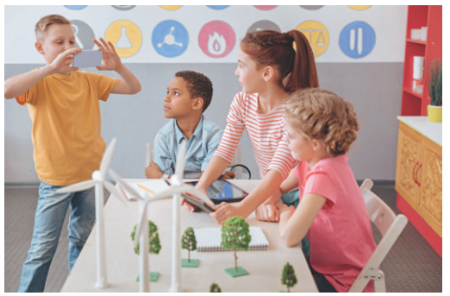
PRACTICE
3
Circle the correct form of the verb in each sentence.
1. Are you still work / working on your project now?
2. Nam and Lan do / are doing quite well at school this year.

Slide 11
PRACTICE
3
Circle the correct form of the verb in each sentence.
3. Does she study / Is she studying at the school library at the moment?
4. Hoa studies / is studying for her exam, so she can’t come to the party right now.

Slide 12
PRACTICE
3
Circle the correct form of the verb in each sentence.
5. We have / are having English three times a week.

Slide 13
PRACTICE
4
Write sentences about what the people are doing or not doing, using the suggestions.
1. The students / do the project / now.
_______________________________________________
2. Mrs Lien / teach us about solar energy / at the moment.
_______________________________________________
3. They / learn about energy / this month.
_______________________________________________
4. She / not swim / in the swimming pool / right now.
_______________________________________________
5. Nowadays, people in Iceland / not use energy from coal.
_________________________________________________

Slide 14
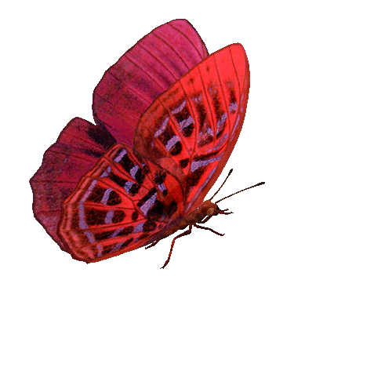
LUCKY FLOWERS
Nowadays, people in Iceland / not use energy from coal.
The students / do the project / now.
She / not swim / in the swimming pool / right now.
Lucky Flower !
Good luck !
Good luck!
Good luck!
They / learn about energy / this month.
Good luck!
Mrs Lien / teach us about solar energy / at the moment.
Nowadays, people in Iceland are not using energy from coal.
They are learning about energy this month.
The students are doing the project now.
Mrs Lien is teaching us about solar energy at the moment.
She is not swimming in the swimming pool right now.

Slide 15
PRACTICE
4
Write sentences about what the people are doing or not doing, using the suggestions.
1. The students / do the project / now.
_______________________________________________
2. Mrs Lien / teach us about solar energy / at the moment.
_______________________________________________
3. They / learn about energy / this month.
_______________________________________________
4. She / not swim / in the swimming pool / right now.
_______________________________________________
5. Nowadays, people in Iceland / not use energy from coal.
_________________________________________________
The students are doing the project now.
Mrs Lien is teaching us about solar energy at the moment.
They are learning about energy this month.
She is not swimming in the swimming pool right now.
Nowadays, people in Iceland are not using energy from coal.

Slide 16
FURTHER PRACTICE
5
Work in pairs. Ask and answer the following questions.
1. What book are you reading now?
2. What sport are you playing these days?
3. What courses are you taking this term?
4. What are you doing to save energy?

Slide 17
CONSOLIDATION
1
WRAP-UP
GRAMMAR:
THE PRESENT CONTINUOUS

Slide 18
CONSOLIDATION
2
HOMEWORK
Do exercises in the workbook.

