Slide 3
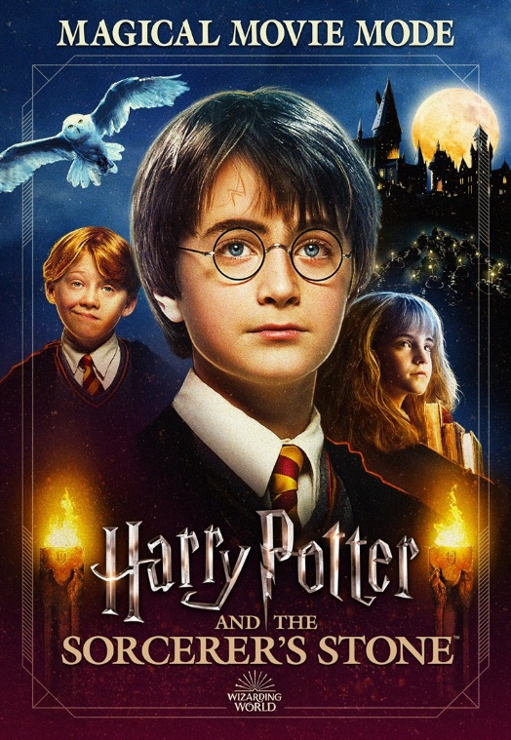
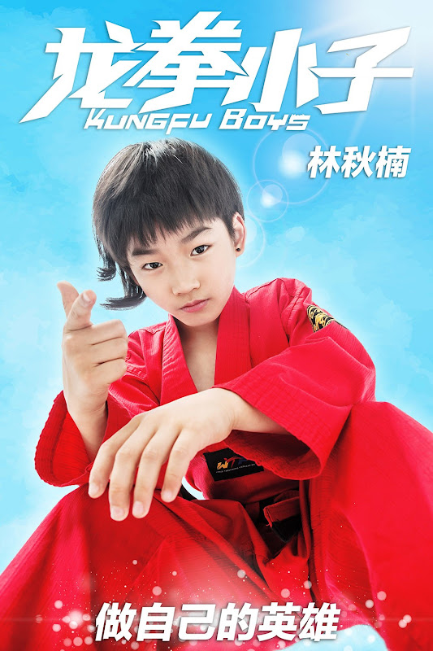
Unit
8
FILMS
LESSON 5: SKILLS 1
Unit
READING
SPEAKING

Slide 4
Discuss the following questions.
Fantasies
Do you like fantasies?
Why or why not?

Slide 5
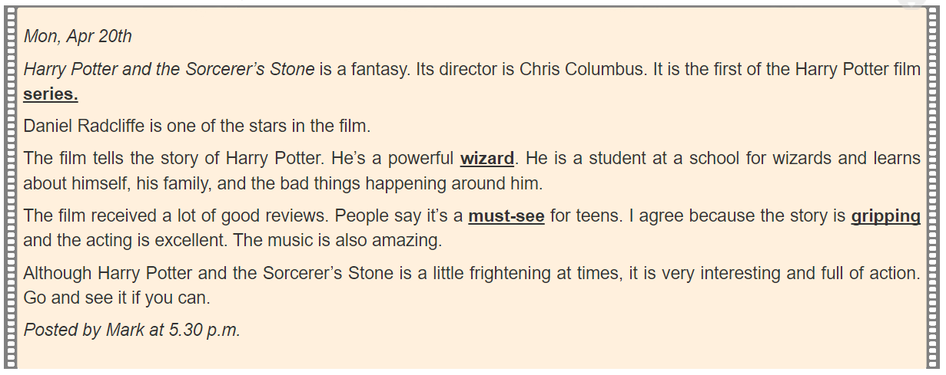
Mark’s blog
Words
1. series
2. wizard
3. must-see
4. gripping
Mon, Apr 20th
Harry Potter and the Sorcerer's Stone is a fantasy. Its director is Chris Columbus. It is the first of the Harry Potter film
Daniel Radcliffe is one of the stars in the film.
The film tells the story of Harry Potter. He's a powerful He is a student at a school for wizards and learns about himself, his family, and the bad things happening around him.
The film received a lot of good reviews. People say it's a for teens. I agree because the story is and the acting is excellent. The music is also amazing.
Although Harry Potter and the Sorcerer's Stone is a little frightening at times, it is very interesting and full of action. Go and see it if you can.
Posted by Mark at 5.30 p.m.
series.
wizard.
must-see
gripping

Slide 6
Read and match the words or phrases with their meanings.
Mon, Apr 20th
Harry Potter and the Sorcerer's Stone is a fantasy. Its director is Chris Columbus. It is the first of the Harry Potter film series.
Daniel Radcliffe is one of the stars in the film.
The film tells the story of Harry Potter. He's a powerful wizard. He is a student at a school for wizards and learns about himself, his family, and the bad things happening around him.
The film received a lot of good reviews. People say it's a must-see for teens. I agree because the story is gripping and the acting is excellent. The music is also amazing.
Although Harry Potter and the Sorcerer's Stone is a little frightening at times, it is very interesting and full of action. Go and see it if you can.
Posted by Mark at 5.30 p.m.
Words | Meanings
1. series | a. something that is so good that you think others should see it
2. wizard | b. related films that tell stories about the same characters
3. must-see | c. very exciting or interesting
4. gripping | d. a man who has magical powers

Slide 7
Read and match the words or phrases with their meanings.
Mon, Apr 20th
Harry Potter and the Sorcerer's Stone is a fantasy. Its director is Chris Columbus. It is the first of the Harry Potter film series.
Daniel Radcliffe is one of the stars in the film.
The film tells the story of Harry Potter. He's a powerful wizard. He is a student at a school for wizards and learns about himself, his family, and the bad things happening around him.
The film received a lot of good reviews. People say it's a must-see for teens. I agree because the story is gripping and the acting is excellent. The music is also amazing.
Although Harry Potter and the Sorcerer's Stone is a little frightening at times, it is very interesting and full of action. Go and see it if you can.
Posted by Mark at 5.30 p.m.
Words - Meanings
1. series: related films that tell stories about the same characters
2. wizard: a man who has magical powers
3. must-see : something that is so good that you think others should see it
4. Gripping : very exciting or interesting

Slide 8
Read again and complete the tables.
Film’s name | Harry Potter and the Sorcerer's Stone
Director
Type of film
Main actor / actress
Main content
Reviews

Slide 9
Read again and complete the tables.
Mon, Apr 20th
.
. It is the first of the Harry Potter film series.
.
The film tells the story of Harry Potter. He's a
The film received a lot of good reviews. People say it's
. I agree because the story is gripping and the acting is excellent. The music is also amazing.
Although Harry Potter and the Sorcerer's Stone is a little frightening at times, it is very interesting and full of action. Go and see it if you can.
Posted by Mark at 5.30 p.m.
Film’s name | Harry Potter and the Sorcerer's Stone
Director | ………………………………..
Type of film | ……………………………………
Main actor / actress | ……………………………………
Main content | …………………………………… ………………………………………………………………………………………………………………
Reviews | ………………………………
Harry Potter and the Sorcerer's Stone is a fantasy.
Its director is Chris Columbus
Chris Columbus
Daniel Radcliffe is one of the stars in the film
fantasy
powerful wizard. He is a student at a school for wizards and learns about himself, his family, and the bad things happening around him
Daniel Radcliffe
A powerful wizard who learns about himself, his family and the bad things happening around him.
a must-see for teens
must-see for teens

Slide 10
Film’s name | Harry Potter and the Sorcerer's Stone
Director
Type of film
Main actor / actress
Main content
Reviews
Chris Columbus
fantasy
Daniel Radcliffe
A powerful wizard who learns about himself, his family and the bad things happening around him.
must-see for teens

Slide 11
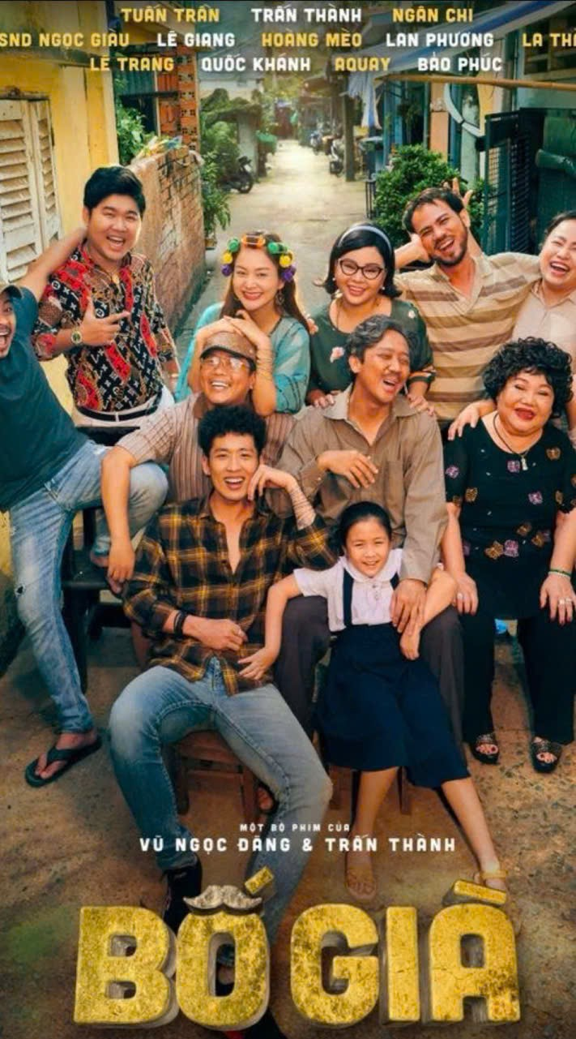
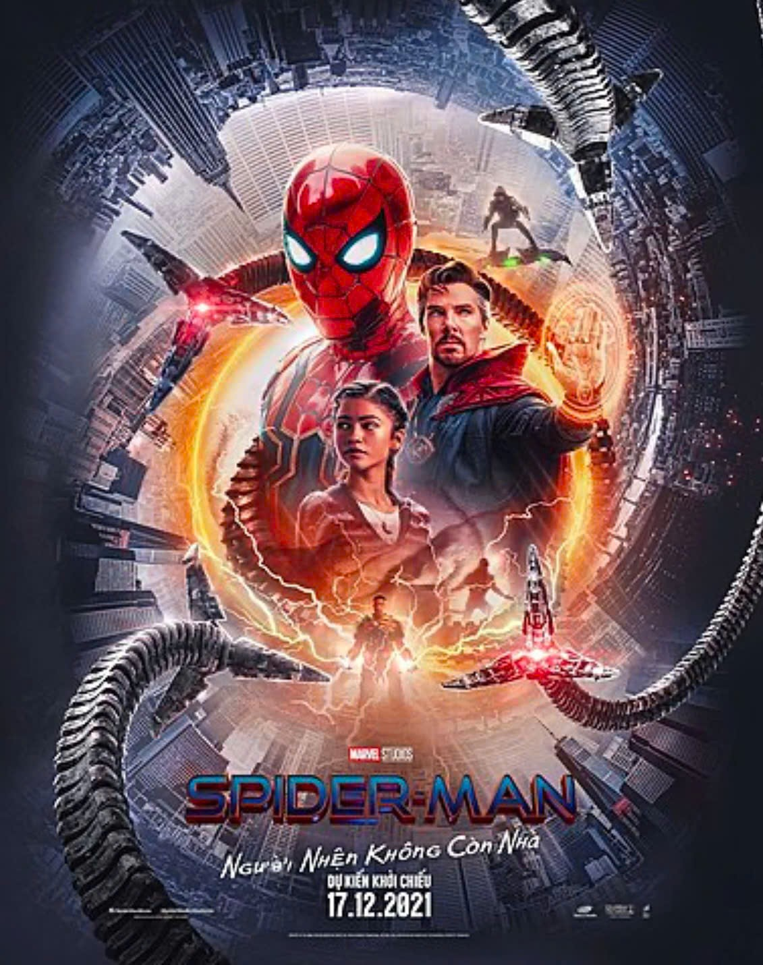
Vinh Centre Cinema

Slide 12
Film’s name | Spider man
Director | Jon Watt
Type of film | Action Film
Main actor / actress | Tom Holland
Main content | About a hero who is a powerful spider-man that must shoulder the mission of fighting to protect the humanity.
Reviews | gripping and interesting
Time | 4.30 p.m and 8.30 p.m daily
Place | Vinh Centre Cinema
Example:
A: How about seeing a film this evening?
B: That’s a great idea. What film shall we see?
4
A:
Spider man.
……………..
B: What time does it start?
B: Where is it?
A: See you tonight

Slide 13
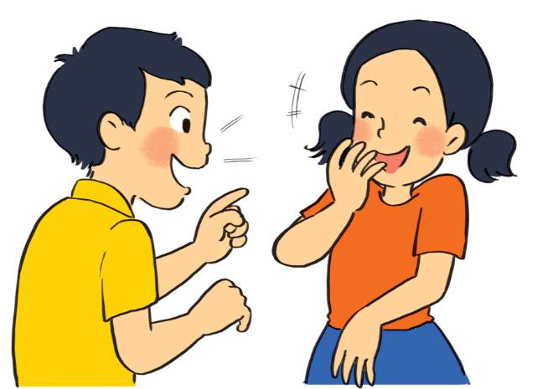
Talk about the favourite films
Film’s name | Spider man
Director | Jon Watt
Type of film | Action Film
Main actor / actress | Tom Holland
Main content | About a hero who is a powerful spider-man that must shoulder the mission of fighting to protect humanity.
Reviews | gripping and interesting
Time | 4.30 p.m and 8.30 p.m daily
Place | Vinh Centre Cinema
Spider Man is on at Vinh Centre Cinema at ………and ………..every day.
It’s a/ an _ _ _ _ _ _ _ _ _ _ _ _ _.
The main actor is _ _ _ _ _ _ _ _ _ _ _ _ _.
It’s about _ _ _ _ _ _ _ _ _ _ _ _ _.
People say _ _ _ _ _ _ _ _ _ _ _ _ _.

Slide 14
What have you learnt?

Slide 15
. HOMEWORK:
- Learn new words by heart.
- Practice the tasks 4, 5 more.
- Prepare Unit 8: SKILLS 2. P89

