Slide 1
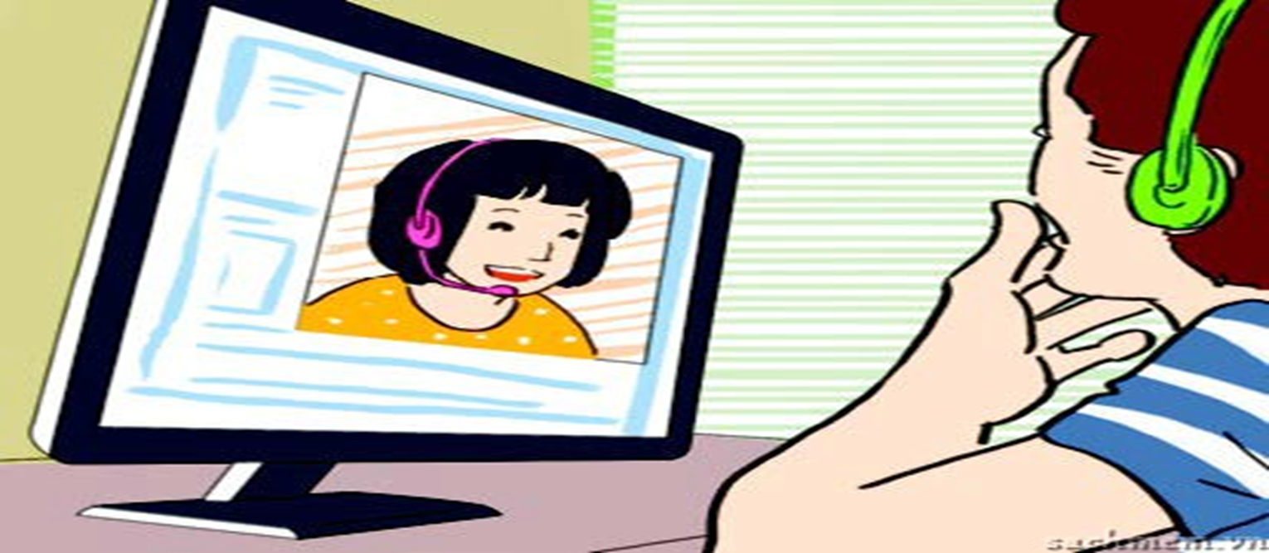
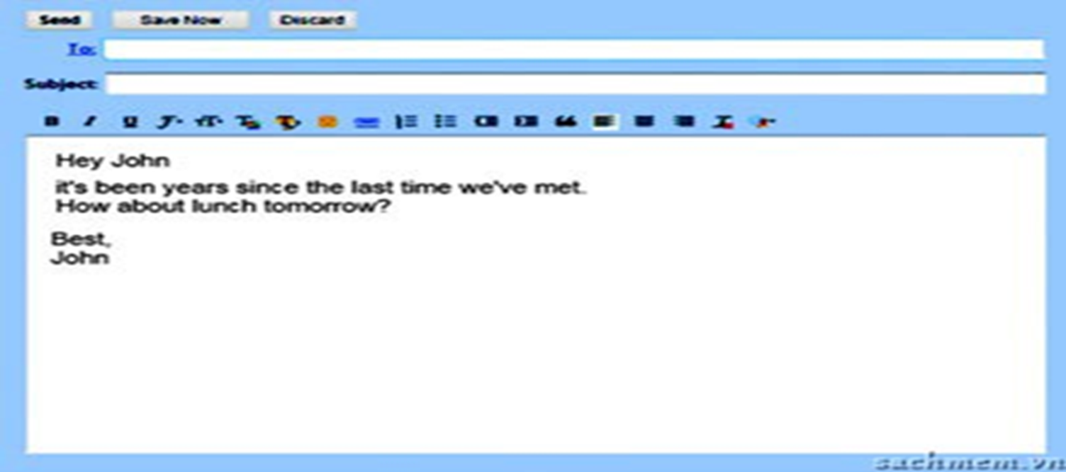
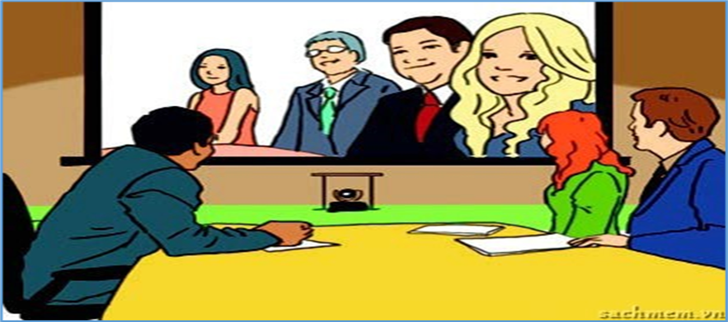
Kim’s Game
START

Slide 2
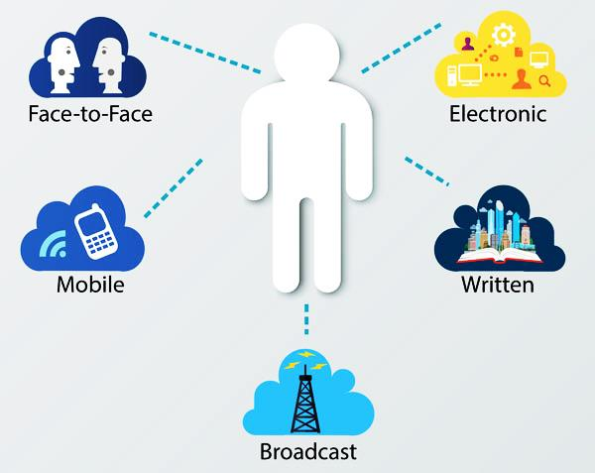
UNIT 10
COMMUNICATION
LESSON 3: A CLOSER LOOK 2

Slide 3
GRAMMAR
Future continuous: review
Verb + to-infinitive

Slide 4
Future continuous: review

Slide 5
Read the conversation between Mai and Vinh. Underline the future continuous tense and discuss .
Mai: Hi Vinh, I plan to come to the cinema at 7 pm tomorrow. Do you want to go with me?
Vinh: Great…, but I will be having my English class at this time tomorrow.
Mai: How about next Sunday?
Vinh: What time will we be going there?
Mai: At 4pm
Vinh: This time next Sunday, I will be having a video conference. I will try to get there at 6pm. Are you ok?
Mai: Yes. Do I need to take you there?
Vinh: Thank you very much, but I will be taking the bus.
1. Form:
Positive:
Negative:
Question:
2. Signals:
3. Usage:

Slide 6
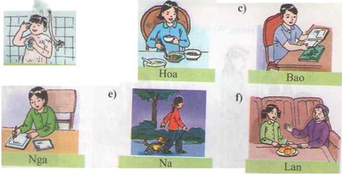
Look at the pictures. Say what each person will be doing at 8 p.m tomorrow

Slide 7
a) Ba will be taking a shower at 8 p.m tomorrow.
b) Hoa will be eating dinner at 8 p.m tomorrow.
c) Bao will be reading a comic at 8 p.m tomorrow
d) Nga will be writing a letter at 8 p.m tomorrow
e) Na will be walking with her dog at 8 p.m tomorrow
f) Lan will be talking to her grandmother at 8 p.m tomorrow

Slide 8
Work in pairs to ask and answer about what you will be doing at a specific time in the future
For example:
A: What will you be doing at 8pm tonight?
B: I will be having a video chatting with my friend from America.

Slide 9
Verb + To- infinitive

Slide 10
Read the conversation between Mai and Vinh again and write down all the verbs that are followed by to-infinitive that you can find
Mai: Hi Vinh, I plan to come to the cinema at 7 pm tomorrow. Do you want to go with me?
Vinh: Great…, but I will be having my English class at this time tomorrow.
Mai: How about next Sunday?
Vinh: What time will we be going there?
Mai: At 4pm
Vinh: This time next Sunday, I will be having a video conference. I will try to get there at 6pm. Are you ok? Mai:
Mai: Yes. Do I need to take you there?
Vinh: Thank you very much, but I will be taking the bus.
Add more some verbs followed by to- infinitive.

Slide 11
Choose the best answer.
1. We’ve just decided _______ some flowers to them.
A. send B. sending C. to send
2. Teenagers love __________ many online friends.
A. have B. to have C. has
3. They choose _______ video conferencing in every meeting.
A. to use B. will use C. using
4. He _______ her face to face this time next week.
a. will meet b. meet C. will be meeting
5. I think in the future many people will prefer ______ by using social media.
to communicate B. will communicate C. communicate
6. Tonight at 8.30 p.m. Phuc __________to his girl friend.
A. email B. will be emailing C. will email

Slide 12
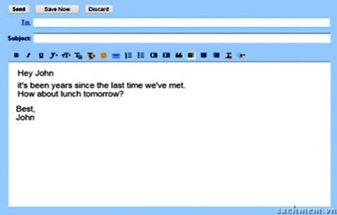
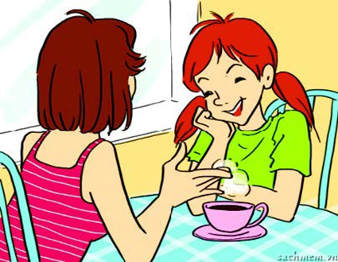
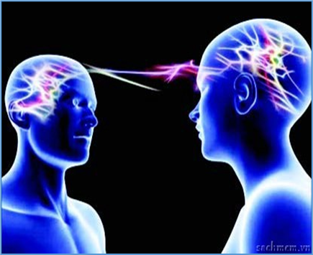
1. We’ve just decided _______ flowers to them A. send B. sending C. to send
1
2
2. Teenagers love __________ many online friends.
A. have B. to have C. has
3. He _______ her face to face this time next week.
A. will meet . B. meet C. will be meeting
3
4
4. They choose ___ video conferencing in every meeting.
A. to use B. will use C. using
5. Tonight at 8.30 p.m. Phuc __________to his girl friend.
A. email B. will be emailing C. will email
5
6
6. I think in the future many people will prefer
______ by using social media
A. to communicate B. will communicate C. communicate

Slide 13
The Dream List. Imagine we are in the year 2050. Work in groups and select three ways of communication that you think will be most common.
1. People throw rubbish in the street. The street doesn’t look attractive.
→ If people didn’t throw rubbish in the street, it would look attractive.
Example:- We will be using video conference in every meeting.
- We will choose to use a video chatting when phoning

Slide 14
HOMEWORK
- Review the grammar points: The Future continuous tense & Verb + to-infinitive.
- Prepare vocabulary for Communication
+

