Slide 2
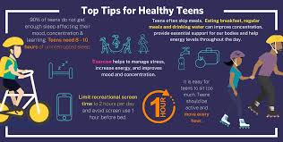
Lesson 1: Getting started

Slide 4
Listen and read.
School Counsellor: Good morning, class. Welcome to our “Tips for Good Physical and Mental Health”. In this session, feel free to ask any questions.
Nick: How can we maintain good physical health?
School Counsellor: You should get enough sleep, eat a healthy diet, and do physical exercise regularly.
Mai: My parents say students of our age need to sleep at least eight hours a day. Is that right?
School Counsellor: Yes, it is.
Phong: But we often find it difficult to get a good night’s sleep, especially before exams. Could you offer us any advice?
School Counsellor: I understand that exams bring about lots of stress. You can reduce this stress by studying long before the exam, not waiting until the night before it.
Phong: Thank you. Do you have any tips about looking after our mental health?
School Counsellor: If you want to have good mental health, you should have a well-balanced life. I mean you should balance your study and life.
Nick: But how can we balance them? School Counsellor: Well, you have to manage your time by planning your schedule and giving priority to your work. And you should keep a balance between study and play.

Slide 5
Match the words with their definitions.
a. a person whose job is to help and support people with problems
b. connected with a person’s body rather than their mind
c. something that you think is more important than other things and should be dealt with first
d. connected with the state of health of the mind
e. having the right amounts of all the different parts that make up something
1. physical
2. mental
3. well-balanced
4. priority
5. counsellor

Slide 6
Complete the sentences with the words in the box.
physical counsellor well-balanced priority mental
priority
1. You should make a list of all the jobs you have to do and give _________ to them.
2. Maintaining a ______________ life often means making time for the things you have to do, as well as the things you want to do in a suitable way.
3. The police asked them to describe his ___________ appearance.
4. You need to maintain your physical and ___________ health.
5. The ______________ is willing to listen to the students to help them solve their problems.
well-balanced
physical
mental
counsellor

Slide 7
Tips for good physical and mental health
Good physical health
Good mental health
School Counsellor: Good morning, class. Welcome to our “Tips for Good Physical and Mental Health”. In this session, feel free to ask any questions.
Nick: How can we maintain good physical health?
School Counsellor: You should get enough sleep,
eat a healthy diet, and do physical exercise regularly.
Mai: My parents say students of our age need to sleep at least eight hours a day. Is that right?
School Counsellor: Yes, it is.
Phong: But we often find it difficult to get a good night’s sleep, especially before exams. Could you offer us any advice?
School Counsellor: I understand that exams bring about lots of stress.
You can reduce this stress by studying long before the exam, not waiting until the night before it.
Phong: Thank you. Do you have any tips about looking after our mental health?
School Counsellor: If you want to have good mental health, you should have a well-balanced life. I mean you should balance your study and life.
Nick: But how can we balance them? School Counsellor: Well, you have to manage your time by planning your schedule and giving priority to your work. And you should keep a balance between study and play.

Slide 8
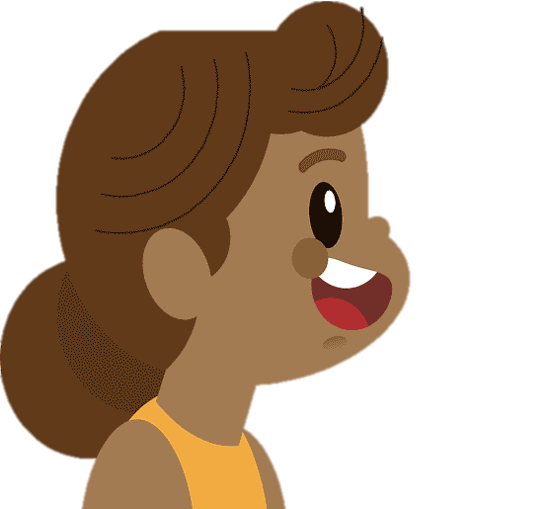
Work in pairs. Interview each other about how healthy you are.
Give each other advice.
Example:
A: How healthy are you? B: I’m tired.
A: You should take a break and do some physical exercise

