Slide 2
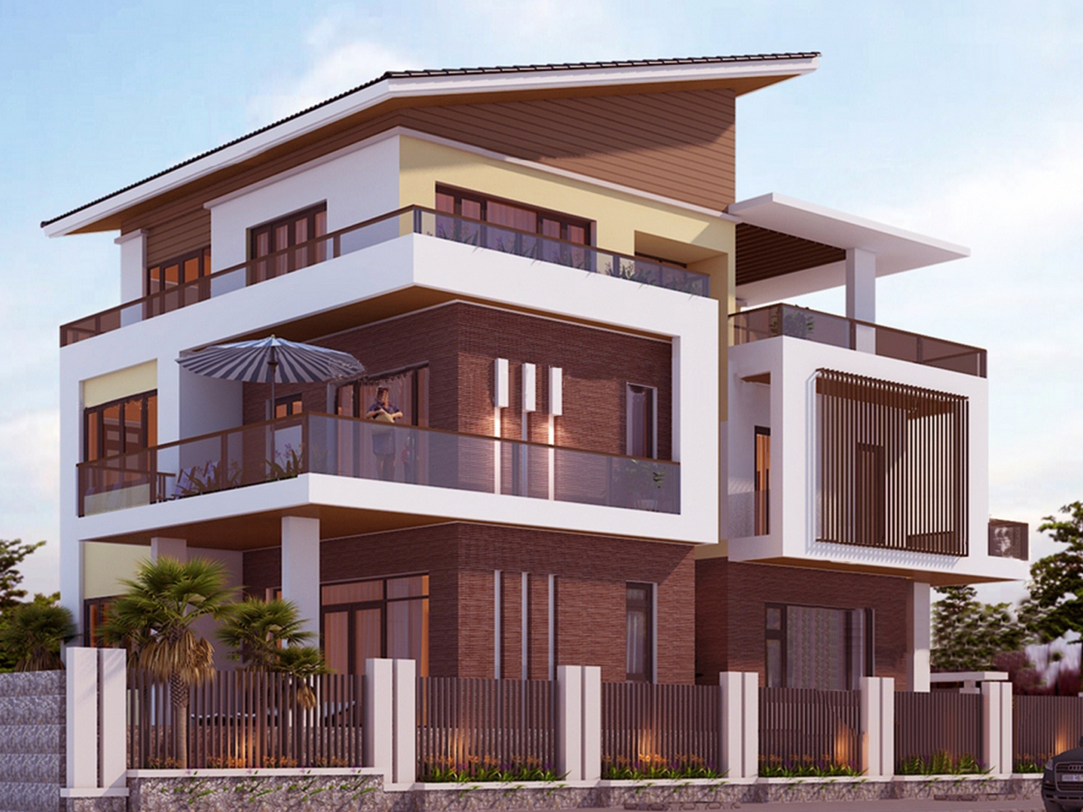

Slide 3
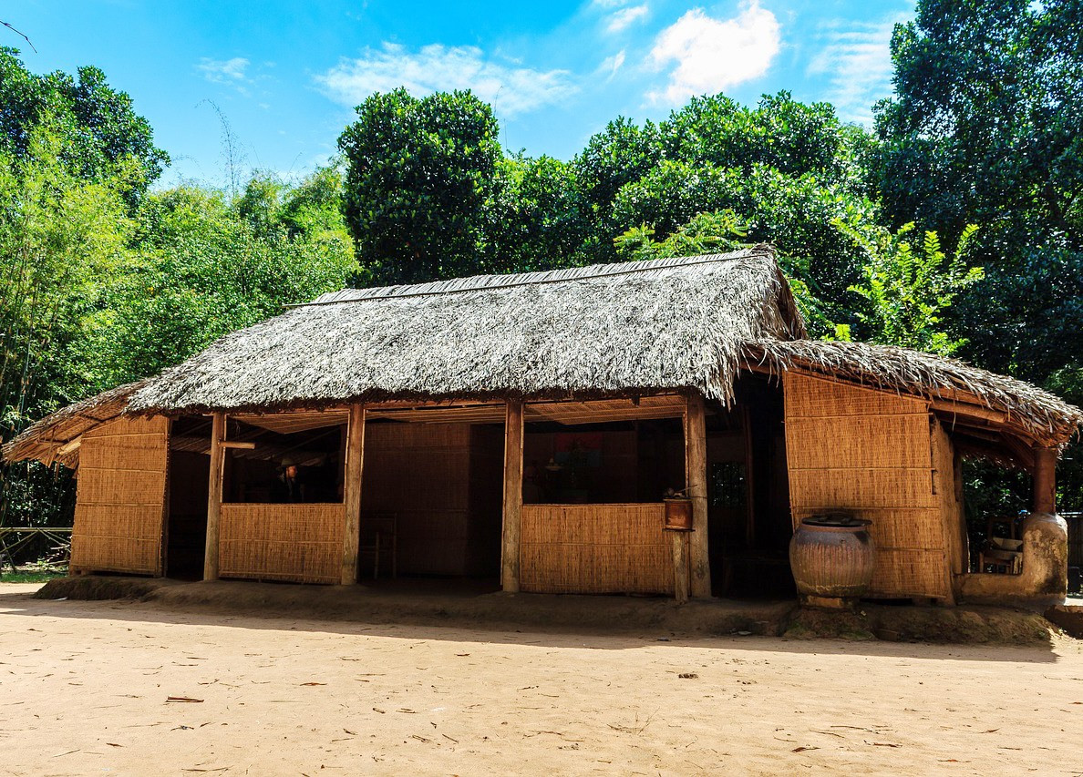

Slide 4
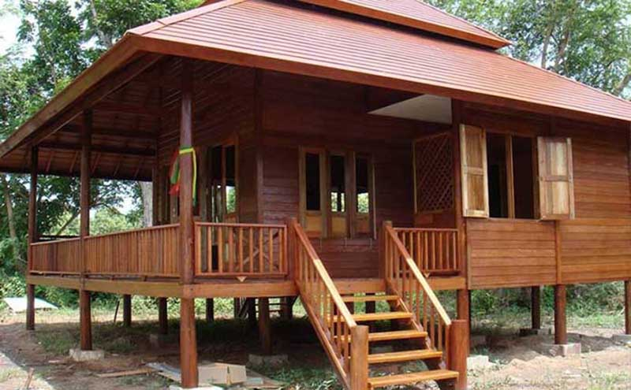

Slide 5
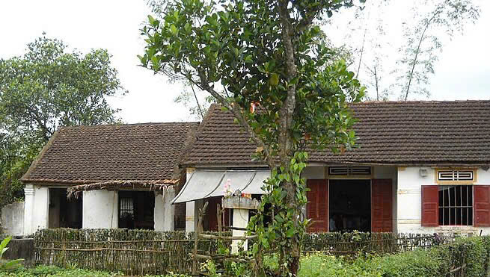

Slide 6
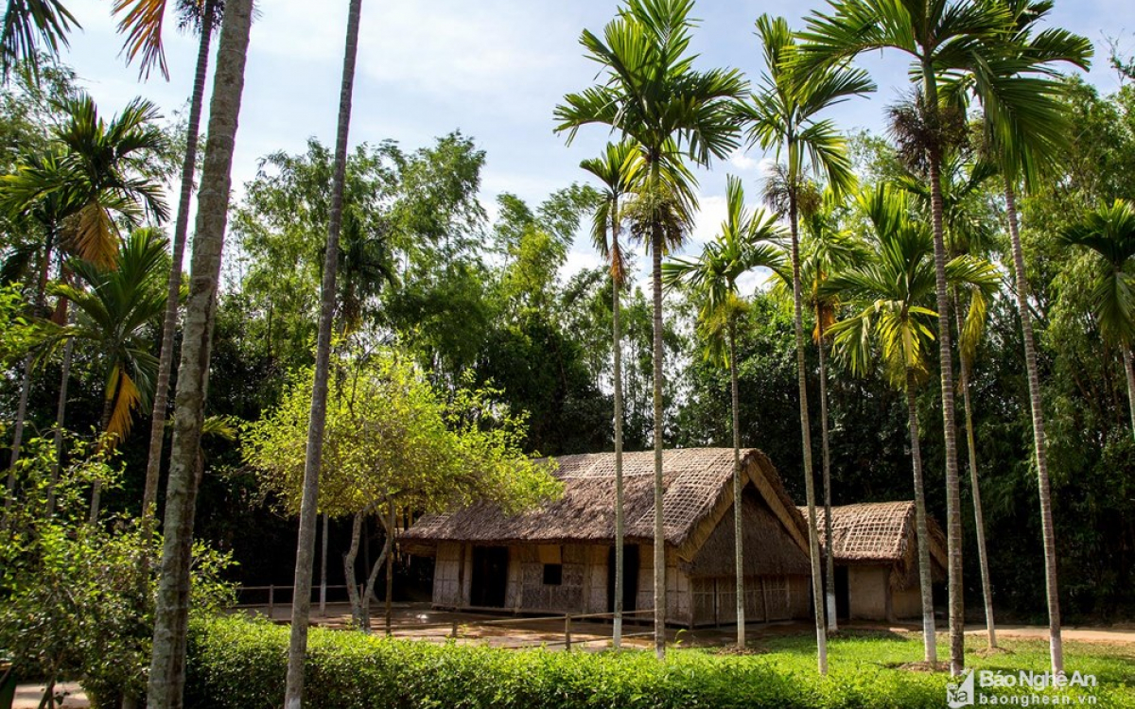

Slide 7
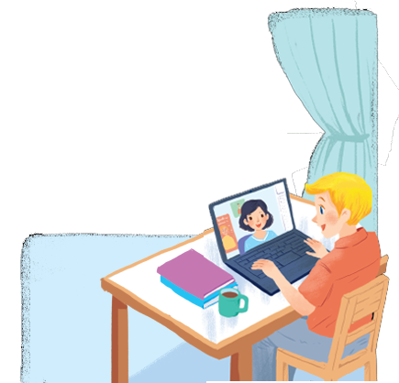
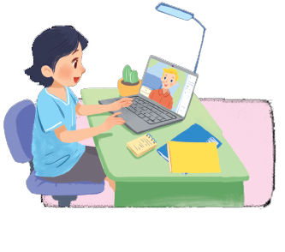
Unit
2
MY HOUSE
LESSON 1: GETTING STARTED
A look inside
1

Slide 8
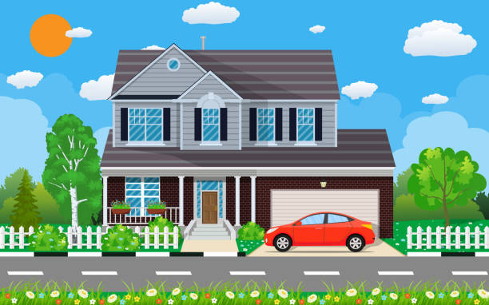
PRESENTATION
town house (n)
nhà phố

Slide 9
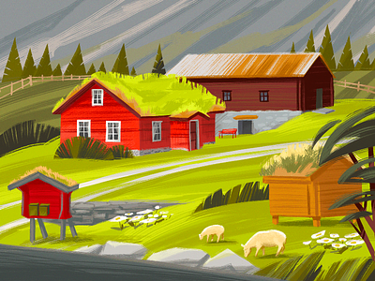
PRESENTATION
country house (n)
nhà ở vùng quê

Slide 10
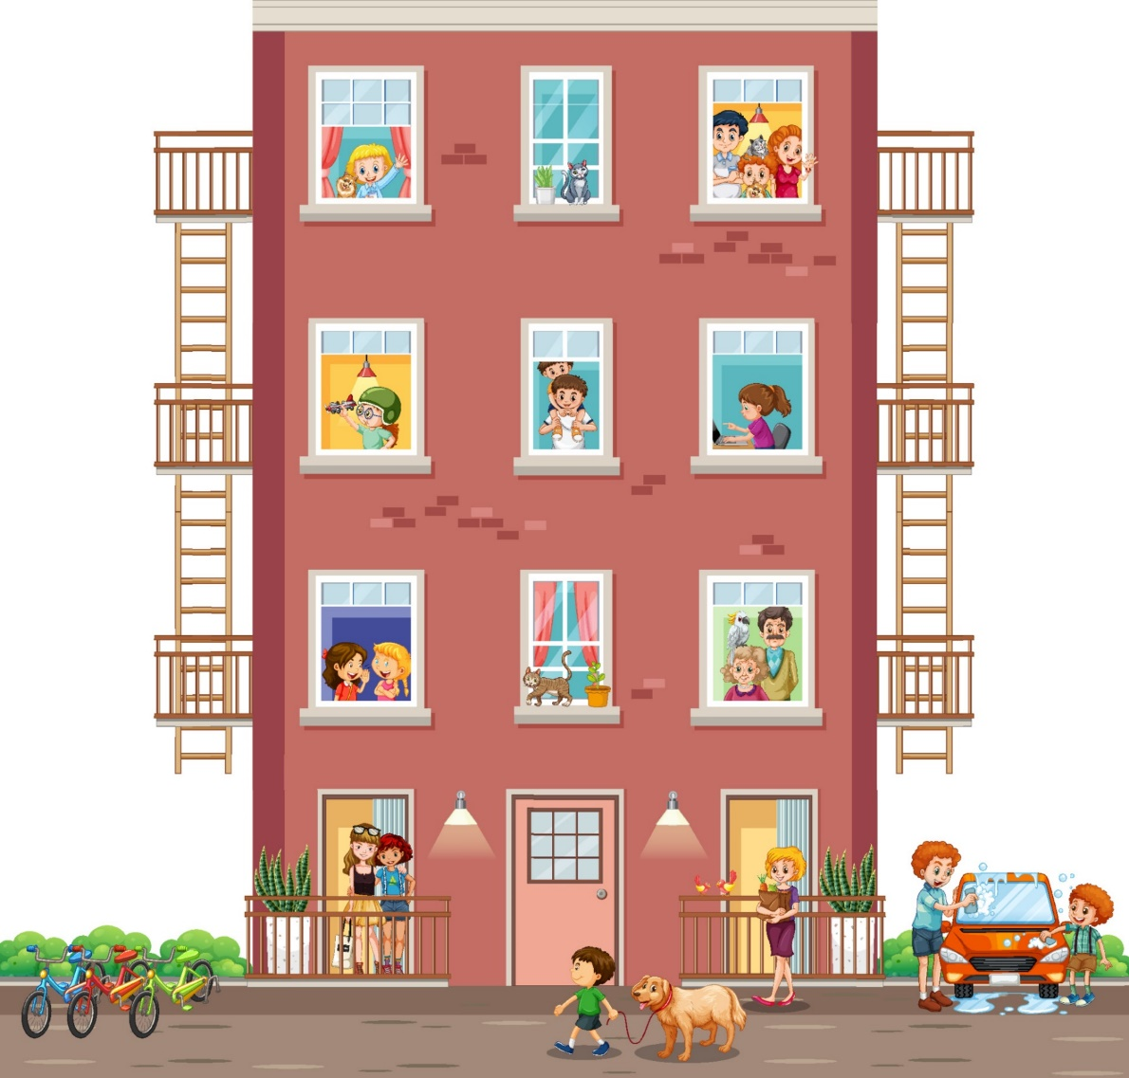
PRESENTATION
flat (n)
căn hộ

Slide 11
PRACTICE
LESSON 1: GETTING STARTED
Mi
Nick
1

Slide 12
PRACTICE
1
A look inside
Listen and read.
Mi: Wow! Your room looks so big, Nick.
Nick: It’s Elena’s room. She’s my sister.
Mi: I see. Is there a TV behind you?
Nick: Yes, there is. Where do you live, Mi?
Mi: I live in a town house. And you?
Nick: I live in a country house. Who do you live with?
Mi: My parents and younger brother. We’re moving to a ﬂat next month!
Nick: Are you?
Mi: Yes. My aunt lives near there, and I can play with my cousin.
Nick: Are there many rooms in your new ﬂat?
Mi: Yes, there are. There’s a living room, three bedrooms, a kitchen and two bathrooms.

Slide 13
PRACTICE
2
Which family members does Mi talk about? Put a tick ().
1. | parents
2. | sister
3. | brother
4. | aunt
5. | cousin

Slide 14
PRACTICE
1
A look inside
Listen and read.
Mi: Wow! Your room looks so big, Nick.
Nick: It’s Elena’s room. She’s my sister.
Mi: I see. Is there a TV behind you?
Nick: Yes, there is. Where do you live, Mi?
Mi: I live in a town house. And you?
Nick: I live in a country house. Who do you live with?
Mi: My parents and younger brother. We’re moving to a ﬂat next month!
Nick: Are you?
Mi: Yes. My aunt lives near there, and I can play with my cousin.
Nick: Are there many rooms in your new ﬂat?
Mi: Yes, there are. There’s a living room, three bedrooms, a kitchen and two bathrooms.

Slide 15
PRACTICE
3
Read the conversation again. Complete each sentence with ONE word.
1. Elena is Nick’s ______.
2. There is a ____ in Elena’s room.
3. Now Mi lives in a _____ house.
4. Nick lives in a ________ house.
5. Mi’s new flat has _____ bedrooms.

Slide 16
PRACTICE
3
Read the conversation again. Complete each sentence with ONE word
sister
1. Elena is Nick’s ______.
2. There is a ____ in Elena’s room.
3. Now Mi lives in a _____ house.
4. Nick lives in a ________ house.
5. Mi’s new flat has ____ bedrooms.
Mi: Wow! Your room looks so big, Nick.
Nick: It’s Elena’s room. She’s my sister.
Mi: I see. Is there a TV behind you?
Nick: Yes, there is. Where do you live, Mi?
Mi: I live in a town house. And you?
Nick: I live in a country house. Who do you live with?
Mi: My parents and younger brother. We’re moving to a ﬂat next month!
Nick: Are you?
Mi: Yes. My aunt lives near there, and I can play with my cousin.
Nick: Are there many rooms in your new ﬂat?
Mi: Yes, there are. There’s a living room, three bedrooms, a kitchen and two bathrooms.
TV
town
country
three

Slide 17
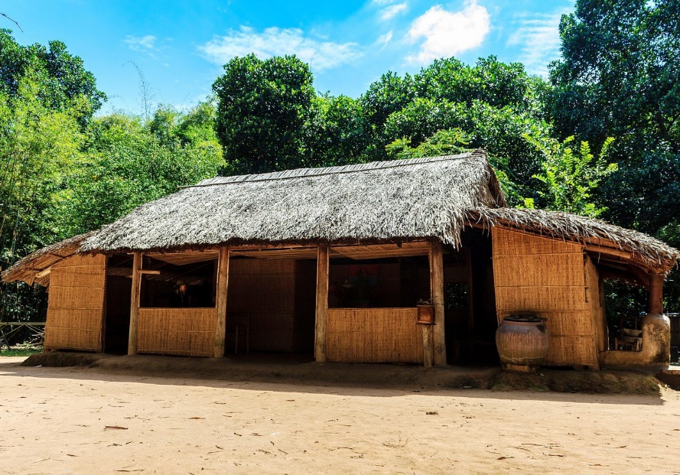

Slide 18
PRACTICE
4
Complete the word web: Types of house
Types of house

Slide 19
PRACTICE
4
Complete the word web: Types of house (Suggested answer)
villa
cottage
town house
country house
Types of house
stilt house
flat
farmhouse

Slide 20
PRODUCTION
5
Ask your friends where they live.
Where do you live?
I live in…………..

Slide 21
CONSOLIDATION
1
Wrap-up
What have we learnt in this lesson?
Vocabulary about house and types of house.
Read and understand content of the conversation.

Slide 22
CONSOLIDATION
2
Homework
- Do exercises in the workbook.
- Prepare for the Project of the unit.

