Slide 1
---------------
Unit
2
CITY LIFE
LESSON 1: GETTING STARTED
How is your city?

Slide 2
WARM-UP
OPTION 1
Answer the questions:
1/ Can you name some big cities in Viet Nam and in the world?
2/ Can you describe something you know about these cities?
(population, traffic, tourist attractions, ….)
THINK!

Slide 3
WARM-UP
OPTION 2
- Work in teams.
- You have 2 minutes think about City advantages and disadvantages.
DEBATE
Advantages team | Disadvantages team

Slide 4
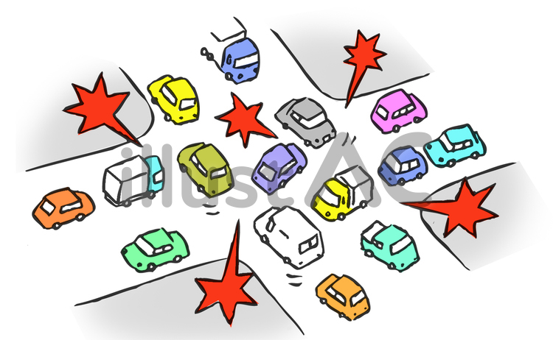
PRESENTATION
a large number of vehicles close together and unable to move or moving very slowly.
traffic jam (n)
/ˈtræf.ɪk ˌdʒæm/
kẹt xe

Slide 5
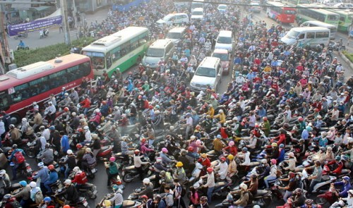
PRESENTATION
a situation in which a place is too blocked or crowded, causing difficulties.
congested (adj)
/kənˈdʒes.tɪd/
tắc nghẽn (giao thông

Slide 6
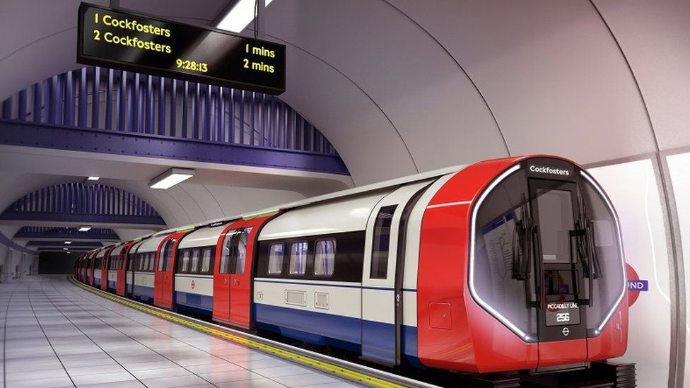
PRESENTATION
an area or piece of land where construction work is taking place
construction site (n)
/kənˈstrʌkʃn saɪt/
công trường xây dựng

Slide 7
PRESENTATION
A railway system in which electric trains travel through tunnels below ground.
underground (n)
/ˌʌndəˈɡraʊnd/
hệ thống tàu điện ngầm

Slide 8
PRESENTATION
having or causing an itch
itchy (adj)
/ˈɪtʃi/
ngứa, gây ngứa

Slide 9
PRACTICE
Look at pictures on p.28
1. What do you see in each picture?
traffic jam /
traffic congestion, …..
2. Are the things in the pictures common in your home town?

Slide 10
PRACTICE
1
Listen and read.
Trang: Hi, Ben. Sorry I couldn’t get online earlier. I got stuck in a traffic jam and came home late.
Ben: No problem, Trang. Did you go by bus?
Trang: No. My dad picked me up. I rarely use the bus. It’s slow and packed with people.
Ben: I mostly get around by underground. It’s more reliable than the bus.
Trang: That’s great.
Ben: But traffic congestion is terrible in London. You know, the more crowded the city gets, the more congested the streets are.

Slide 11
PRACTICE
1
Listen and read.
Trang: Yeah … and the more polluted they may become. There’s a construction site in my neighbourhood. It’s dusty, so people easily get itchy eyes.
Ben: It must be noisy, too. The noise probably makes people feel stressed sometimes.
Trang: That’s right. But new buildings make the city look modern and attractive. Do you remember the grand building downtown?
Ben: Of course. How’s it now? When I left Viet Nam, they nearly finished it.

Slide 12
PRACTICE
1
Listen and read.
Trang: Well, it’s now a shopping mall. Teens like it because it’s modern and fun.
Ben: Do you often go there?
Trang: Sometimes. I watch movies there with my sister. I want to go there more often, but it’s a bit pricey.
Ben: It’s expensive here in London, too …
Say the words in the text that you think are related to the topic City life.

Slide 13
PRACTICE
1
Listen and read.
Underline the words in the text that you think are related to the topic City life.

Slide 14
PRACTICE
2
Read the conversation again and tick T (true) or F (False).
 | T | F
1. The bus in Trang’s city is slow and crowded.
2. The underground system in Ben’s city is unreliable.
3. There is a dusty and noisy construction site near Trang’s house.
√
√
“get around by underground. It’s more reliable than the bus.”
√

Slide 15
PRACTICE
2
Read the conversation again and tick T (true) or F (False).
 | T | F
1. The bus in Trang’s city is slow and crowded.
2. The underground system in Ben’s city is unreliable.
3. There is a dusty and noisy construction site near Trang’s house.
√
√
“get around by underground. It’s more reliable than the bus.”
√

Slide 16
PRACTICE
2
Read the conversation again and tick T (true) or F (False).
 | T | F
1. The bus in Trang’s city is slow and crowded.
2. The underground system in Ben’s city is unreliable.
3. There is a dusty and noisy construction site near Trang’s house.
√
√
“get around by underground. It’s more reliable than the bus.”
√

Slide 17
PRACTICE
2
Read the conversation again and tick T (true) or F (False).
 | T | F
1. The bus in Trang’s city is slow and crowded.
2. The underground system in Ben’s city is unreliable.
3. There is a dusty and noisy construction site near Trang’s house.
√
√
“get around by underground. It’s more reliable than the bus.”
√

Slide 18
PRACTICE
2
Read the conversation again and tick T (true) or F (False).
 | T | F
1. The bus in Trang’s city is slow and crowded.
2. The underground system in Ben’s city is unreliable.
3. There is a dusty and noisy construction site near Trang’s house.
√
√
“get around by underground. It’s more reliable than the bus.”
√

Slide 19
PRACTICE
4
Choose the correct answer A, B, C, or D
1. I like getting around by ______. I hate the smell of car exhaust.
A. underground | B. private car
C. taxi | D. bus
2. Road dust may badly affect our ______.
A. stomach | B. back
C. eyes | D. leg

Slide 20
PRACTICE
4
Choose the correct answer A, B, C, or D
3. Many teens fancy spending their weekends in an entertainment ______.
A. industry | B. value
C. business | D. centre

Slide 21
PRODUCTION
5
Quiz: A lifestyle survey: City life or Village life?
Complete the quiz. Then compare your choices with your friends’ and the teacher’s explanation. Which suits you more, life in the city or in a village?
You have 4 minutes to do this activity individually.

Slide 22
Compare your choices with your partner.
PRODUCTION
1. What kind of house do you want to live in? | 2. How do you like to get around?
A. A small and modern apartment. B. A house with a garden | A. By public transport. B. By motorbike or bicycle.
3. Where do you frequently enjoy visiting? | 4. How do you describe your favourite neighbourhood?
A. Shops, restaurants, cinemas, and art galleries. B. Local farmers’ markets. | A. Crowded and busy. B. Quiet and green.
5. How do you like to spend time outdoors?
A. Going for a walk or running in the park. B. Doing gardening or visiting next-door neighbours.

Slide 23
PRODUCTION
Compare your choices with your partner.
If you choose lots of A.
You will fit in the city.
If you choose lots of B.
The village is your better choice.

Slide 24
PRODUCTION
Show me more ideas about:
City Life | Village Life

Slide 25
PRODUCTION
EXTRA ACTIVITY
Work in groups and talk about the differences between living in the city and living in the countryside.

Slide 26
PRODUCTION
EXTRA ACTIVITY
 | LIVING IN THE CITY | LIVING IN THE COUNTRYSIDE
Accommodation
Means of transport
Facilities
Neighbourhood
Outdoor activities

Slide 27
CONSOLIDATION
1
Wrap-up
What have we learnt in this lesson?
Gain an overview about the topic City life
Gain vocabulary to talk about life in the city

Slide 28
CONSOLIDATION
2
Homework
- Prepare for the Project of the unit
- Open book p.27
- Work in groups to brainstorm about the features of a city you want to live in the future and draw a picture of it.
- You will show and present in Lesson 7 – Looking back and Project.

