Slide 2
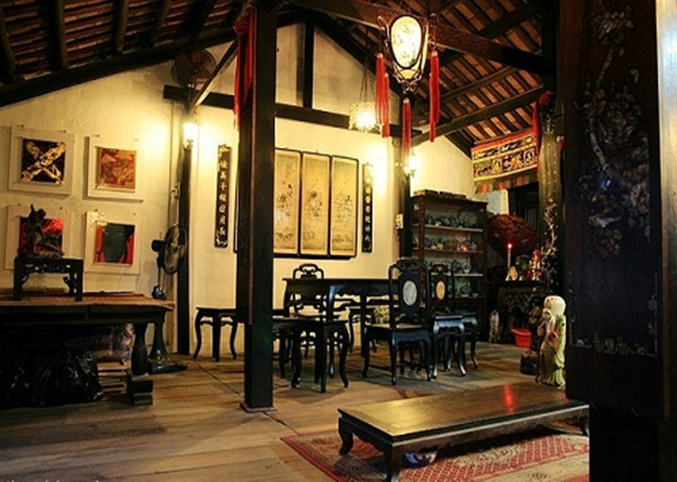
Notes:
Thiếu tên bài đọc.

Slide 4
Thursday, November 7th,2024
Unit 4
MY NEIGHBOURHOOD
Period 27: GETTING STARTED
Lost in the old town!

Slide 5
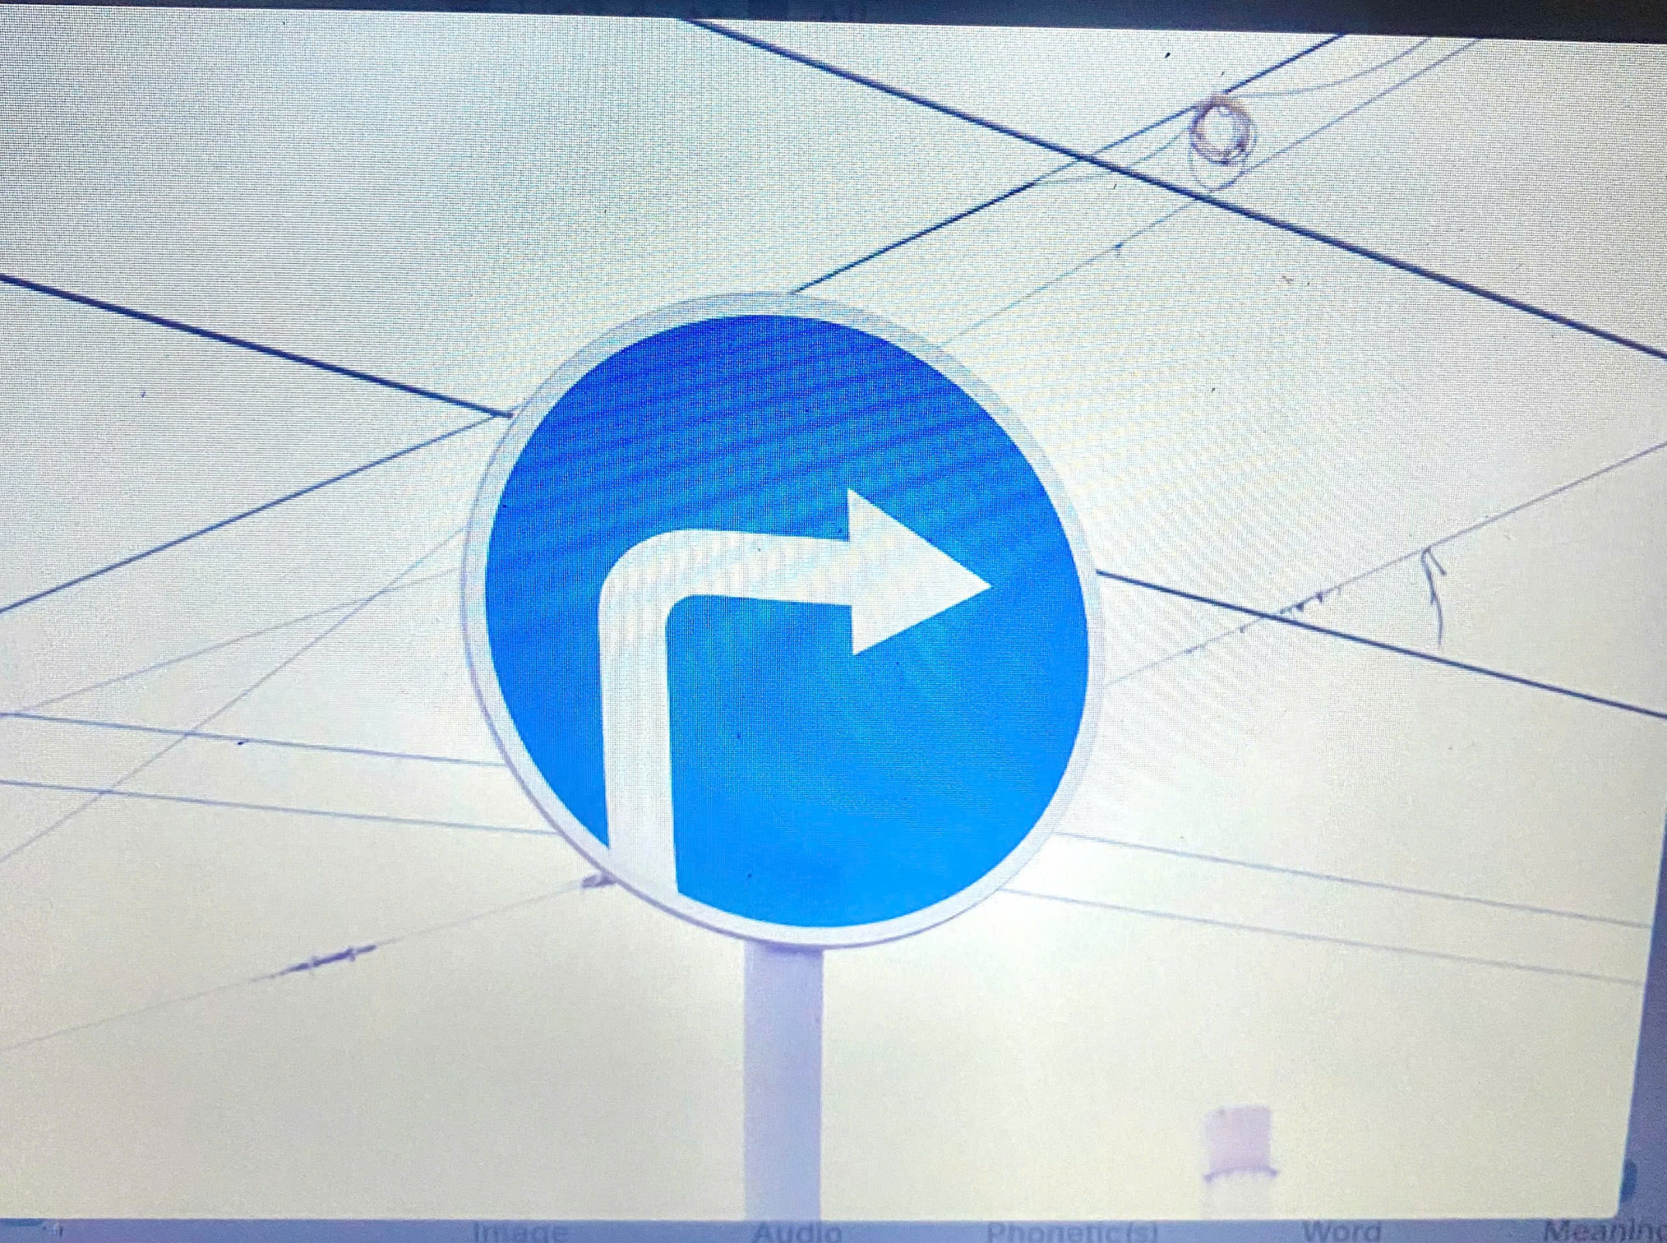

Slide 6
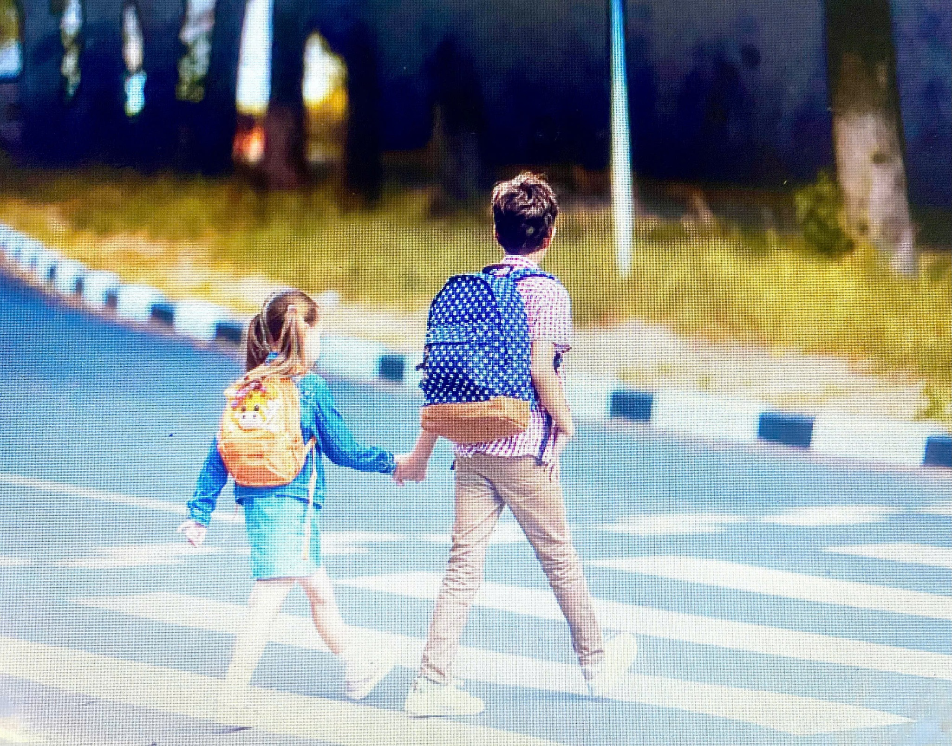

Slide 8
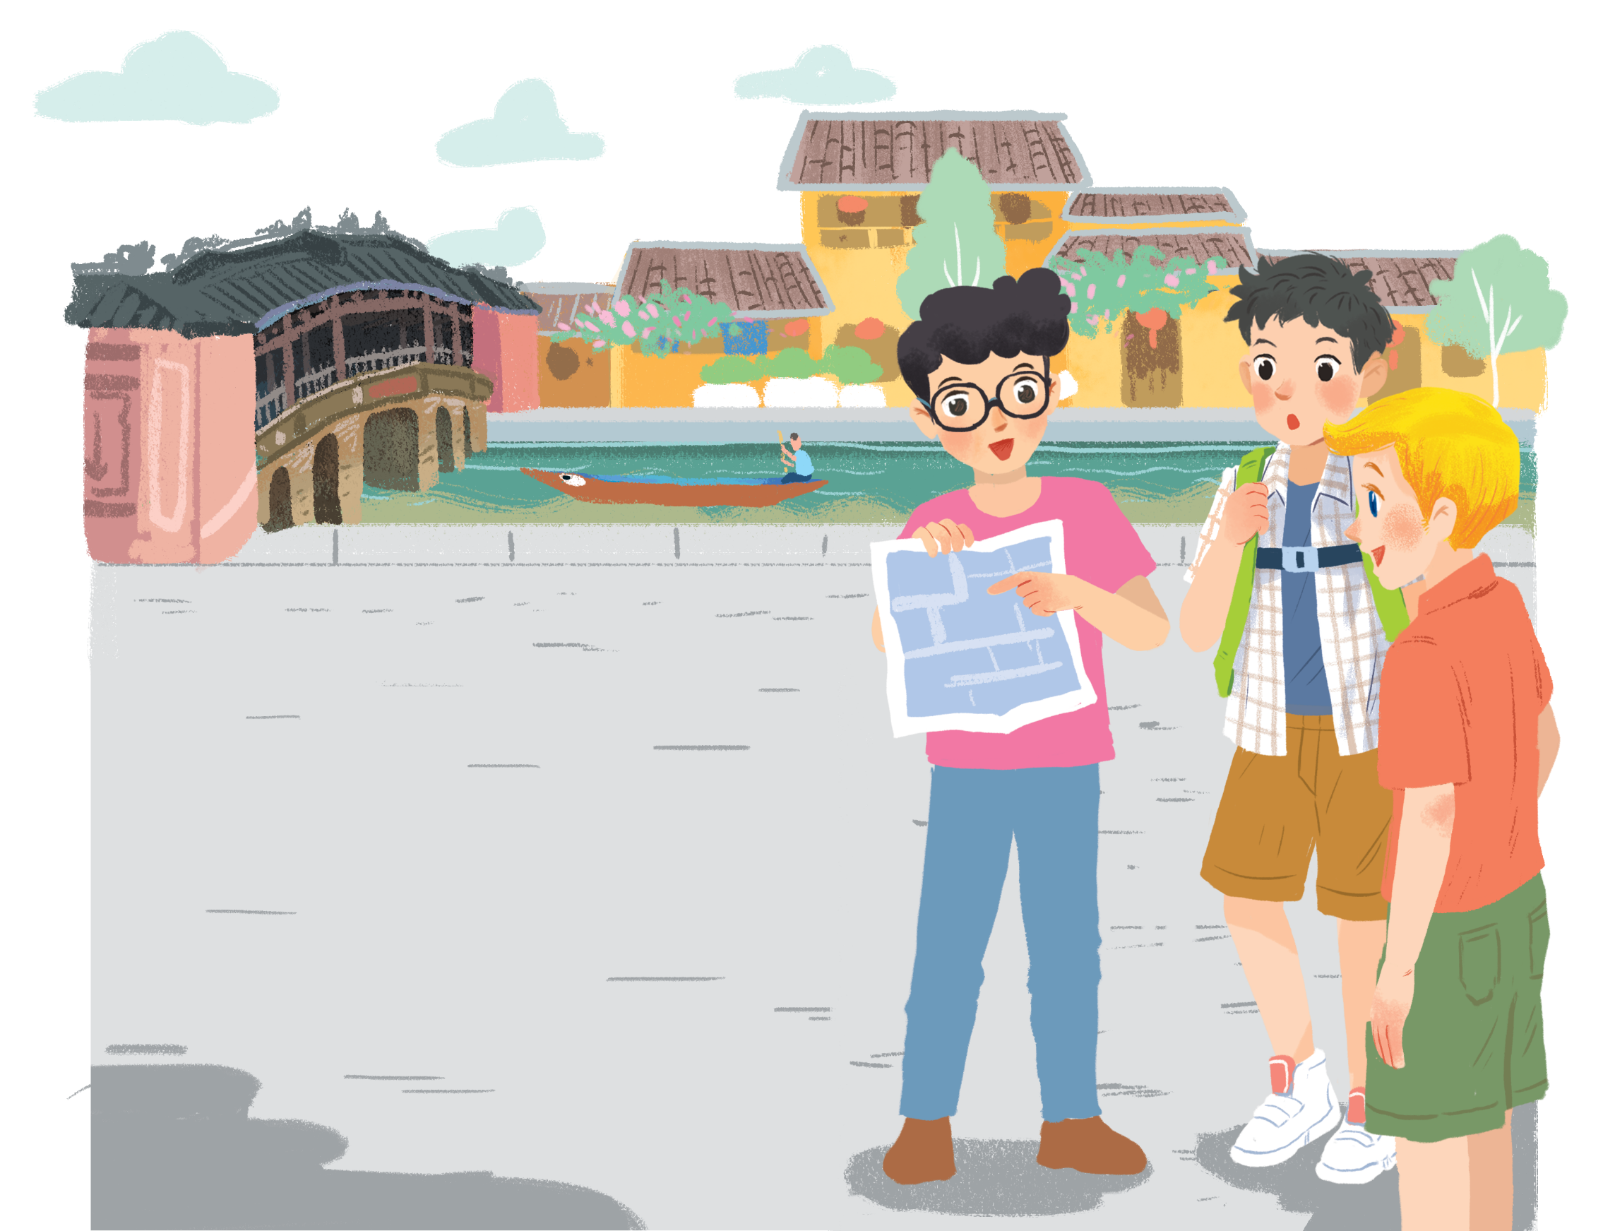

Slide 9
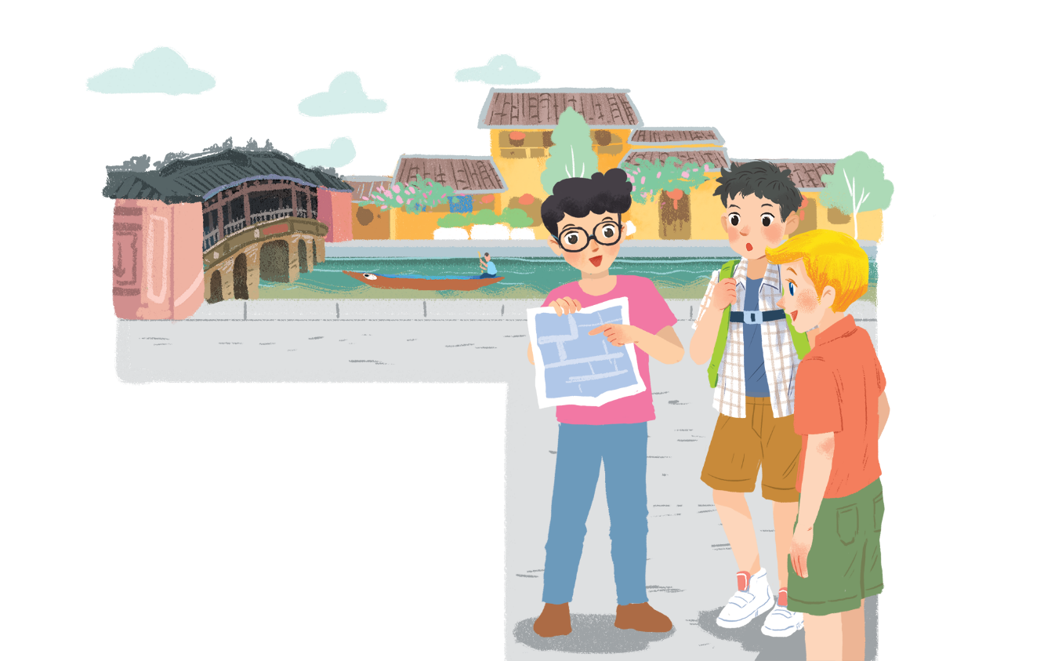
Lost in the old town!
Phong: Wow! We’re in Hoi An. I’m so excited.
Nick: Me too. It’s so beautiful. Where shall we go first?
Khang: Let’s go to Chua Cau.
Phong: Well, but Tan Ky house is nearer. Shall we go there first?
Nick & Khang: OK, sure.
Phong: First, cross the road, and then turn left.
Nick: Fine, let’s go.
Phong: Wait.
Khang: What’s up, Phong?
Phong: I think we’re lost.
Nick: Look, there’s a girl. Let’s ask her.
Phong: Excuse me? Can you tell us the way to Tan Ky House?
Girl: Sure. Go straight. Take the second turning on the left, and then turn right.
Phong, Nick & Khang: Thank you.

Slide 10
Lost in the old town!
Phong: Wow! We’re in Hoi An. I’m so excited.
Nick: Me too. It’s so beautiful. Where shall we go first?
Khang: Let’s go to Chua Cau.
Phong: Well, but Tan Ky house is nearer. Shall we go there first?
Nick & Khang: OK, sure.
Phong: First, cross the road, and then turn left.
Nick: Fine, let’s go.
Phong: Wait.
Khang: What’s up, Phong?
Phong: I think we’re lost.
Nick: Look, there’s a girl. Let’s ask her.
Phong: Excuse me? Can you tell us the way to Tan Ky House?
Girl: Sure. Go straight. Take the second turning on the left, and
then turn right.
Phong, Nick & Khang: Thank you.
b. Nick, Khang and Phong arrive in Hoi An
c. Nick, Khang and Phong decide to go to Tan Ky House
d. Nick, Khang and Phong get lost.
e. Phong asks a girl how to get to Tan Ky House.
a. The girl shows them the way to Tan Ky House.

Slide 11
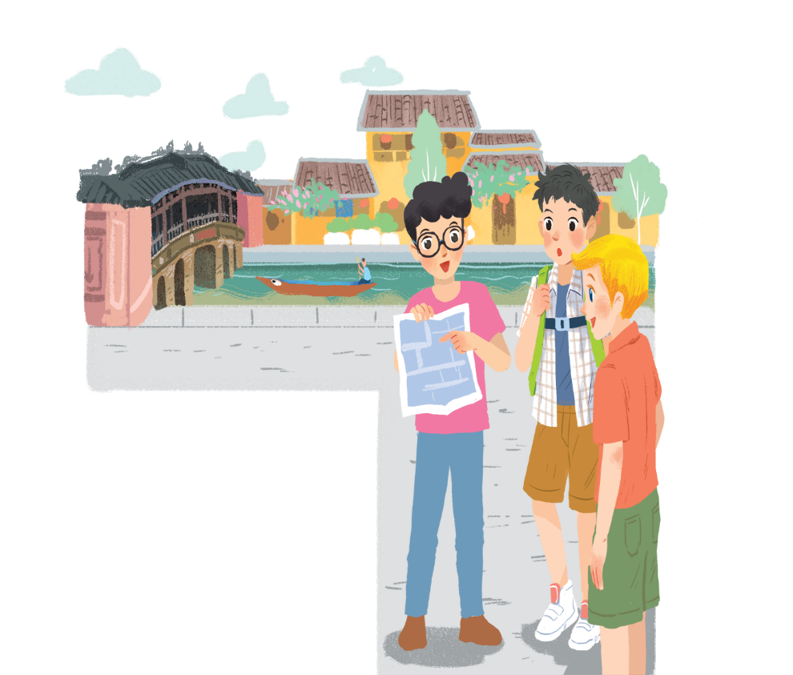
Find sentences used to make suggestions
Phong: Wow! We’re in Hoi An. I’m so excited.
Nick: Me too. It’s so beautiful. Where shall we go first?
Khang: Let’s go to Chua Cau.
Phong: Well, but Tan Ky house is nearer.
Shall we go there first?
Nick & Khang: OK, sure.
Phong: First, cross the road, and then turn left.
Nick: Fine, let’s go.
Phong: Wait.
Khang: What’s up, Phong?
Phong: I think we’re lost.
Nick: Look, there’s a girl. Let’s ask her.
Phong: Excuse me? Can you tell us the way to Tan Ky House?
Girl: Sure. Go straight. Take the second turning on the left, and then turn right.
Phong, Nick & Khang: Thank you.

Slide 13
Now match these directions with the diagrams below.
1
turn right
2
3
take the second turning on the left
cross the road
turn left
5
4
go straight
A.
turn right
C.
turn left
E.
take the second turning on the left
B.
cross the road
D.
go straight

Slide 14
Lost in the old town!
Phong: Wow! We’re in Hoi An. I’m so excited.
Nick: Me too. It’s so beautiful. Where shall we go first?
Khang: Let’s go to Chua Cau.
Phong: Well, but Tan Ky house is nearer. Shall we go there first?
Nick & Khang: OK, sure.
Phong: First, cross the road, and then turn left.
Nick: Fine, let’s go.
Phong: Wait.
Khang: What’s up, Phong?
Phong: I think we’re lost.
Nick: Look, there’s a girl. Let’s ask her.
Phong: Excuse me? Can you tell us the way to Tan Ky House?
Girl: Sure. Go straight. Take the second turning on the left, and then turn right.
Phong, Nick & Khang: Thank you.

Slide 15
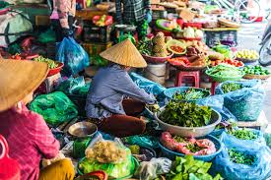
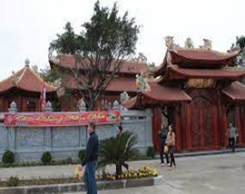
Find places
Xuan Pho Market
Post office
Example:
Tran Temple
A: Go straight. Take the second turning on the left. It’s on your right.
B: Is that Tran Temple?
A: No, try again.
Xuan Pho Primary School
Nghi Xuan Bank
Supermarket
Petrol station
Tiktok café
Pho Hai secondary school
You are here

Slide 16
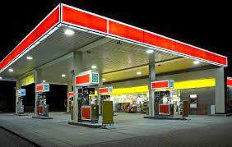
Xuan Pho Market
Post office
Tran Temple
Xuan Pho Primary School
Nghi Xuan Bank
Supermarket
Petrol station
Tiktok café
Pho Hai secondary school
You are here

Slide 17
Homework
Learn vocabulary by heart .
Practice asking and giving directions with friends .
Prepare next lesson: Unit 4 –
Lesson 2: A closer look 1.
-

Slide 18
Thanks for your attention !

