Slide 1
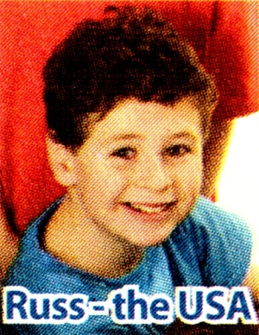
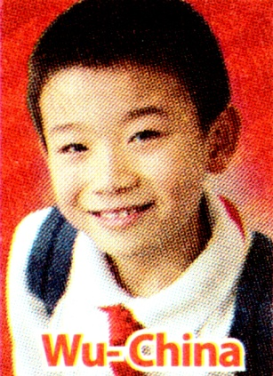
Russ
Wu
Mai

Slide 2
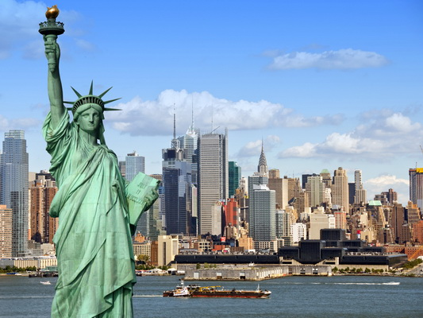
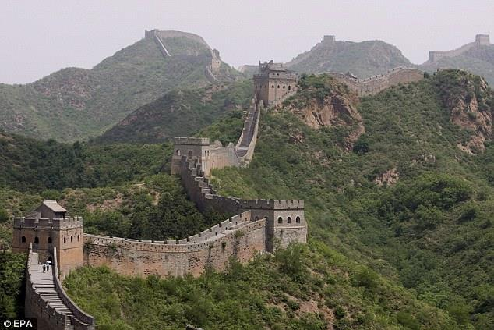

Slide 3
Reading

Slide 4
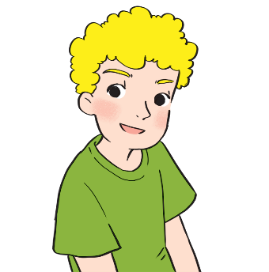
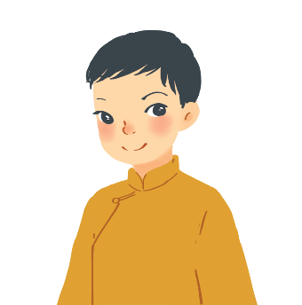
Read the passages and decide who says sentences 1 – 5.
A
I often go to Times Square with my parents to welcome the New Year. When the clock strikes midnight, colourful fireworks light up the sky. Everybody cheers and sings.
Russ – the USA
B
On New Year’s Day, we dress beautifully and go to our grandparents’ houses. We wish them Happy New Year and they give us lucky money. Then we go out and have a day full of fun.
Wu - China
c
I learn some customs about Tet from my parents. People give rice to wish for enough food and buy salt to wish for good luck. Dogs are lucky animals but cats are not. A cat’s cry sounds like "poor" in Vietnamese.
Mai – Viet Nam

Slide 5
A. Russ
B. Wu
C. Mai
Statements | Who
1. Dogs are lucky animals. | C
2. We welcome the New Year at Times Square.
3. Children get lucky money.
4. We give rice to wish for enough food.
5. Children dress beautifully.
A
B
C
B

Slide 6
Test your memory!
Tick () the things which appear in the passages, and cross (×) the ones which don’t.
a. Lucky money
e. A day full of fun


b. A cat’s cry
f. Decorating the
house


c. fireworks
g. Saying wishes


d. Cheering and
singing
h. Visiting relatives



Slide 7
Speaking

Slide 8
Work in pairs. These are some activities from the reading passages in 1. Tell your group if you do them during Tet.
Example:
go to Times Square to welcome the New Year
I go to Time Square to welcome the New Year.
I don’t go to Time Square to welcome the New Year.

Slide 9
1.
watch fireworks on New Year’s Eve
2.
Sing when the New Year comes
3.
get lucky money
4.
go out and have fun
5.
dress beautifully
6.
buy salt for happiness

Slide 10
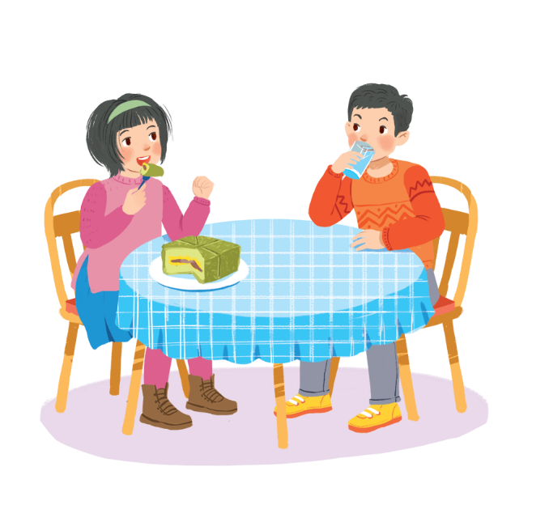
Work in groups. Read the list and discuss what you should or shouldn’t do at Tet.
break things
make a wish
dress beautifully
say “have fun!” to friends
help decorate our houses
play games all night
invite friends home
ask for lucky money
play loud music
Hey, you shouldn’t eat all that banh chung!

Slide 11
6
OUR TET HOLIDAY
Unit Period 45 - lesson 5: SKILLS 1
Speaking
WHO’S FASTER?

Slide 12
Who’s faster?
2
1
RED
BLUE
3
5
1
7
4
3
8
2
3
5
6
8
4
6
7
1
2
4
5
6
8
7
9

Slide 13
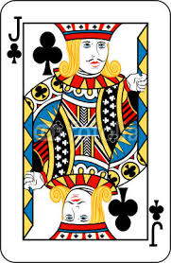
Who’s faster?
10
09
08
07
06
05
04
03
02
01
00
We ................ play games all night.
shouldn’t

Slide 14
Who’s faster?
10
09
08
07
06
05
04
03
02
01
00
We make a wish.
should
..............

Slide 15
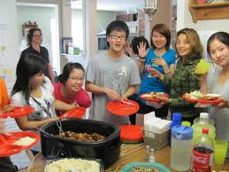
Who’s faster?
10
09
08
07
06
05
04
03
02
01
00
We .......... invite friends home to welcome the New Year.
should

Slide 16
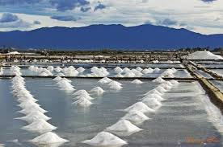
Who’s faster?
10
09
08
07
06
05
04
03
02
01
00
we dress beautifully.
should
...........

Slide 17
Who’s faster?
10
09
08
07
06
05
04
03
02
01
00
We ….......… break things.
shouldn’t

Slide 18
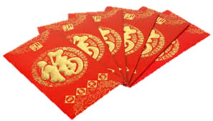
Who’s faster?
10
09
08
07
06
05
04
03
02
01
00
We ask for lucky money
….........…
shouldn’t

Slide 19
Who’s faster?
10
09
08
07
06
05
04
03
02
01
00
We ….......… play music loud
shouldn’t

Slide 20
Who’s faster?
10
09
08
07
06
05
04
03
02
01
00
We say “Have fun!” to friends.
should
….......…

Slide 21
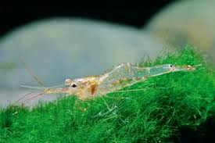
Who’s faster?
10
09
08
07
06
05
04
03
02
01
00
We help decorate our houses.
should
….......…

Slide 22
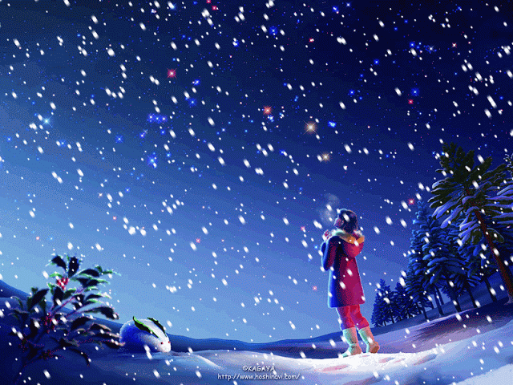
Thank for attending ours!
Good bye for now!

