Slide 1
LAM HONG SECONDARY SCHOOL
ENGLISH 7
Welcome the Teachers to our class
Notes:
1

Slide 2
Unit 7
TRAFFIC
Lesson 2: A closer look 1

Slide 4
WARM-UP: JUMBLED WORDS
MEANS OF TRANSPORT
1- OTBA
2- ITANR
3- NPEILARA
4- RSOTRPCA
5- OTMIROEKB
-> BOAT
-> TRAIN
-> AIRPLANE
-> SPORT CAR
-> MOTORBIKE

Slide 5
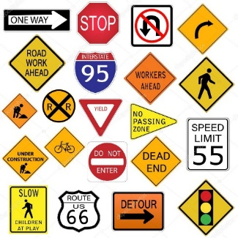
PRESENTATION
road sign (n):
/ˈrəʊd saɪn/
BIỂN BÁO
GIAO THÔNG

Slide 6
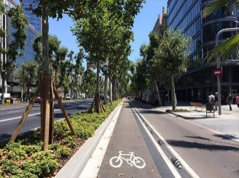
PRESENTATION
cycle lane (n)
/ˈsaɪkl leɪn/
LÀN ĐƯỜNG
DÀNH RIÊNG CHO XE ĐẠP

Slide 7
PRESENTATION
traffic lights
/ˈtræfɪk laɪt/
ĐÈN GIAO THÔNG

Slide 8
PRESENTATION
New words | Pronunciation | Meaning
1. road sign (n) | /ˈrəʊd saɪn/ | biển báo giao thông
2. cycle lane (n) | /ˈsaɪkl leɪn/ | làn đường dành riêng cho xe đạp
3. traffic light (n) | /ˈtræfɪk laɪt/ | đèn giao thông

Slide 9
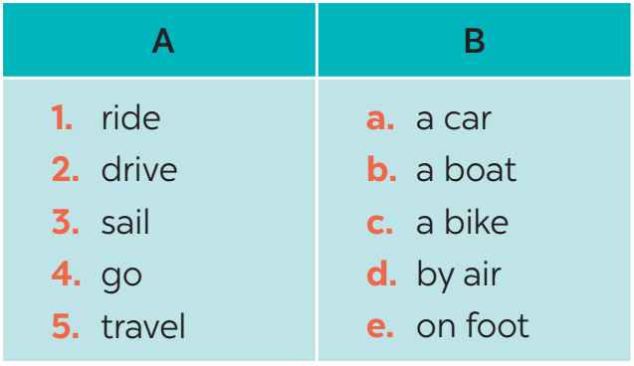
VOCABULARY
1
Match the words in A with the phrases in B.
1. c
2. a
3. b
4. e
5. d

Slide 10
VOCABULARY
2
Look at these road signs. Then write the correct phrases under the signs.
No right turn
cycle lane
traffic lights
Hospital ahead
School ahead
No cycling

Slide 11
VOCABULARY
3
Work in pairs. Take turns to say which of the signs in 2 you see on the way to school.
A: On the way to school, I can see a “ no right turn” sign.
B: On my way to school there is a hospital, so I can see a “hospital ahead” sign.

Slide 12
PRONUNCIATION
aɪ/ and /eɪ/

Slide 14
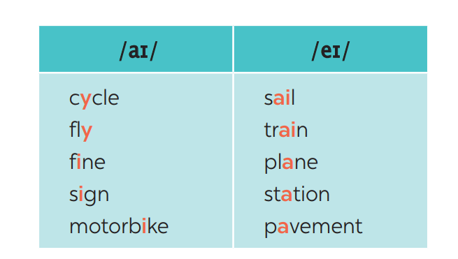
PRONUNCIATION
4
Listen and repeat. Pay attention to the sounds /aɪ/ and /eɪ/.

Slide 15
PRONUNCIATION
5
Underline the words with the sound /aɪ/ and circle the words with the sound /eɪ/. Then listen, check and repeat
1. The bus station is far from my house.
2. Remember to ride your bike carefully.
3. We must obey traffіc rules for our safety.
4. You have to get there in time for the train.
5. Don’t ride on the pavement.

Slide 16
CONSOLIDATION
2
HOMEWORK
Exercises in the workbook

