Slide 1
LAM HONG SECONDARY SCHOOL
ENGLISH 7
Welcome the Teachers to our class
Notes:
1

Slide 2
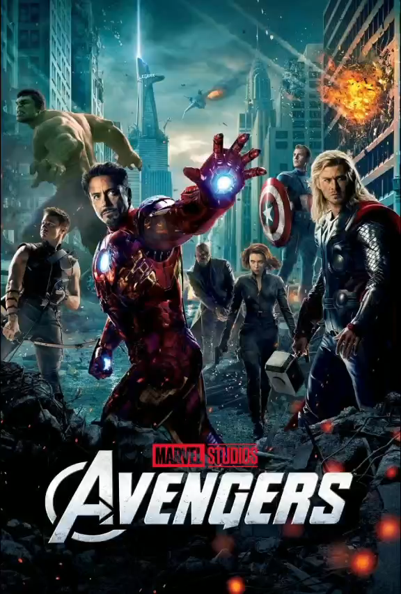
WARM-UP
Watch the video and write down the types of the films.
WHICH TYPES OF FILMS CAN YOU SEE IN THE VIDEO?

Slide 4
UNIT 8: FILMS
Lesson 6: Skills 2

Slide 5
PRE-LISTENING
1
Work in pairs. Discuss the following question.
What do you like / dislike about a comedy?
MAKES PEOPLE LAUGH
MOSTLY NOT EDUCATIONAL
HELPS PEOPLE RELAX
SOME ARE NOT SUITABLE FOR CHILDREN
REDUCES STRESS

Slide 6
WHILE-LISTENING
WHILE-LISTENING
2
Mark and Hoa are talking about the film Naughty Twins.
Listen to their conversation. Who stars in the film?
Linda Brown and Susan Smith
Linda Smith and Susan Brown
Linda Brown and Susan Smith
Susan Linda and Brown Smith

Slide 7
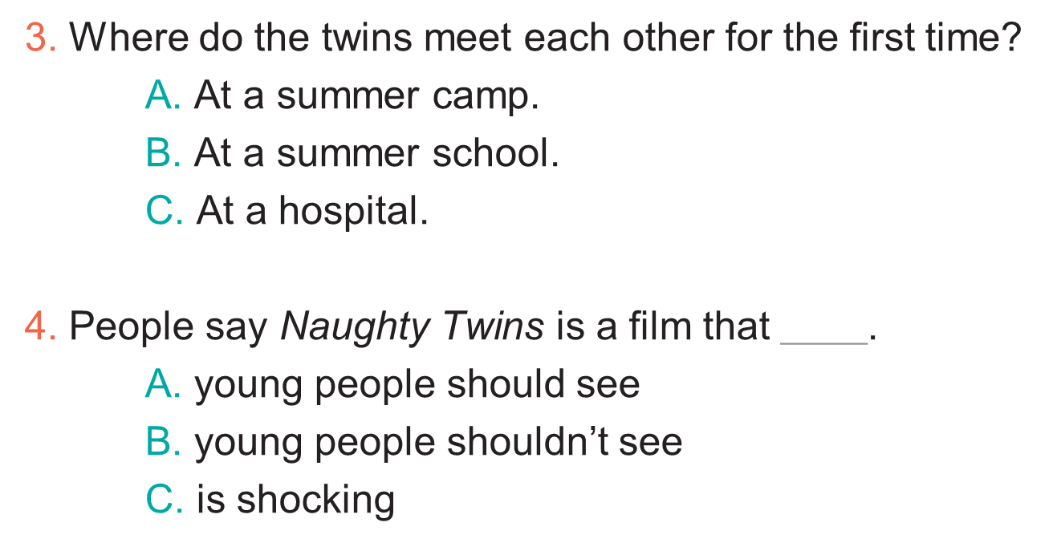
WHILE-LISTENING
3
Listen to the conversation again. Choose the best answer to each question below.
1. Naughty Twins is a ______. A. comedy
B. science fiction film
C. horror film
2. The main characters are ______. A. old classmates
B. twin brothers
C. twin sisters

Slide 8
PRE-WRITING
1. How many part are there in the paragraph?
There are 3 parts
2. What are they?
Introduction
Body
Conclusion

Slide 9
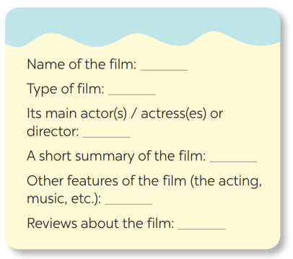
PRE-WRITING
4
Make notes about one of your favourite films.
Harry Potter
Fantasy / Fiction
Daniel Radcliffe, Emma Watson,
Rupert Grint
A group of teenage wizards and witches in Hogwarts fight against the Dark Lord.
Great acting, beautiful scences
Gripping, moving, funny

Slide 10
WHILE-WRITING
5
Write a paragraph of about 70 words about your favourite film, using the information in .
4
My favourite film is the Harry Potter series. It is based on one of the best selling novels. They are fantasy and fiction films about the wizard named Harry Potter and his friends: Ron and Hermione. Daniel Radcliffe, Emma Watson, Rupert Grint starred in this film. I like this film and I find it gripping, moving and funny, too. The scenes were set in the beautiful spots in the UK and the acting was really great.

Slide 11
CONSOLIDATION
1
Wrap-up
In this lesson, we have learnt to:
listen for special information about a comedy;
write a short paragraph about your favorite film.

Slide 12
CONSOLIDATION
2
Homework
Prepare for the next lesson: Looking back & Project

