Slide 1
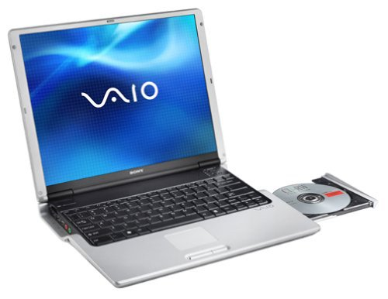
WELCOME TEACHERS TO OUR CLASS
LAM HONG SECONDARY SCHOOL
Teacher: Phạm Thị Mai Anh
Chào mừng quý Thầy Cô và các em học sinh
Notes:
1

Slide 3
WARM-UP
What did you see when you first came to our school?
How did you feel?

Slide 4
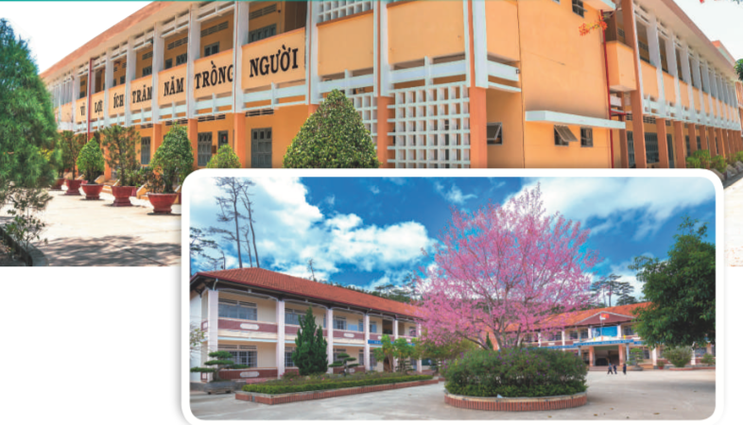
Unit 6: A VISIT TO A SCHOOL
Lesson 1: GETTING STARTED (P 60-61)
A visit to Binh Minh Lower Secondary School
NVL

Slide 5
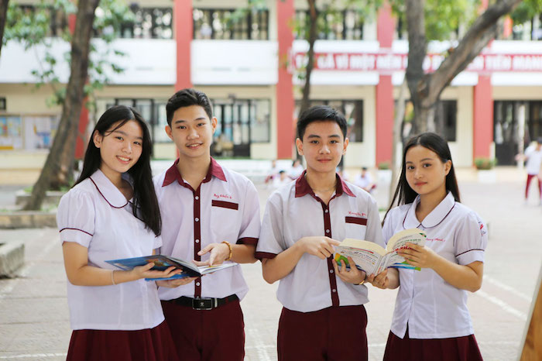
Vocabulary
lower secondary school
/ˈləʊər ˈsekəndrɪ skuːl/
trường trung học cơ sở

Slide 6
Vocabulary
member (n)
/ˈmembər/
thành viên

Slide 7
Vocabulary
remind (v)
/rɪˈmaɪnd/
gợi nhớ, nhắc nhở

Slide 8
Vocabulary
forget (v)
# remember (v)
/fə'get/
quên

Slide 9
Vocabulary
New words | Pronunciation | Meaning
1. lower secondary school | /ˈləʊər ˈsekəndrɪ skuːl/ | trường trung học cơ sở
2. member (n) | /ˈmembər/ | thành viên
3. remind (v) | /rɪˈmaɪnd/ | gợi nhớ/ nhắc nhở
4. forget (v) | /fə'get/ | quên

Slide 10
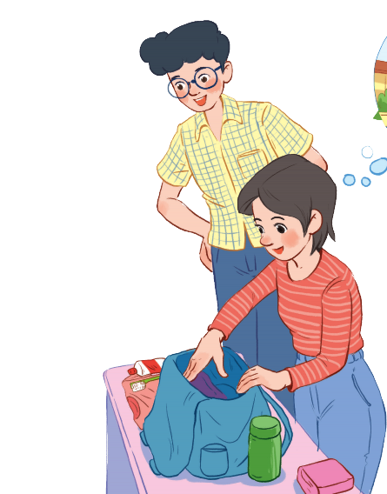
PRESENTATION
Set the scene
1.Who are they?
- They are Phong and Mi
2. What is the girl doing?
Mi is putting some clothes in her backpack.
3. What are they talking about?
- They are talking about a visit to Binh
Minh Lower Secondary School.
Phong
Mi

Slide 11
PRACTICE
1
Listen and read.
Phong: What are you doing, Mi? Mi: I’m preparing to visit Binh Minh Lower Secondary School. Phong: Sounds great! I think that’s one of the best schools in my neighbourhood. Who is going with you and when? Mi: My teacher and my classmates. We’re going in the afternoon. Phong: I see. What will you do there? Mi: Well, I think we’ll visit the school library, the computer room, and the gym. We’ll meet the students and share ideas for a project in our English class. Phong: That’s interesting. What else will you do there? Mi: We’ll meet the members of their Go Green Club and take photos of the school. Phong: Fantastic! so don’t forget to take your camera. Mi: I almost forgot. Thanks for reminding me.

Slide 12
Game: Lucky numbers
1
2
3
4
5
6

Slide 13
LUCKY NUMBER!

Slide 14
1. What are they talking about?
A. A visit to a computer room. B. A visit to a school. C. A visit to a school library.
Phong: What are you doing, Mi?
Mi: I’m preparing to visit Binh Minh Lower Secondary School.

Slide 15
LUCKY NUMBER!

Slide 16
2. Who is going to visit the school? A. Mi and her teacher. B. Mi and her classmates. C. Mi, her teacher and her classmates.
Phong: Sounds great! I think that’s one of the best schools in my neighbourhood. Who is going with you and when? Mi: My teacher and my classmates. We’re going in the afternoon.

Slide 17
3. Where is the school? A. In the city. B. In the countryside. C. In Phong’s neighbourhood.
Phong: Sounds great! I think that’s one of the best schools in my neighbourhood. Who is going with you and when?

Slide 18
4. When are they going?
A. In the morning. B. In the afternoon. C. At noon.
Phong: Sounds great! I think that’s one of the best schools in my neighbourhood. Who is going with you and when? Mi: My teacher and my classmates. We’re going in the afternoon.

Slide 19
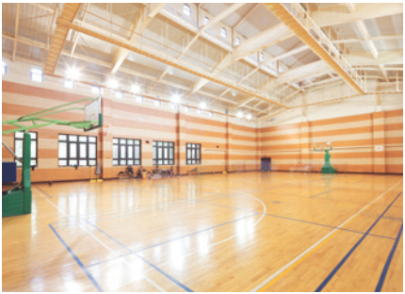
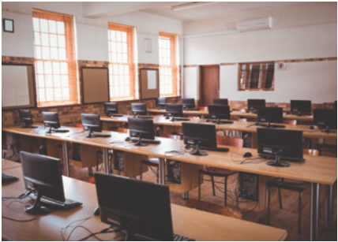
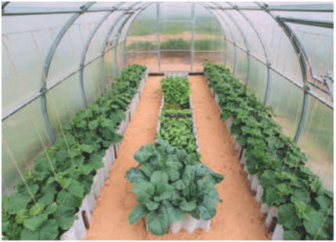
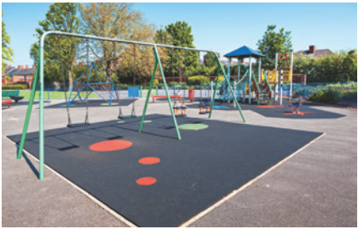
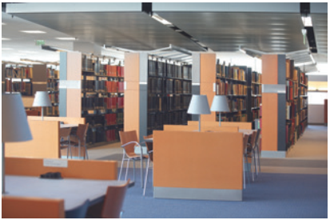
PRACTICE
3
Name these places, using the words and phrases from the box.
computer room school library
school garden playground gym
1. gym
2. computer room
3. school garden
4. playground
5. school library

Slide 20
PRACTICE
4
Complete the following sentences with the words in the box.
computer room
school library
school garden
playground
gym
1. The school _______________ is very small, so not many children can play in it.
2. We learn how to use the Internet in the _______________ twice a week.
3. They have school meetings in the _______________ when it rains.
4. There are a lot of books, magazines, and newspapers in the _______________.
5. Our class usually waters the vegetables in the _______________ on Friday afternoons.
playground
computer room
gym
school library
school garden

Slide 21
PRODUCTION
5
Work in pairs. Ask and answer questions about Nick’s timetable, using when and where.
Subject | Time | Place
Maths | 8 a.m. Monday, Tuesday, Friday | Classroom (room 302)
Biology | 9 a.m. Thursday | Science lab
Information Technology | 2 p.m. Wednesday | Computer room
Physical Education | 3 p.m. Monday, Thursday | School gym
History | 3:30 p.m. Tuesday | School library
Example: A: When does Nick have maths? B: At 8 a.m. on Monday, Tuesday, and Friday. A: And where does he have it? B: In his classroom, room 302.

Slide 22
CONSOLIDATION
1
WRAP-UP
Topic of the unit
A visit to a school
Vocabulary
School facilities

Slide 23
HOMEWORK
- Learn vocabulary by heart.
- Practice the conversation again.
- Practice talking about school facilities.
- Do exercises in workbook.
- Prepare: Lesson 2- A closer look 1(P 62).

Slide 24
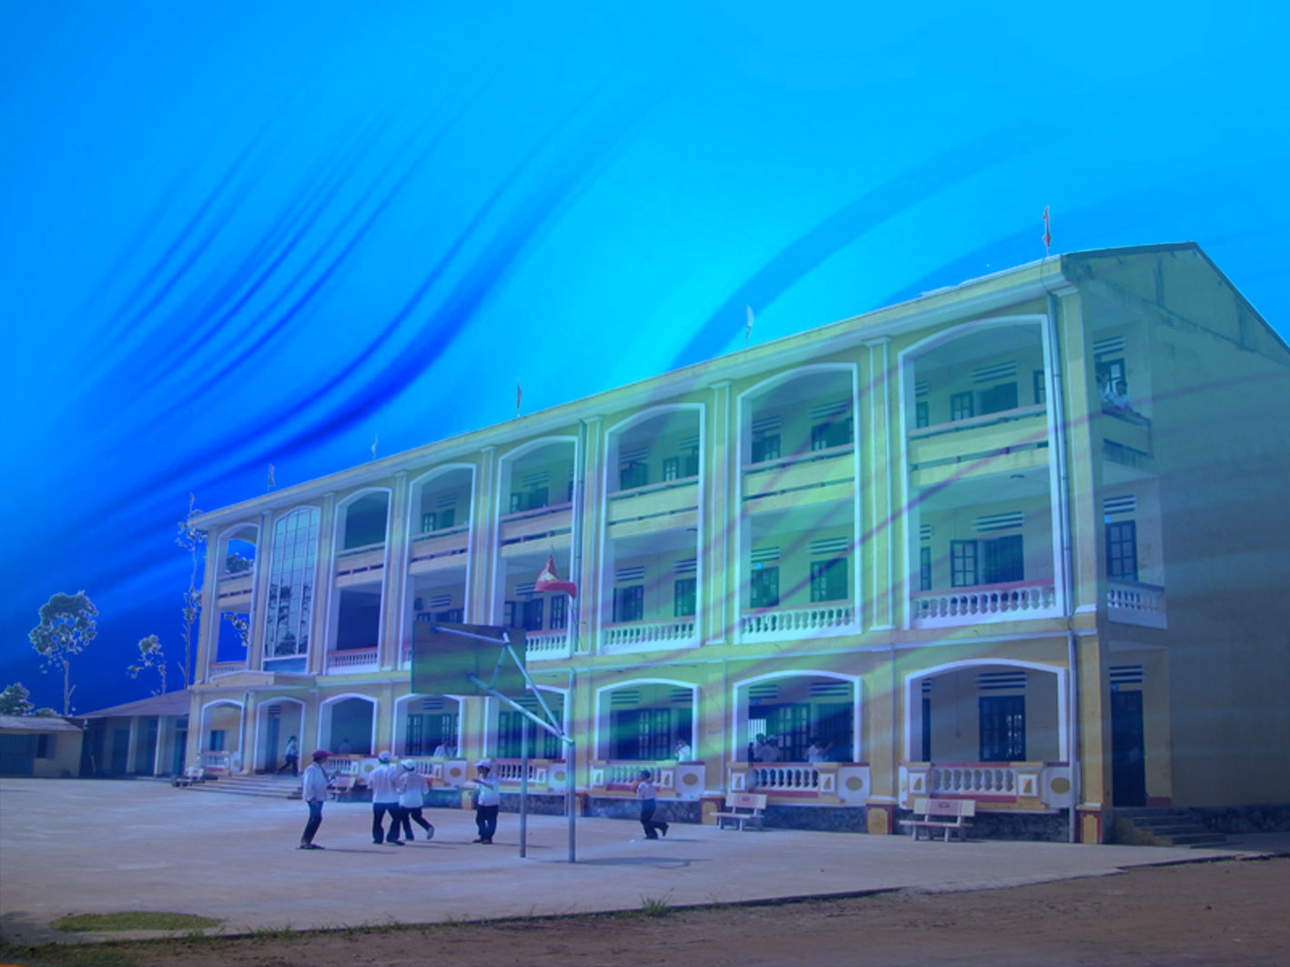
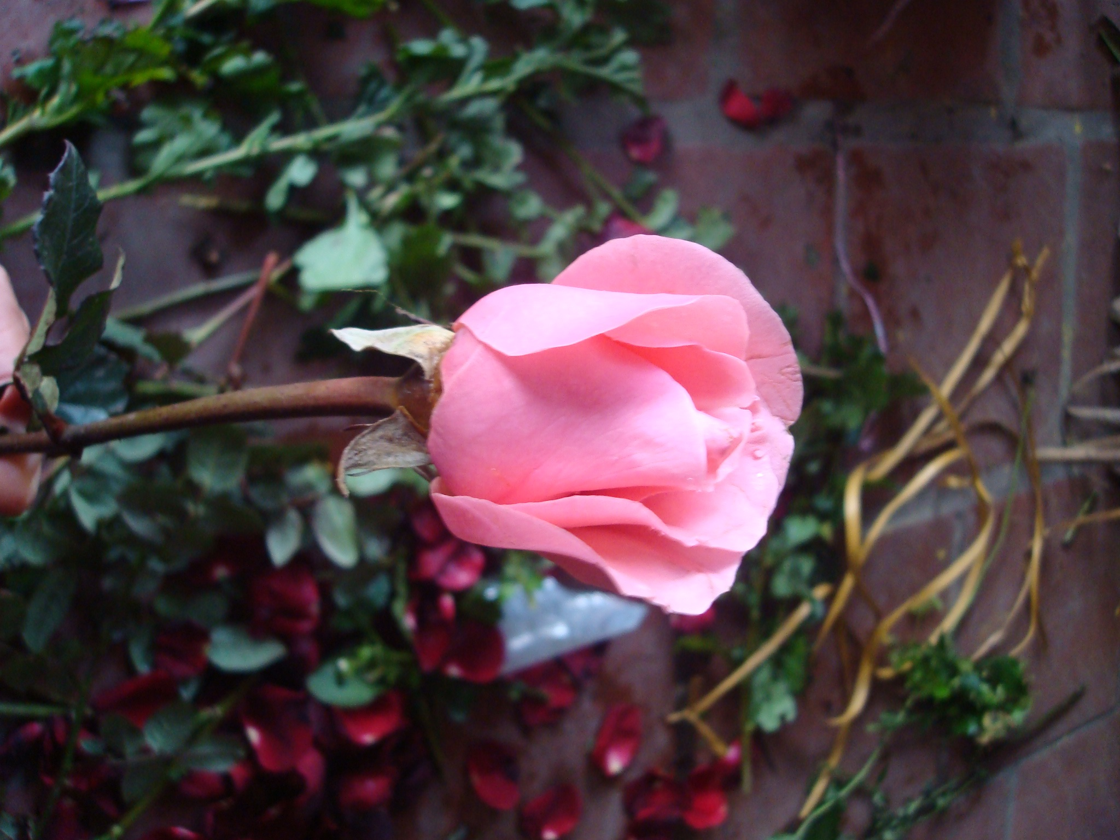
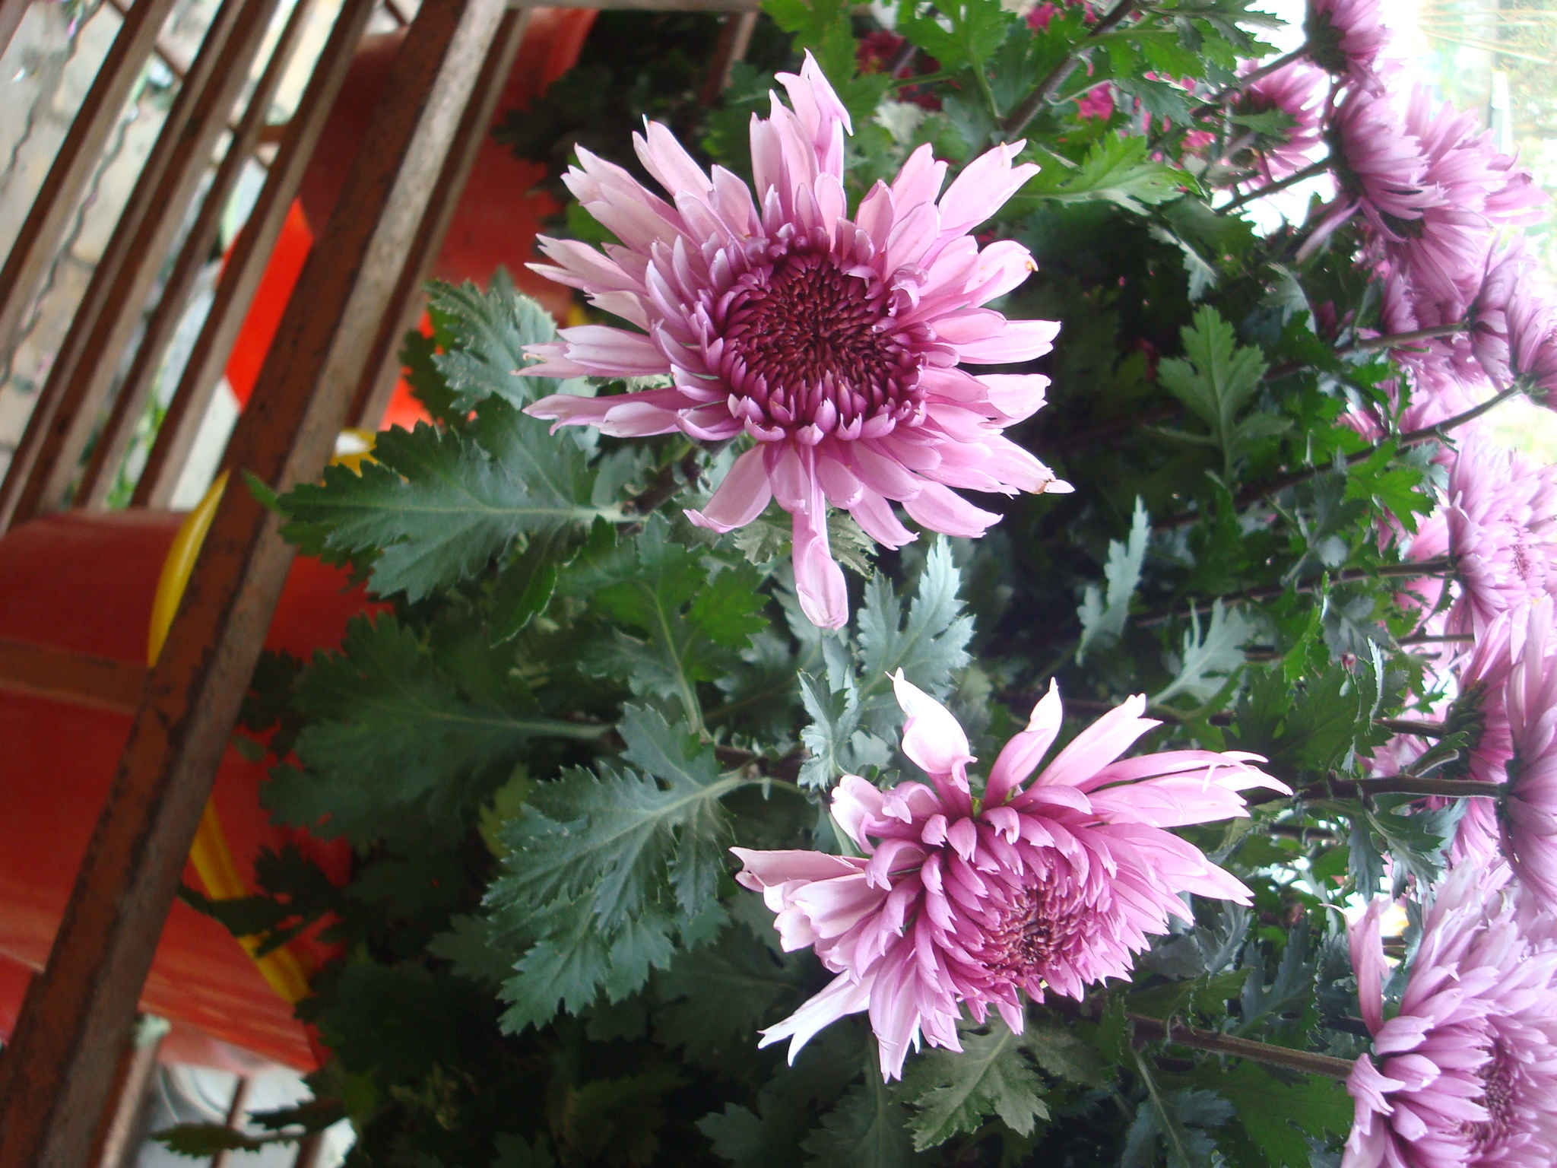
Thanks for your attendance
Goodbye!

