Slide 1
WELCOME TEACHERS TO OUR CLASS TODAY

Slide 3
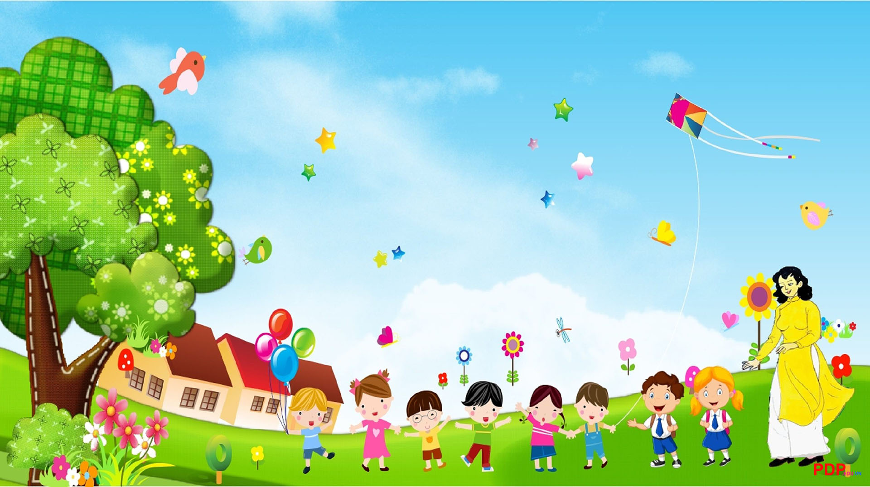
UNIT 8: FILMS
Lesson 7: Looking back+ Project

Slide 4
1. Vocabulary.
I. LOOKING BACK:
a. Types of film.
Descriptions for the types of film.
1. This type of film makes you laugh.
2. This is a frightening type of film.
3. This type of film has supernatural events.
4. This type of film is about life in the future, robots, and space travel.
5. This type of film gives us useful information about animals, science or technology.
Notes:
1. science fiction film
2. comedy
3. horror film
4. documentary
5. fantasy
a. This type of film makes you laugh.
b. This type of film has supernatural events.
c. This type of film gives us useful information about animals, science or technology.
d. This type of film is about life in the future, robots, and space travel.
e. This is a frightening type of film.

Slide 5
a. TYPES OF FILM:
1. comedy
This type of film makes you laugh.
2. horror film
This is a frightening type of film.
3. fantasy
This type of film has supernatural events.
4. science fiction film
This type of film is about life in the future, robots, and space travel.
5. documentary
This type of film gives us useful information about animals, science or technology.
Notes:
1. science fiction film
2. comedy
3. horror film
4. documentary
5. fantasy
a. This type of film makes you laugh.
b. This type of film has supernatural events.
c. This type of film gives us useful information about animals, science or technology.
d. This type of film is about life in the future, robots, and space travel.
e. This is a frightening type of film.

Slide 6
Choose the correct answer A, B C or D to complete each sentence.
b. Adjectives:
1. The film was long and ___________ . Many people went home before it ended.
A. dull B. exciting C. funny D. shocking
2. The film is too ___________ with a lot of fighting and killing scenes.
A. funny B. dull C. interesting D. violent
3. A ___________ story often makes us feel afraid.
A. moving B. interesting C. frightening D. sad
4. The news was ___________. I couldn’t believe it.
A. funny B. shocking C. confusing D. bored
5. ___________ films often make us cry.
A. Amusing B. Moving C. Funny D. boring
6. The road signs were ___________ and we soon got lost.
A. confusing B. shocking C. interesting D. exciting

Slide 7
2. GRAMMAR:
Connectors
Although/ Though
However
We use them to connect 2 contrasting ideas or 2 clauses
Although/Though + clause 1 ( S +V), + clause 2 (S +V ).
Clause 1 ( S +V). However, + clause 2 (S +V).
Clause 2 ( S +V)+ although/Though + + clause 1 (S +V ).

Slide 8
Combine the two sentences, using although/ though/ However
1. He arrived late. he left the cinema early. (although/ though)
Although/ Though he arrived late, he left the cinema early.
2. Cinema tickets are expensive. The number of people going to cinemas is increasing. (however)
Cinema tickets are expensive. However, the number of people going to cinemas is increasing.
3. Some food and drinks in the cinema are very expensive. People still buy them. (although/ though)
Though/ Although some food and drinks in the cinema are very expensive, people still buy them.
4. I don't really like to go to the cinema. I don't want to stay home tonight. (although/ though)
Although/ Though I don't really like to go to the cinema, I don't want to stay home tonight.
5. The film received good reviews. Only a few people saw it. (however)
The film received good reviews. However, Only a few people saw it.

Slide 9
II. Project
Your favourite film

Slide 10
II. PROJECT:
- name of the film; - type of film; - its director and main actors / actresses; - a short summary; - your overall opinions about the film; - the showtime and cinema; - pictures or photos to illustrate the film.
Choose one of your favourite films
Design a poster
Present your products

Slide 11
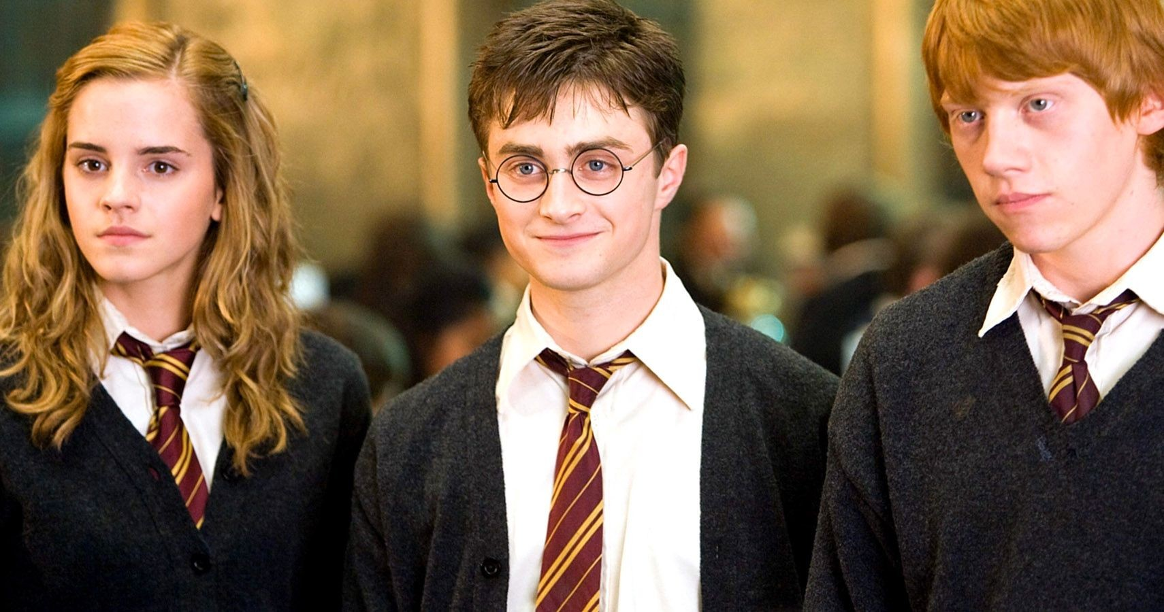
Name of the film
- It’s a fantasy film series.
- It’s directed by David Heyman
- Daniel Radcliffe, Rupert Grint, and Emma Watson star as the three leading characters: Harry Potter, Ron Weasley, and Hermione Granger
- The film tells the story of Harry Potter, a powerful wizard. He studies at Hogwarts try to fight the bad things happening around him.
- It’s a must-see for teens because the story is gripping and the acting is excellent. The music is also amazing.
- You can see them on many websites or Netflix.
type of film
its director
main actors / actresses
a short summary
pictures, photos about the film
reviews
showtime and cinema
Notes:
- name of the film
- type of film
- its director and main actors / actresses
- a short summary
- your overall opinion about the film
- the showtime and cinema
- pictures or photos to illustrate the film

Slide 12
Let’s talk about your favorite film!
Posters exhibition

Slide 13
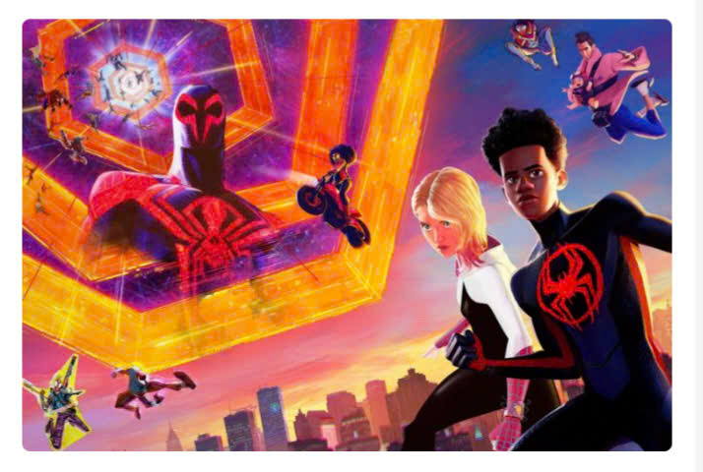
Good films

Slide 14
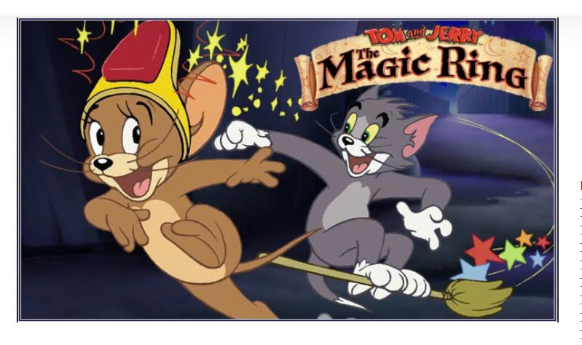
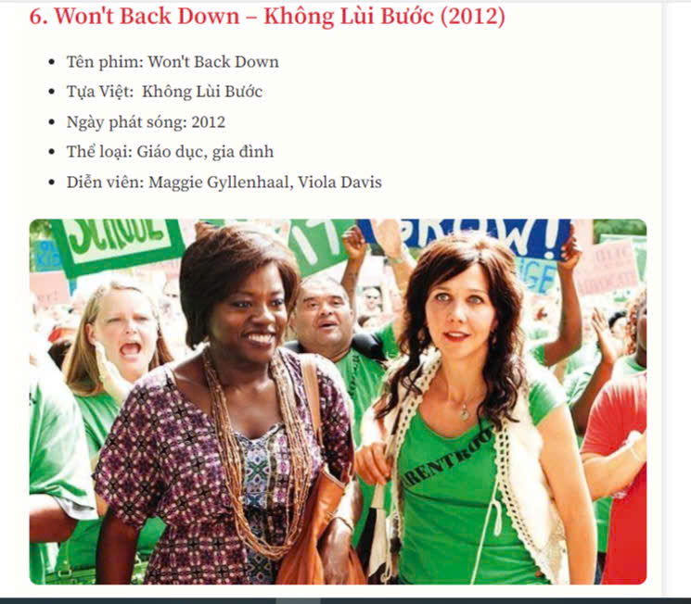
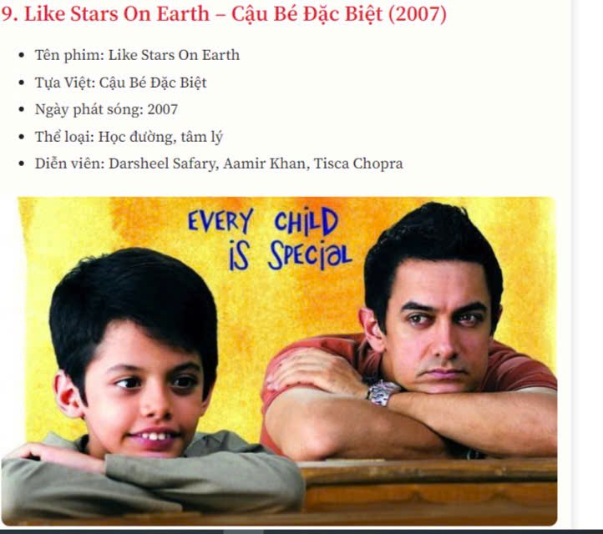
Good films

Slide 15
WRAP UP
LOOKING BACK
PROJECT
Vocabulary
Grammar
Talk about your favourite film
- Nouns (Types of film)
- Adjectives (describe types of film)
although/ though/ however

Slide 16
III. Homework
Review vocabulary, grammar and do all exercises
Write a paragraph about your favorite film.
- Prepare for the next lesson: Unit 9: Festivals around the world Lesson 1: Getting started: Vocabulary- festivals, dialogue, things you do at festival.

Slide 17
Thank you for your attention!
Please keep this slide for attribution

