Slide 1
WELCOME TO OUR CLASS

Slide 2
GUESSING
Discuss with partner:
Where are these cities ?

Slide 3
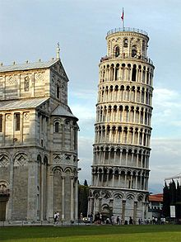
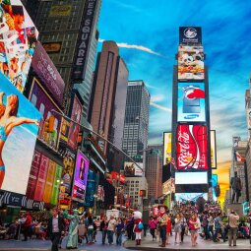
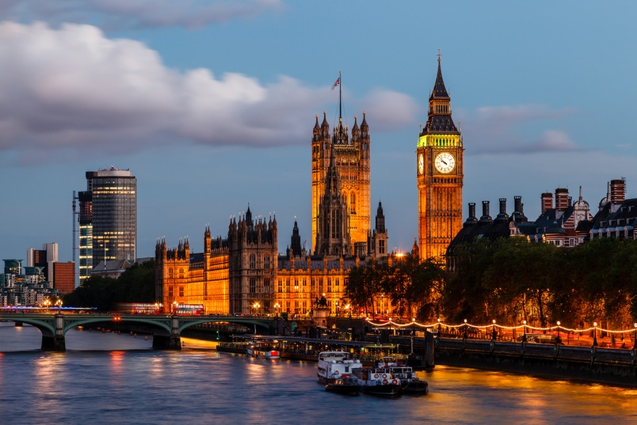
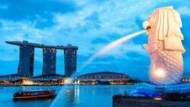
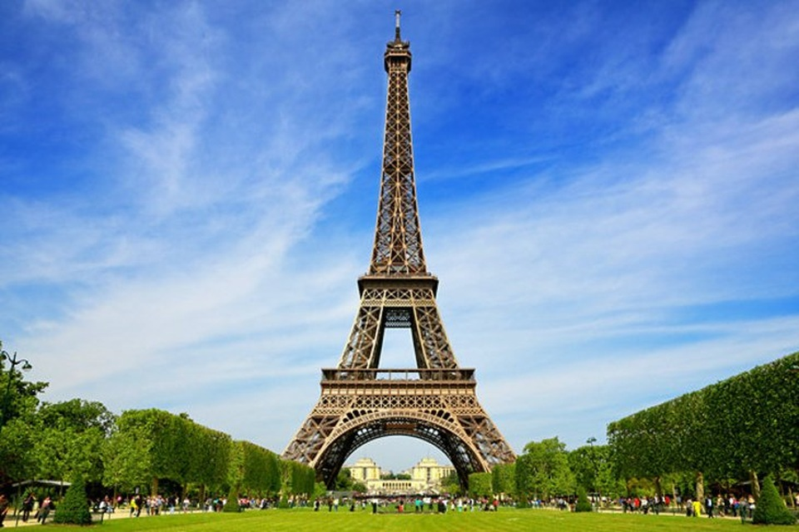
GUESSING
Where are these places?
Pisa- Italy
Time square – New York- the USA
London- the UK
Sydney- Australia
Marina bay-Singapore
Eiffel Tower – France

Slide 4
UNIT 9: CITIES OF THE WORLD
LESSON 1: GETTING STARTED

Slide 5
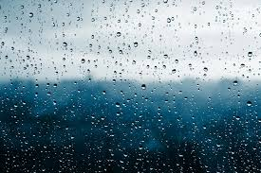
I. New words :
Rainy
(adj)
/ˈreɪni/
Có mưa

Slide 6
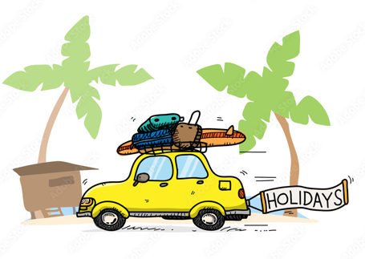
holiday
(n)
/ˈhɒlədeɪ/
kỳ nghỉ

Slide 7
crowded
(adj)
/ˈkraʊ.dɪd/
đông đúc

Slide 8
exciting
(adj)
/ɪkˈsaɪ.tɪŋ/
hào hứng
= interesting

Slide 9
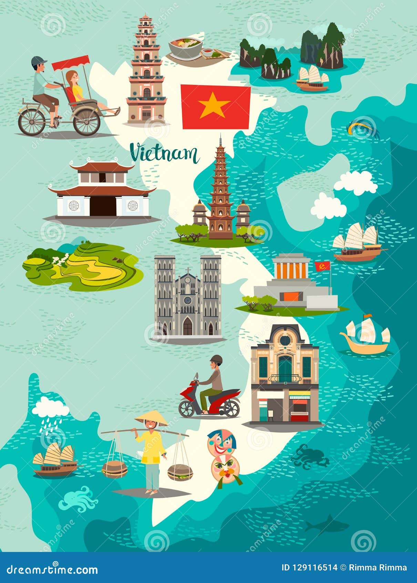
Landmark
(n)
/ˈlænd.mɑːk/
địa điểm thu hút khách
du lịch.

Slide 10
UNIT 9: CITIES OF THE WORLD
LESSON 1: GETTING STARTED
New words : | Meaning
Holiday (n) | kỳ nghỉ
Rainy ( adj) | trời có mưa
crowded( adj) | đông đúc
Exciting = interesting (adj) | hào hứng, thú vị
Landmark (n) | địa điểm thu hút khách du lịch.

Slide 12
What ’s disappeared?
Holiday

Slide 13
What ’s disappeared?
Landmark

Slide 14
What ’s disappeared?
Crowded

Slide 15
What ’s disappeared?
Rainy

Slide 16
What ’s disappeared?
Exciting = interesting

Slide 17
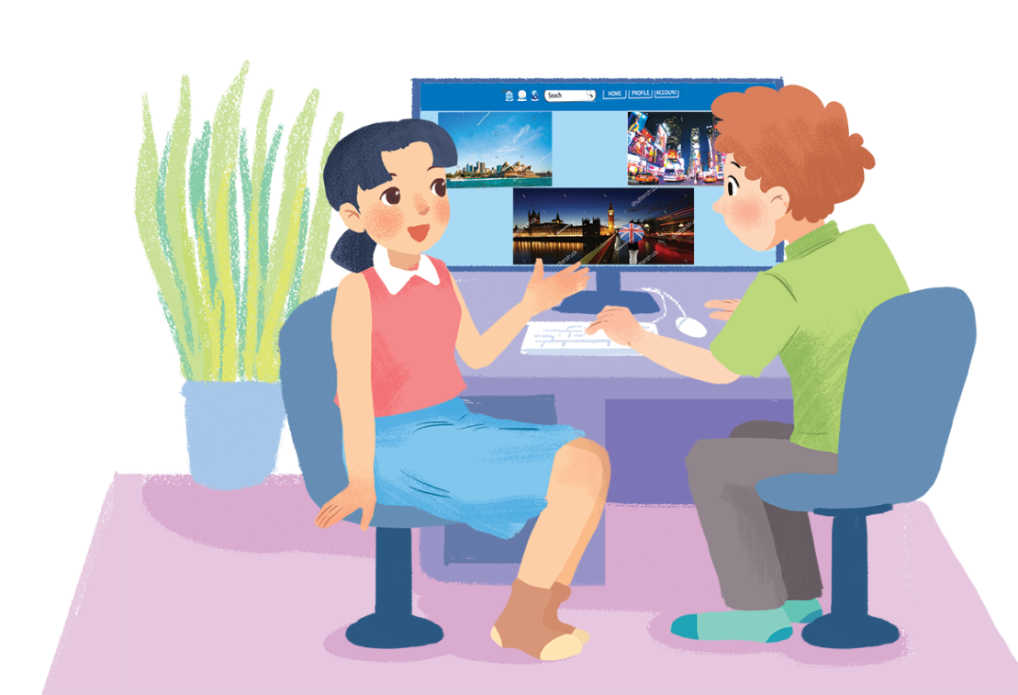
WHAT NICE PHOTOS!
Who are they?
→ They are Tom and Mai.
What are they doing?
→ They are using the Net.
What might they talk about?
→ They might talk about some cities of the world.

Slide 18
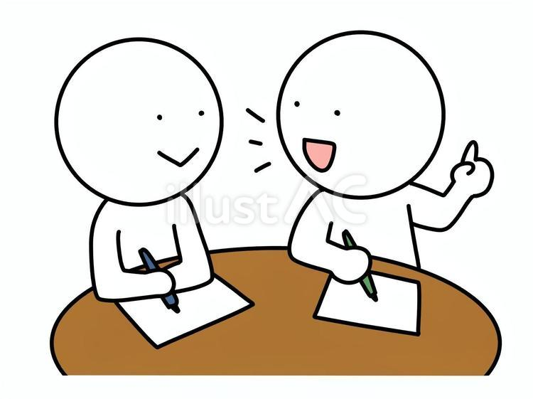
II. Listen and repeat.
What nice photos!
Mai: Tom, are these photos from your vacations?
Tom: Yes, they are. This is Sydney, a city in Australia.
Mai: What’s it like?
Tom: It’s exciting with a lot of beaches.
Mai: What a beautiful place!
Tom: Yes, its beaches are very clean.
Mai: Wonderful. Oh, this is London. Isn’t it raining?
What bad weather!
Tom: Yes, it rains all the time. Can you see Big Ben?
Mai: Yeah ... on the River Thames. It’s a landmark of London.
Tom: It is. And this is Times Square in New York, crowded but interesting.
Mai: You’re lucky to visit many places.
Tom: I am. What about your vacations?
Mai: Here are some photos of mine. This is ...

Slide 19
What nice photos!
What cities can you see?
Mai: Tom, are these photos from your vacations?
Tom: Yes, they are. This is Sydney, a city in Australia.
Mai: What’s it like?
Tom: It’s exciting with a lot of beaches.
Mai: What a beautiful place!
Tom: Yes, its beaches are very clean.
Mai: Wonderful. Oh, this is London. Isn’t it raining?
What bad weather!
Tom: Yes, it rains all the time. Can you see Big Ben?
Mai: Yeah ... on the River Thames. It’s a landmark of London.
Tom: It is. And this is Times Square in New York, crowded but interesting.
Mai: You’re lucky to visit many places.
Tom: I am. What about your vacations?
Mai: Here are some photos of mine. This is ...

Slide 20
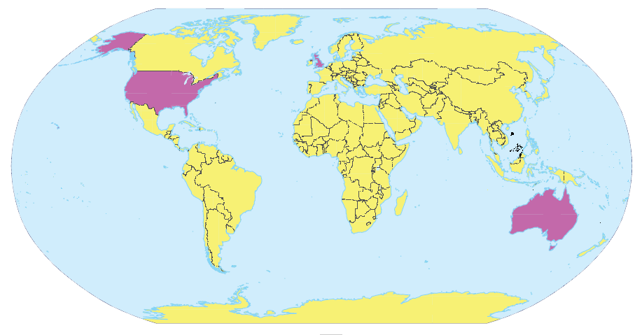
Write the names of the cities in the correct place.
1.
New York
2.
London
Sydney
London
New York
3.
Sydney

Slide 21
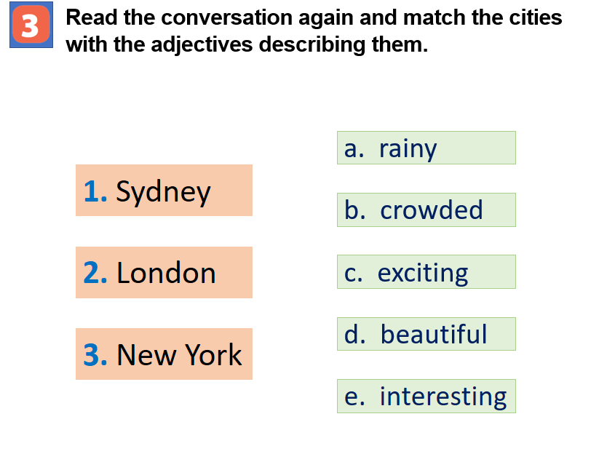
27

Slide 22
Blind box

Slide 23
Which blind box do you want?
1
2
3
4
5

Slide 24
Xé túi mù

Slide 25
What does Tom say about Sydney?
A. It is exciting and beautiful.
B. It is boring and quiet.
C. It has bad weather.
D. It is a small town.

Slide 26
What nice photos!
Mai: Tom, are these photos from your vacations?
Tom: Yes, they are. This is Sydney, a city in Australia.
Mai: What’s it like?
Tom: It’s exciting with a lot of beaches.
Mai: What a beautiful place!
Tom: Yes, its beaches are very clean.
Mai: Wonderful. Oh, this is London. Isn’t it raining? What bad weather!
Tom: Yes, it rains all the time. Can you see Big Ben?
Mai: Yeah... on the River Thames. It’s a landmark of London.
Tom: It is. And this is Times Square in New York, crowded but interesting.
Mai: You’re lucky to visit many places.
Tom: I am. What about your vacations?
Mai: Here are some photos of mine. This is…

Slide 27
Xé túi mù

Slide 28
What is the weather like in London?
A. It is always sunny.
B. It is hot and dry.
It is bad and rainy.
D. It never rains.

Slide 29
SUGGEST
What nice photos!
Mai: Tom, are these photos from your vacations?
Tom: Yes, they are. This is Sydney, a city in Australia.
Mai: What’s it like?
Tom: It’s exciting with a lot of beaches.
Mai: What a beautiful place!
Tom: Yes, its beaches are very clean.
Mai: Wonderful. Oh, this is London. Isn’t it raining? What bad weather!
Tom: Yes, it rains all the time. Can you see Big Ben?
Mai: Yeah... on the River Thames. It’s a landmark of London.
Tom: It is. And this is Times Square in New York, crowded but interesting.
Mai: You’re lucky to visit many places.
Tom: I am. What about your vacations?
Mai: Here are some photos of mine. This is…

Slide 31
How does Tom describe Times Square in New York?
A. Quiet but boring
B. Crowded but interesting
C. Empty and peaceful
D. Small and quiet

Slide 32
SUGGEST
What nice photos!
Mai: Tom, are these photos from your vacations?
Tom: Yes, they are. This is Sydney, a city in Australia.
Mai: What’s it like?
Tom: It’s exciting with a lot of beaches.
Mai: What a beautiful place!
Tom: Yes, its beaches are very clean.
Mai: Wonderful. Oh, this is London. Isn’t it raining? What bad weather!
Tom: Yes, it rains all the time. Can you see Big Ben?
Mai: Yeah... on the River Thames. It’s a landmark of London.
Tom: It is. And this is Times Square in New York, crowded but interesting.
Mai: You’re lucky to visit many places.
Tom: I am. What about your vacations?
Mai: Here are some photos of mine. This is…

Slide 34
What is a famous landmark in London mentioned in the conversation?
A. The Eiffel Tower
B . Big Ben
C . The Statue of Liberty
D. Sydney Opera House

Slide 35
Xé túi mù

Slide 36
Lucky blind box

Slide 37
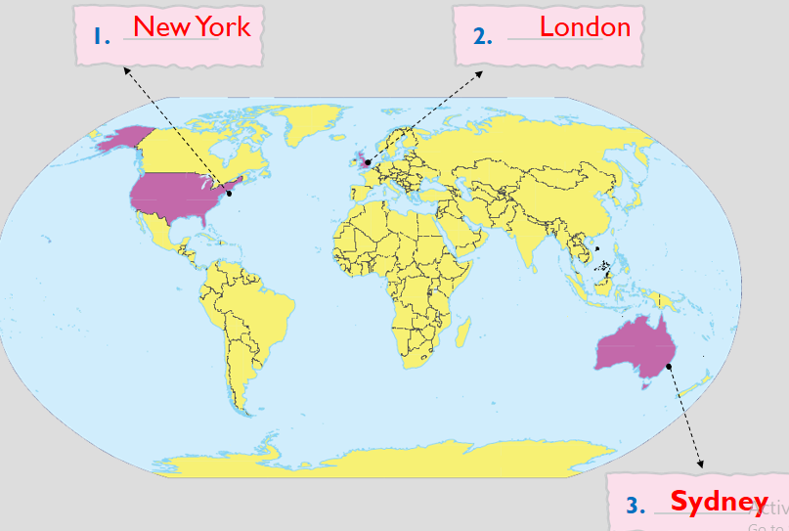
Match the cities with their landmarks.
1. Ha Noi
2. London
3. New York
4. Sydney
Ha Noi

Slide 38
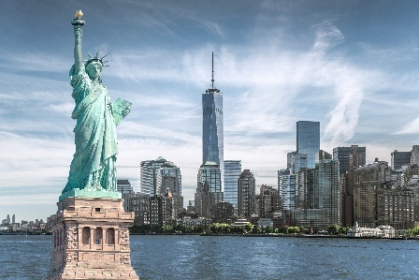
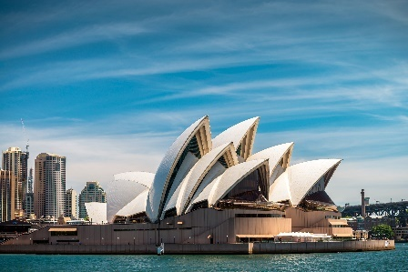
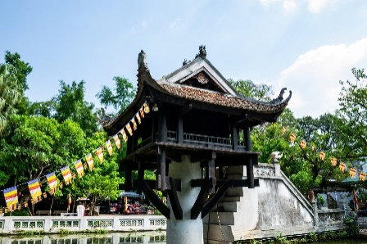
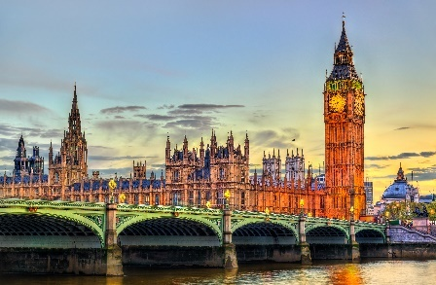
What place is it?
a
b
d
c
Statue of Liberty
Opera House
Big ben
One Pillar pagoda

Slide 39
Match the cities with their landmarks.
1. Ha Noi
2. London
3. New York
4. Sydney
a
b
d
c
Statue of Liberty
Opera House
Big ben
One Pillar pagoda

Slide 40
Work in group
 | Student 1 | Student 2 | Student 3 | Student 4
What city do you like?
Where is it?
Why do you like it?

Slide 41
Tell me about your favorite city.

Slide 42
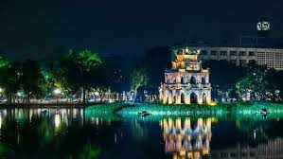
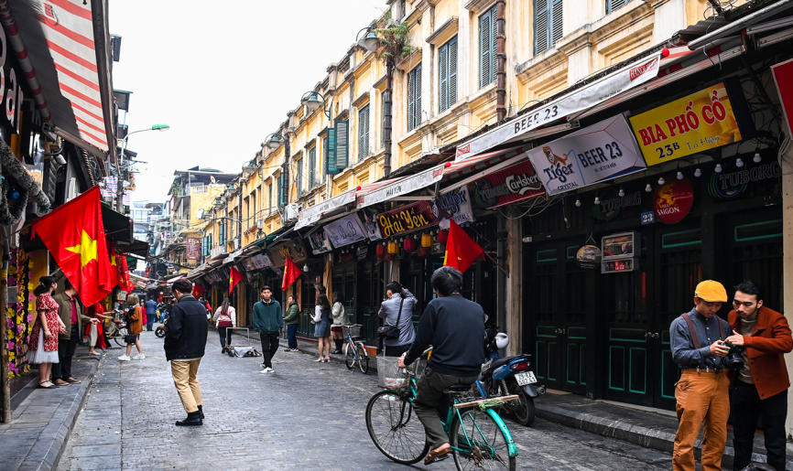
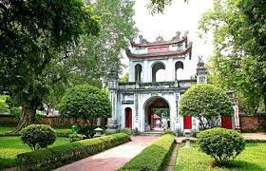
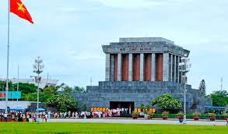
Ha Noi
Hanoi Old Town Quarter
Hoan Kiem Lake
Temple of Literature
Ho Chi Minh Mausoleum

Slide 43
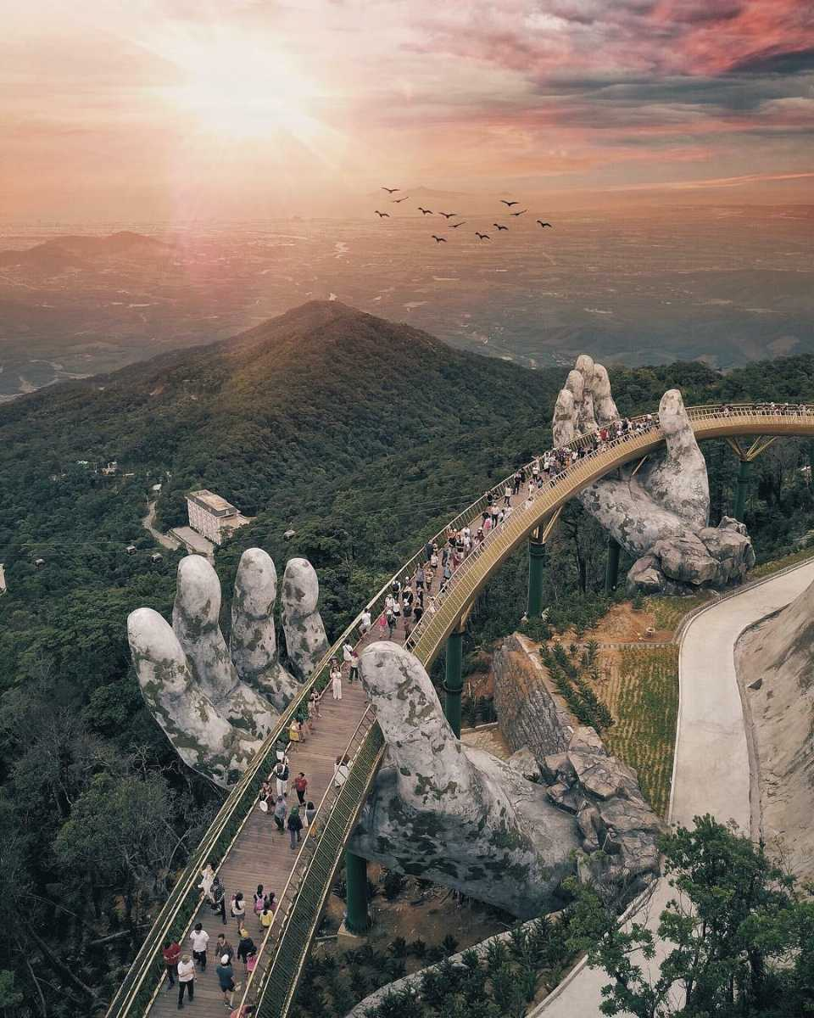
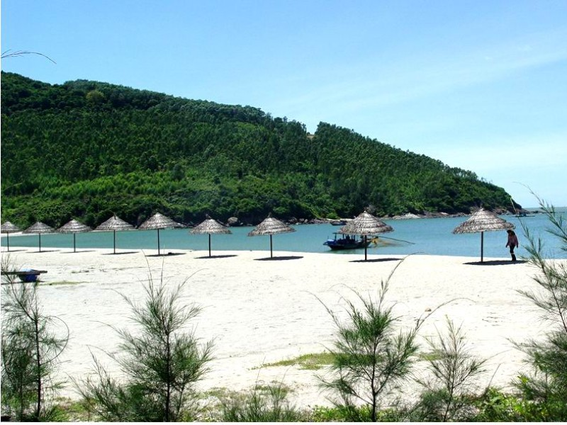
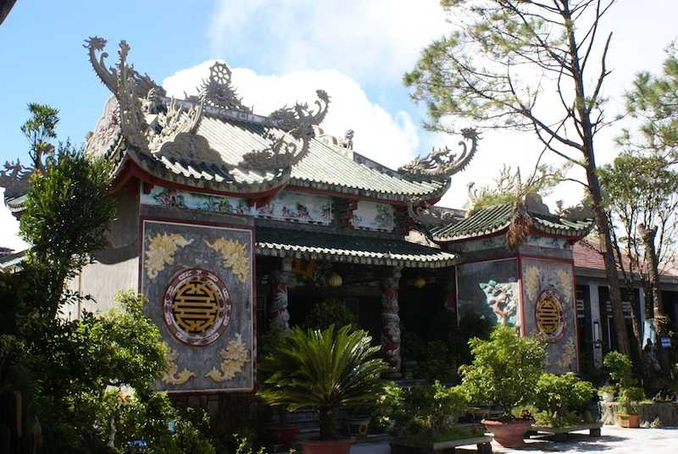
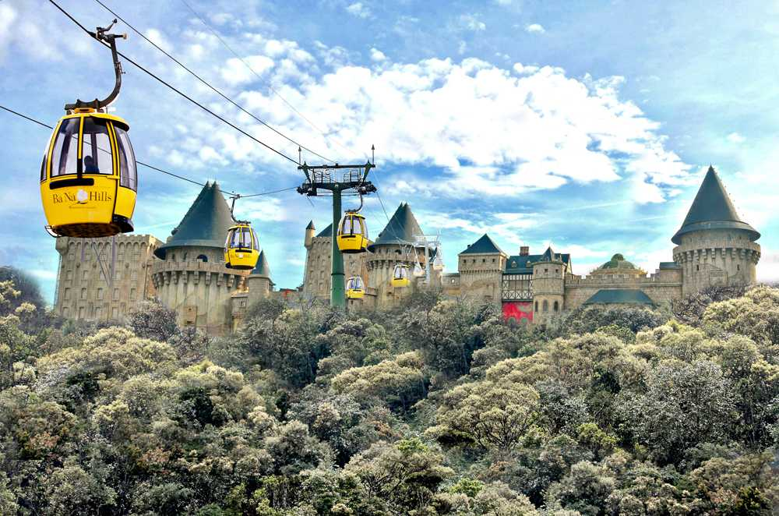
Da Nang
Golden Bridge
My Khe Beach
Linh Ung Pagoda
Ba Na Hills

Slide 44
homework
- Learn by heart all the new words.
- Go to the Internet and search for the information on your favourite cities in the world (food, people, weather, etc.)
- Prepare lesson 2 ( A closer look 1).

