Slide 1


WELCOME TEACHERS TO OUR CLASS
LAM HONG SECONDARY SCHOOL
Chào mừng quý Thầy Cô và các em học sinh

Slide 2

Sing a song : My body song.

Slide 3
Monday, October 14th 2024
UNIT 3: My friends
Lesson 1: Getting started
- A surprise guest.

Slide 4

Watch and write as many body parts as you can

Slide 5
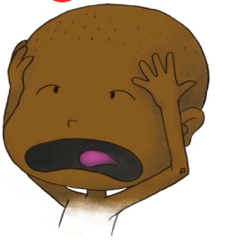
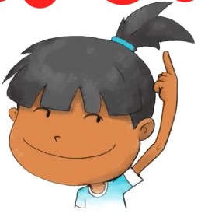
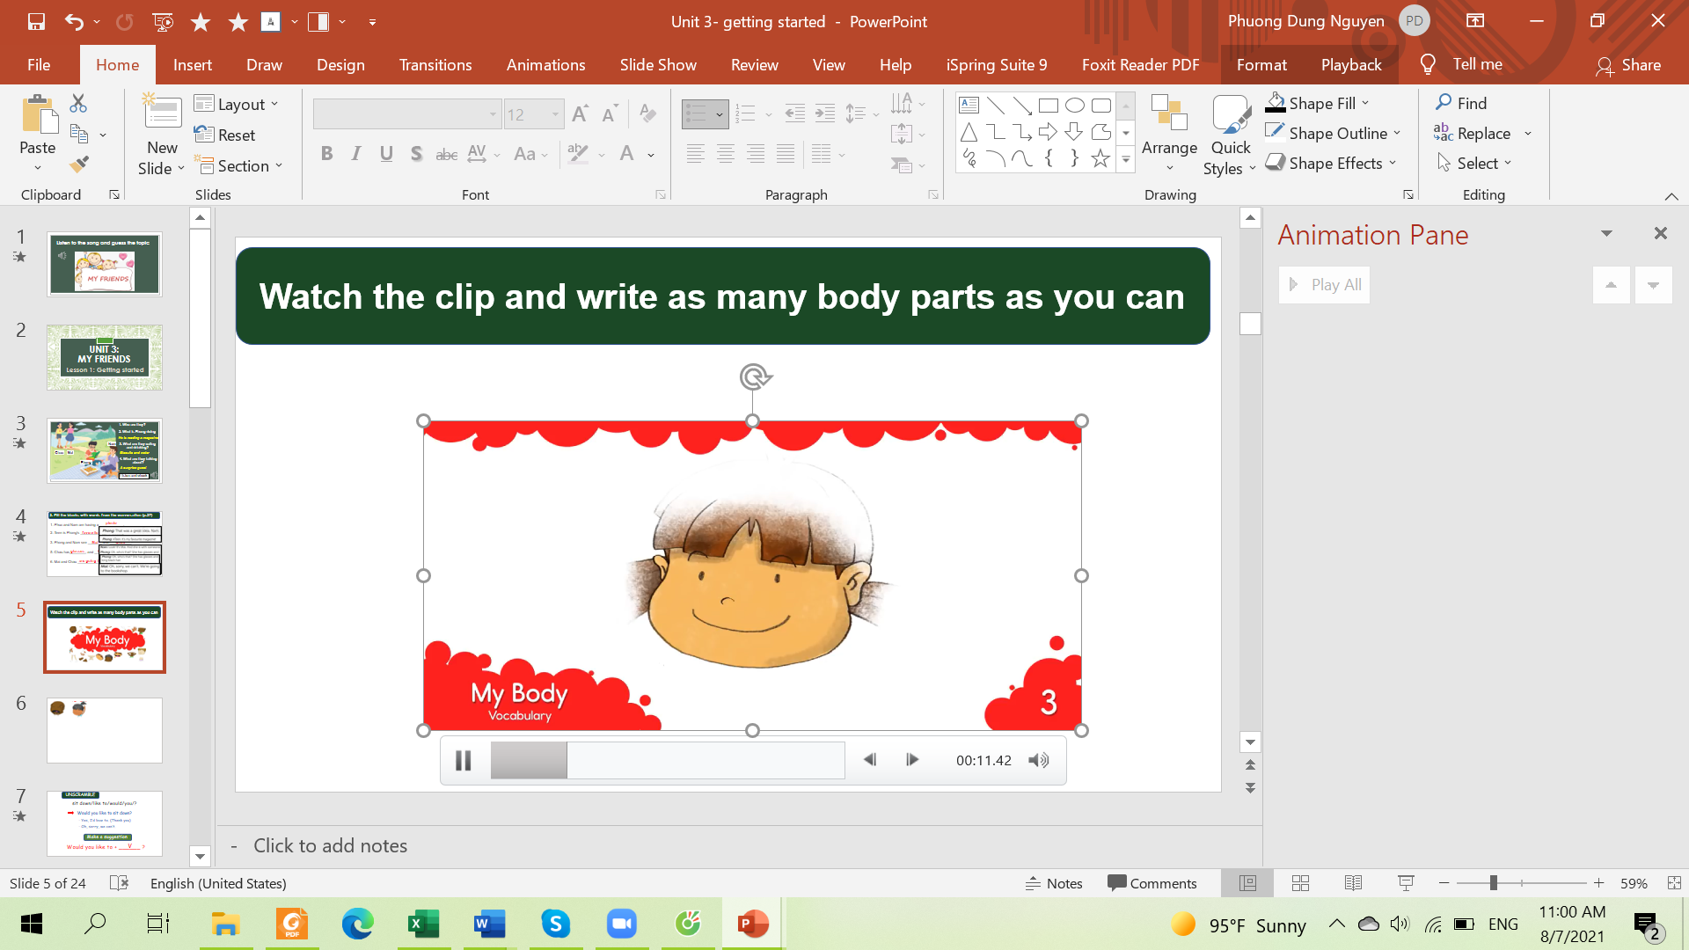
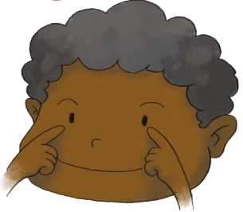
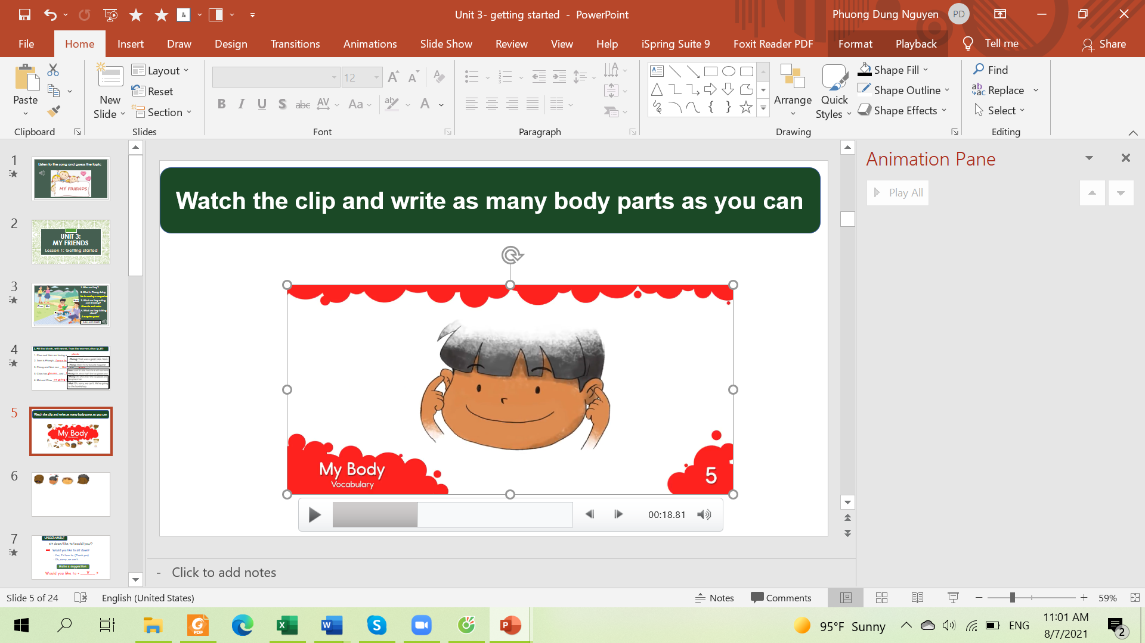
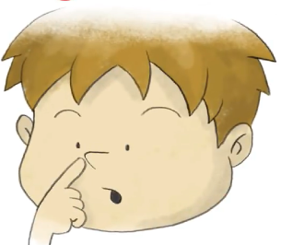
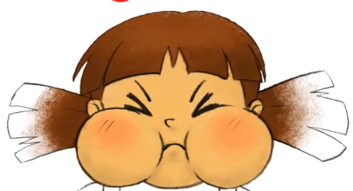
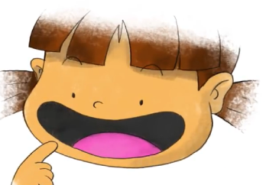


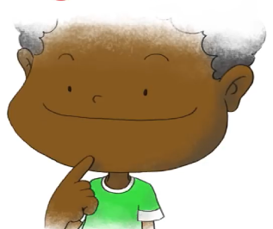
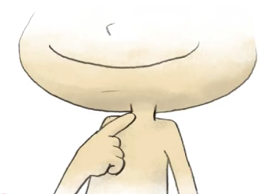
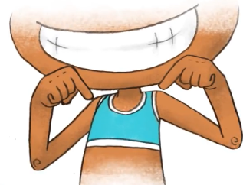
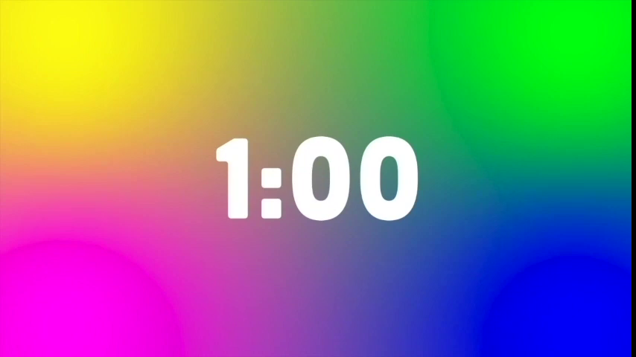

head
hair
face
eyes
ears
nose
cheeks
mouth
teeth
tongue
Listen and repeat
chin
neck
shoulders

Slide 6
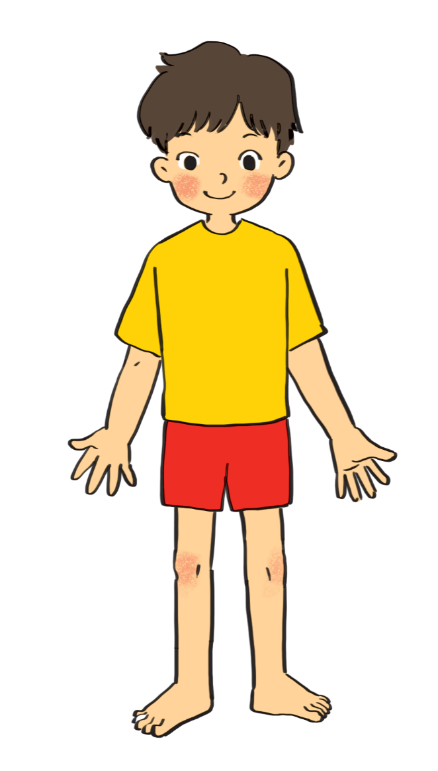

3. Write the body parts (p.27)
1.
eye
10.
hair
9.
cheek
Swap the answer with your partner
nose
2.
8.
mouth
3.
shoulder
7.
arm
4.
hand
5.
leg
6.
foot

Slide 7

Do you have a lot of friends?

Slide 8

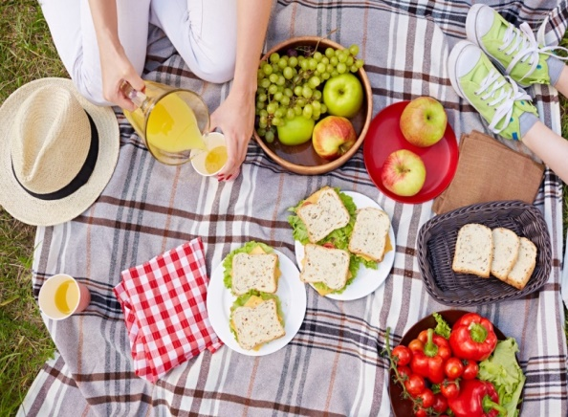


What can you do with your friends?
…………….
We can eat and drink together
We can play some games
we sing some songs

Slide 9
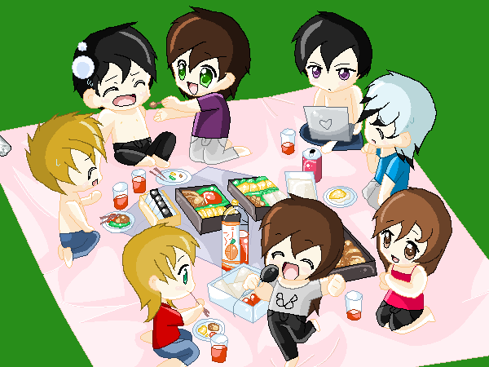
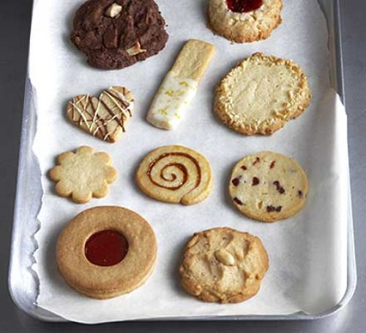


I. Vocabulary:
- picnic (n):
dã ngoại
-- biscuit (n): (n):
bánh quy
glasses (n ) :
mắt kính
magazine (n):
tạp chí
- surprise (adj):
bất ngờ, ngạc nhiên

Slide 10
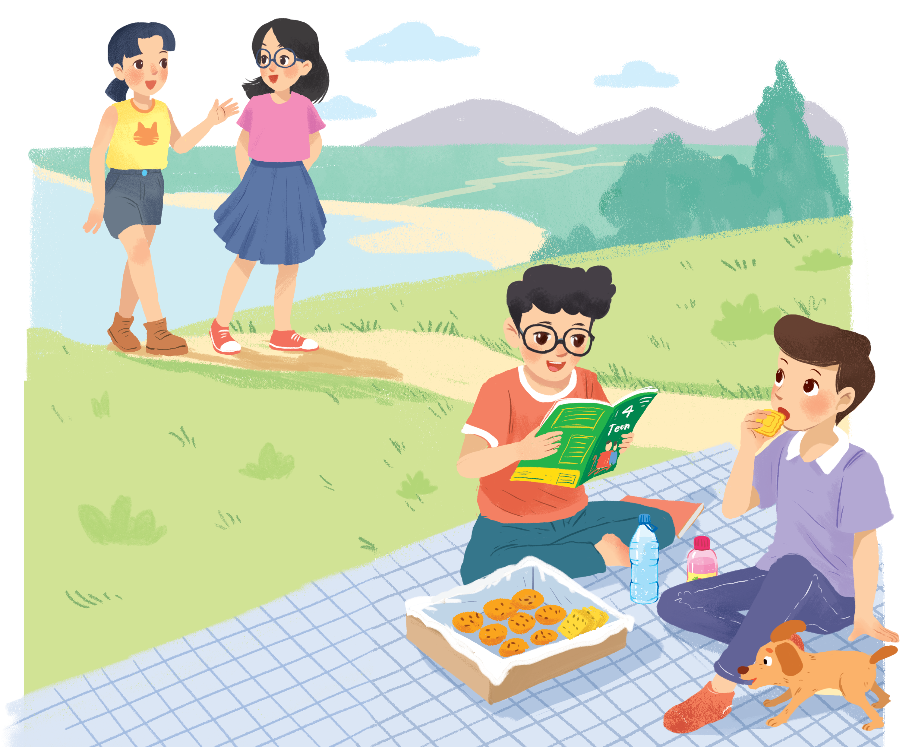
Look and answer.
1. Who are they?
They are Chau, Mai, Phong and Nam.
2. What is Phong doing?
He is reading a magazine.
Nam
3. What are Phong and Nam eating and drinking?
Chau
Mai
Biscuits and water.
4. What are they talking about?
Phong
Listen and check

Slide 11
Listen and read. (P.26)
Phong: That was a great idea, Nam. I love picnics!
Nam: Please pass me the biscuits.
Phong: Sure. Here you are.
Nam: Thanks. What are you reading, Phong?
Phong: 4Teen. It's my favourite magazine!
Nam: Look! It's Mai. And she is with someone.
Phong: Oh, who's that? She has glasses and long black hair.
Nam: I don't know. They're coming over.
Mai: Hi there. This is my friend Chau.
Phong & Nam: Hi, Chau. Nice to meet you.
Chau: Nice to meet you, too.
Nam: Would you like to sit down? We have lots of food.
Mai: Oh, sorry, we can't. We're going to the bookshop.
Chau: Bye for now.
Phong & Nam: Bye bye.

Slide 12
Let’s check!
4. What are they talking about?
A surprise guest
Nam: Look! It's Mai. And she is with someone.
Phong: Oh, who's that? She has glasses and long black hair.
Nam: I don't know. They're coming over.
Mai: Hi there. This is my friend Chau.
Phong & Nam: Hi, Chau. Nice to meet you.
Chau: Nice to meet you, too.
Nam
Chau
Mai
Phong

Slide 13
2. Read again and fill in the blanks!
1. Phuc and Nam are having a ____________.
2. 4Teen is Phong's ____________________ .
3. Phong and Nam see _______ and ___________.
4. Chau has________, and _________________.
5. Mai and Chau _____________ the bookshop.

Slide 14
Let’s check!
1. Phuc and Nam are having a ____________.
picnic
Phong: That was a great idea, Nam. I love picnics!
Nam: Please pass me the biscuits.
2. 4Teen is Phong's __________________.
favourite magazine
Nam: Thanks. What are you reading, Phong?
Phong: 4Teen. It's my favourite magazine!

Slide 15
Let’s check!
3. Phong and Nam see ___________ and ___________.
Mai
Chau
Nam: Look! It's Mai. And she is with someone.
Phong: Oh, who's that? She has glasses and long black hair.
Nam: I don't know. They're coming over.
Mai: Hi there. This is my friend Chau.
Phong & Nam: Hi, Chau. Nice to meet you.

Slide 16
Let’s check!
4. Chau has _____________, and _________________.
glasses
long black hair
Nam: Look! It's Mai. And she is with someone.
Phong: Oh, who's that? She has glasses and long black hair.
Nam: I don't know. They're coming over.
Mai: Hi there. This is my friend Chau.
Phong & Nam: Hi, Chau. Nice to meet you.

Slide 17
Let’s check!
5. Mai and Chau _____________ the bookshop.
are going to
Phong & Nam: Hi, Chau. Nice to meet you.
Chau: Nice to meet you, too.
Nam: Would you like to sit down? We have lots of food.
Mai: Oh, sorry, we can't. We're going to the bookshop.

Slide 18
How can you describe your friends?

She has long hair.
BFF
✗
She has long eyes.
Which one is correct?
Notes:
Some words go together but some don’t

Slide 19
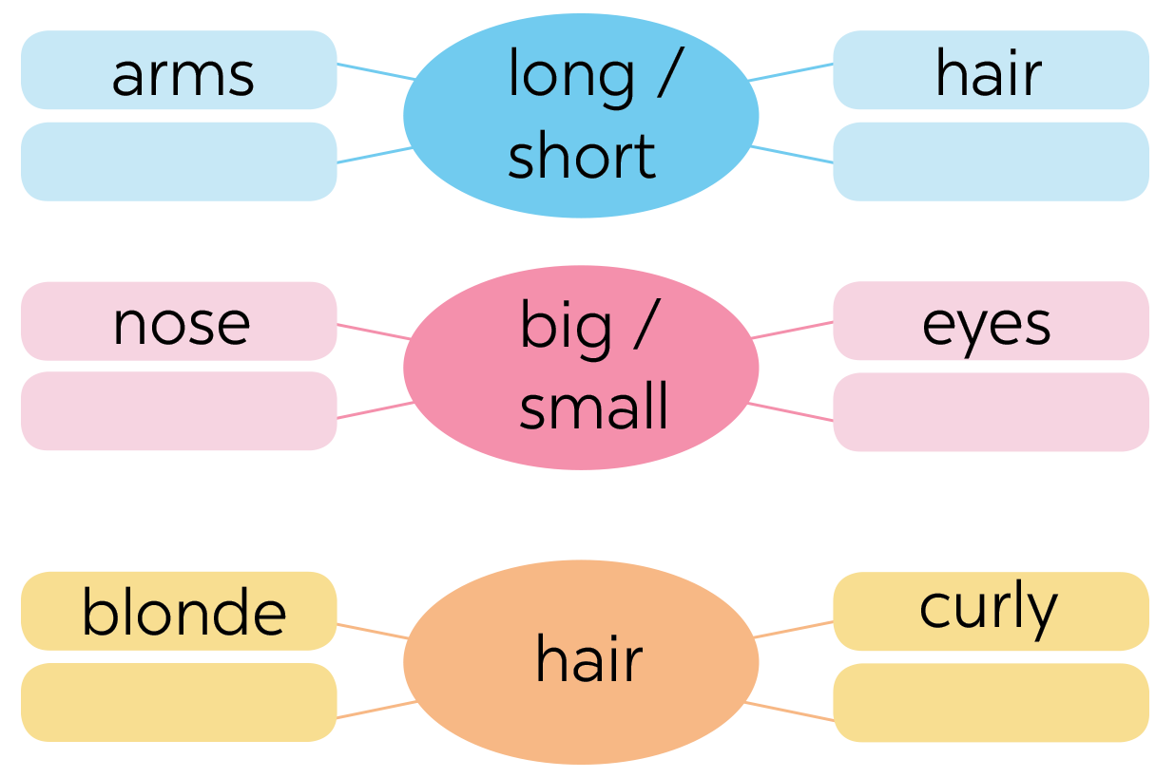

4. Work in group. Complete the word webs.
legs
feet
hands
ears
black
straight

Slide 20
5. Mini game
Secret man

Slide 21
5. Game: Secret man.
-
-
- choose a friend in your class
Don’t tell his/her name to others
- Write two sentences to describe that friend (2 mins)
- Come to the board & ask others to guess your friend
Eg: - He/ She is short and small
- He/ She has short black hair
Who is this? -> He/ She is .....

Slide 22
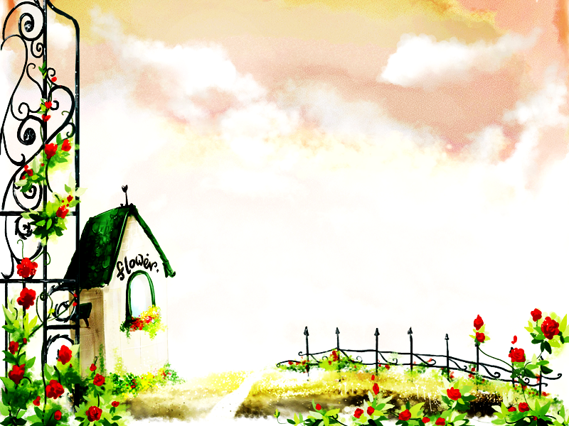
HOMEWORK
Learn by heart vocab.
Read the dialogue again.
Write two sentences to describe your friend
Prepare A closer look 1.

Slide 23

Thank you!
Have a nice day!

