Slide 2
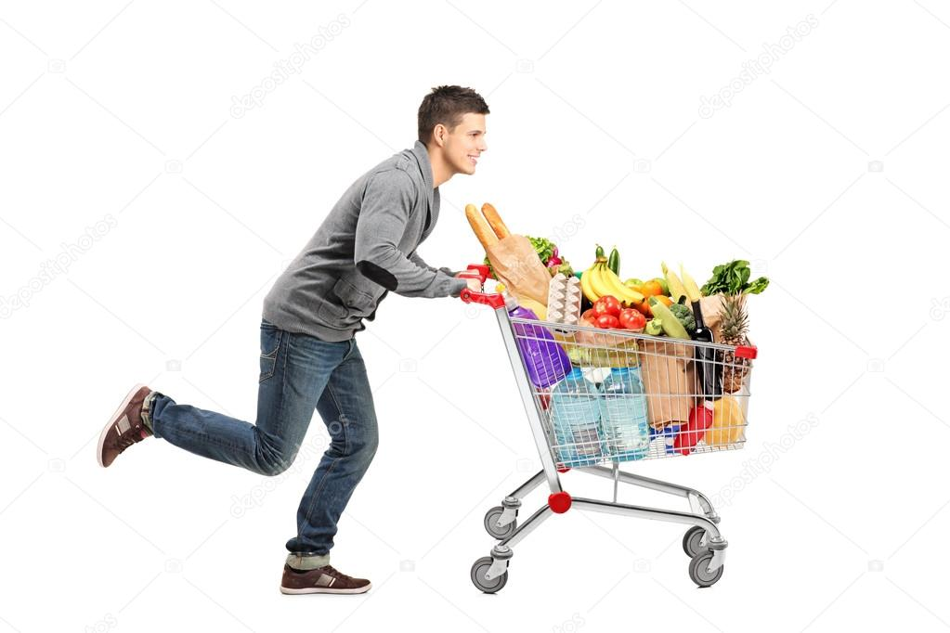
WARM-UP
SHOPPING
Answer the questions:
1. Do you like shopping?
2. Where do you often go shopping?
3. Can you name some markets or supermarkets that you know?
4. Do you prefer shopping in an open-air market or in a supermarket?

Slide 3
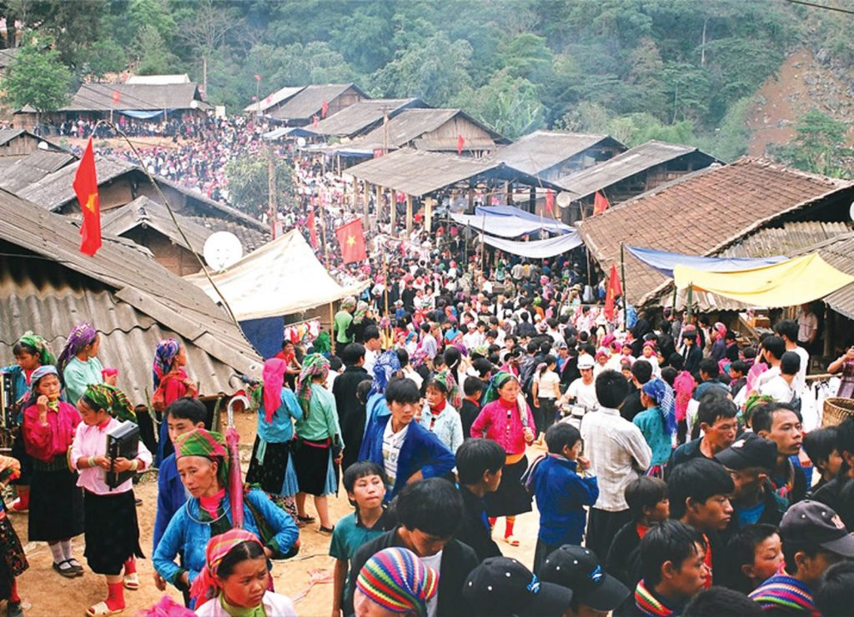
Unit
8
SHOPPING
LESSON 1: GETTING STARTED
My favourite shopping place
1

Slide 4
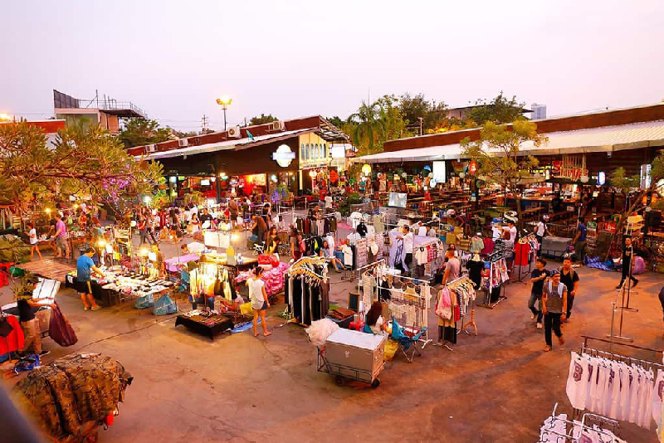
PRESENTATION
VOCABULARY
open-air market (n)
/ˌəʊpən ˈeə(r) ˈmɑːkɪt/
Chợ họp ngoài trời

Slide 5
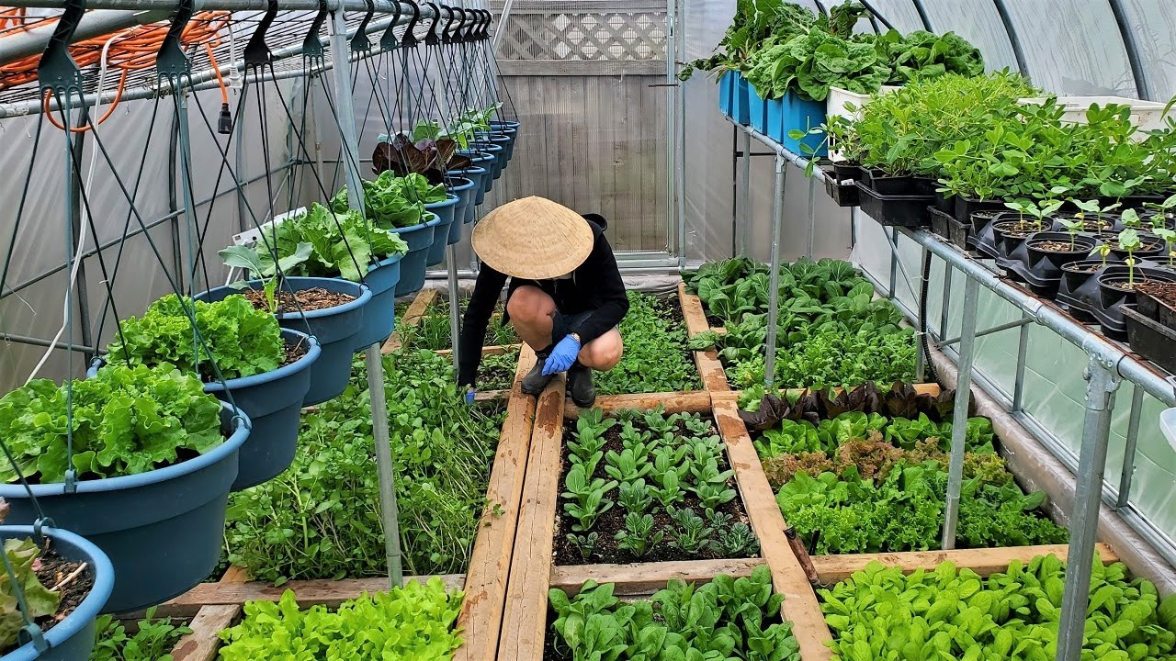
PRESENTATION
VOCABULARY
home-grown (adj)
/ˌhəʊm ˈɡrəʊn/
Tự trồng

Slide 6
PRESENTATION
VOCABULARY
home-made (adj)
/ˌhəʊm ˈmeɪd/
Tự làm

Slide 7
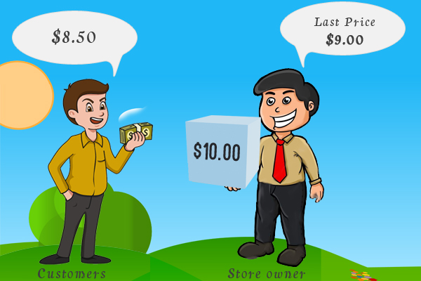
PRESENTATION
VOCABULARY
bargain (v)
/ˈbɑːɡən/
mặc cả

Slide 8
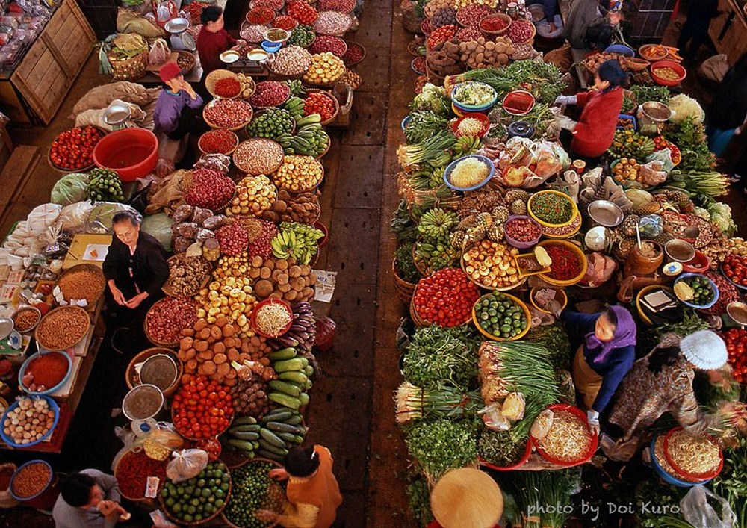
PRESENTATION
VOCABULARY
farmers’ market (n)
/ˈfɑːməz mɑːkɪt/
chợ nông sản

Slide 9
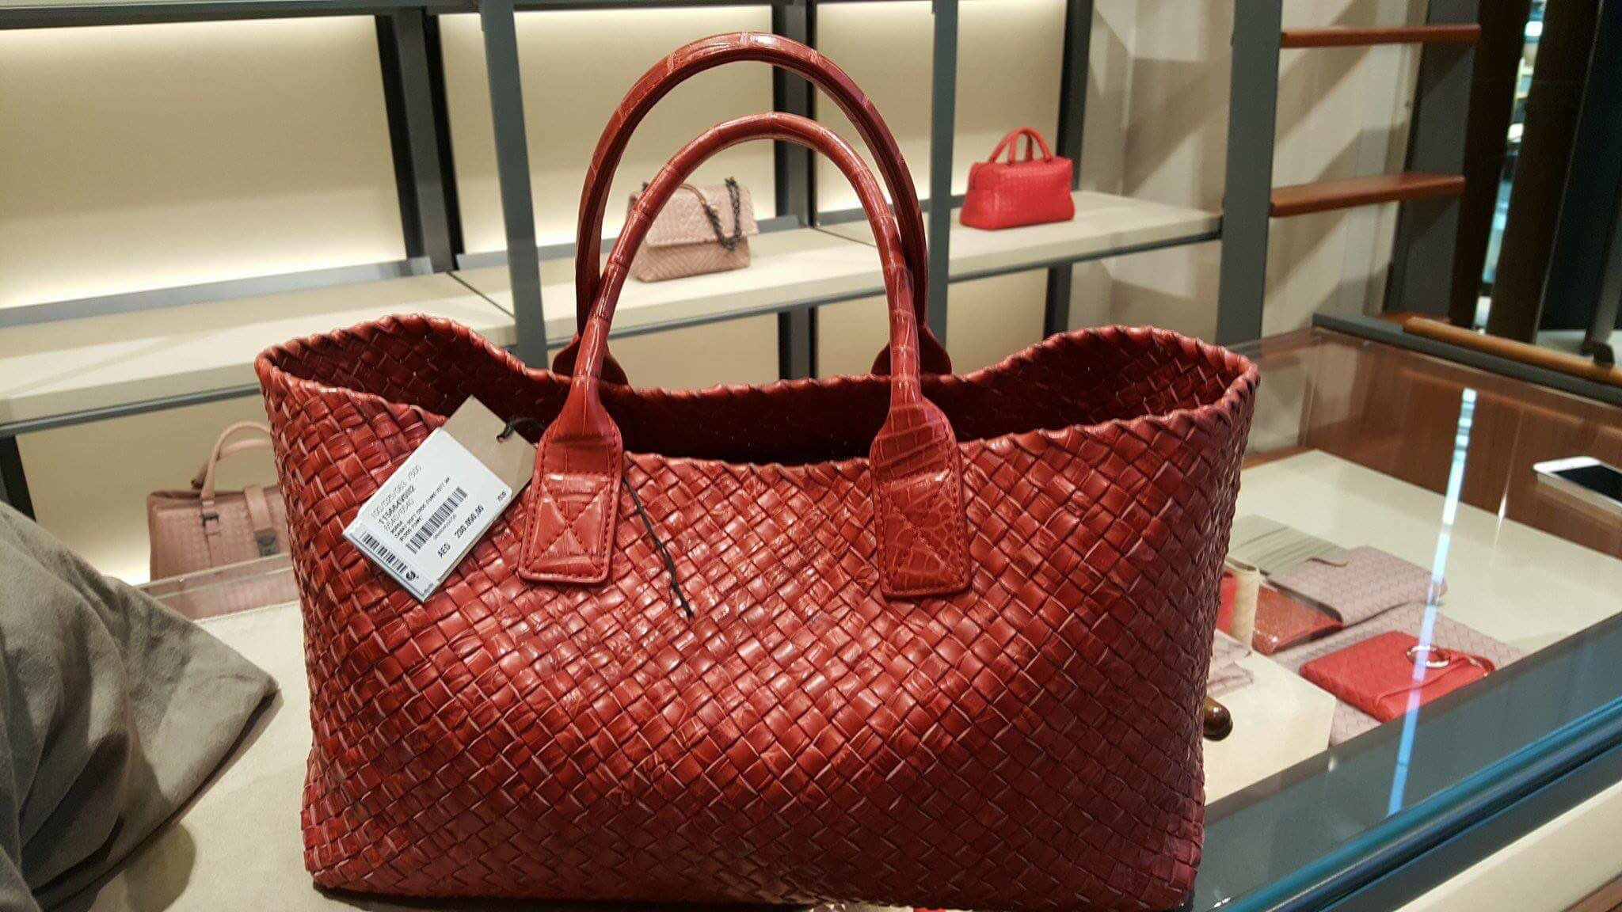
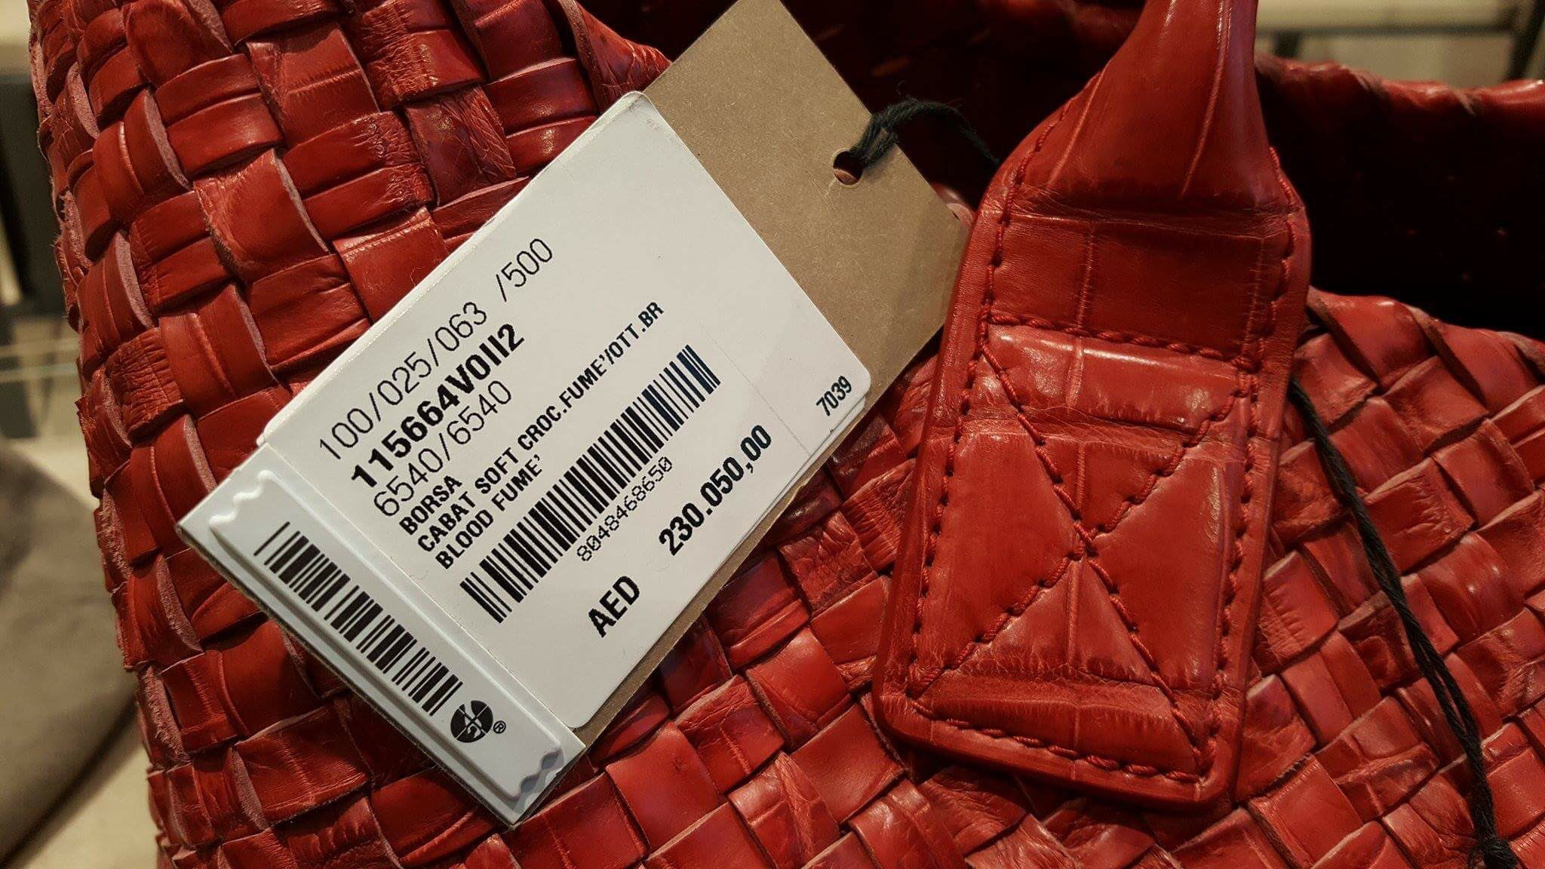
PRESENTATION
VOCABULARY
price tag (n)
/ˈpraɪs tæɡ/
nhãn ghi giá mặt hàng

Slide 10
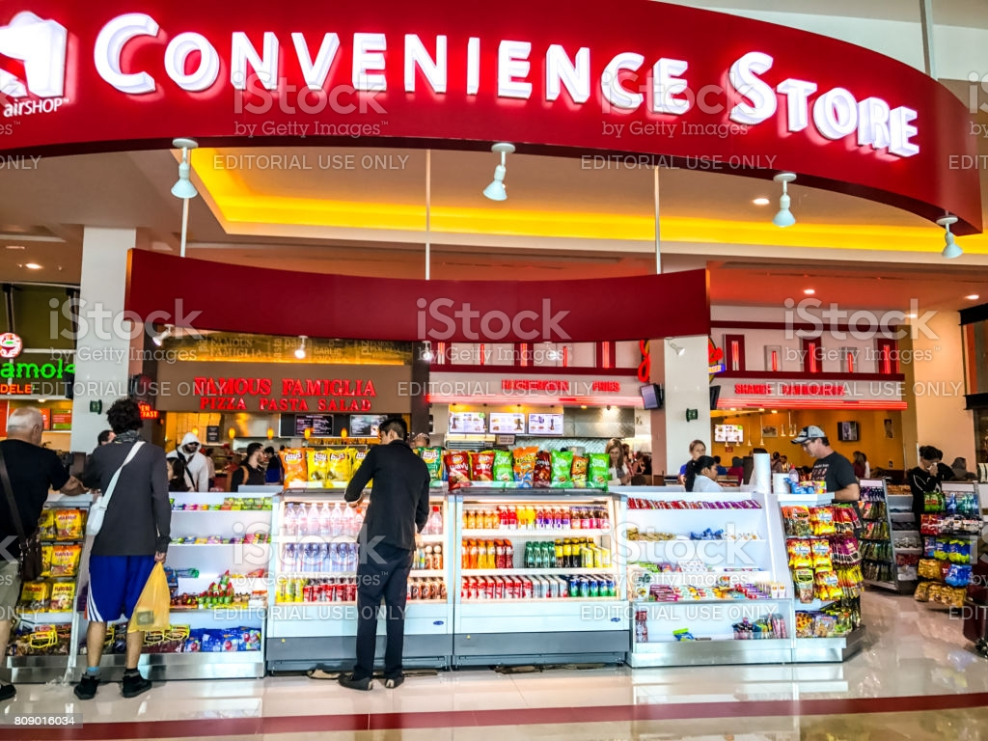
PRESENTATION
VOCABULARY
convenience store (v)
/kənˈviːniəns stɔː(r)/
Cửa hàng tiện lợi

Slide 11
VOCABULARY
PRESENTATION
New words | Pronunciation | Meaning
1. open-air market (n) | /ˌəʊpən ˈeə(r) ˈmɑːkɪt/ | chợ họp ngoài trời
2. home-grown (adj) | /ˌhəʊm ˈɡrəʊn/ | tự trồng
3. home-made (adj) | /ˌhəʊm ˈmeɪd/ | tự làm
4. bargain (v) | /ˈbɑːɡən/ | mặc cả
5. farmers’ market (n) | /ˈfɑːməz mɑːkɪt/ | chợ nông sản
6. price tag (adj) | /ˈpraɪs tæɡ/ | nhãn ghi giá mặt hàng
7. convenience store (n) | /kənˈviːniəns stɔː(r)/ | cửa hàng tiện lợi

Slide 12
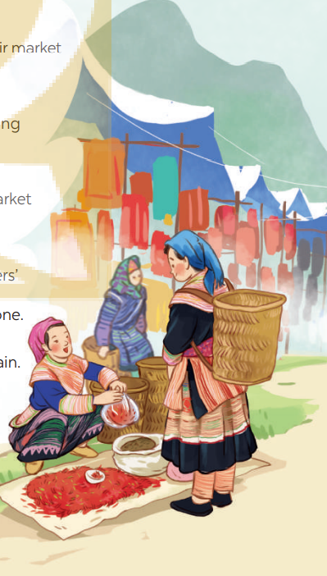
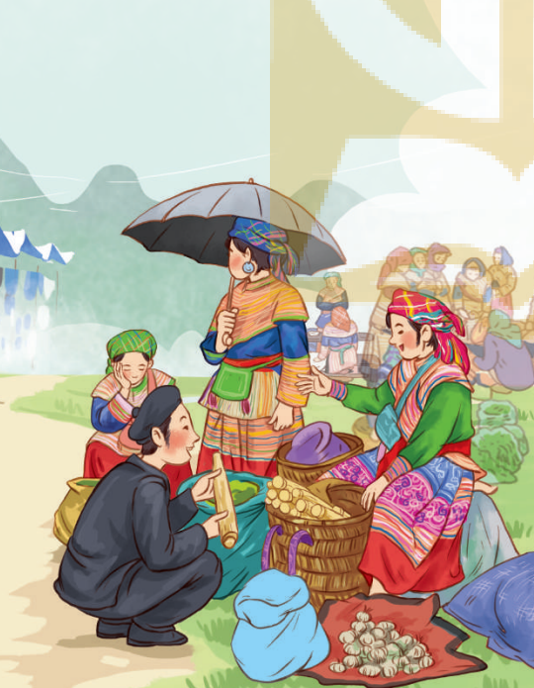
CHATTING
LEAD-IN
Answer the questions:
1. What are the pictures of?
2. What are the people in the pictures doing?

Slide 13
PRACTICE
1
Listen and read.
Mai: How was your trip to Bac Ha, Alice? Alice: It’s awesome. I like Bac Ha Fair. It’s an open-air market in Lao Cai. Mai: What do you like about it? Alice: Many things. Theo people at the market were wearing really colourful costumes. Mai: Yeah…They came from different minority groups. Alice: I think so, and most of the products sold at the market were home-grown and home-made. I love it. Mai: Do you have similar markets in New Zealand? Alice: We do. Back in my city, Auckland, we have a farmers’ market every Saturday where farmers sell their products. My mother loves shopping there, and she rarely misses one. Mai: I prefer shopping at the supermarket. I can find almost everything I need there, I don’t have to bargain. All the items have fixed prices on their price tags. Alice: Right. It’s more convenient. Mai: Yeah…Oh, I’ve got to go. My art lesson starts at one o’clock, and I want to go to a convenience store on the way. See you later.
Alice: See you.

Slide 14
PRACTICE
2
Mai and Alice mentioned four places where they can buy things. Complete the list.
1. open-air market
2. ____________________________________
3. ____________________________________
4. ____________________________________
farmers’ market
supermarket
convenience store

Slide 15
PRACTICE
3
Match the types of markets with the features.
Types of markets | Features
open-air market supermarket | It’s outdoor. Goods are display on shelves. Shoppers can bargain. All items have fixed prices. The weather does not affect shopping.

Slide 16
PRACTICE
4
Complete the sentences with the words and phrases from the box.
home -grown
bargaining
home -made
price tag
convenience store
- What is “_____________”?
- It’s when buyers talk to the sellers to get a lower price.
2. A _______________ is a small shop and is usually open 24/7.
3. This salad is made of ___________ vegetables.
4. How much is this T-shirt? I cannot see the ___________.
5. Try our ___________ bread, Mai. My mother made it this morning.

Slide 17
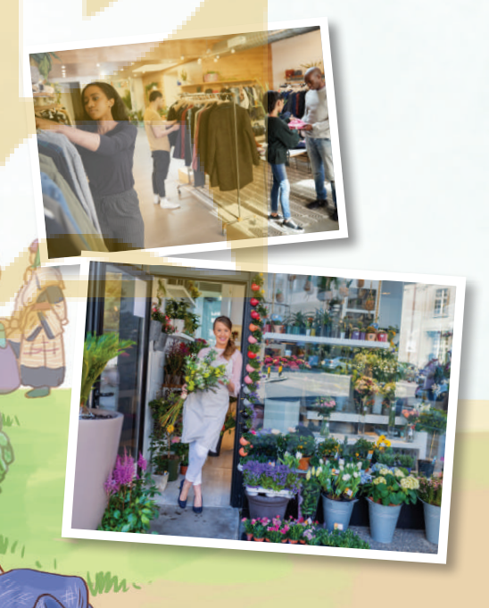
PRODUCTION
5
GAME: Listing- Work in groups. Quickly write down the names of some speciality shops. The group with the most correct answers wins.
speciality shop
Example:
- clothes shop
- florist’s
/ˌspeʃiˈæləti ʃɒp/
Cửa hàng bán đồ chuyên dụng

Slide 18
PRODUCTION
5
GAME: Listing- Work in groups. Quickly write down the names of some specialty shops. The group with the most correct answers wins.
Suggested answers:
candy shop
music shop
computer shop
barber’s
hairdresser’s
gift shop
pet shop
shoe shop
clothes shop
florist’s
bakery
butcher’s
bookshop
greengrocer’s
stationer’s
dairy
café

Slide 19
CONSOLIDATION
1
Wrap-up
What have we learnt in this lesson?
identify the topic of the unit
use lexical items related to shopping
identify the language features that are covered in the unit

Slide 20
CONSOLIDATION
2
Homework
Name some places for shopping they have learnt about in the lesson.
Learn the new words and phrases by heart.
Do Exercise ………..page ……Unit 8/Workbook

Slide 21
Website: hoclieu.vn
Fanpage: facebook.com/sachmem.vn/

