Slide 2
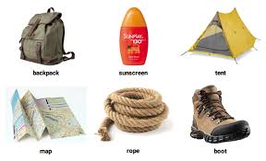
Name of each item
backpack
tent
suncream
map
rope
boot
When do we use six objects?

Slide 3
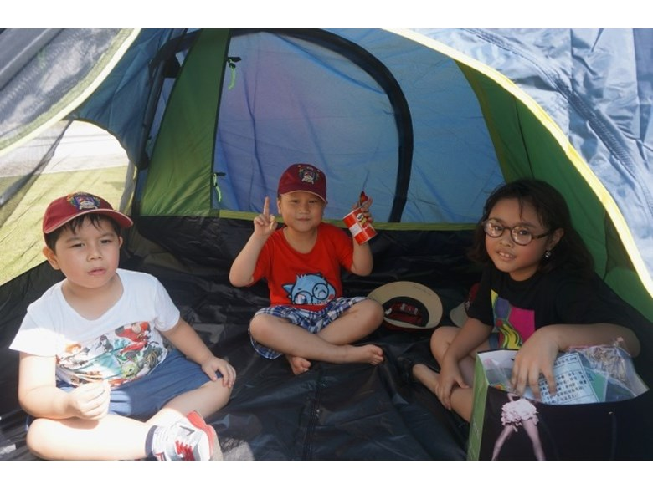
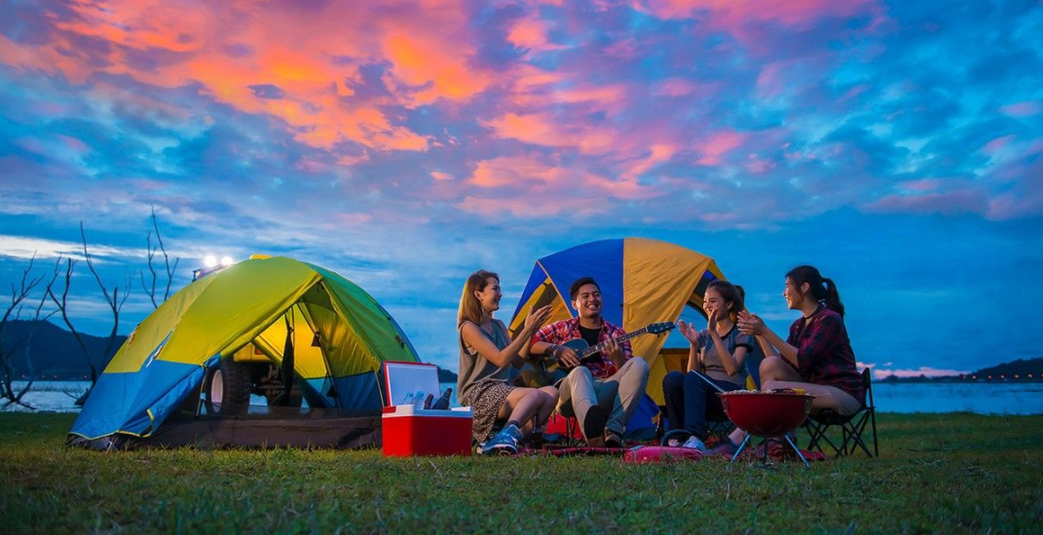
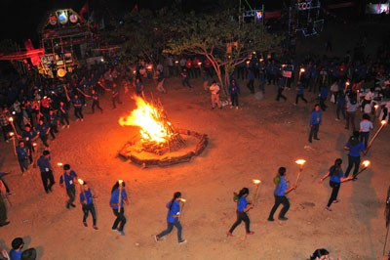
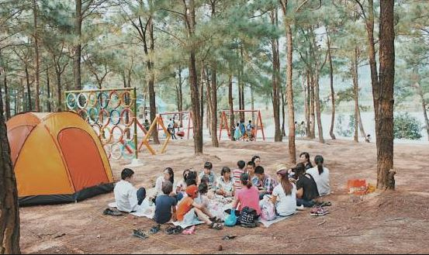
Go camping

Slide 4
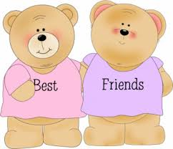
UNIT 3: MY FRIENDS
Lesson 5: Skills 1

Slide 5
Reading

Slide 6
Look at the advertisement above and answer the questions.
1.
Who is the Superb Summer Camp for?
It’s for kids between 10 and 15 years old.
2.
What can people do at this summer camp?
They play sports and games, draw pictures, play music, learn life skills, go on field trips, etc.

Slide 8
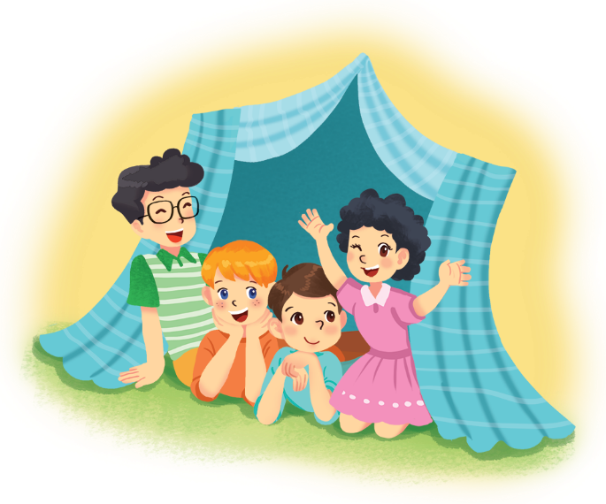
Read the text and write T (True) or F (False). Correct the false statements.
To: My parents <parents.nguyen@webmail.com>
Subject: My first day at the superb summer camp
Hi Mum and dad,
Here I am at the Superb Summer Camp. Mr Black asked us to write emails in English! Wow, everything here is in English! I have some new friends: Jimmy, Phong, and Nhung. They’re in the photo. Jimmy has blonde hair and blue eyes. He’s clever and creative. He likes taking photos. Phong is the tall boy. He’s sporty and plays basketball very well. Nhung has curly black hair. She’s kind. She shared her lunch with me today.
We’re having fun. Jimmy’s taking photos of me. Phong’s reading a comic book, and Nhung’s playing the violin. I must go now.
Please write soon.
Love,
Nam

Slide 9
Example:
Nam is writing to his teacher. F
(his parents)
1.
The children can speak Vietnamese at the camp.
2.
Nam has four new friends.
3.
Phong likes taking photos.
4.
Nam thinks Nhung is kind.
5.
Phong is tall and sporty.

Slide 10
Read the text and write T (True) or F (False). Correct the false statements.
T
1. The children can speak Vietnamese at the camp.
F
2. Nam has four new friends.
T
3. Phong likes taking photos.
F
5. Phong is tall and sporty.
F
4. Nam thinks Nhung is kind.
To: My parents <parents.nguyen@webmail.com>
Subject: My first day at the superb summer camp
Hi Mum and dad,
Here I am at the Superb Summer Camp. Mr Black asked us to write emails in English! Wow, everything here is in English! I have some new friends: Jimmy, Phong, and Nhung. They’re in the photo. Jimmy has blonde hair and blue eyes. He’s clever and creative. He likes taking photos. Phong is the tall boy. He’s sporty and plays basketball very well. Nhung has curly black hair. She’s kind. She shared her lunch with me today.
We’re having fun. Jimmy’s taking photos of me. Phong’s reading a comic book, and Nhung’s playing the violin. I must go now.
Please write soon.
Love,
Nam

Slide 11
Example:
Nam is writing to his teacher. F
(his parents)
1.
The children can speak Vietnamese at the camp.
F
They speak English only.
2.
Nam has four new friends.
F
He has three.
3.
Phong likes taking photos.
F
Jimmy likes taking photos.
4.
Nam thinks Nhung is kind.
T
5.
Phong is tall and sporty.
T

Slide 12
Speaking

Slide 13
Read about the three students below. Is the Superb Summer Camp suitable for all of them? Why or Why not?
1.
Mi is 12 years old. she likes drawing and writing stories. She’s good at english. she’s creative and friendly.
The camp is suitable for her because it suits her age and she can use English. She can also develop her creativity at the camp.
2.
An is 16 years old. he doesn’t know English. He’s funny and kind.
The camp does not seem to suit Nam. He may be too old for the camp and he can’t speak English.
3.
Vy is 14 years old. She likes playing sports. Her English isn’t very good. She’s clever, but she isn’t active.
The camp suits Vy. It suits her age and it can help her improve her English.

Slide 14
Think about yourself. Do you want to go to this kind of camp? Why or Why not?
Example:
I want to go to this camp because I can speak English there.

Slide 15
Think about yourself. Do you want to go to this kind of camp? Why or Why not?
Example:
I want to go to this camp because I can speak English there.
I want to go to this camp because I'm good at English and I love sports. This camp is a good opportunity for me to improve my life skills, leadership and creativity. I also love field trips.

Slide 16
III. HOME ASSIGNMENT
- Practice describing an interesting group activity
-Do Ex: D1,2,3-Unit 3 in workbook
- Prepare : Unit 3 Skills 2
Good bye !

