Slide 1
Unit
6
Preserving our heritage
Unit
FAMILY LIFE
COMMUNICATION AND CULTURE / CLIL
LESSON 7

Slide 2
LESSON 7
COMMUNICATION AND CULTURE / CLIL
WARM-UP
Lucky number
Task 1: Listen and complete the conversation.
Task 2: Make similar conversations.
EVERYDAY ENGLISH
CULTURE
Task 1: Read the text and answer the questions.
Task 2: Discussion.
CONSOLIDATION
Wrap-up
Homework

Slide 3
WARM-UP
LUCKY NUMBER
- Ss work in 4 groups.
- There are 8 numbers, including 3 lucky numbers and 5 numbers corresponding to 5 questions.
- Pick a lucky number ➔ get one point without having to answer the question.
- Pick a question ➔ answer “Where is it?”
- One point for a correct answer.

Slide 4
WARM-UP
Answer the question in each number.
1
2
3
4
5
6
7
8

Slide 5
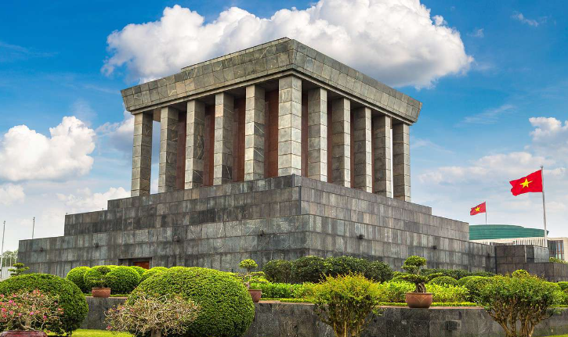
WARM-UP
Question 1
➔ HO CHI MINH MAUSOLEUM
BACK

Slide 6
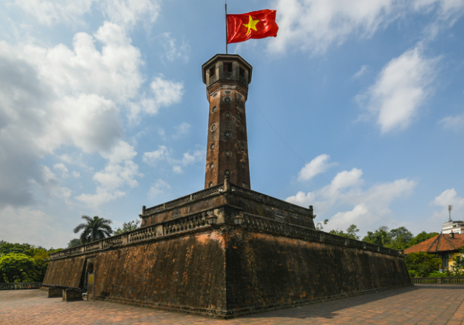
WARM-UP
Question 2
➔ HANOI FLAG TOWER
BACK

Slide 7
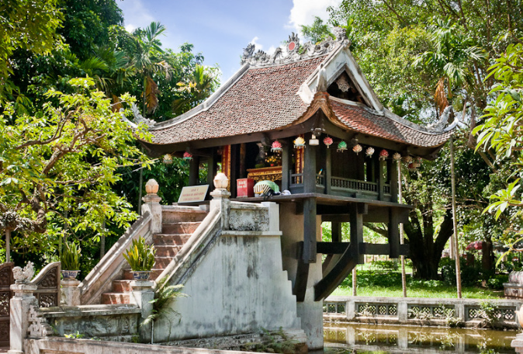
WARM-UP
Question 3
➔ ONE-PILLAR PAGODA
BACK

Slide 8
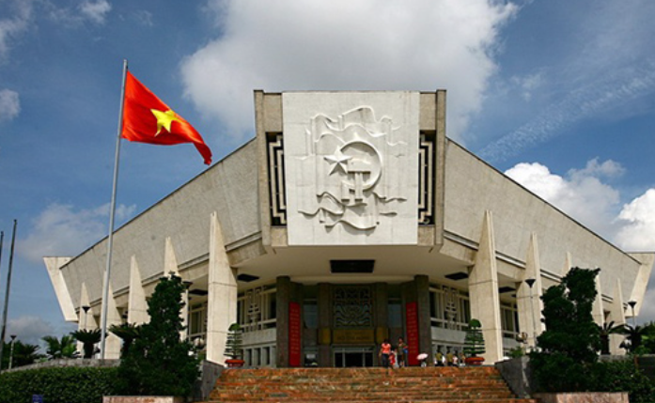
WARM-UP
Question 4
➔ HO CHI MINH MUSEUM
BACK

Slide 9
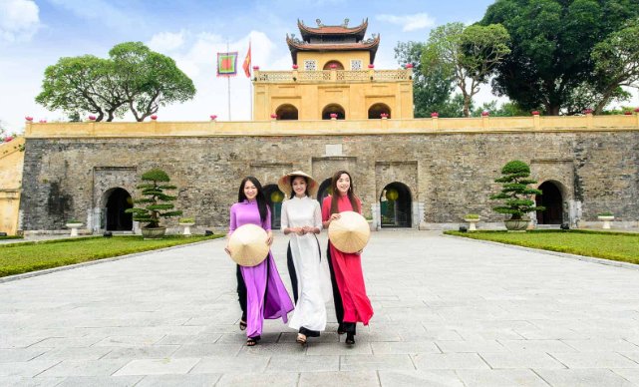
WARM-UP
Question 5
➔ IMPERIAL CITADEL OF THANG LONG
BACK

Slide 10

WARM-UP
BACK

Slide 11

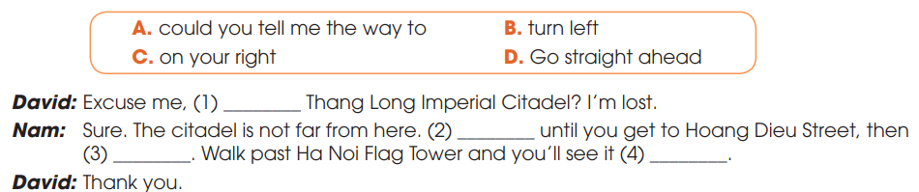
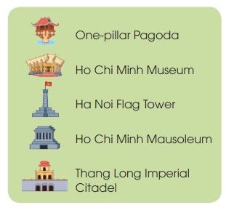
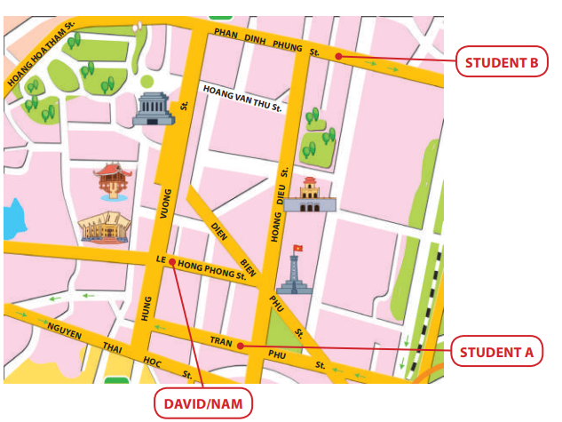
EVERYDAY ENGLISH
1
Listen and complete the conversation.
A
D
B
C

Slide 12
EVERYDAY ENGLISH
Useful expressions
Asking for directions | Give directions
+ Can you tell me the way to …? + Excuse me, is … near here? + How do/can I get to …? + What is the best/easiest way to …? + Could you show me how to get to …? | + Go straight ahead/on. + Walk along … street/road. + Walk past the (post office/bank). + Turn left/right at the traffic lights/into Star Street. + Take the first/second road/turning on the left. + It’s on your left/right. + It’s next to/opposite/between/at the end of/behind/in front of… + It’s (just) around the corner.

Slide 13
EVERYDAY ENGLISH
2
Make similar conversation for these situations.
1. Student A asking for directions to Ho Chi Minh Mausoleum.
2. Student B asking for directions to Ha Noi Flag Tower.

Slide 14
EVERYDAY ENGLISH
2
Work in pairs. Make similar conversation for these situations.
Situation 1.
A: Could you tell me the way to Ho Chi Minh Mausoleum?
B: Sure. Go straight ahead until you get to Hung Vuong Street. Turn right and walk straight on for a few minutes. You’ll see it on your left.

Slide 15
EVERYDAY ENGLISH
2
Work in pairs. Make similar conversation for these situations.
Situation 1.
A: Excuse me. Can you show me the way to Ho Chi Minh Mausoleum?
Oh, it’s not far from here. Go straight ahead and turn right into Hung Vuong Street. Then walk along Hung Vuong Street and you can see it on the left.
A: Thank you so much.
B:

Slide 16
EVERYDAY ENGLISH
2
Work in pairs. Make similar conversation for these situations.
Situation 2
B: Excuse me, is Ha Noi Flag Tower near here?
A: Yes. It’s quite near. Turn left into Hoang Dieu Street and walk along the street. You’ll see it on your left, at the corner of Hoang Dieu and Dien Bien Phu Street.

Slide 17
EVERYDAY ENGLISH
2
Make similar conversation for these situations.
Student B asking for directions to Ha Noi Flag Tower.
Situation 2.
B: Excuse me. How can I get to Hanoi Flag Tower?
A: Sure. Walk along Phan Dinh Phung Street and take the second turn on the left into Hoang Dieu Street. Walk past the Thang Long Imperial Citadel. Hanoi Flag Tower is just behind it.
B: Thank you very much.

Slide 18

CULTURE
crowdfunding (n)
huy động vốn từ cộng đồng
/ˈkraʊdfʌndɪŋ/
the practice of funding a project or an activity by raising many small amounts of money from a large number of people, usually using the internet
hoạt động tài trợ cho một dự án hoặc một hoạt động bằng cách huy động nhiều khoản tiền nhỏ từ một số lượng lớn người, thường là sử dụng internet

Slide 19

CULTURE
non-profit (adj)
phi lợi nhuận
/ˌnɒn ˈprɒfɪt/
without the aim of making a profit
không nhằm mục đích kiếm lợi nhuận

Slide 20

CULTURE
regardless of (prep.)
bất kể
/rɪˈɡɑːdləs əv/
paying no attention to something/somebody; treating something/somebody as not being important
không chú ý đến cái gì/ai đó; coi cái gì/ai đó là không quan trọng

Slide 21
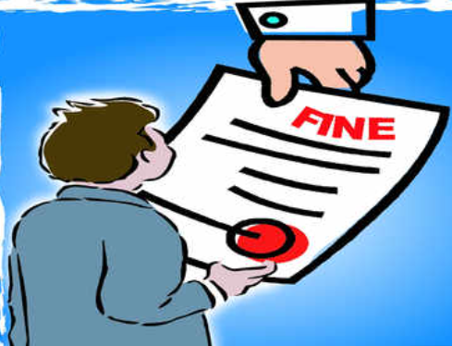
CULTURE
fine (n)
Tiền phạt
/faɪn/
a sum of money that must be paid as punishment for breaking a law or rule
một số tiền phải trả như một hình phạt cho việc vi phạm pháp luật hoặc quy tắc

Slide 22

CULTURE
unique (adj)
độc nhất
/juˈniːk/
being the only one of its kind
là người duy nhất của loại hình này

Slide 23
Form | Pronunciation | Meaning
crowdfunding (n) | /ˈkraʊdfʌndɪŋ/ | the practice of funding a project or an activity by raising many small amounts of money from a large number of people, usually using the internet
2. non-profit (adj) | /ˌnɒn ˈprɒfɪt/ | without the aim of making a profit
3. regardless of (prep) | /rɪˈɡɑːdləs əv/ | paying no attention to something/somebody; treating something/somebody as not being important
4. fine (n) | /faɪn/ | a sum of money that must be paid as punishment for breaking a law or rule
5. unique (adj) | /juˈniːk/ | being the only one of its kind

Slide 24



CULTURE
1
Read the text and answer the questions.
Which country … 1. raises money from the public for restoring its heritage? 2. organises successful festivals that attract visitors from around the world? 3. fines people heavily if they damage its heritage?
1
2
3
Spain
Australia
Italy

Slide 25
CULTURE
2
Work in groups. Discuss the following questions
Are the methods of preserving heritage in the text used in Viet Nam?
Which one do you think works best in Viet Nam?
Các phương pháp bảo tồn di sản trong văn bản có được sử dụng ở Việt Nam không?
Bạn nghĩ cái nào hoạt động tốt nhất ở Việt Nam?

Slide 26
CONSOLIDATION
1
Wrap-up
What have you learnt today?
How heritage is preserved around the world;
Review expressions for asking for and giving directions.

Slide 27
CONSOLIDATION
2
Homework
Do exercises in the workbook.
Prepare for Lesson 8 - Unit 6.

Slide 28

Website: hoclieu.vn
Fanpage: facebook.com/tienganhglobalsuccess.vn/
Website: hoclieu.vn
Fanpage: facebook.com/sachmem.vn/

