Slide 1
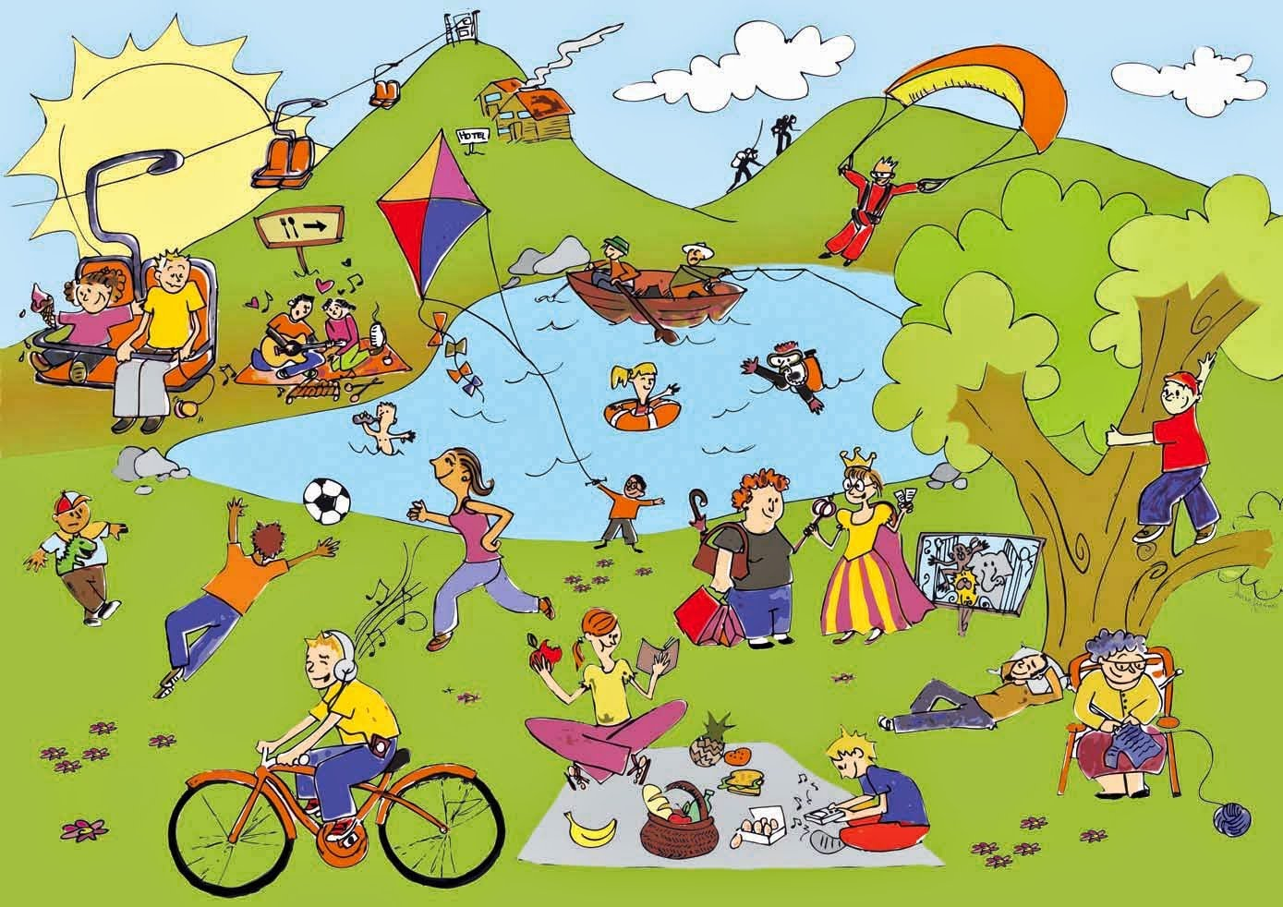
Unit
1
LEISURE TIME
LESSON 6: SKILLS 2
1

Slide 2
WARM-UP
How to play:
One student goes to the board and gets one activity from the teacher.
This student acts the activity without saying.
The rest of class guess the activity.
HOT SEAT

Slide 3
PRE-LISTENING
1
Answer the questions.
1. In your opinion, what activities can we do with our friends in our leisure time?
2. Why should we spend time
with our friends?

Slide 4
LISTENING
2
Listen to an interview with Mark about his leisure activities. Choose the correct answer.
1. When does Mark usually have free time?
A. At weekends. B. On Sundays. C. On Saturdays.
2. Who does he spend his free time with?
A. His neighbours and friends.
B. His family and relatives. C. His family and friends.

Slide 5
PRACTICE
3
Listen to the interview again. Fill in each blank in the table with no more than two words.
Activities | Reason
Inviting friends to his house Cooking and watching a (1) ______ | Fun and better than going to the (2) ________
Going to the (3) ______ to play volleyball or skateboard | Stay in (4) ______
Going for a (5) ________ around our city | See different (6) ______
video
cinema
park
shape
bike ride
places

Slide 6
WRITING
4
Work in pairs. Ask and answer the questions.
Questions
Sample answers
1. When do you usually have free time?
2. What do you usually do with your friends in your free time?
3. Why do you do these activities?
1. I often have free time at the weekend.
2. Sometimes I hang out with my friends in our favourite café.
3. Because it’s the time that we can talk with each other.

Slide 7
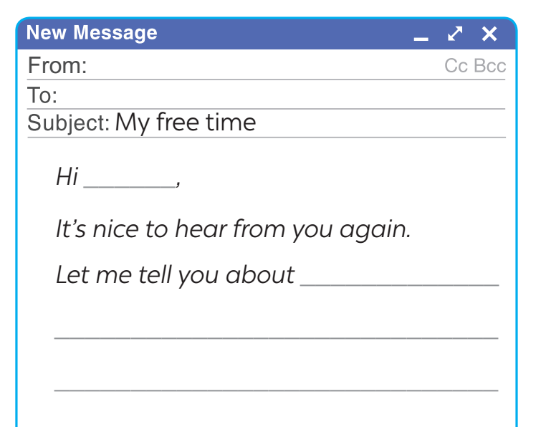
WRITING
5
Write an email (80 - 100 words) to a penfriend to tell him / her about what you usually do with your friends in your free time. Use your answers in 4.
Start and end the email as follows:

Slide 8
CONSOLIDATION
1
Wrap-up
What have we learnt in this lesson?
Listen to someone talking about their leisure activities
Write an email to talk about leisure activities

Slide 9
CONSOLIDATION
2
Homework
Do exercises in the workbook.

Slide 10
Website: hoclieu.vn
Fanpage: facebook.com/www.tienganhglobalsuccess.vn/

