Slide 2
Unit
1
LEISURE TIME
LESSON 4: COMMUNICATION
1

Slide 3
WARM-UP
Answer the questions:
1. What do you like doing in your free time?
2. What do your friends like doing in their free time?
3. What do young people in Viet Nam often do in their free time?
LEISURE ACTIVITIES

Slide 4
EVERYDAY ENGLISH
1
Listen and read the conversations. Pay attention to the highlighted sentences.
Trang: Would you like to go to the cooking club with me this Sunday?
Ann: I’d love to. Thanks.
1
Tom: Do you fancy going for a walk?
Mark: That’s great. Thanks.
2
Structures | Examples
How to invite | Would you like to… Do you fancy…
How to accept invitations | I’d love to. That’s great.

Slide 5
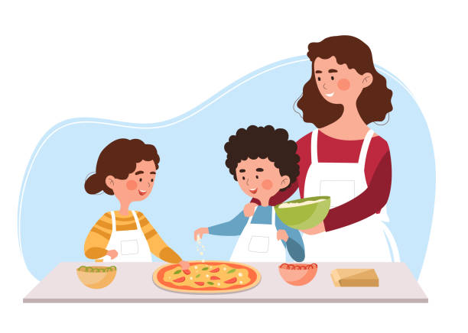
PRACTICE
2
Work in pairs. Practise inviting and accepting invitations in the following situations. Remember to use the highlighted language in 1.
You invite your friend to play badminton.
You invite your friend to make paper flowers with you.
You invite your friend to try your home-made pizza.

Slide 6
TEEN’S LEISURE ACTIVITIES AROUND THE WORLD
3
Work in pairs. Answer the question.
What is the activity in each picture?
doing origami
playing badminton
snowboarding

Slide 7
TEEN’S LEISURE ACTIVITIES AROUND THE WORLD
4
Read what three teenagers say about their leisure activities. Complete the table with the information from the text.
Name | Country | Leisure activity | Person / People to do the activity with | Benefits of the activity
Sakura | Japan
Eric | Switzerland
Lan | Viet Nam
doing origami
no one
helps her to relax
snowboarding
parents
improves his overall health and balance
playing badminton
best friend
- improves her muscle strength
- reduces stress

Slide 8
TEEN’S LEISURE ACTIVITIES AROUND THE WORLD
5
Work in groups. Ask and answer the questions.
Which of the activities in 4 do you want to try?
Why do you want to try it?

Slide 9
CONSOLIDATION
1
Wrap-up
What have we learnt in this lesson?
How to invite and accept invitations

Slide 10
CONSOLIDATION
2
Homework
Do exercises in the workbook.

Slide 11
Website: hoclieu.vn
Fanpage: facebook.com/www.tienganhglobalsuccess.vn/

